Slide 1
Cell Inclusions

Slide 2
Ergastic substances or cell inclusions are the products of cell metabolism, appearing and disappearing at various stages of cell’s life-cycle.
In majority of cases they are waste products of simple chemical nature compared to protoplasmic components which are more complex.
These ergastic substances may be present in the cell walls or vacuoles or in the organelles of protoplasm. They may be present in soluble or insoluble state and may be organic or inorganic in nature

Slide 3
These substances belong to three categories:
  Reserve food,
  Inorganic Materials (Mineral matter)
  Secretory products
  Excretory products.

Slide 4
Reserve food
They occur in the form of starch, glycogen, fat droplets and aleurone grains.
Starch grains
Starch is the most important storage food. It is insoluble in water. Starch grains are found in all parts of the plant although in storage organs, e.g., seeds, fruits, rhizome etc., these are found in larger amount.
It is of two types:
(a) Temporary starch and
(b) Permanent starch.

Slide 5
The temporary starch, which is also known as assimilatory starch, is formed in the process of photosynthetic during day and converted to sugar during night.
The permanent starch, which is also known as reserve starch, is found mostly in rhizome, seeds and fruits. Sugar above a certain level is converted to permanent starch.

Slide 6
Starch grains contain a polymer of C₆H₁₀O₅.
Starch grains are of different shapes and form.
Each starch grain has a central proteinaceous area called helium.
Starch is deposited around it in the form of eccentric or concentric layers.
The starch grains are oval eccentric in potato; oval and concentric in gram or pea; rounded, flat and concentric in wheat and polyhedral with radiating lines in maize.

Slide 7
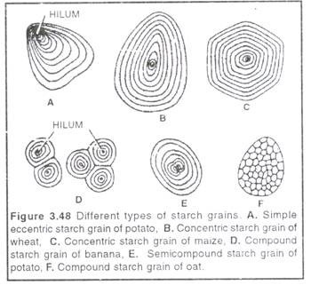

Slide 8
Glycogen Granules:
They are minute granules of storage carbohydrates which occur in animal cells. The granules are flattened, circular or oval bodies which may form rosette-shaped aggregates.
Fat droplets:
They occur in both plant and animal cells. In plants fat droplets or globules occur abundantly inside the seeds either in endosperm (e.g., castor, coconut) or cotyledons [e.g., groundnut, mustard].

Slide 9
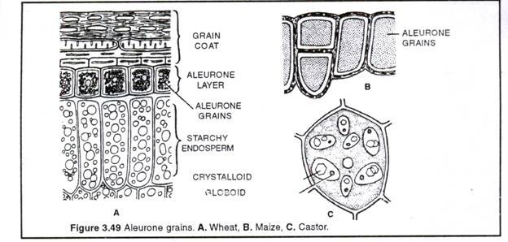
Aleurone Grains:
They are insoluble storage proteins occur inside special leucoplasts called aleuroplasts. They occur in the outer endosperm cells of cereals, such as wheat, rice, maize grains.

Slide 10
Inorganic Materials (Mineral Matter)
The accumulation of inorganic materials within the plant and their cells mostly takes place in the form of calcium salts or anhydrous silicate salts.
One very important type of deposit is that of calcium oxalate which is common in plants of many families.
Their crystalline particles are of various shapes such as prismatic, needle-shaped, rhomboidal (diamond-shaped) etc.

Slide 11
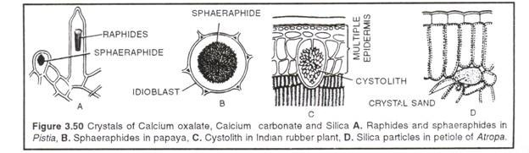
Very often the crystals occur as compound aggregates called druses, sphaerites etc.
Elongated crystals are called styloids and raphides.
Raphides occur in the form of bundles.
Some crystals occur in special type of cells such as in case of idioblast cells.

Slide 12
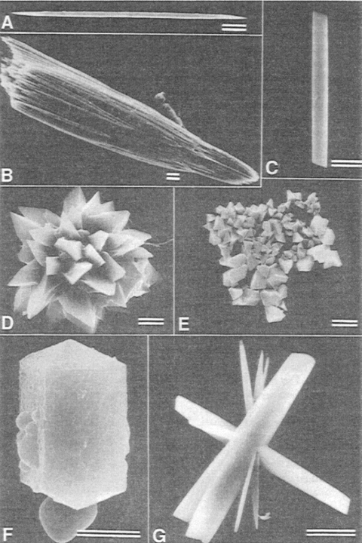
Type of crysals
SEMS of calcium oxalate crystals.
(A) Single raphide crystal from leaf raphide bundle of Psychotria punctata (Rubiaceae).
(B) Leaf raphide crystal bundle of Psychotria punctato.
(C) Styioid crystalfrom leaf spongy mesophyil of Peperomio (Piperaceae).
(D) Druse crystal from leaf of Opuntio (Cactaceae).
(E) Crystal sand from petiole of Nicotiona glouco (Solanaceae).
(F) Prismatic crystals from leaf of Begonia (Begoniaceae).
(G) Aggregate crystal complex from leaf spongy mesophyll of Peperomio astrid (Piperaceae). All line scales equal S l~m.
From V. R. Franceschi and H.T. Horner (1980), Calcium oxalate crystals in plants, Botanical Review 46(4), 361-427. Used with permission of the New York Botanical Garden, copyright 1980.

Slide 13
Types of crystals
Raphides:
They are long, thin, needlelike, generally monohydric crystals with pointed ends that are usually aggregated into sheath like bundles that are considered a single unit.
The individual crystals are surrounded by a membrane, and the entire bundle is usually covered by a mass of mucilage.
Raphides are often deposited within enlarged idioblastic cells, known as raphide sacs, that are conspicuously distinct from neighboring cells.
Raphides are fairly common in many monocot families, but they also are abundant in the dicotyledonous families Balsaminaceae, Rubiaceae, and Dilleniaceae.
Acicular crystals:
Although not always distinguished from raphides, are small needle like forms that do not occur in bundles.
This crystal type can be seen in Acanthaceae, Lauraceae, and Myristicaceae.

Slide 14
Druses:
sometimes called cluster crystals, are compound crystals that are loosely united into a sharp pointed spherical mass in which the many component crystals protrude from the surface to give the whole structure a star-shaped appearance.
This crystal type displays many variations in form, including the pointed-star crystal.
Druses are common in several families, including Leguminosae, Juglandaceae, Polygonaceae, and Tiliaceae.
Prismatic crystals:
They are solitary rhombohedrons or octohedrons of varied size that are widespread but commonly found in secondary xylem and phloem parenchyma cells. This is the most common type of crystal in wood.

Slide 15
Crystal sand consists of a granular mass of many fine particulate accumulations of microcrystals scattered throughout the cell, in which they have a sandy appearance.
Examples of crystal sand can be seen in the stem cells of Acuba (Cornaceae), Amaranthus (Amaranthaceae), and Sambucus (Caprifoliaceae).
Styloids are large, long, solitary crystals at least four times as long as they are broad, with pointed or square ends.
They are less commonly encountered than the preceding types. Styloid crystals can be seen in Liliaceae and in the leaves of Iris (Iridaceae).
Unusually large styloids have been recorded in the secondary xylem of a few woody species. In the genus Henriettea of the Melastomataceae, for example, extremely large styloids occur measuring 24 to 80 pm in diameter and 240 to 560 lam in length.

Slide 16
Very often, crystals of calcium carbonate are also found in some plants.
One very well known example is the cystolith found in some plants [e.g., Ficus leaves), which are found on an outgrowth of cell wall towards the interior of cell and this outgrowth bears CaC0₃depositions.
Leaves of Ficus species have cystoliths in their epidermal cells.

Slide 17
Cystoliths are typically located in enlarged surface cells of leaves called lithocysts, where the calcium carbonate is deposited over a cellulosic extension that hangs from the wall.
Cystoliths are found in several unrelated dicotyledonous families but are especially abundant and variable in members of the order Urticales Ulmaceae, Cannabaceae, Moraceae, Urticaceae).
Spherical, bacilliform, and fusiform (curved or straight) types of cystoliths are most common; stellate or vermiform shapes occur rarely.
Cystoliths may be systematically useful at various taxonomic levels, as evidenced by the general correspondence between cystolith shape and tribal circumscription within the Urticaceae.

Slide 18
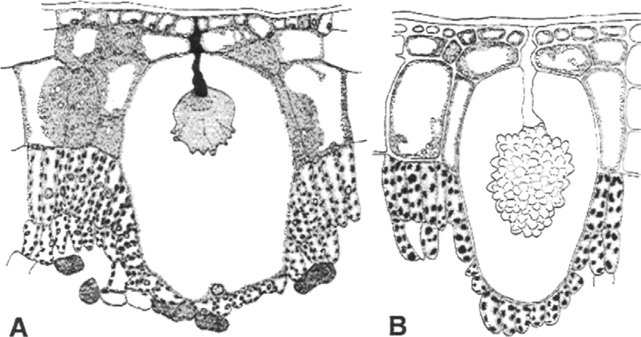
Cystoliths in leaves of Ficus elastica (Moraceae).
(A) Mature lirhocyst The calcium carbonate has been dissolved away showing the cellulose matrix of the cyscolit~.
(B) Mature lichocyst showing the grapelike deposit of calcium carbonate upon the cystolirh scall~ Both x 927. Reprinted with permission from Ajello ( 1941 ), Am. J. Bo~. 28, 589-594.

Slide 19
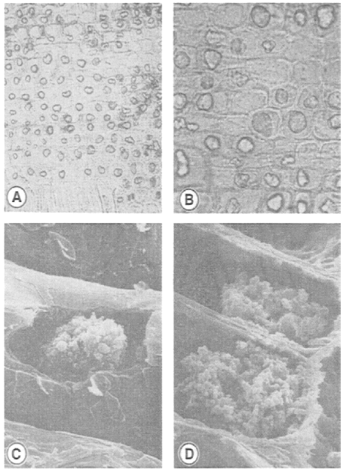
Silica sand
Silica grains in wood of Hibbe~a (Dilleniaceae).
(A) H. trachyphylla, radial section showing abundant silica grains in ray parenchyma cells, x 125.
(B) H. aitigena, radial section showing solitary silica grains in wood ray cells, x 230.
(C) H. deplancheana, SEM illustrating granular surface of silica grain, x 2600.
(D) H. tontoutensis, SEM illustrating very granular silica grain, x 4300. Reprinted with permission from Dickison (1984). IAWA Bull. n.s. 5, 341-343. The International Association of Wood Anatomists.

Slide 20
Deposits of silica (SiO2) are often abundant in the wood cells of dicotyledons and in the stems and leaf cells of some monocotyledons.
However, silica is clearly characteristic of some families and not of others.
Among those species of woody dicotyledons that have been studied, approximately 80% of the wood silica was present in the xylem ray cells.
Silica may form as an incrustation on the wall or as inclusions called silica grains or silica bodies in the cell lumen.
In many cases but not always, the silica body conforms to the shape of the cell in which it occurs.
The size of silica bodies tends to be quite variable. Silica may resemble calcium oxalate crystals, but it is amorphous and non crystalline and so does not show birefringence when viewed under polarized light.

Slide 21
Because silica is resistant to breakdown, it can be used to identify fossil or subfossil plant materials that have undergone certain types of fossilization.
In addition to its presence or absence, the shape of individual silica bodies can be diagnostically important as an aid in classification.
Solitary silica bodies are often located within small, almost isodiametrically shaped cells called stegmata, which may have thickened inner and anticlinal walls and which are sometimes lignified or suberized.
In all palms, stegmata are arranged in longitudinal rows adjacent to the vascular or nonvascular fibrous bundles of the stem and leaf. These continuous or discontinuous files of silica containing cells are never positioned in the epidermis of Palmae.

Slide 22
Secretory Products
Many substances secreted by special glands and organs, are found in plants, such as:
  Colouring matter
  Enzymes
  Nectar

Slide 23
Colouring matter:
Plants possess green colouring matter because of the presence of chlorophyll a and chlorophyll b.
They also contain orange and yellow pigments, carotene and xanthophyll.
The flowers and fruits become differently coloured because of the presence of carotene and xanthophyll.
Blue, purple and pink colours are due to anthocyanin pigments which are found in vacuolar sap of fruits and petals of flowers and young leaves of some plants.

Slide 24
Enzymes:
Enzymatic proteins occur in colloidal state in the protoplasm. These enzymes convert complex organic food into simple compounds. For instance, enzyme diastase converts starch into glucose.
Nectar:
Nectar, secreted by nectaries in plants, attracts insects for pollination because it is sweet and contains sucrose, glucose and fructose.

Slide 25
Excretory Products
Several chemical substances which are of no use to plants are produced during metabolic reactions.
These waste products are called excretory products, but the plants do not have any special mechanism to remove these substances.
However, some of these are thrown away by way of dropping of old leaves, bark and flowers.
These excretory products are found as cell inclusions.

Slide 26
Alkaloids
Glucosides
Tannins
Latex
Essential oils
Resins
Gums
Organic Acids

Slide 27
Alkaloids:
These are nitrogenous compounds, made up of carbon, hydrogen, oxygen and nitrogen.
They are found in storage organs of plants such as seeds, bark and leaves.
They are insoluble in water but soluble in alcohol. They have sour taste and some are poisonous.
However, a large number of alkaloids, such as quinine, reserpine, nicotine, caffeine, thein, strychnine, morphine, atropine, are used as medicines.

Slide 28
Glucosides
These are degradation products of carbohydrates. Some, such as digitoxin used in heart diseases, are used as medicine.
Tannins
They are sour in taste and related to glucosides. They occur {n vacuolar sap, cell wall, bark and leaves of some plants. They are found mostly in unripe fruits. They are used on a large scale for hardening of leather, a process called tanning of leather.

Slide 29
Latex:
It is a milky substance secreted by latex glands. Robber secreted by the rubber tree Hevea brasiliensis is an important example.
Essential oils:
These are volatile oils produced by special glint’s and cells. Aroma in flowers, leaves and bark are due to essential oils.

Slide 30
Resins:
Produced by the oxidation of essential oils. These are found in some special glands or canals either alone or in combination with essential oils. These are insoluble in water but soluble in ether and alcohol. These are used in the manufacture of paints and varnishes.
Gums:
Produced by the disintegration of cellulose cell wall. They are soluble in water. Used for sticking purposes, and also as medicine.

Slide 31
Organic Acids:
These are found in leaves and fruits. Tartaric acid is found in fruits of Tamarind, oxalic acid in Oxalis and citric acid in Citrus fruits.

