Slide 1
Research Methodology
Mr. Ghanshyam Parmar
PD 404

Slide 2
MEANING OF RESEARCH
The systematic method consisting of
  enunciating the problem,
  formulating a hypothesis,
  collecting the facts or data,
  analysing the facts and
  reaching certain conclusion either in the form of solutions towards the concerned problem or
  in certain generalisations for some theoretical formulation.

Slide 3
Other meanings
Research is an endeavour to discover answers to intellectual and practical problems through the application of scientific method.
“Research is a systematized effort to gain new knowledge”.
Research is the systematic process of collecting and analyzing information (data) in order to increase our understanding of the phenomenon about which we are concerned or interested.

Slide 4
Other meanings
Research in common parlance refers to a search for knowledge.
Once can also define research as a scientific and systematic search for pertinent information on a specific topic.
In fact, research is an art of scientific investigation.
The Advanced Learner’s Dictionary of Current English lays down the meaning of research as “a careful investigation or inquiry specially through search for new facts in any branch of knowledge.” -Redman and Mory

Slide 5
According to Clifford Woody research comprises
  Defining and redefining problems,
  Formulating hypothesis or suggested solutions;
  Collecting, organizing and evaluating data;
  Making deductions and reaching conclusions;
  And at last carefully testing the conclusions to determine whether they fit the formulating hypothesis.

Slide 6
D. Slesinger and M. Stephenson in the Encyclopaedia of Social Sciences define research as
  “The manipulation of things, concepts or symbols for the purpose of generalising to extend, correct or verify knowledge, whether that knowledge aids in construction of theory or in the practice of an art.”3

Slide 7
Research is, thus, an original contribution to the existing stock of knowledge making for its advancement. It is the persuit of truth with the help of study, observation, comparison and experiment.

Slide 8
OBJECTIVES OF RESEARCH
Find out truth which is hidden and which has not been discovered yet
Gain familiarity with a phenomenon or to achieve new insights into it.
Portray accurately the characteristics of a particular individual, situation or a group
Determine the frequency with which something occurs or with which it is associated with something else
Test a hypothesis of a casual relationship between variables

Slide 9
Motivation in research
Research degree along with its consequential benefits
Face the challenge in solving the unsolved problem
Get intellectual joy of doing some creative work
Service to society
Get respectability

Slide 10
Research method VS. Research Methodology
Research methods include all those techniques/methods that are adopted for conducting research.
While research methodology is the way of systematically solving the research problem.
It is science of studying how research is conducted scientifically.
Hence it is not only important for the researcher to know the research methods, but also the scientific approach called methodology.

Slide 11
Research Methodology
Three elements
  Theoretical perspective or orientation that guide research and logic of inquiry
  Tools and techniques of data collection
  Methods of data analysis

Slide 12
Different terminology
Research techniques refers to the practical aspects of collecting data and the way the data obtained is organized and analyzed.
Research Tools are the instruments that are used for data collection and its analysis.
  Questionaries'/schedule
  Dairies
  Check list
  Maps
  Photos
  Drawing etc.

Slide 13
Data analysis involves a set of statistical techniques used in establishment relationship between the different variables and evaluating the accuracy of the results.

Slide 14
Research approaches
Quantitative approach:- Involves collection of quantitative data, which are put to rigorous quantitative analysis in formal and rigid manner
  -Inferential
  -Experimental
  -Simulation

Slide 15
Inferential approach
To form a data base from which to infer characteristics or relationships of population.
Usually means survey research where a sample of population is studied to determine its characteristics.

Slide 16
Experimental research
Some variables are manipulated to observe their effect on other variables
Much greater control over the research environment

Slide 17
Simulation approach
Involves construction of an artificial environment within which relevant information and data can be generated

Slide 18
Qualitative approach
Qualitative approach:- uses the methods of subjective assessment of opinions, behaviors and attitudes.
Subjective assessment of,
  Attitudes
  Opinions
  Behaviour
  Not subjected to rigorous quantitative analysis

Slide 19
TYPES OF RESEARCH
Descriptive
Analytical
Applied
Fundamental
Quantitative
Qualitative
Conceptual

Slide 20
Empirical
One-time research / longitudinal
Field-setting research/laboratory/simulation
Clinical / laboratory
Historical
Conclusion oriented
Decision oriented

Slide 21
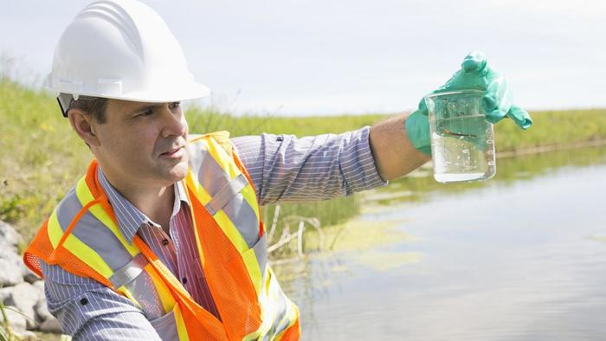
Descriptive research

Slide 22
Case example for Descriptive Studies
A researcher wants to know why individuals in Community A have a higher rate of a rare form of cancer when compared to those living in Community B.
To find out the reasons for the differences in cancer rates in these two communities, the investigator surveyed residents about their lifestyle, noted the types of businesses that were present in the community and searched medical records.
The researcher found that the headquarters for the Pesticide Chemical Plant is located in Community A, there is a higher rate of cigarette smoking in this community and residents tended to delay or skip going to the doctor for an annual checkup.
In Community B, the largest employer was a department store and on average, residents did not smoke as much as residents from Community A. However, like individuals from Community A, Community B residents tended to delay or skip their annual checkup with their doctor.

Slide 23
Descriptive research
Descriptive studies are aimed at finding out "what is," so observational and survey methods are frequently used to collect descriptive data (Borg & Gall, 1989).
Descriptive research does not fit neatly into the definition of either quantitative or qualitative research methodologies, but instead it can utilize elements of both, often within the same study.
The term descriptive research refers to the type of research question, design, and data analysis that will be applied to a given topic. Descriptive statistics tell what is, while inferential statistics try to determine cause and effect.

Slide 24
Summary
Surveys & fact-finding enquiries
Objective: Description of state of affairs as it exists at time of study.
Ex post facto research – social science & business research
Has no control over variables
Can only report what has happened or what is happening
E.g. consumers preferences, frequency of shopping

Slide 25

Analytical Research

Slide 26
Analytical research
Analytical research is a specific type of research that involves critical thinking skills and the evaluation of facts and information relative to the research being conducted.
A variety of people including students, doctors and psychologists use analytical research during studies to find the most relevant information.
From analytical research, a person finds out critical details to add new ideas to the material being produced.
Analytical research explores a topic in-depth, often beginning with a question that asks why or how.

Slide 27
Some researchers conduct analytical research to find supporting evidence to current research being done in order to make the work more reliable.
Other researchers conduct analytical research to form new ideas about the topic being studied.
Analytical research is conducted in a variety of ways including literary research, public opinion, scientific trials and Meta-analysis.

Slide 28
Summary
Has to use facts / information already available
Analyze these to make critical evaluation of material

Slide 29

Applied research

Slide 30
Example for Applied Research:
Research that is directed towards specific objectives such as the development of a new drug, therapy, or surgical procedure.
It involves the application of existing knowledge, much of which is obtained through basic research, to a specific biomedical problem.
Applied research can be conducted with animals, non-animal alternatives such as computer models or tissue cultures, or with humans.

Slide 31
Example of Applied research
Investigating which treatment approach is the most effective for reducing anxiety
A hospital might conduct applied research on how to prepare patients for certain types of surgical procedures.
A business might hire an applied psychologist to assess how to design a workplace console to maximize efficiency and productivity while minimizing worker fatigue and error.

Slide 32
Applied research
Applied research is a methodology used to solve a specific, practical problem of an individual or group. The study and research is used in business, medicine and education in order to find solutions that may cure diseases, solve scientific problems or develop technology.

Slide 33
Apple’s iPod sales increased by 200% from 2001 to 2008. but the sales decreased by 6% in 2009. What is the reason for this decrease?
The question is: what will apple do about this problem?

Slide 34
Summary of Applied research
Finding a solution for an immediate problem / for pressing practical problem
Society / industrial / business organization
Aimed at certain conclusions
Marketing research / evaluation research
Principle: To find a solution to some pressing practical problem

Slide 35
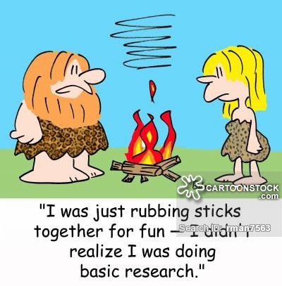

Fundamental research

Slide 36
Fundamental research
Basic research: to determine or establish fundamental facts and relationships within a discipline or field of study. It develop theories

Slide 37
Basic or "pure" Research:
Research conducted to increase the base knowledge and understanding of the physical, chemical, and functional mechanisms of life processes and disease.
It is fundamental and not directed to solving any particular biomedical problem in humans or animals.
This type of research often involves observing, describing, measuring, and experimental manipulation and provides the building blocks upon which the other types of research (applied and clinical) are based.

Slide 38
Examples of Fundamental research
How do nerves convey signals to the brain via biochemical?
How do taste and smell change with age?

Slide 39
Summary of Fundamental research
Generalisation
Formulation of a theory
Gaining knowledge for knowledge’s sake is ‘pure’ or ‘basic' research
Finding information
E.g. with view to make generalization about human behavior
Research concerning some natural phenomenon or relating to pure mathematics are examples of fundamental research.
Principle: To find information with broad base of application and add to the already existing scientific knowledge

Slide 40

Quantitative research

Slide 41
Quantitative research
Quantitative research aims to answer a specific research question; it is tangible and countable in nature and the designs are predetermined and structured, remaining consistent throughout the study making them potentially reproducible.
They involve the researcher(s) either intervening in participants’ healthcare in some way, for example, administering a treatment in order to test its effect; or observing participants without manipulating their behavior or course of treatment.

Slide 42
There are lots of different types of interventional and observational studies; the study design is chosen based on how well it can answer the research question of interest while being ethical and cost-effective.

Slide 43
Its main characteristics are
The data is usually gathered using structured research instruments.
The results are based on larger sample sizes that are representative of the population.
The research study can usually be replicated or repeated, given its high reliability.
Researcher has a clearly defined research question to which objective answers are sought.

Slide 44
All aspects of the study are carefully designed before data is collected.
Data are in the form of numbers and statistics, often arranged in tables, charts, figures, or other non-textual forms.
Project can be used to generalize concepts more widely, predict future results, or investigate causal relationships.
Researcher uses tools, such as questionnaires or computer software, to collect numerical data.

Slide 45

Example of Quantitative research
clearly defined
Research question

Slide 46
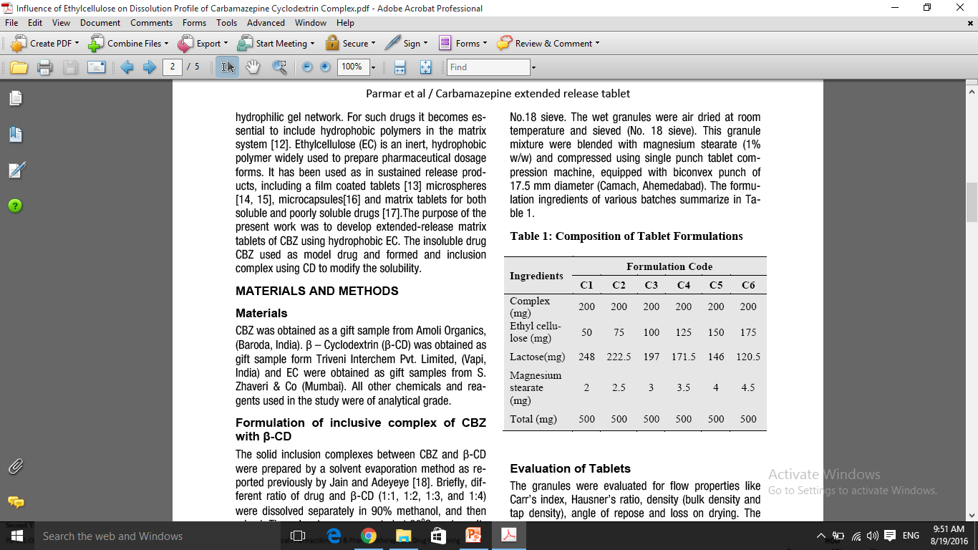
Data are in the form of
numbers and statistics
Optimized Design

Slide 47
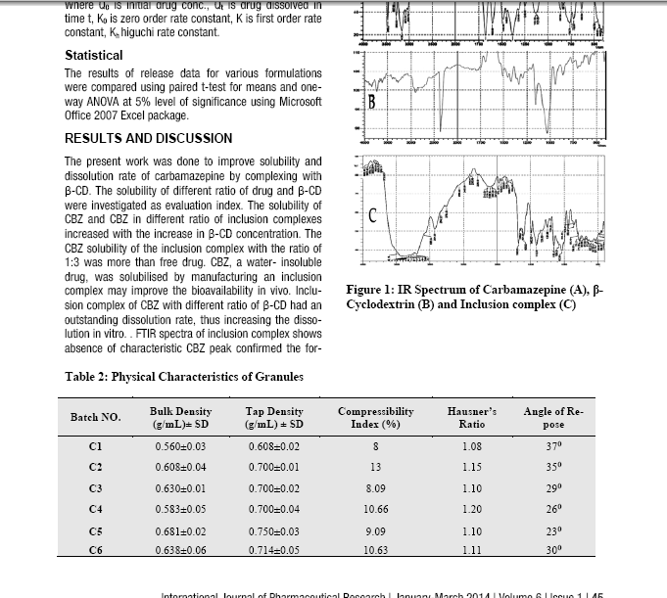

Slide 48
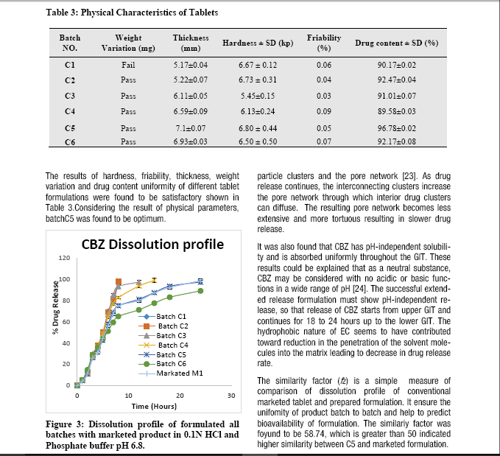

Slide 49
Summary of Quantitative research
Based on measurement of quantity or amount
Expressed in terms of quantity
Various available statistical and econometric methods are adopted for analysis.
E.g. correlation, regression, time series analysis etc.

Slide 50
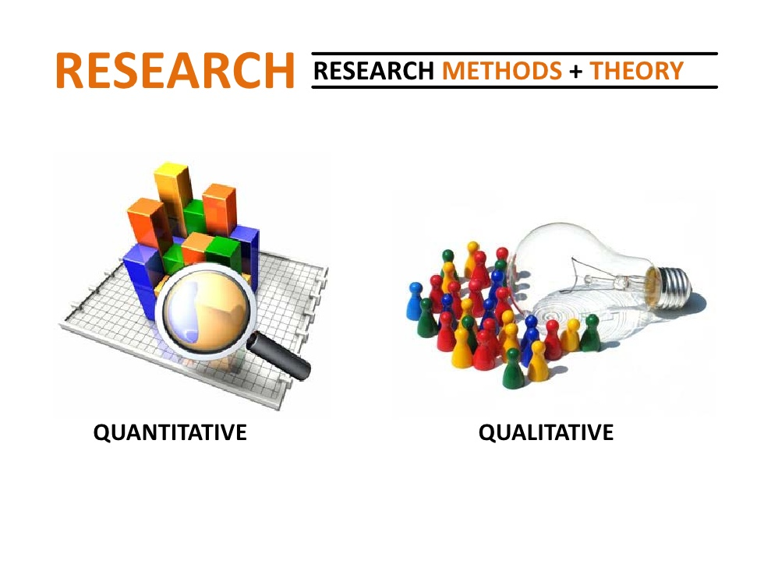
Qualitative research

Slide 51
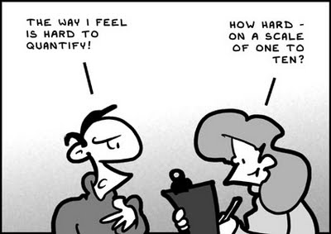

Slide 52
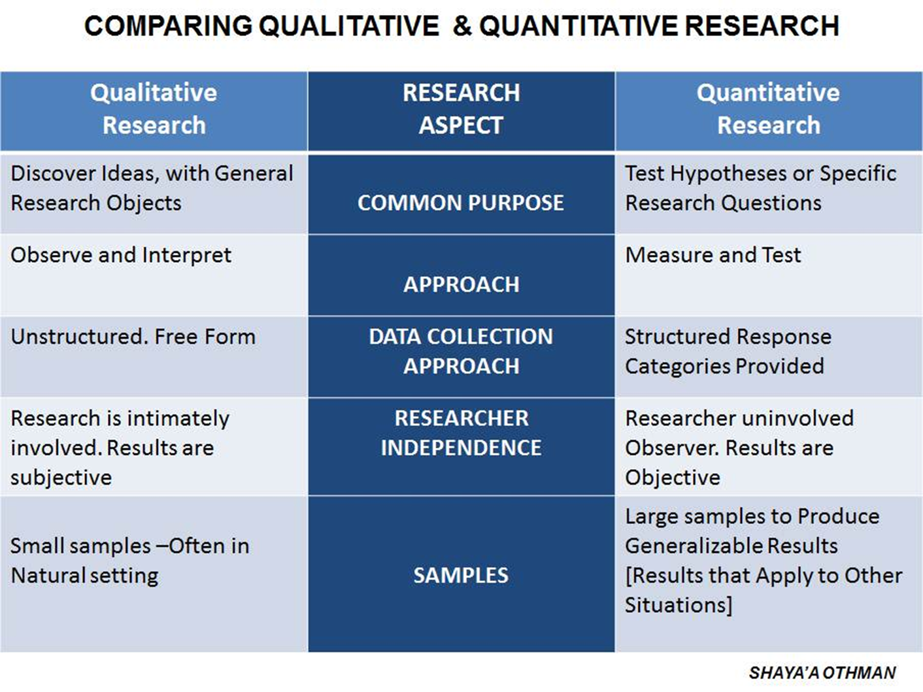

Slide 53
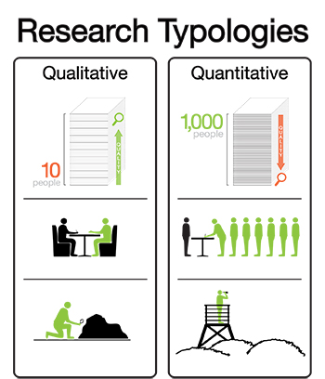

Slide 54
Qualitative research
Qualitative Research is primarily exploratory research. It is used to gain an understanding of underlying reasons, opinions, and motivations. It provides insights into the problem or helps to develop ideas or hypotheses for potential quantitative research
Qualitative research involves disciplined inquiry that examines people’s lives, experiences and behaviors, and the stories and meanings individuals ascribe to them.
It can also investigate organizational functioning, relationships between individuals and groups, and social environments.

Slide 55
Qualitative research
This approach to research can involve the studied use and collection of a variety of empirical materials such as case studies, personal experience, life stories, interviews, observations, and cultural texts.
Qualitative Research is primarily exploratory research. It is used to gain an understanding of underlying reasons, opinions, and motivations. It provides insights into the problem or helps to develop ideas or hypotheses for potential quantitative research
It may bring new insights into the experiences of individuals, groups or communities, or into issues such as environmental change, public policies and planning.
Qualitative research may also have quantitative elements or aspects.

Slide 56
Commonly used approaches to data collection in qualitative research
Interviews
  structured interviews,
  semi-structured interviews
  unstructured interviews,
  Key informant interviews
  Sample informant interviews
  Life story or oral history
  Focus groups
  Observation
  Archival research
  On-line research

Slide 57
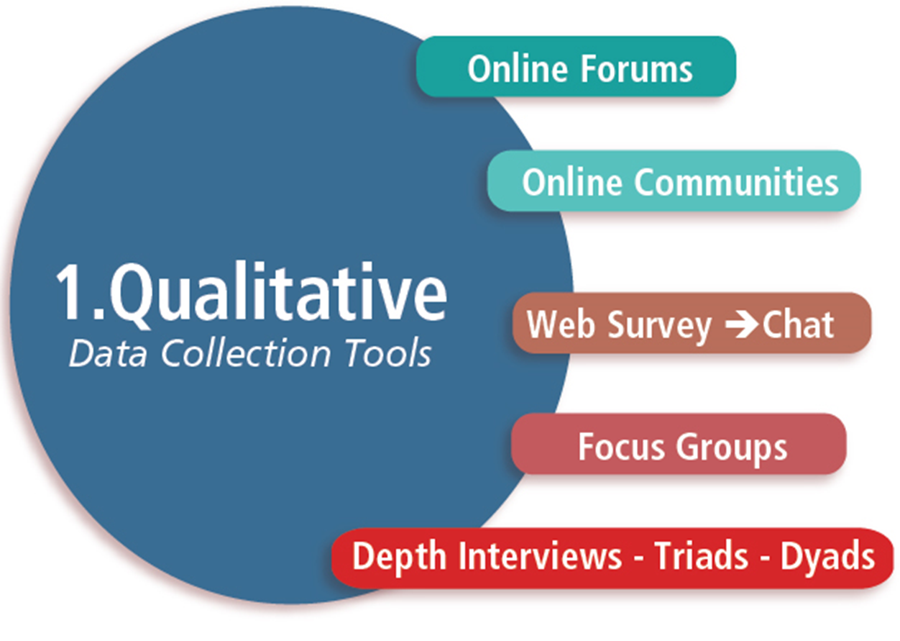
Other common approaches as data collection tools

Slide 58
Summary of Qualitative research
Concerned with qualitative phenomenon
Motivation research – an important type
  E.g. how people feel or what they think about a particular subject or institution
To discover underlying motives
Seek guidance

Slide 59

Conceptual Research

Slide 60
Conceptual research focuses on the concept or theory that explains or describes the phenomenon being studied.
  What causes disease?
  How can we describe the motions of the planets?
  What are the building blocks of matter?

Slide 61
The conceptual researcher sits at his desk with pen in hand and tries to solve these problems by thinking about them.
He does no experiments but may make use of observations by others, since this is the mass of data that he is trying to make sense of.
Until fairly recently, conceptual research was considered the most honorable form of research—it required using the brain, not the hands.

Slide 62
Conceptual research
Related to abstract ideas / theory
To develop new concepts / reinterpret existing ones.
Generally philosopher and thinker use it for developing new concept or for reinterpreting the existing one.

Slide 63
Emperical Research

Slide 64
“Empirical Research: Getting Your Hands Dirty”

Slide 65
Empirical research relies on experience or observation alone, often without due regard for system and theory. It is data-based research, coming up with conclusions which are capable of being verified by observation or experiment.
We can also call it as experimental type of research. In such a research it is necessary to get at facts firsthand, at their source, and actively to go about doing certain things to stimulate the production of desired information.

Slide 66
Example
Aristotle taught that large cannonballs fell to earth faster than small ones, and many generations of professors repeated his teachings until
Galileo proved them wrong. Galileo was an empiricist of the best sort, one who performed original experiments not merely to destroy old theories but to provide the basis for new theories.

Slide 67
Empirical research
Data-based research
Relies on experience / observation alone
Verified by observation / experiment
Works to get enough facts to prove / disprove hypothesis
Evidence gathered by this is most powerful support possible for a given hypothesis

Slide 68
Some other types of research
•Cross-sectional research/one time
  -Research is confined to a single time-period
•Longitudinal research
  -Carried over several-time periods
•Field-setting/laboratory/simulation
  -Depends upon the environment

Slide 69
•Clinical research
  -case-study method
•Diagnostic research
  -In depth approaches to reach basic casual relations
•Historical research
  -Utilizes historical sources like documents, remains, etc

Slide 70
Research methods
All those methods/techniques that are used for conduction of research
Refer to the methods the researchers use in performing research operations
Method used by the researcher

Slide 71
Put into 3 groups,
Methods which are concerned with data collection
Statistical techniques for establishment of relationship b/w data & unknown
Evaluating the accuracy of results obtained

Slide 72
Significance of Research
Research inculcates scientific and inductive thinking and it promotes the development of logical habits of thinking and organisation.
The role of research in several fields of applied economics, whether related to business or to the economy as a whole, has greatly increased in modern times.
Research provides the basis for nearly all government policies in our economic system.
Decision-making may not be a part of research, but research certainly facilitates the decisions of the policy maker.

Slide 73
Research has its special significance in solving various operational and planning problems of business and industry.
Research is equally important for social scientists in studying social relationships and in seeking answers to various social problems.

Slide 74
Additional significances
To those students who are to write a master’s or Ph.D. thesis, research may mean a careerism or a way to attain a high position in the social structure;
To professionals in research methodology, research may mean a source of livelihood;
To philosophers and thinkers, research may mean the outlet for new ideas and insights;
To literary men and women, research may mean the development of new styles and creative work;
To analysts and intellectuals, research may mean the generalizations of new theories.

Slide 75
Nutshell
Research is the fountain of knowledge for the sake of knowledge and an important source of providing guidelines for solving different business, governmental and social problems.

Slide 76
RESEARCH PROBLEM
OR
RESEARCH QUESTION
OR
RESEARCH TOPIC

Slide 77
INTRODUCTION
A research problem is a question that researcher wants to answer or a problem that a researcher wants to solve
Identification & formulation of a research problem is the first step of the research process.

Slide 78
Selection of research problem depends on several factors such as researcher’s knowledge, skills, interest, expertise, motivation & creativity with respect to the subject of inquiry.
It is believed that most of the good research studies need lots of time for selection of a research problem.

Slide 79
DEFINITION
According to Kerlinger, ‘A problem is an interrogative sentence or statement that asks what relation exists between two or more variable.’
The answer to question will provide what is having pursued in the research.

Slide 80
R.S. Woodworth defines problem as ‘a situation for which we have no ready & successful response by instinct or by previous acquired habit. We must find out what to do’, i.e. the solution can be found out only after an investigation.
In other words, ‘a research problem is an area of concern where there is a gap in the knowledge base needed for professional practices.

Slide 81
IDENTIFICATION OF RESEARCH PROBLEM
Identification of a research problem is the first & most important step in research process.
Generally, a broad area is selected & then a broad topic is delimited or narrowed down to a specific one-sentence statement of the problem.
This step of the research process is considered as the most difficult & challenging, & needs lots of time.
A research problem may come from several sources:

Slide 82
Consultation with experts
Personal Experience
Practical Experience
Sources of
Research Problem
Exposure to field situations
Critical Appraisal of literature
Folklores
Previous Research
Intuition
Existing theories
Brainstorming
Social Issues

Slide 83
Personal Experiences:
Day-to-day personal experience of a research may serve as good source of ideas to formulate a research problem.
For example, a researcher observed domestic violence suffered by wives of alcoholic husbands.
This experience may provide ideas to identity several research problems related to domestic violence against women.
There may be so many such life experiences of a researcher which could be used to develop a research problem.

Slide 84
Practical Experiences:
Researcher gets plenty of ideas to formulate research problems from their clinical experiences.
Every curious researcher has several questions to be answered which are encountered during clinical experience.
Such clinical experiences could be rich sources of ideas to identify a significant research problem.

Slide 85
Critical Appraisal of literature:
When we critically study books & articles relating to the subject of our interest, including research report, opinion articles, & summaries of clinical issues, pertinent questions may arise in our mind.
These may strike reader’s mind indirectly by stimulating imagination & directly by stating what additional research is needed.
For example, to reads an article on the prevalence of the pin site infection among patients with external fixators; while reading this article researcher learns that there is lack of harmony about pin site care.
This information may serve as a basis to formulate a research problem.

Slide 86
Previous Experience:
A body of knowledge should be developed on a sound foundation of research findings.
Usually at the end of a research further research problems are suggested, based on the shortcomings of previous research, which can be investigated.

Slide 87
Existing theories:
Research is a process of theory development & theory testing.
It an existing theory is used in developing a researchable problem, a specific statement from the theory must be isolated.
Generally, a part of parts of the theory are subjected to testing in the clinical situation.
The testing of an existing theory is definitely needed in profession; therefore, they serve as good sources of research problems.

Slide 88
Social issues:
Sometimes, topics are suggested by more global contemporary social or political issues of relevance to the health care community.
For example, HIV/AIDS, female foeticide, sexual harassment, domestic violence, & gender equality in health care & in research are some of the current social & political issues of concern for health care professionals.

Slide 89
Brainstorming:
Brainstorming sessions are good techniques to find new questions, where an intensified discussion among interested people of the profession is conducted to find more ideas to formulate a good research problem.
For example, ideas for studies may emerge from reviewing research priorities by having brainstorming session with other colleague, researchers, or faculties.

Slide 90
Intuition:
Traditionally institutions are considered good sources of knowledge as well as sources to find new research problems.
It is believed that reflective mind is good sources of ideas, which may be used to formulate a good research problem.

Slide 91
Folklores:
Common beliefs could be right or wrong.
For examples, it is generally believed that studying just before the test decrease the score.
We believe we should not study just before test to relax our mind.
Researchers can conduct a research study on whether one should study before the test or not.

Slide 92
Exposure to field situations:
During field exposure, researchers get variety of experiences, which may provide plenty of ideas to formulate research problems.
For example, while working in field a researcher observed a specific traditional practice for cure of disease condition, which can be used as research problem to investigate its efficacy.

Slide 93
Consultation with experts:
Experts are believed to have sound experience of their respective field, which may suggest a significance problem to be studied.
In addition, expert may help in finding a current problem of discipline to be solve, which may serve as basis for formulation of research problem.

Slide 94
CRITERIA FOR SELECTING A GOOD RESEARCH PROBLEM

Slide 95
Significance to profession
A problem which a researcher is selecting should have significance to profession or it will not serve any purpose.
A research problem is significant for profession when it is directed to develop or refine the body of professional knowledge.

Slide 96
Count…
A research problem could be considered significant for profession if it fulfils the following criteria:
Profession & patients, Professionals, & health care fraternity will benefit from the study.
The results will improve clinical practices.
Promotes theory development or testing.
Provides solutions of current practice needs
Generate information to get practical implications for profession.

Slide 97
Original
It is fundamentally considered that every research problem should be new & unique in itself.
Therefore, it is the key responsibility of a researcher that an innovative knowledge is used for selecting a research problem, so as to extend the growth of existing body of knowledge on a profession.

Slide 98
Feasible
Feasibility is an essential consideration of any research project.
Regardless of how significant or researchable a problem may be, the feasibility of research problem in reference to time, availability to subjects, facilities, equipment & money, & ethical considerations should be checked.
It will help the researcher to decide whether selected problem is appropriate or inappropriate & study can be actually carried out

Slide 99
Time:
Time is always a factor to be considered.
It is wise to allow more time than seems to be needed because unexpected delays frequently occur.

Slide 100
Count…
Cost:
All research projects cost money; some studies are much more expensive than others.
The researcher must consider realistically the financial resources available.
Equipment & supplies:
All research projects require some type of resources.
Therefore, before making the final decision to conduct a study, an accurate determination of the needed equipment & supplies should be ensured.
If researcher takes into consideration equipment & supplies in the early phases of a research project, there are less chances of the project to be revised or discarded later because of equipment or supply problems.

Slide 101
Count…
Administrative support:
Many research projects require administrative support.
The researcher may find it very difficult to conduct research independently.
Financial as well as psychological support from administrative is very helpful.
Knowing that your superiors support your research efforts can be very powerful motivating force.

Slide 102
Count…
Peer support:
Many research ideas have never been developed because potential researchers received no support from their peers.
One of the best ways to determine a researchable problem is through interactions & discussions with other
A climate of shared interest in research is essential among the members of the profession.

Slide 103
Count…
Availability of subjects:
A researcher may believe that study subjects are readily available for the study. But this may not be the case.
Potential subjects may not meet the study criteria, may be unwilling to participate, or may already be participating in other studies.
Researcher’s competence:
A research problem can only be feasible if it is in accordance with researcher’s competence, where researcher is capable to handle a given research problem.

Slide 104
Count…
Ethical considerations:
A researcher must ensure that the research problem can be considered by the ethical committee without undue hurdles.
A very important topic of research cannot be considered feasible unit & unless it is in accordance with ethical guideline.

Slide 105
Solvable/researchable:
Problem selected is considered good only if it is solvable so that chances of insolvability of problem should be minimized.
It will enhance relevant results.
For example, a researcher selects a research problem to know the existence of God in this universe.
These sorts of problems are ambiguous & impossible to solve.
Therefore, the researcher must ensure that a research problem selected for the study is solvable.

Slide 106
Current:
A good research problem must be based on the current problems & needs of a profession, so that results generated will be of more use.
Furthermore, more number of the professionals will be interested in the research conducted on the current issues of their profession.

Slide 107
Interesting:
A research problem can only be considered good if it is an accordance with researcher’s field of interest.
A research problem must be as per the motivation of the researcher & it should be fascinating to the researcher, so that research is conducted with full enthusiasm & not merely for its accomplishment.

Slide 108
FORMULATION OF RESEARCH PROBLEM

Slide 109
Selection of a research areas
Reviewing the literature & theories
Delimiting the research topic
Evaluating the research problem
Formulating final statement of research problem

Slide 110
Selection of a research area:
Formulate of a research problem begins with selection of a broad research topic from personal experience, literature, previous research, & theories in which researcher is interested & has significance for profession.
For example, a researcher gets an idea to conduct a study on the female feticide.
Therefore, he or she initially begins with such broad research topic.

Slide 111
Reviewing literature & theories:
After getting a broad idea for research, he or she needs to review the literature & theories.
Literature is reviewed to know what has already been done in this selected areas of research.
Review of theories provides an opportunity for researcher to plan a research problem to contribute towards either testing or development of a theory/conceptual model.

Slide 112
Delimiting the research topic:
In this step, researcher proceeds from a general area of interest to more specific topic of research to conduct a study.
For example, initially a researcher decide to conduct a study on female feticide; later in this stage researcher limits it to specific research topic
‘a study on perception of women about causes & prevention of female feticide in selected rural communities of district Vadodara, Gujarat’.
In this stage, a researcher clearly identifies variables, population, & setting of research study.

Slide 113
Evaluating the research problem
Once researcher is clear about the specific research problem, next the research problem must be carefully evaluated for its significance, researchability, & feasibility.
Feasibility of the research problem should be evaluated for time, cost, availability of subjects & resources, administrative & peer support, ethical consideration, & researcher’s competence & interest.

Slide 114
Formulating final statement of research problem:
After establishing the significance, researchability, & feasibility, then researcher finally formulates a final statement of a research problem.
A statement of research problem could be in declarative or interrogative format

Slide 115
Count…
Declarative format:
In this format, a research problem is stated in declarative statement.
For example:
‘A descriptive study on prevalence of bedsores among unconscious patients admitted in intensive care unit of Dhiraj hospital, Vadodara’.
‘A exploratory study on contributing factors of maternal mortality in selected rural communities of district Vadodara, Gujrat’.

Slide 116
Count…
Interrogative format:
In interrogative format, a research problem is stated in question form.
For example:
‘What is the influence of level of hemoglobin on pin site infection among patients with external skeletal fixators admitted in orthopedic wards of Dhiraj hospital, Vadodara.
‘What is the effect of ginger or morning sickness on pregnant women in selected urban communities of district Vadodara, Gujrat.

Slide 117
Count…
The choice of either of these two types of format formulation of a research problem depends on the researcher’s preference & institutional policies.
Declarative format much popular among researchers.
For the formulation of a research problem it is preferable. it is fulfils the following features:
Research problem is clearly, precisely articulated.
It clearly states the variables, population, & research setting under study.
Variable are expressed in measurable terms.
The type of study also may be included in the statement of research problem.

Slide 118
References
The Advanced Learner’s Dictionary of Current English, Oxford, 1952, p. 1069.
L.V. Redman and A.V.H. Mory, The Romance of Research, 1923, p.10.
The Encyclopaedia of Social Sciences, Vol. IX, MacMillan, 1930.

Slide 119
Thank you

