Slide 1
ANTIVIRAL AGENTS
By- Mr. Dillip Dash

Slide 2
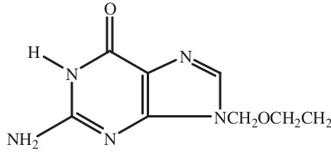
1. Anti Herpes Agents
Acyclovir
It is a guanosine derivative and has potent antiviral activity against herpes virus. Acyclovir phosphorylates to its active form Acyclovir monophosphate by thymidine kinase. The phosphorylation reaction occurs faster within cell of herpes virus than in normal cell. The monophosphate is the converted into diphosphate and triphosphate by host cell enzyme guanosine monophosphate kinase. Acyclovir triphosphate is active antiviral agent that inhibits herpes DNA polymerase. Thereby inhibit herpes virus DNA replication.

Slide 3
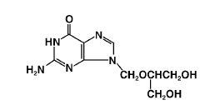
Ganciclovir
Ganciclovir is a potent inhibitor of viruses of the herpes family. Ganciclovir phosphorylate to its active form ganciclovir triphosphate by kinase enzyme. Ganciclovir triphosphate inhibits replication of viral DNA by inhibition of the viral DNA polymerase.

Slide 4
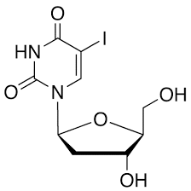
Idoxuridine
Idoxuridine, which closely resembles thymidine, inhibits thymidylic phosphorylase and specific DNA polymerases, which are necessary for the incorporation of thymidine into viral DNA. Idoxuridine is incorporated in place of thymidine into viral DNA, resulting in faulty DNA and the inability to infect or destroy tissue or to reproduce. Idoxuridine is incorporated into mammalian DNA as well.

Slide 5
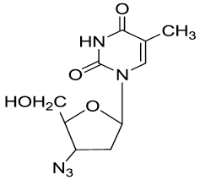
ANTI RETROVIRAL AGENTS
Nucleotide reverse transcriptase inhibitors
Zidovudine
Zidovudine is a thymidine analogue. Cellular enzymes convert Zidovudine into the effective triphosphate form. Zidovudine works by selectively inhibiting HIV's reverse transcriptase, which is necessary for production of HIV's double-stranded DNA, that would be subsequently integrated into the genetic material of the infected cell (where it is called a provirus). At very high doses, Zidovudine triphosphate form may also inhibit DNA polymerase used by human cells to undergo cell division.

Slide 6
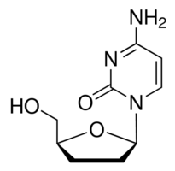
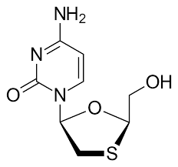
Zalcitabine
Mode of action is similar to Zidovudine.
Lamivudine
Mode of action is similar to Zidovudine.

Slide 7
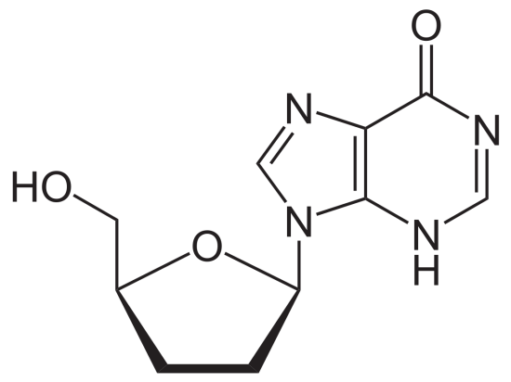
Didanosine
It is used in combination with other medication as a part of highly active anti retroviral therapy. It is a synthetic purine dideoxy nucleoside. It is phosphorylated in the host cell to the diphosphate dideoxy adenosine which inhibit reverse transcriptase enzyme and interfere with viral replication.

Slide 8
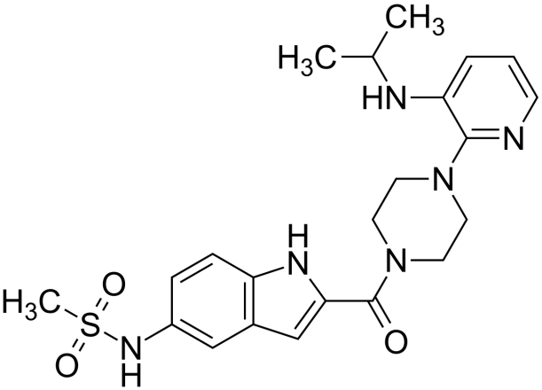
Non-Nucleotide reverse transcriptase inhibitors
Delavirdine
Delavirdine is a non-nucleoside reverse transcriptase inhibitor (nNRTI) with activity against Human Immunodeficiency Virus. Delavirdine binds directly to reverse transcriptase (RT) and blocks the RNA dependent DNA polymerase activities by causing a disruption of the enzyme's catalytic site. The activity of Delavirdine does not compete with template or nucleoside triphosphates.

Slide 9
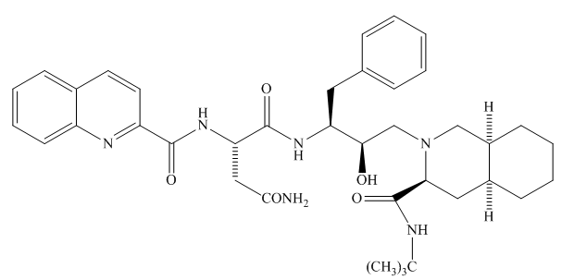
Protease Inhibitors
Saquinavir
Saquinavir is a protease inhibitor. Proteases are enzymes that cleave protein molecules into smaller fragments. HIV protease is vital for both viral replication within the cell and release of mature viral particles from an infected cell. Saquinavir binds to the active site of the viral protease and prevents cleavage of viral polyproteins, preventing maturation of the virus.

Slide 10
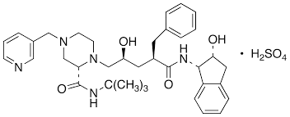
Indinavir
Mode of action same as Saquinavir.

Slide 11
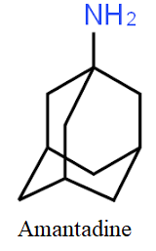
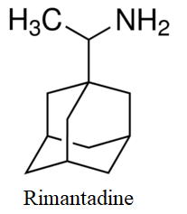
Anti Influenza Agents
These drugs interfere with the viral protein (M2 ion Chanel) and interfere with the viral replication. M2 (Matrix2) is a proton selective ion chanel protein. Proton conductance by M2 ion chanel is essential for the viral replication.

Slide 12
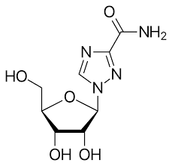
Non-selective Antiviral Agents
Ribavirin
It is a guanosine analog used to stop viral RNA synthesis, thus, it is a nucleoside inhibitor. Ribavirin interferes with RNA metabolism required for viral replication.

