Slide 1

Gas Chromatography
Dr. Ashim Kumar Sen
Associate Professor
Department of Pharmacy
Sumandeep Vidyapeeth Deemed to be University
Piparia, Waghodia, Vadodara-391760, Gujarat, India.
Mobile No. +919377977540
Email Id: ashimsen.dop@sumandeepvidyapeethdu.edu.in

Slide 2

Invention of Chromatography
Mikhail Tswett invented chromatography in 1901 during his research on plant pigments.
He used the technique to separate various plant pigments such as chlorophylls, xanthophylls and carotenoids.
Mikhail Tswett
Russian Botanist
(1872-1919)
Notes:
http://en.wikipedia.org/wiki/Mikhail_Tsvet
The method was described on 30 December 1901 at the XI Congress of Naturalists and Physicians (XI съезд естествоиспытателей и врачей) in St. Petersburg. The first printed description was in 1903, in the Proceedings of the Warsaw Society of Naturalists, biology section. He first used the term "chromatography" in print in 1906 in his two papers about chlorophyll in the German botanical journal, Berichte der Deutschen botanischen Gesellschaft. In 1907 he demonstrated his chromatogaph for the German Botanical Society.
Tsvet's work was ignored for several decades because of diverse reasons: the tragic events in Russia at the beginning of the 20th century, the fact that Tsvet originally published only in Russian (what made his results inaccessible to western scientists) and an article denying Tsvet's findings. Willstater and Stoll tried to repeat Tsvet's experiments but because they used an aggressive adsorbent (what destroys the chlorophyll's) were not able to do so. They published their results and Tsvet's chromatography method went into oblivion. It was recollected 10 years after his death thanks to German scientist Edgar Lederer and Austrian biochemist Richard Kuhn and the work of Martin and Synge.

Slide 3
Original Chromatography Experiment
Start: A glass
column is filled
with powdered
limestone
(CaCO₃).
End: A series of colored bands is
seen to form,
corresponding to
the different pigments in the original plant extract. These bands were later determined to be chlorophylls, xanthophylls and carotenoids.
Later
An EtOH extract
of leaf pigments
is applied to the
top of the column.
EtOH is used to
flush the pigments
down the column.

Slide 4
Chromatography: (Greek = chroma “color” and graphein “writing” ) Tswett named this new technique chromatography based on the fact that it separated the components of a solution by color.
Common Types of Chromatography
Tswett’s technique is based on Liquid Chromatography. There are now several common chromatographic methods. These include:
Paper Chromatography
Thin Layer Chromatography (TLC)
Liquid Chromatography (LC)
High Pressure Liquid Chromatography (HPLC)
Ion Chromatography
Gas Chromatography (GC)
Notes:
p.674

Slide 5
Paper and Thin Layer Chromatography
The solvent moves up paper by capillary action,
carrying mixture components at different rates.
solvent
front
Later
solvent

Slide 6
How Does Chromatography Work?
In all chromatographic separations, the sample is transported in a mobile phase. The mobile phase can be a gas, a liquid, or a supercritical fluid.
The mobile phase is then forced through a stationary phase held in a column or on a solid surface. The stationary phase needs to be something that does not react with the mobile phase or the sample.
The sample then has the opportunity to interact with the stationary phase as it moves past it. Samples that interact greatly, then appear to move more slowly. Samples that interact weakly, then appear to move more quickly. Because of this difference in rates, the samples can then be separated into their components.
Notes:
page 675

Slide 7
Chromatography is based on a physical equilibrium
that results when a solute is transferred between the mobile and a stationary phase.
K = distribution
coefficient or
partition ratio
A
A
A
A
A
C
K
=
S
A
A
C
A
M
A
Where C_{S} is the molar concentration of the solute in the stationary phase and C_{M} is the molar concentration in the mobile phase.
A
A
A
Cross Section of Equilibrium in a column.
“A” are adsorbed to the stationary phase.
“A” are traveling in the mobile phase.

Slide 8
In a chromatography column, flowing gas or liquid
continuously replaces saturated mobile phase and results in movement of A through the column.
Flow
Column is packed
with particulate
stationary phase.
As a material travels through the column, it assumes a Gaussian concentration profile as it distributes between the stationary packing phase and the flowing mobile gas or liquid carrier phase.

Slide 9
In a mixture, each component has a different distribution coefficient, and thus spends a different amount of time absorbed on the solid packing phase vs being carried along with the flowing gas
Flow
Flow
Flow
Flow
More volatile materials are carried through the column more rapidly than less volatile materials, which results in a separation.

Slide 10
If a detector is used to determine when the components elute from the column, a series of Gaussian peaks are obtained, one for each component in the mixture that was separated by the column.
Note: The first two components were not completely separated.
Peaks in general tend to become shorter and wider with time.

Slide 11
The Theoretical Plate
Theoretical plate is a term coined by Martin & Synge. It is based on a study in which they imagined that chromatographic columns were analogous to distillation columns and made up or numerous discrete but connected narrow layers or plates. Movement of the solute down the column then could be treated as a stepwise transfer.
Theoretical plates (N) measure how efficiently a column can separate a mixture into its components. This efficiency is based on the retention time of the components and the width of the peaks.
Notes:
pp.681-682

Slide 12
N = Number of theoretical plates (a measure of efficiency)
t_{R}
w_{b}
t_{R} is the retention time; it is measured from the injection peak
(or zero) to the intersection of the tangents.
w_{b} is the width of the base of the triangle; it is measured at the intersection of the tangents with the baseline.

Slide 13
t_{R}
t_{R}
w_{b}
w_{b}
Larger N
Smaller N
When the retention time, t_{R}, is held constant, the column that produces peaks with narrower bases, w_{b}, will be more efficient – have a greater N value.
Likewise a column that produces wider peaks will be less efficient – have a smaller N value.
This is because a smaller denominator, w_{b}, will yield a larger overall number and a larger denominator will yield a smaller number.

Slide 14
Gas Chromatography
Good for volatile samples (up to about 250 ºC)
0.1-1.0 microliter of liquid or 1-10 ml vapor
Can detect <1 ppm with certain detectors
Can be easily automated for injection and data analysis

Slide 15
Components of a Gas Chromatograph
Gas Supply: (usually N₂ or He)
Sample Injector: (syringe / septum)
Column: 1/8” or 1/4” x 6-50’ tubing packed with
small uniform size, inert support coated with
thin film of nonvolatile liquid
Detector: TC - thermal conductivity
FID - flame ionization detector

Slide 16
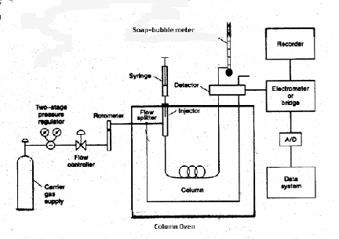
Schematic of a Commercial Gas Chromatograph

Slide 17
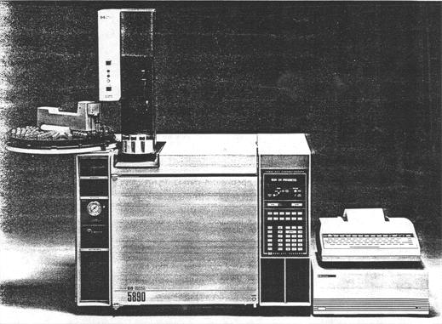
HP 5890 Capillary Gas Chromatograph
with Robotic Sample Injector and Data Station

Slide 18
Our GC System
(Limited to volatile chlorine containing organic compounds.)
Gas Supply: propane line gas
Injector: 0.3 ml of vapor through latex tubing
Column: 5 ml pipet filled with Tide detergent
Detector: based on Beilstein reaction of chlorinated hydrocarbons with hot Cu metal to give bright blue/green flame coloration.

Slide 19
GC Construction
TOP
Ring Stand
CdS Photocell mounted in
Clamps
Straw/Stopper bracket
5ml pipet
Packed with Tide
Attach leads to computer
1 ml Syringe
Black paper
cylinder
SIDE
Buret Valve
Latex coupling
Align photocell with
midpt. of flame
Cu coil
Gas inlet
Fiber plugs

Slide 20
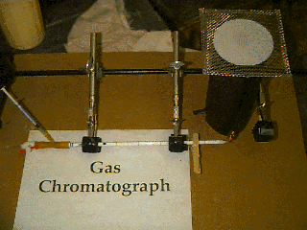

Slide 21
Wrapping the detector coil
(Detail of Cu coil winding.)
*Do not leave any gaps between turns.
Pipet
Hold here with thumb while winding 18-20
turns around the pipet.
Do NOT use the Coil Adjusting Tool for this step.
2. Bend so mounting post is centered in coil
using the Coil Adjusting Tool**
Side View
End View
Do NOT try to adjust coil in pipet tip!
**Coil Adjusting Tools are located in the Hood.
(Please return them to the Hood as soon as your are finished with them.)

Slide 22
Filling the Column
1. Add about 1 tsp of dry/sifted Tide
to fill pipet within 1/4” of top
(Tide has been sifted and dried,
so keep lid closed on container.)
2. Tap column with a pencil
to settle the powder.
3. Use a plug of fiberfill
to hold Tide in place
*Do not compact Tide into column.
**Do not leave any dead space at head of column.

Slide 23
Burner Adjustment Parameters
Adjustment of height
above pipet tip will
affect the fuel / air ratio.
Length of coil will affect
flame stability.
For best results, flame should be 1/4” - 3/8” high,
non-luminous (blue), and non-flickering.

Slide 24
Detail of Sensor (CdS Photoresistor)
Check that leads
are not shorted
inside straw.
face of sensor should
be 1/8” back from
end of straw
foam plug
Straw covered
with electrical tape
Note: The sensor should be tested by connecting to computer and checking voltage in light and with sensor face covered with your finger.

Slide 25
Sensor Alignment
Top View
Flame Shield
Sensor/Stopper
Column
Flame
1. Remove sensor from stopper and sight through tube.
2. Adjust clamp so that base of flame can be seen.
3. Carefully replace sensor in tube.

Slide 26
Sensor Response Curve
1.1 M Ω
(dark)
R (Ω)
350 Ω
(bright)
Brightness
The sensor has the largest change in resistance in the low light region. (Blue flame is best.)
Too much light will ‘saturate’ the sensor.
Place wire gauze on top of flame shield to block room light and drafts.

Slide 27
Sample Injection
1. Fill sample vapor only in syringe (NOT liquid!).
2. Overfill syringe then adjust to desired amount.
3. Do not let the sample remain in the syringe long before
injecting to avoid vapor loss into the rubber plunger of
the syringe.
4. Rotate the syringe when piercing the latex tubing to avoid
a pressure surge which may blow out the flame.
5. Inject as close as possible to the column head.
6. Push the plunger fairly rapidly during injection.
7. Chloroform (CHCl₃ ) may require a larger amount
than suggested to get adequate sensor response

Slide 28
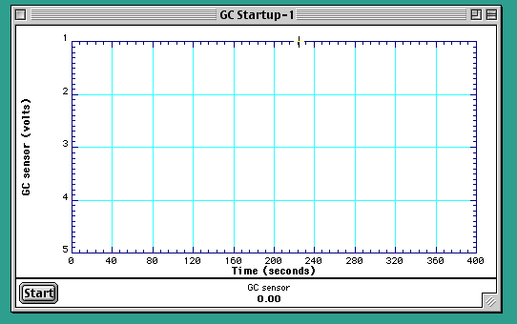
General Settings for GC Startup program
Y axis: 1-5 v (0-1 volt is in bright light, 4-5 volt is dark)
X axis: 0-400 seconds

Slide 29
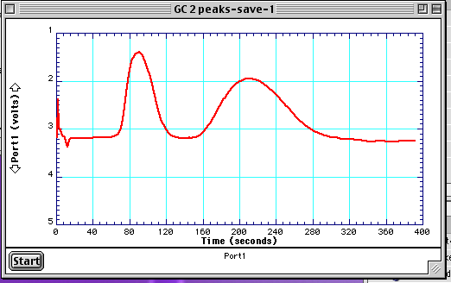
Plot of GC Elution Data for
Dichloromethane and Chloroform
On 25 cm Tide Column
Good: Peaks are smooth, well separated and elute quickly

Slide 30
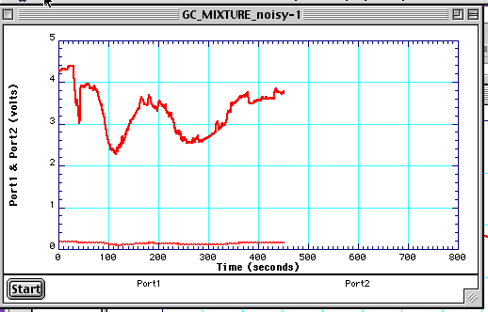
Plot of GC Elution Data for
Dichloromethane and Chloroform
On 25 cm Tide Column
Poor: peaks are noisy, due to flickering flame, and elute slowly.
To fix: Adjust sensor so that it is looking at the blue portion
of the flame. (Verify the flame is blue.)

Slide 31
Printing Elution Curves
From File menu in GC program choose Export Data A
1. Give the file a name.
2. Choose text option.
3. Save to desktop.
4. Send it to your email accounts* via minermail using web.
* Don’t forget to cc Dr. Bolon bolonc@umr.edu
5. Open file, highlight text, copy and paste to your
favorite graphing program (e.g. Excel).

Slide 32
Determination of the Amount
of Sample Components Present
The peak height is proportional to the amount
of material eluting from the column at any given time,
The area under the peak is a measure of the total
amount of material that has eluted from the column.
Electronic integrators are used for area measurement
in commercial GCs. We will be using ALGEBRA. ☺

Slide 33
The Gaussian curve can be approximated as triangular in shape, to simplify area measurement.
Area = 1/2 w_{b} h
h
w_{b}
NOTE: the height is measured to the top of the tangents,
which is above the actual curve peak.

Slide 34
If voltage data is very noisy, resulting in poor peak shape,
some peak parameters may be estimated from visual
observations, however areas cannot be calculated. So have the TA verify your data before you take apart your GC.
retention time
peak
width
Blue Flame
Green Flame
Blue Flame
onset of green
end of green

Slide 35
Experiments
1. Test run of CH₂Cl₂ without sensor check for visible
color, reasonable width and retention time on column.
2. Run of Pure Compounds: (1 good run of each)
CH₂Cl₂ (Dichloromethane aka Methylene Chloride)
  CHCl₃ (Chloroform)
3. Mixture: CH₂Cl₂:CHCl₃ (2:3 mix)
Collect voltage vs time data and also note visual onset
and disappearance of green flame color.

Slide 36
Data and Calculations
(There is a separate handout available with this information.)
A. Graphs (3) from computer
1. Elution data for pure CH₂Cl₂
2. Elution data for pure CHCl₃
3. Elution data for mixture
B. Calculations (handwritten, for each graph)
1. Peak Area = 1/2 (W x H)
2. Number of theoretical plates, N = 16 (T_{R} / W_{b})²

Slide 37
Checkout
1-pipet (5 ml graduated, for GC column)
1-flow regulator (buret valve)
1-clothespin
1-pair forceps
1-1cc syringe
1-flame shield (black construction paper cylinder)
1-sensor/stopper
1-coil adjusting tool
1-pc Cu wire (discard after use)

Slide 38
In Hoods:
Tide (Replace lid to prevent moisture absorption)
teaspoons
plastic funnels
fiberfill (looks like cotton)
CH₂Cl₂ - dichloromethane or methylene chloride
(clear septum vial)
CHCl₃ - chloroform
(brown septum vial)
Notes:
Work in groups of four. ☺

Slide 39
Hazards
Needles are sharp.
Detector coil is hot.
Carrier gas is flammable.
CH₂Cl₂ and CHCl₃ are toxic.
Waste
Empty Tide from columns into solid waste.
Do NOT use water to clean column.
Stockroom will clean stuck columns.
This Week
Review Session – November 29, 8:30-10:00pm in G3.
Next Week (December 3-6)
*Final Exam – 1-2 Hour Exam during regularly
scheduled class time. You will need a calculator.
**Checkout after exam. $35 fine for not checking out.
(This means NO Chem 2 Final during Finals Week.)

