Slide 1
The Prevention of Cruelty to Animal Act - 1960

Slide 2
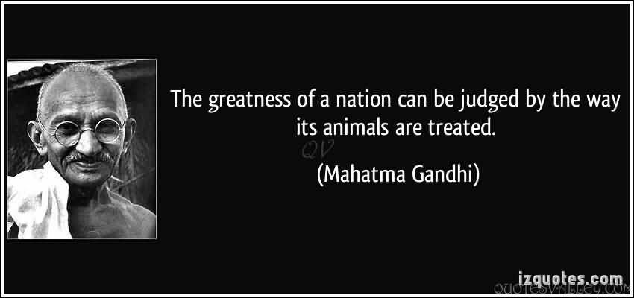

Slide 9
OBJECTIVES:
To prevent the infliction of unnecessary pain or suffering on animals.
To amend laws relating to the prevention to cruelty to animals.

Slide 10
Definitions :
(a) "animal" means any living creature other than a human being,
(b) "domestic animal" means any animal which is tamed or which has been or is being sufficiently tamed (domesticated) to serve some purpose for the use of man or which, although it neither has been nor is intended to be so tamed, is or has become in fact wholly or partly tamed

Slide 11
Definitions :
(c) "owner", used with reference to an animal, includes not only the owner but also any other person for the time being in possession or custody of the animal, whether with or without the consent of the owner.
(d) "phooka" or "doom dev" includes any process of introducing air or any substance into the female organ of a milch(mammal) animal with the object of drawing off from the animal any secretion of milk;

Slide 12
FUNCTIONS:
(a) to keep the law in force in India, for the prevention of cruelty to animals under constant study and advise the Government on the amendments to be undertaken in any such law from time to time;
(b) to advise the Central Government on the making of rules under this Act with a view to preventing unnecessary pain or suffering to animals generally, and more particularly when they are being transported from one place to another or when they are used as performing animals or when they are kept in captivity or confinement;

Slide 13
(c) to advise the Government or any local authority or other person on improvements in the design of vehicles so as to lessen the burden on draught animals;
(d) to take all such steps as the Board may think fit for amelioration of animals by encouraging or providing for, the construction of sheds, water-troughs and the like and by providing for veterinary assistance to animals:

Slide 14
(e) to advise the Government or any local authority or other person in the design of slaughter-houses or the maintenance of slaughter houses or in connection with slaughter of animals so that unnecessary pain or suffering, whether physical or mental, is eliminated in the pre-slaughter stages as far as possible, and animals are killed; wherever necessary, in as humane manner as possible;

Slide 15
(f) to take all such steps as the Board may think fit to ensure that unwanted animals are destroyed by local authorities, whenever it is necessary to do so, either instantaneously or after being rendered insensible to pain or suffering.
(g) to encourage by the grant of financial assistance or otherwise, the formation or establishment of pinjrapoles, rescue homes, animal shelters, sanctuaries and the like, where animals and birds may find a shelter when they have become old and useless or when they need protection:

Slide 16
(h) to co-operate with, and co-ordinate the work of, associations or bodies established for the purpose of preventing unnecessary pain or suffering to animals or for the protection of animals and birds;
(i) to give financial and other assistance to animal welfare organizations functioning in any local area or to encourage the formation of animal welfare organizations in any local area which shall work under the general supervision and guidance of the Board;

Slide 17
(j) to advise the Government on matters relating to the medical care and attention which may be provided in animal hospital, and to give financial and other assistance to animal hospitals whenever the Board thinks it necessary to do so;
(k) to impart education in relation to the humane treatment of animals and to encourage the formation of public opinion against the infliction of unnecessary pain or suffering to animals and for the promotion of animal welfare by means of lectures, books, posters, cinematographic exhibitions and the like;
(l) to advise the Government on any matter connected with animal welfare or the prevention of infliction of unnecessary pain or suffering on animals.

Slide 18
Exemption in this section shall apply to -
(a) the dehorning of cattle, or the castration(removal of the testicles) or branding or nose roping of any animal in the prescribed manner, or
(b) the destruction of stray dogs in lethal chambers or by such other methods as may be prescribed or
(c) the destruction of any animal under the authority of any law for the time being in force; or
(d) the commission or omission of any act in the course of the destruction or the preparation for destruction of any animal as food for mankind unless such destruction or preparation was accompanied by the infliction of unnecessary pain or suffering.

Slide 19
Penalty for practicing phooka or doom dev :
If any persons upon any cow or other milch animal the operation called practicing phooka or doom dev or any other operation (including injection of any or doom dev. substance) to improve lactation which is injurious to the health of the animal or permits such operation being performed upon any such animal in his possession or under his control, he shall be punishable with fine which may extend to one thousand rupees, or with imprisonment for a term which may extend to two years, or with both, and the animal on which the operation was performed shall be forfeited to the Government.

Slide 20
The act provides committee and subcommittees for control and supervision of ‘Experimentation on Animals’. The committee is empowered to make rules on different matters related to conduct of such experiments. The committee is also empowered to inspect places/ institutions and prohibit such institutions from carrying on any experiments on animals. The act has prescribed penalties for the contravention of order made by the committee and breach of the condition imposed by the committee.

Slide 21
The Act has also imposed restrictions on ‘Exhibition and Training of Performing Animals’. With relates to that the Act provides for the following:
Registration.
Prohibitions/restrictions.
Power to enter and inspect premises.
Offences, penalties and exemptions.

