Slide 1
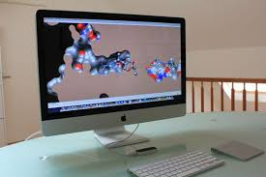
Insilico Drug Design
Prepared by:
Ashish Shah
M.Pharm (Chemistry)
Assistant Professor
Department of pharmacy, Sumandeep Vidyapeeth

Slide 2

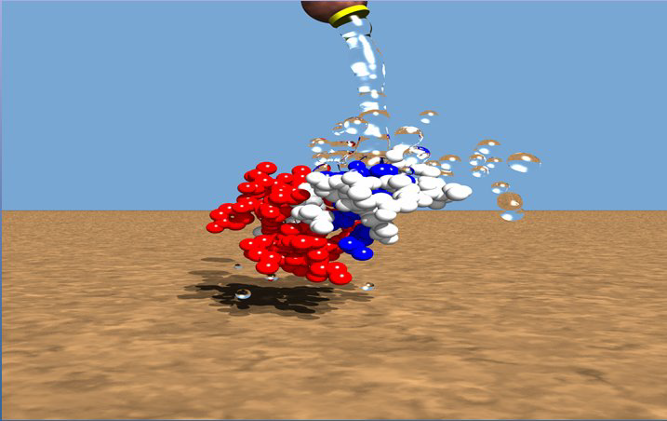
What is CADD?????
  Computational Chemistry/CADD is the chemistry whose major goals are to create efficient mathematical approximations and computer programs that calculate the properties of future drug molecules and thus helping in the process of drug design and discovery.

Slide 3
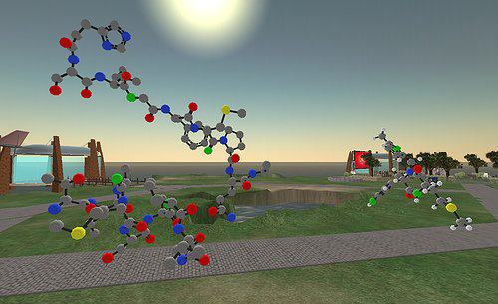
Why CADD…?
Drug Discovery today are facing a serious challenge because of the increased cost and enormous amount of time taken to discover a new drug, and also because of rigorous competition amongst different pharmaceutical companies.

Slide 4

Computer-aided drug design (CADD)
Known ligand(s)
No known ligand
Structure-based drug design (SBDD)
Protein-ligand docking
De novo design
Known protein structure
Ligand-based drug design (LBDD)
1 or more ligands
Similarity searching
Several ligands
Pharmacophore searching
Many ligands (20+)
Quantitative Structure-Activity Relationships (QSAR)
CADD of no use
Need experimental data of some sort
Unknown protein structure

Slide 5
In silico design
In silico design
Receptor based
Ligand based
Combinatorial
Denovo based

Slide 6
Receptor/structure based approach
Active site identification
No Ligand fragments grouping
Fit for receptor Complex growing yes
No
yes
Potential drug Change receptor

Slide 7
Ligand based approach
Pharmacophore identification
Pharmacophore modification
No
Fit to receptor
Yes
Potential drug

Slide 8
Combinatorial based approach
Automated or semi automated process of synthesising large quantity of compounds in small scale
Purely based on molecular modeling study of binding site.
Searching large data bases to identify proper ligand.
Denovo based approach

Slide 9
Different terms used in in-silico design
Receptor/Host/Lock – receiving molecule (protein) – large.
Ligand/ Guest/ Key – molecule bind to receptor –small.
Docking – Computational simulation of a candidate – preffered orientation of ligand binding site to a receptor.
Binding mode – conformation of ligand-receptor bound to each other.
Pose – a candidate binding mode.
Scoring – evaluating a particular pose by counting the number of favourable intermolecular interactions.

Slide 10
Ranking – classify ligands most likely to interact favourably to a particular relation based on ∆G of binding.
Hit – Ligand with high rank.
Lead – hit with biological activity.
Pharmacophore – spacial arrangement of atoms or groups believed to be responsible for biological activity.
Rational drug design – Modulation of specific biological target may have therapeutic value.
QSAR – Study of physico chemical properties of a compound with its biological/pharmacological activity.
Drug design – design of ligands.

Slide 11
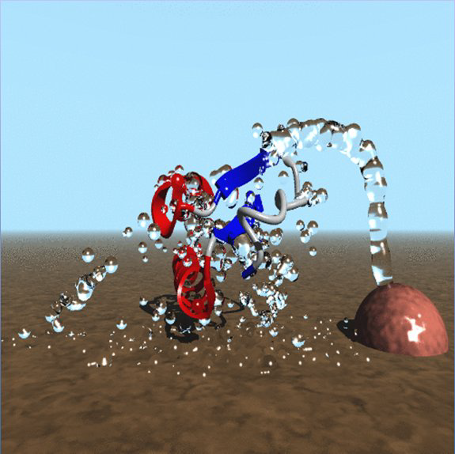
Drug targets
Enzyme – inhibitors
Receptors - agonists or antagonists
Ion channel – blockers
Transporter –inhibitors
DNA - blockers

Slide 12

Docking
Docking attempts to find the “best” matching between two molecules

Slide 13
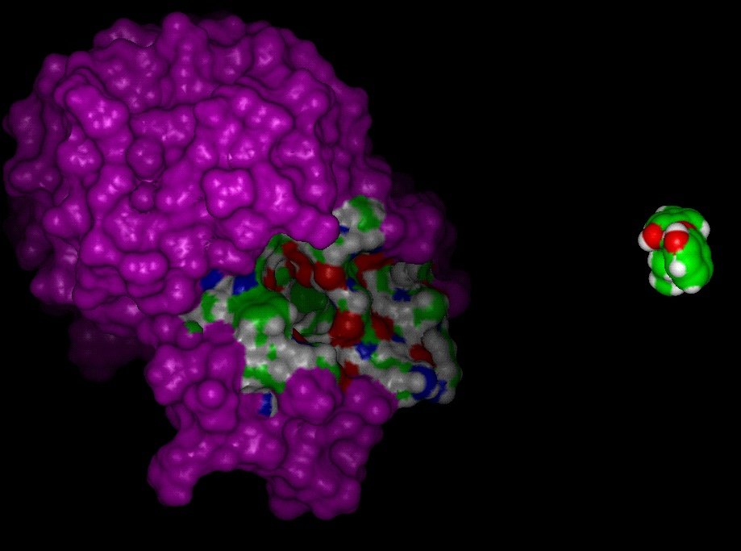
....a more serious definition….
Docking is a method which predicts the preffered orientation of one molecule to a second when bound to form a stable complex with overall minimum energy.
Docking is used to predict both strength & type of signal produced.

Slide 14
Aim of molecular docking is to achieve an optimized conformation & relative orientation between protein ligand such that ∆G is minimized.
It is to study. . . . .
Whether the two molecules interact with each other
If so what is the orientation that maximizes the interaction which minimizing the total energy of the complex
Goal. . .
Given a protein structure and predict its ligand bindings.

Slide 15
Why We Do Docking?
Drug discovery costs are too high: ~$800 millions, 8~14 years, ~10,000 compounds (DiMasi et al. 2003; Dickson & Gagnon 2004)
Drugs interact with their receptors in a highly specific and complementary manner.
Core of the target-based structure-based drug design (SBDD) for lead generation and optimization.
Lead is a compound that
  shows biological activity,
  is novel, and
  has the potential of being structurally modified for improved bioactivity, selectivity.

Slide 16

Why is docking important?
It is of extreme relevance in cellular biology
It is the key to rational drug design

Slide 17
Types of Docking
There are 2 types of docking,
1.Rigid docking
2.Flexible docking
Rigid Docking
In the rigid docking molecules are rigid, in 3D space of one of the molecule which brings it to an optimal fit with the other molecules in terms of a scoring function.
Flexible Docking
In flexible docking molecules are flexible ,confirmations of the receptor and the ligand molecules , as they appear in complex.

Slide 18
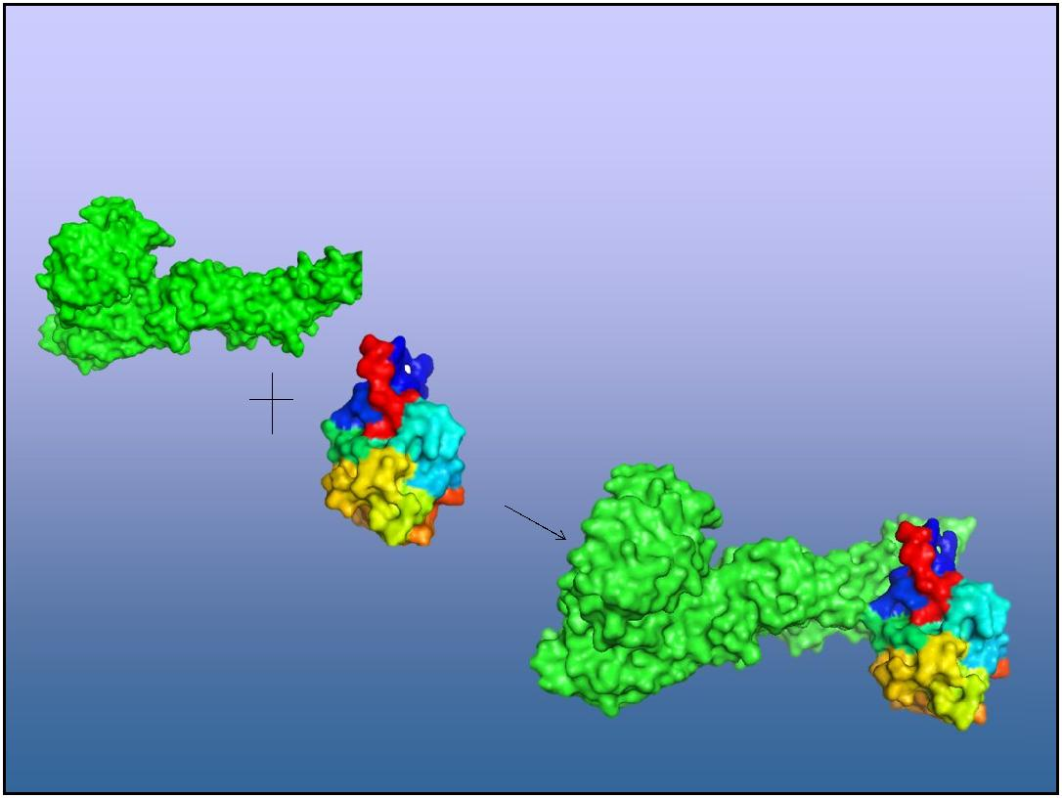
Types of Docking studies
Protein-Protein Docking
Both molecules are rigid
Interaction produces no change in conformation
Similar to lock-and key model

Slide 19
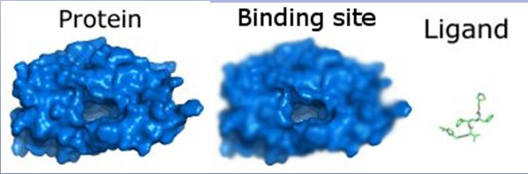
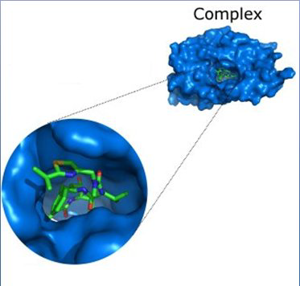
Continued…
Protein-Ligand Docking
Ligand is flexible but the receptor protein is rigid.
Interaction produces conformational changes in ligand.

Slide 20
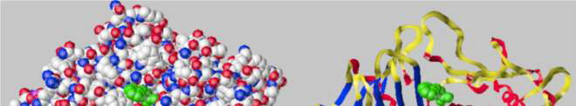
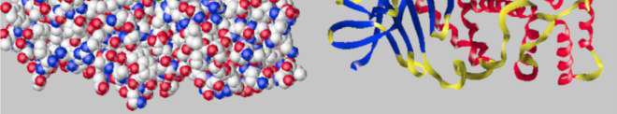
Some “real” Docking
Thermolysin protein with one of its known inhibitors

Slide 21
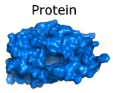
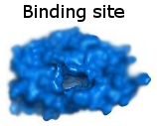

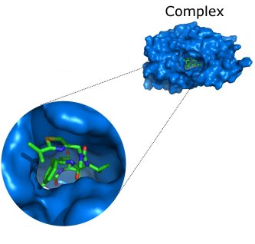
Protein-ligand docking
A Structure-Based Drug Design (SBDD) method
  “structure” means “using protein structure”
Computational method that mimics the binding of a ligand to a protein
Given...
Predicts...
  The pose of the molecule in the binding site
  The binding affinity or a score representing the strength of binding

Slide 22
Pose vs. binding site
Binding site (or “active site”)
  the part of the protein where the ligand binds
  generally a cavity on the protein surface
  can be identified by looking at the crystal structure of the protein bound with a known inhibitor
Pose (or “binding mode”)
  The geometry of the ligand in the binding site
  Geometry = location, orientation and conformation
Protein-ligand docking is not about identifying the binding site

Slide 23
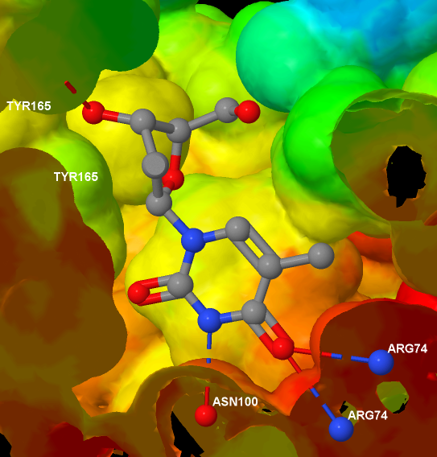
Uses of docking
The main uses of protein-ligand docking are for
  Virtual screening, to identify potential lead compounds from a large dataset (see next slide)
  Pose prediction
Pose prediction
If we know exactly where and how a known ligand binds...
  We can see which parts are important for binding
  We can suggest changes to improve affinity
  Avoid changes that will ‘clash’ with the protein

Slide 24
Introduction to protein-ligand docking
Practical aspects
Searching for poses
Scoring functions
Assessing performance

Slide 25
Preparing the protein structure
PDB structures often contain water molecules
  In general, all water molecules are removed except where it is known that they play an important role in coordinating to the ligand
PDB structures are missing all hydrogen atoms
  Many docking programs require the protein to have explicit hydrogens. In general these can be added unambiguously, except in the case of acidic/basic side chains
An incorrect assignment of protonation states in the active site will give poor results
Glutamate, Aspartate have COO- or COOH
  OH is hydrogen bond donor, O- is not
Histidine is a base and its neutral form has two tautomers

Slide 26
Preparing the protein structure
For particular protein side chains, the PDB structure can be incorrect
Crystallography gives electron density, not molecular structure
  In poorly resolved crystal structures of proteins, isoelectronic groups can give make it difficult to deduce the correct structure
Affects asparagine, glutamine, histidine
Important? Affects hydrogen bonding pattern
May need to flip amide or imidazole
  How to decide? Look at hydrogen bonding pattern in crystal structures containing ligands

Slide 27
Ligand Preparation
A reasonable 3D structure is required as starting point
  During docking, the bond lengths and angles in ligands are held fixed; only the torsion angles are changed
The protonation state and tautomeric form of a particular ligand could influence its hydrogen bonding ability
  Either protonate as expected for physiological pH and use a single tautomer
  Or generate and dock all possible protonation states and tautomers, and retain the one with the highest score
Enol
Ketone

Slide 28
The search space
The difficulty with protein–ligand docking is in part due to the fact that it involves many degrees of freedom
  The translation and rotation of one molecule relative to another involves six degrees of freedom
  There are in addition the conformational degrees of freedom of both the ligand and the protein
  The solvent may also play a significant role in determining the protein–ligand geometry (often ignored though)
The search algorithm generates poses, orientations of particular conformations of the molecule in the binding site
  Tries to cover the search space, if not exhaustively, then as extensively as possible
  There is a tradeoff between time and search space coverage

Slide 29
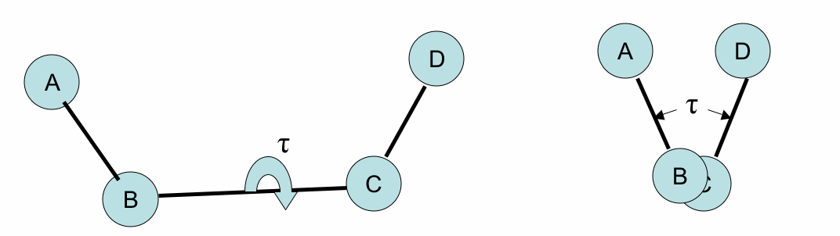
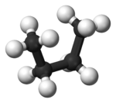
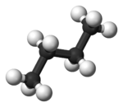
Torsion angles
These two diagrams show the same arrangement of four atoms from different viewpoints: the one on the right is the view down the BC bond
The torsion angle (τ in the diagram above) in a chain of four atoms A-B-C-D is the angle between:
  (1) the plane formed by A-B-C
  (2) the plane formed by B-C-D
Changing the torsion angle is equivalent to rotating part of the molecule around the B-C bond (the rotatable bond)
Not all bonds allow rotation:
  In general, single bonds are rotatable, but double bonds have their torsion angle fixed at either 0 or 180
Different values for the torsion angles in a molecule give rise to different 3D structures
  These are called conformations of the molecule
Torsion angles are also known as dihedral angles

Slide 30
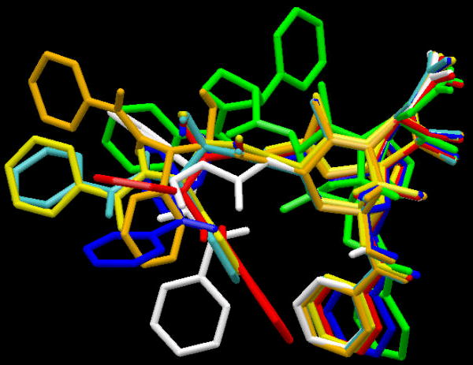
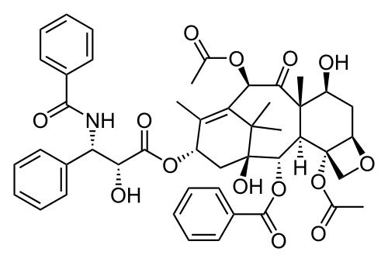
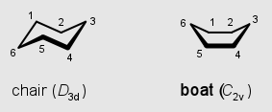
Ligand conformations
Conformations are different three-dimensional structures of molecules that result from rotation about single bonds
  That is, they have the same bond lengths and angles but different torsion angles
For a molecule with N rotatable bonds, if each torsion angle is rotated in increments of θ degrees, number of conformations is (360º/ θ)^{N}
  If the torsion angles are incremented in steps of 30º, this means that a molecule with 5 rotatable bonds with have 12^5 ≈ 250K conformations
Having too many rotatable bonds results in “combinatorial explosion”
Also ring conformations
Taxol
Notes:
12^5/12^4 = 12

Slide 31
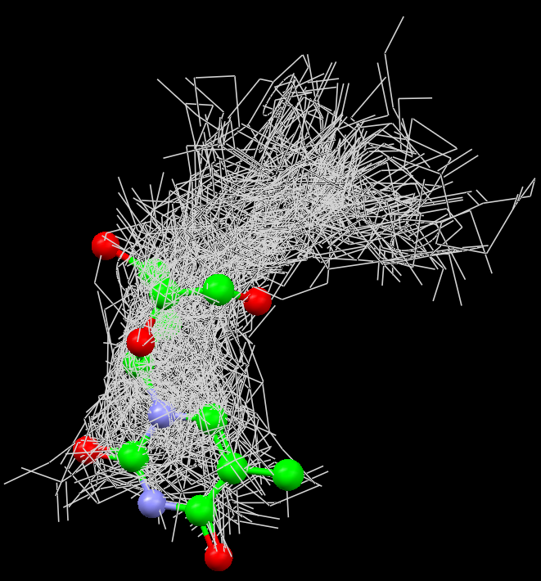

Slide 32
Search Algorithms
We can classify the various search algorithms according to the degrees of freedom that they consider
Rigid docking or flexible docking
  With respect to the ligand structure
Rigid docking
The ligand is treated as a rigid structure during the docking
  Only the translational and rotational degrees of freedom are considered
To deal with the problem of ligand conformations, a large number of conformations of each ligand are generated in advance and each is docked separately
Examples: FRED (Fast Rigid Exhaustive Docking) from OpenEye, and one of the earliest docking programs, DOCK

Slide 33
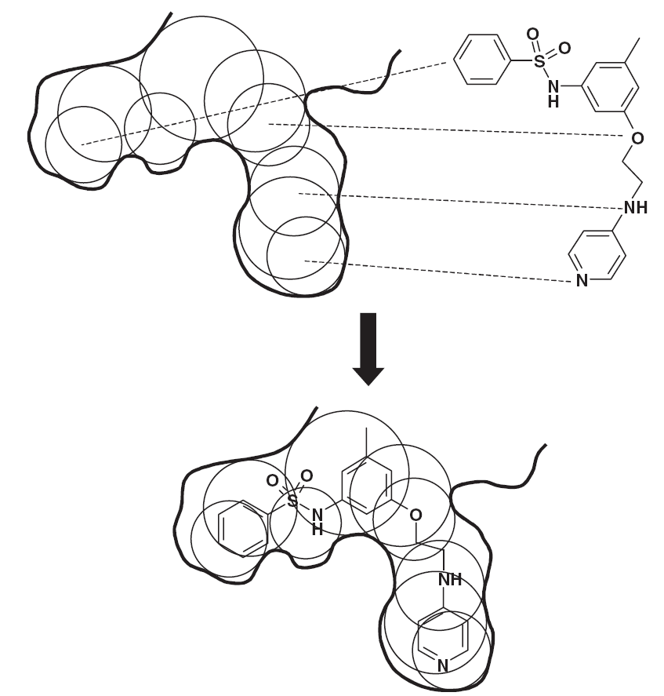
The DOCK algorithm – Rigid docking
The DOCK algorithm developed by Kuntz and co-workers is generally considered one of the major advances in protein–ligand docking [Kuntz et al., JMB, 1982, 161, 269]
The earliest version of the DOCK algorithm only considered rigid body docking and was designed to identify molecules with a high degree of shape complementarity to the protein binding site.
The first stage of the DOCK method involves the construction of a “negative image” of the binding site consisting of a series of overlapping spheres of varying radii, derived from the molecular surface of the protein
AR Leach, VJ Gillet, An Introduction to Cheminformatics

Slide 34
The DOCK algorithm – Rigid docking
Ligand atoms are then matched to the sphere centres so that the distances between the atoms equal the distances between the corresponding sphere centres, within some tolerance.
The ligand conformation is then oriented into the binding site. After checking to ensure that there are no unacceptable steric interactions, it is then scored.
New orientations are produced by generating new sets of matching ligand atoms and sphere centres. The procedure continues until all possible matches have been considered.
AR Leach, VJ Gillet, An Introduction to Cheminformatics

Slide 35
Flexible docking
Flexible docking is the most common form of docking today
  Conformations of each molecule are generated on-the-fly by the search algorithm during the docking process
  The algorithm can avoid considering conformations that do not fit
Exhaustive (systematic) searching computationally too expensive as the search space is very large
One common approach is to use stochastic search methods
  These don’t guarantee optimum solution, but good solution within reasonable length of time
  Stochastic means that they incorporate a degree of randomness
  Such algorithms include genetic algorithms (GOLD, Autodock), simulated annealing (AutoDock)
An alternative is to use incremental construction methods
  These construct conformations of the ligand within the binding site in a series of stages
  First one or more “base fragments” are identified which are docked into the binding site
  The orientations of the base fragment then act as anchors for a systematic conformational analysis of the remainder of the ligand
  Example: FlexX

Slide 36
Flexible docking using a Genetic Algorithm (GA)
A genetic algorithm is a stochastic algorithm that can be used to solve global optimisation problems
  It is based on ideas from Darwinian evolution
An initial population of chromosomes is generated randomly
  Each chromosome represents a pose, so a large number of poses are randomly generated in the binding site
Pairs of high-scoring chromosomes (“parents”) are combined to generate “children”
  For example, the location of one high-scoring pose may be combined with the torsion angles of another high-scoring pose to generate a new ‘child’ pose
Children are randomly mutated
  For example, a torsion angle or the orientation of the child pose might be altered randomly
Selection of the fittest to produce the next generation
  The highest scoring of the new poses are combined with the highest scoring of the original poses to make the next generation
Repeat for N generations or until no significant improvement is observed
  We have identified a high scoring pose

Slide 37
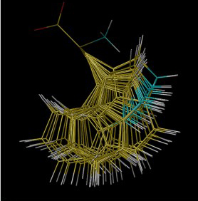
Handling protein conformations
Most docking software treats the protein as rigid
  Rigid Receptor Approximation
This approximation may be invalid for a particular protein-ligand complex as...
  the protein may deform slightly to accommodate different ligands (ligand-induced fit)
  protein side chains in the active site may adopt different conformations
Some docking programs allow protein side-chain flexibility
  For example, selected side chains are allowed to undergo torsional rotation around acyclic bonds
  Increases the search space
Larger protein movements can only be handled by separate dockings to different protein conformations
  Ensemble docking (e.g. GOLD 5.0)
Notes:
Tryptophan

Slide 38
Components of docking software
Typically, protein-ligand docking software consist of two main components which work together:
1. Search algorithm
  Generates a large number of poses of a molecule in the binding site
2. Scoring function
  Calculates a score or binding affinity for a particular pose
To give:
  The pose of the molecule in the binding site
  The binding affinity or a score representing the strength of binding

Slide 39
The perfect scoring function will…
Accurately calculate the binding affinity
  Will allow actives to be identified in a virtual screen
  Be able to rank actives in terms of affinity
Score the poses of an active higher than poses of an inactive
  Will rank actives higher than inactives in a virtual screen
Score the correct pose of the active higher than an incorrect pose of the active
  Will allow the correct pose of the active to be identified
“actives” = molecules with biological activity

Slide 40
Classes of scoring function
Broadly speaking, scoring functions can be divided into the following classes:
  Forcefield-based
    Based on terms from molecular mechanics forcefields
    GoldScore, DOCK, AutoDock
  Empirical
    Parameterised against experimental binding affinities
    ChemScore, PLP, Glide SP/XP
  Knowledge-based potentials
    Based on statistical analysis of observed pairwise distributions
    PMF, DrugScore, ASP

Slide 41
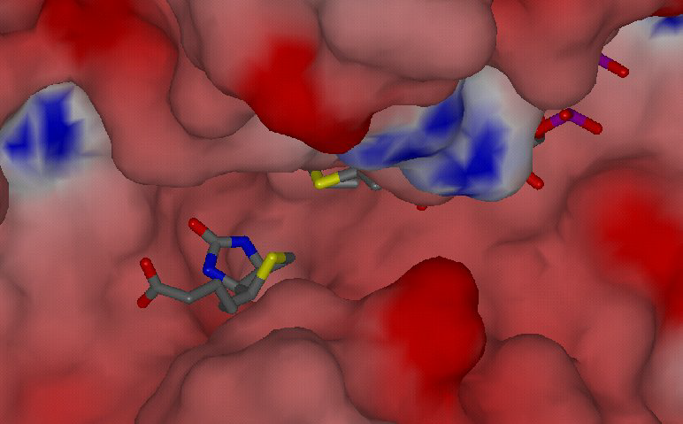
Available Docking Software…
DOCK (1982,2001)
FlexX (1996)
Hammerhead (1996)
Surflex (2003)
SLIDE (2002)
AutoDock (1990,1998)
ICM (1994)
MCDock (1999)
GOLD (1997)
GemDock (2004)
FRED (2002)
Glide (2004)
Yucca (2005)
vLife(Biopredicta)

Slide 42
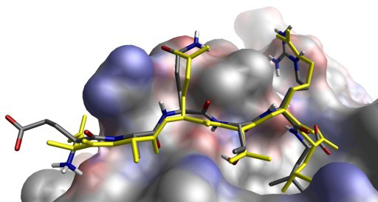
Application of Molecular Docking in
Modern Drug Discovery
Determine the lowest free energy structures for the receptor ligand complex.
Search database and rank hits for lead generation.
Calculate the differential binding of a ligand to two different macromolecular receptors.
Study the geometry of a particular complex.
Propose modification of a lead molecules to optimize potency or other properties.
de novo design for lead generation.
Library design.

Slide 43
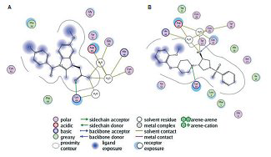
Application of Molecular Docking in
Modern Drug Discovery
Case Study-
Identification of Inhibitors for Simultaneous Inhibition of Anti-Coagulation and Anti-Infamatory Activities of Snake venom Phospholipase A2. (1994)
169000 compounds
300 compounds
32 promising compounds
Pharmacophore Based-screening
Molecular docking

Slide 44
Growing Evidence of Achievements….!!
Molecular Docking has resulted in several breakthrough classes of new drug.
Drug | Target | Company
Dorzolamid | Carbonic anhydrase (Hypercapnic Vantilatory failure) | Merck Sharp and Dohme (Harlow, UK)
Saquinavir | HIV protease | Roche (Welwyn, UK)
Relenza | Neuraminidase | Biota (Melbourne, Australia

Slide 45
Growing Evidence of Achievements….!!
1. Discovery of Indinavir, the HIV protease inhibitor. (1992)
2. Identification of Haloperidol as a lead compound in a structure- based design for non-peptide inhibitor of HIV.
3. Carbonic Anhydrase (treatment of glaucoma) (2002)
4. Renin (treatment of hypertension)
5. Dyhrofolate reductase (antibacterial) (1992)
6. Neuraminidase (antiviral)
7. HIV-1 aspartic proteinase (anti-acquired immunodeficiency syndrome)

Slide 46
Conclusion…
1.Molecular docking give the promising contributions to identification and optimization of ligand in modern drug discovery.
2.The combination of the chemical information of natural products with docking-based virtual screening will play an important role in drug discovery in the post-genomic era as more and more new potential targets emerge from the functional genomic studies.
3.Docking-based virtual screening lead to much higher hit rate than
traditional screening methods. (e.g., HTS)

Slide 47
Future Directions
Pharmaceutical history indicated that natural products provided a large number of drugs to the market. But, even for the currently used drug targets, available natural products have not been tested completely.
Computational medicinal methods, can contribute its unique role in achieving the task of examining the interaction of all existing natural products with all possible targets and establishing thier rational use.

Slide 48

THANK YOU

