Slide 1
Redox titrations

Slide 2
Redox titration:
It is a titration in which the reaction between the
analyte and titrant is the oxidation and reduction.
Redox reaction:
A redox reaction is involving transfer of electrons.
Oxidation is a process in which a substance loses electrons.
Reduction is a process in which a substance gains electrons.
They cannot take place without each other.

Slide 3

Redox reaction:
An oxidizing agent is a substance that oxidizes others by accepting electrons.
A reducing agent is a substance that reduces others by donating electrons.

Slide 4
Standard solutions:
Oxidizing agents:
Ceric ammonium sulphate
Ceric ammonium nitrate
Potassium permanganate
Ferric ammonium sulphate
Potassium bromate
Potassium iodate
Reducing agents:
oxalic acid
ferrous ammonium sulphate
potassium arsenite
sodium thiosulphate

Slide 5
Redox titration methods:
Permanganometry
Cerimetry
Dichromatometry
Iodometry and iodimetry
Iodatometry
bromatometry

Slide 6

Potassium permanganate:
It is the most powerful oxidizing agent
The standard potential Eº is 1.51 volts
In acidic solutions the reduction can be
represented by:
Permanganate manganous ion

Slide 7
Sulphuric acid is the most suitable acid
No action upon permanganate solution
But with HCl, there is a likelihood of the reaction:
Above reaction can be seen in particular with iron salts,
No problem to be used for H₂O₂

Slide 8
Preparation of 0.02M KMnO₄:
?
Atomic weights:
K=39
Mn=55
Preparation of 0.1N KMnO₄:
?

Slide 9
KMnO₄ is not a primary standard
Difference between primary and secondary standard:
In titrimetry certain chemicals are used frequently
in defined concentrations as Reference solutions.
Such substances are called as primary standard or
secondary standard.
Criteria to be a primary standard:
It is a compound of sufficient purity.
It should not be hygroscopic,
The total amount of impurities should not exceed
0.01-0.02%,
4. It should be readily soluble.
5.The titration error should be neglizible.

Slide 10
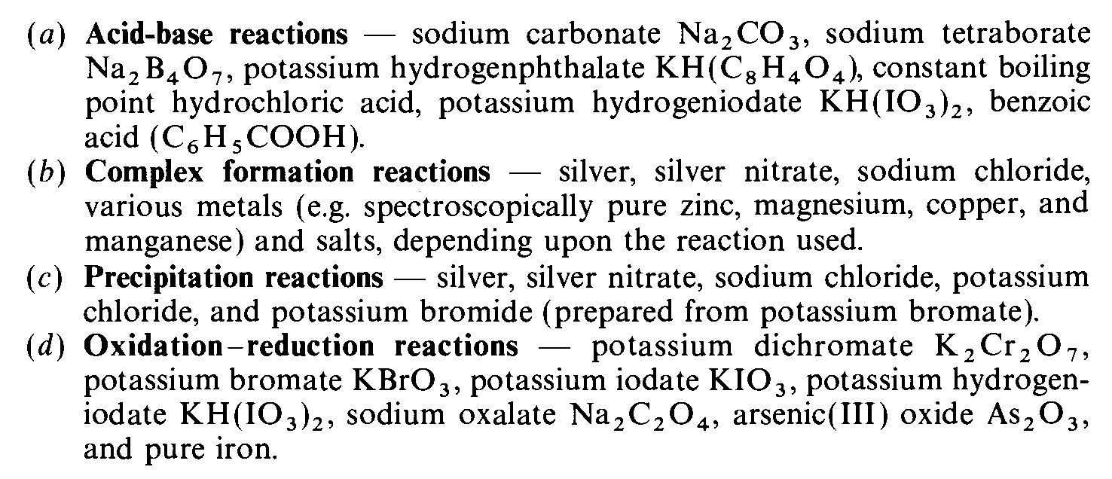
The commonly employed primary standard substances are:

Slide 11
Secondary standards are;
1. Influenced by atmosphere/environment,
2.Concentration change over time,
3.Usually powerful reactants,
4.Usually cheap & easy to use.

Slide 12
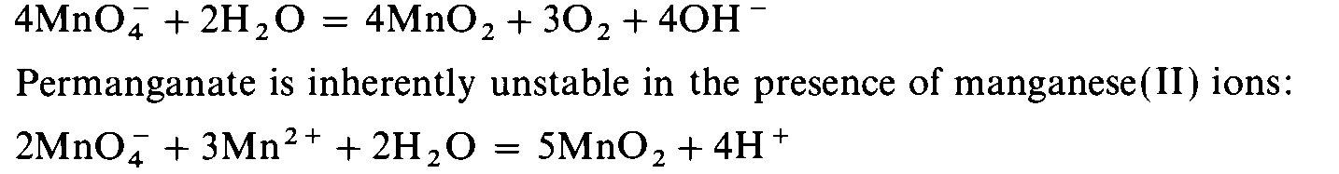
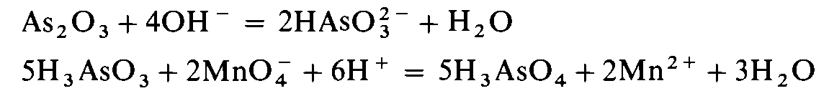
standardization of KMnO₄
KMnO₄ is not a primary standard:

Slide 13
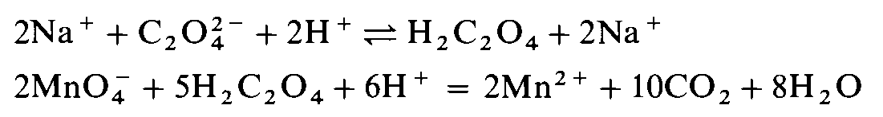

Slide 14
Ceric ammonium sulphate:
It is a powerful oxidizing agent,
Its reduction potential is 1.43,
It can be used only in acid solution,
It has an intense yellow color.
The advantages are:
1.They are remarkably stable for prolong time.
2. they can be used even in high conc HCl.

Slide 15
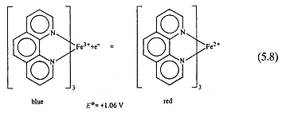
Ferroin solution:

Slide 16
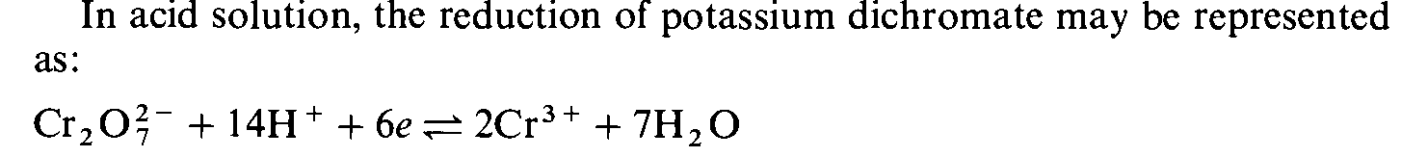
Potassium dichromate:
It is not a powerful oxidizing agent as potassium
permanganate.
It can be obtained pure,
It is stable,
Excellent primary standard substance.
Orange green

Slide 17



1.The direct iodometric titration method(iodimetry):
titration with standard solution.
2. The indirect iodometric titration method(iodometry)
titration of iodine liberated in chemical reactions.

Slide 18
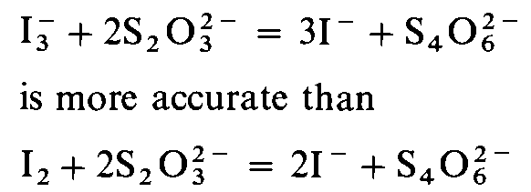

It is weaker oxidizing agent,
Redox potential is 0.5355,
Two important sources of error in titrations
involving iodine are:
a. loss of iodine due to its appreciable volatility,
b. acid solutions of iodide are oxidized by O2 from the air.

Slide 19


Standard solution containing
potassium iodide and potassium iodate:
this solution is stable,
yields Iodine in the presence of acid.
Preparation of 0.05M Iodine solution:
tri-iodide

Slide 20
1.Dissolve 20gms of iodate-free KI in 30-40mL of water in a
glass-stoppered 1L graduated flask.
2.Weigh out about 12.7gms of resublimed iodine and
transfer into the above solution.
3.Insert the glass stopper into the flask, and shake in the cold
Until all the iodine has dissolved.
4. Allow the solution to acquire room temparature,
and make up to the mark with distilled water.
5. The solutions must be kept in cool and dark place.

Slide 21



