Slide 1


SOLUBILITY ENHANCEMENT BY VARIOUS TECHNIQUES
PRESENTED BY-
PIYUSHKUMAR SADHU
SUMANDEEP VIDYAPEETH DEEMED UNIVERSITY
DEPARTMENT OF PHARMACY
PIPARIA – VADODARA.
1

Slide 2
CONTENTS-
INTRODUCTION
IMPORTANCE OF SOLUBILITY
NEED OF IMPROVING SOLUBILITY TECHNIQUES OF SOLUBILITY
ENHANCEMENT
APPLICATIONS
2

Slide 3
INTRODUCTION
Solubility :
The term ‘Solubility’ is defined as maximum amount of solute that can be dissolved in a given amount of solvent to form a homogenous system at specified temperature.
The solubility of a drug is represented through various concentration expressions such as parts, percentage, molarity, molality, volume fraction, mole fraction.
3

Slide 4


Table 1: USP & BP Solubility criteria
Definition | Parts of solvent required for one part of solute
Very soluble | < 1
Freely soluble | 1 - 10
Soluble | 10 - 30
Sparingly soluble | 30 - 100
Slightly soluble | 100 - 1000
Very slightly soluble | 1000 - 10,000
Insoluble | > 10,000
4

Slide 5
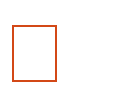
Factors affecting solubilisation
Particle size.
Temperature.
Pressure.
Molecular size.
Nature of solute & solvent.
Polarity.
Polymorphs.
5

Slide 6
NEED FOR SOLUBILITY ENHANCEMENT
There are variety of new drugs & their derivatives are available. But less than 40% of lipophilic drugs candidates fail to reach market due to poor bioavailability, even though these drugs might exhibit potential pharmaco-dynamic activities.
The lipophilic drug that reaches market requires a high dose to attain proper pharmacological action.
The basic aim of the further formulation & development is to make that drug available at proper site of action within optimum dose.
6

Slide 7
Solubility of drug is largely due to,
Polarity of the solvents, that is, to its dipole moment. A polar solvent dissolves ionic solutes and other polar substances.
The ability of solute to form hydrogen bond with solvent.
Also depends on the ratio of the polar to non polar groups of the molecule.
As the length of a non-polar chain of an aliphatic alcohol increases, the solubility of the compound in water decreases.
Straight chain monohydric alcohols, aldehyde, ketones, and acids with more than four or five carbons cannot enter into the hydrogen bonded structure of water and hence are only slightly soluble.
7

Slide 8
Process of solubilisation
The separation of the molecule of the solvent to provide space in the solvent for solute.
The breaking of intermolecular ionic bonds in the solute.
The interaction between the solvent and the solute molecule or ion.
8

Slide 9
When additional polar groups are present in the molecule, as found in tartaric acid, propylene glycol, glycerin, water solubility increases greatly.
Branching of the carbon chain reduces the non-polar effect and leads to increased water solubility.
Tertiary butyl alcohol is miscible in all proportions with water, where as n-butyl alcohol is slightly dissolved.
9

Slide 10
Techniques Of Solubility Enhancement
1)Particle Size Reduction
Conventional methods
Micronization
Nanosuspension 2)Hydrotropy 3)Cosolvency
4)Solubilization by Surfactants 5)Solid Dispersion
The fusion (melt) method
The solvent method
Dropping method
  pH adjustment
  High Pressure Homogenization
  Supercritical fluid recrystallization(SCF)
10
9) Sonocrystallisation

Slide 11
10) Complexation
Physical Mixture
Kneading method
Co-precipitate method
Spray Drying
Inclusion Complex Formation-Based Techniques
Kneading Method
Lyophilization/Freeze-Drying Technique
Microwave Irradiation Method
Liquisolid technique
Micro-emulsion
Self-Emulsifying Drug Delivery Systems
Neutralization
Cryogenic Method
Spray Freezing onto Cryogenic Fluids
Spray Freezing into Cryogenic Liquids (SFL)
Spray Freezing into Vapor over Liquid (SFV/L)
Ultra-Rapid Freezing (URF)
18) Polymeric Alteration
19) Salt formation

Slide 12
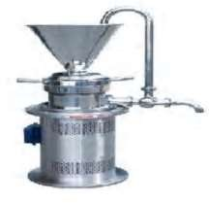
PARTICLE SIZE REDUCTION
The solubility of drug is often intrinsically related to drug particle size as a particle becomes smaller, the surface area increases,increase in solubility.
TECHNIQUES OF PARTICLE SIZE REDUCTION-
Micronization
Nanosuspension
Micronization:
Micronization increases the dissolution rate of drugs through increased surface area; by decreasing particle size, it does not increase equilibrium solubility.
Micronization of drugs is done by milling techniques using jet mill, rotor stator colloid mills and so forth .
Micronization is not suitable for drugs having a high dose number because it
does not change the saturation solubility of the drug

Slide 13
2) Nanosuspension:
This technology is applied to poorly soluble drugs that are insoluble in both water and oils.
A pharmaceutical nanosuspension is biphasic systems consisting of nano sized drug particles stabilized by surfactants for either oral and topical use or parenteral and pulmonary administration.
The particle size distribution of the solid particles in nanosuspensions is usually less than one micron with an average particle size ranging between 200 and 600 nm.
3)HYDROTROPY:
Hydrotropy is a solubilization phenomenon whereby addition of large
amount of a second solute results in an increase in the aqueous solubility of existing solute.
Concentrated aqueous hydrotropic solutions of sodium benzoate, sodium salicylate, urea, nicotinamide, sodium citrate, and sodium acetate have been observed to enhance the aqueous solubilities of many poorly water-soluble drugs.

Slide 14
4)COSOLVENCY:-
The solubility of poorly soluble drugs in water can be increased by mixing it with some water miscible solvent in which the drug is readily soluble. This
process is known as cosolvency and the solvent used in combination are known
as cosolvent.
Cosolvent system works by reducing the interfacial tension between the
aqueous solution and hydrophobic solute & it is known as solvent blending.
The cosolvents are having hydrogen acceptor or donor groups with a small hydrocarbon region. The hydrophobic hydrocarbon region usually interferes with the hydrogen bonding network of water which consequently reduces the intermolecular attraction of water while the hydrophilic hydrogen bonds ensures
¹⁴ water solubility.

Slide 15
5)SOLUBILIZATION BY SURFACTANTS:-
Surfactants are the agents which reduces surface tension and enhance the dissolution of lipophilic drugs in aqueous medium.
The surfactants are also used to stabilize drug suspensions.
When the concentration of surfactants more than their critical micelle concentration (CMC, which is in the range of 0.05–0.10% for most surfactants), micelle formation occurs which entrap the drugs within the micelles. This is known as micellization and generally results in enhanced solubility of poorly soluble drugs.
15

Slide 16
6)SOLID DISPERSION:
Solid dispersion as group of solid products consisting of at least two different components, generally, a hydrophilic matrix, and a hydrophobic drug.
Solid dispersion can also be referred as the dispersion of one or more active ingredients in an inert matrix at solid state prepared by the melting,
solvent, and melting solvent method.
Hydrophilic carriers used for solid dispersions include polyvinyl pyrrolidone,
polyethylene glycols, Plasdone-S630.
Many times surfactants may also used in the formation of solid dispersion.
Surfactants like Tween- 80, Docusate sodium, Myrj-52, Pluronic-F68 and
16
Sodium Lauryl Sulphate are used

Slide 17
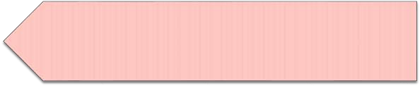



TECHNIQUES OF SOLID DISPERSION
The fusion (melt) method:
Accurately weighed amounts of carrier(s) are placed in an aluminum pan on a hot plate and liquefy, with constant stirring, at a temperature of about 60°C.
An accurately weighed amount of active drug is incorporated into the melted carrier(s) with stirring to ensure homogeneity. The mixture is heated until a clear homogeneous melt is obtained.
The pan is then removed from the hot plate and allowed to cool at room temp.
The solvent method:
Accurately weighed amounts of active drug and carrier(s) are dissolved in minimum quantities of chloroform in a round-bottom flask. The solvent is removed using a rotary evaporator.
The obtained solid dispersion is transferred on to the aluminum pan and
allowed to dry at room temperature.
17

Slide 18
7)Dropping method:
A solid dispersion of a melted drug-carrier mixture is pi petted and then dropped onto a plate, where it solidifies into round particles.
The size and shape of the particles can be influenced by factors such as the viscosity of the melt and the size of the pipette. Because viscosity is highly temperature dependent, it is very important to adjust the temperature so that when the melt is dropped onto the plate it solidifies to a spherical shape.
8)pH ADJUSTMENT:-
To access the solubility of this approach, the buffer capacity and tolerability
of the selected pH are important to consider.
Solubilized excipients that increase environmental pH within the dosage form to a range higher than pKa of weekly acidic drugs increase the solubility of that drug, those excipients that act as alkalizing agents may increase the solubility of weekly basic drugs. Eg. Phenobarbiton
18

Slide 19
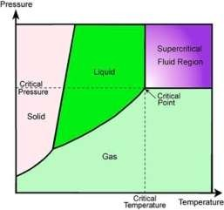
High-pressure homogenization:-
It has been used to prepare nanosuspension of many poorly water soluble drugs. In this method, the suspension of a drug and surfactant is forced under pressure through a nanosized aperture valve of a high pressure homogenizer.
The principle of this method is based on cavitation in the aqueous phase. The
cavitations forces within the particles are sufficiently high to convert the drug microparticles into nanoparticles.
The concern with this method is the need for small sample particles before
loading and the fact that many cycles of homogenization are required.
SUPERCRITICAL FLUID RECRYSTALLIZATION(SCF):-

Slide 20
Those fluids are referred to as supercritical fluids which are having temperature and pressure greater than its critical temperature and critical pressure so as they are acquire properties of both gas and liquid.e.g-carbon dioxide.
As the drug gets solubilized within SCF they can be recrystallized with reduced particle
size of drug.
11)SONOCRYSTALLISATION:-
The novel approach for particle size reduction on the basis of crystallization by
using ultrasound is Sonocrystallisation.
Sonocrystallisation utilizes ultrasound power characterized by a frequency range of 20–100 kHz for inducing crystallization.
It’s not only enhances the nucleation rate but also an effective means of size
reduction and controlling size distribution of the active pharmaceutical ingredients.
Most applications use ultrasound in the range 20 kHz-5 MHz

Slide 21
12)COMPLEXATION:-
Complexation of drugs with cyclodextrins has been used to enhance aqueous solubility and drug stability.
Cyclodextrins of pharmaceutical relevance contain 6, 7 or 8 dextrose molecules (α, β, γ-cyclodextrin) bound in a 1,4-configuration to form rings of various diameters.
The ring has a hydrophilic exterior and lipophilic core in which appropriately sized organic molecules can form noncovalent inclusion complexes resulting in increased aqueous solubility and chemical stability.
Complexation relies on relatively weak forces such as London forces, hydrogen bonding and hydrophobic interactions.
TECHNIQUE OF COMPLEXATION
1. Physical Mixture:
Active drug with suitable polymer in different ratios mixed in a mortar for
about one hour with constant trituration. The mixture is passed through sieve
²¹ no. 80 and stored in dessicator over fused calcium chloride.

Slide 22



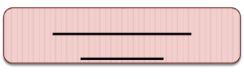


Kneading Method:
Active drug with suitable polymer in different ratios is added to the mortar and
triturated with small quantity of ethanol to prepare a slurry
Slowly the drug is incorporated into the slurry with constant trituration.,The
prepared slurry is then air dried at 250C for 24hrs.
The resultant product is pulverized and passed through sieve no. 80 and stored
in dessicator over fused calcium chloride
Co-precipitate Method:
Active drug is dissolved in ethanol at room temperature and
suitable polymer is dissolved in distilled water.
Different molar ratios of active drug and suitable polymers are mixed
respectively.
The mixture is stirred at room temperature for one hour and the solvent is evaporated. The resultant mass is pulverized
and passed through sieve no. 80 and stored in a desiccators.
22

Slide 23
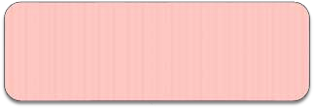
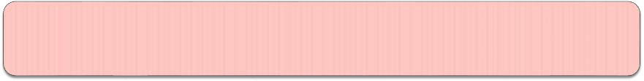
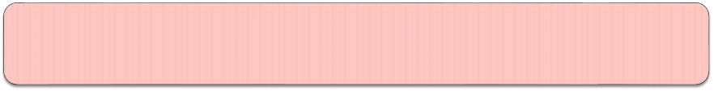
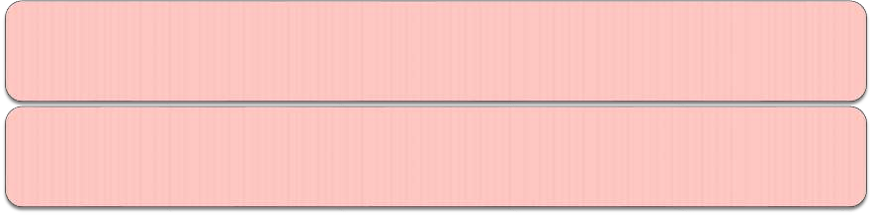
SPRAY DRYING:
The solvent evaporation of drug and polymer solution in different ratio is carried out by using spray dryer.
The solutions are prepared by dissolving drug in methanol and polymer in distilled water and mix both solutions, which produces a clear solution.
The solvent evaporated by using evaporator.
The spray dried mixture of drug with polymer is obtained in 20–30 min.

Slide 24
14)INCLUSION COMPLEX FORMATION-BASED TECHNIQUES
Inclusion complexes are formed by the insertion of the nonpolar molecule or the nonpolar region of one molecule (known as guest)into the cavity of another molecule or group of molecules (known as host).EXA- cyclodextrin
The cavity of host must be large enough to accommodate the guest and small enough to eliminate water, so that the total contact betweenthe water and the nonpolar regions of the host and the guest is reduced

Slide 25
TECHNIQUES OF INCLUSION COMPLEX METHOD-
Lyophilization/Freeze-Drying Technique:
In order to get a porous, amorphous powder with high degree of interaction
between drug and CD.
In this technique, the solvent system from the solution is eliminated
through a primary freezing and subsequent drying of the solution containing both drug and CD at reduced pressure.
Thermolabile substances can be successfully made into complex form by this method.
limitations –
Use of specialized equipment,
Time consuming process,
Poor flowing powdered product.
Microwave Irradiation Method:
This technique involves the microwave irradiation reaction between drug and complexing agent using a microwave oven.

Slide 26
LIQUISOLID TECHNIQUE:-
where a liquid may be transformed into a free flowing, readily compressible and apparently dry powder by simple physical blending with selected carrier and coating material.
The liquid portion, which can be a liquid drug, a drug suspension or a drug solution in suitable non-volatile liquid vehicles, is incorporated into the porous carrier material.
Once the carrier is saturated with liquid, a liquid layer is formed on the particle surface which is instantly adsorbed by the fine coating particles.
Thus, an apparently dry, free flowing, and compressible powder
is obtained.

Slide 27
MICRO-EMULSION:-
A micro emulsion is an optically clear pre-concentrate, isotropic, thermo dynamically stable transparent (or translucent) system, containing a mixture of oil, hydrophilic surfactant and hydrophilic solvent which dissolves a poorly water soluble drug.
Micro-emulsions have been employed to increase the solubility of many drugs that are practically insoluble in water, along with incorporation of proteins for oral, parenteral, as well as percutaneous /transdermal use.
SELF-EMULSIFYING DRUG DELIVERY SYSTEMS:
It use the concept of in situ formation of emulsion in the gastrointestinal tract.
The mixture of oil, surfactant, co-surfactant, one or more hydrophilic solvents and cosolvent forms a transparent isotropic solution that is known as the self-emulsifying drug delivery system (SEDDS).
The poorly soluble drug can be dissolved in a mixture of surfactant and oil
₂₇which is widely known as preconcentrate.

Slide 28






NEUTRALLIZATION
Drug is added in alkaline solution like sodium hydroxide, ammonium hydroxide.
A solution of β- Cyclodextrin is then added to dissolve the joined
drug. The clear solution obtained after few seconds under agitation is neutralized using HCl solution until reaching the equivalence point.
At this moment, the appearance of a white precipitate could be
appreciated, corresponding to the formation of the inclusion compound.
The precipitate is then filtered and dried
28

Slide 29
CRYOGENIC METHOD:
It is developed to enhance the dissolution rate of drugs by creating nanostructured amorphous drug particles with high degree of porosity at very low-temperature conditions.
Cryogenic inventions can be defined by the type of injection device (capillary, rotary, pneumatic, and ultrasonic nozzle), location of nozzle (above or under the liquid level), and the composition of cryogenic liquid (hydrofluoroalkanes, N2, Ar, O2, and organic solvents).
POLYMERIC ALTERATION:
Different crystalline forms of a drug that may have different properties are known as Polymorphs.
Polymorphs may differ in physicochemical properties such as physical and chemical stability, shelf-life, melting point, vapor pressure, intrinsic solubility, dissolution rate, morphology, density and biological activities as well as bioavailability.
metastable crystalline polymorphs, metastable forms are associated with higher energy with increased surface area, subsequently solubility, ₂₉bioavailability and efficacy.

Slide 30
SALT FORMATION:
Dissolution rate of particular salt is usually different from that of parent compound.
Sodium and potassium salt of week acid dissolve more rapidly than that of
pure salt.
Limitation of salt formation-
epigastric distress due to high alkalinity,
reactivity with atmospheric water and carbon dioxide leads to precipitation,
patientcompliance and commercilation

Slide 31
APPLICATION OF SOLUBILITY
Solubility is represents a fundamental concept in fields of research such as chemistry , physics, food science, pharmaceutical, and biological sciences.
The solubility of a substance becomes specially important in the pharmaceutical field because it often represents a major factor that controls the bioavailability of a drug substance
Solubility is commonly used to describe the substance, to indicate a substance's polarity ,to help to distinguish it from other substances, and as a guide to applications of the substance.

Slide 32
Solubility of a substance is useful when separating mixtures.
Moreover, solubility and solubility-related properties can also provide important information regarding the structure of drug substances, and in their range of possible intermolecular interactions.

Slide 33





