Slide 1
Null hypothesis,
Level of significance,
Power of test,
P value,
Statistical estimation of confidence intervals.
Mr. Ghanshyam Parmar

Slide 2
CONFIDENCE INTERVALS (CI)
Scientific Experimentation
Experiments designed to estimate some parameter or property of a system
(It is concern with Estimation)
Comparative experiments, where two or more treatments or experimental conditions are to be compared.
(It is concern with hypothesis testing)

Slide 3
Parameter estimates obtained from samples are usually meant to be used to estimate the true population parameters.
The sample mean and variance are typical estimators or predictors.
The true mean and variance, and are often called “point” estimates.

Slide 4
POINT ESTIMATE
Estimate obtained from a sample
Inference about the population
Point estimate is only as good as the sample it represents
Random samples from the population - Point estimates likely to vary

Slide 5

ISSUE ???
Variation in sample statistics

Slide 6

SOLUTION
Estimating a population parameter with a confidence interval

Slide 7

CONFIDENCE INTERVAL
A range of values so constructed that there is a specified probability of including the true value of a parameter within it

Slide 8
CONFIDENCE LIMITS
Two extreme measurements within which an observation lies
End points of the confidence interval
Larger confidence – Wider interval

Slide 9
A point estimate is a single number
A confidence interval contains a certain set of possible values of the parameter
Lower
Confidence
Limit
Upper
Confidence
Limit
Point Estimate
Width of
confidence interval

Slide 10
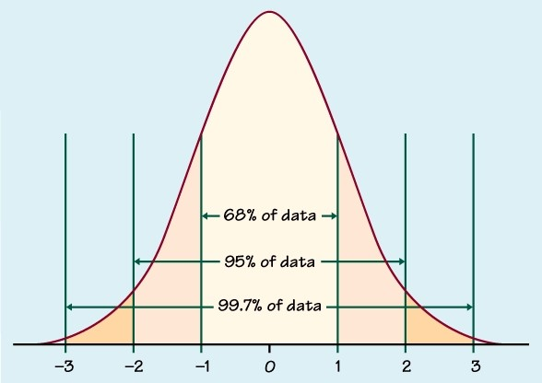
If the distribution of means is normal and σ is known, an interval with confidence coefficient, P (probability), can be computed using a table of the cumulative standard normal distribution.

Slide 11
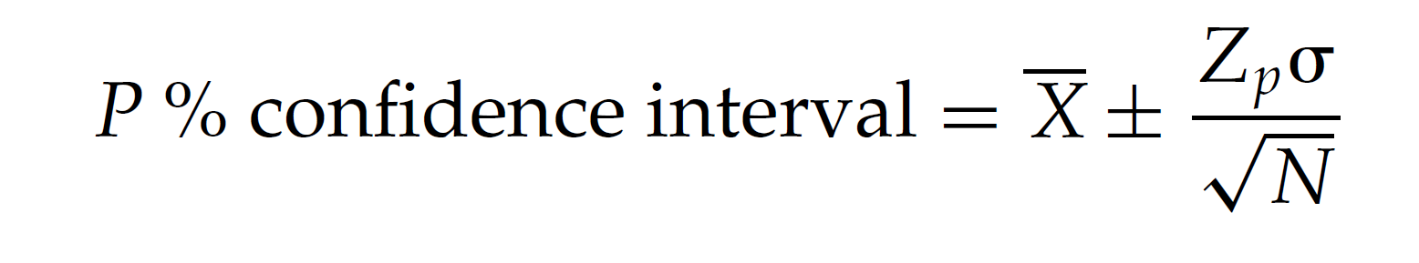
A two-sided confidence interval, symmetric about the observed mean, is calculated as follows:

Slide 12

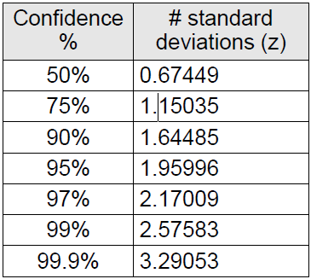
CONFIDENCE INTERVAL

Slide 13
Application
For the most commonly used 95% confidence interval, Z = 1.96, corresponding to (0.95 + l)/2 = 0.975 of the area in the cumulative standard normal distribution.
Other common confidence coefficients are 90% and 99%, having values of Z equal to 1.65 and 2.58, respectively.
Confidence intervals play an important role in the evaluation of drugs and drug products.

Slide 14
What Are P values?
P-values are the probability of obtaining an effect at least as extreme as the one in your sample data, assuming the truth of the null hypothesis.

Slide 15
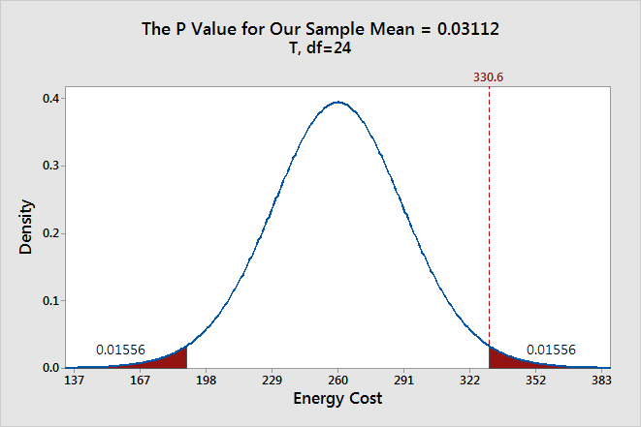

Slide 16

P value
95% CI corresponds to hypothesis testing with P <0.05

Slide 17
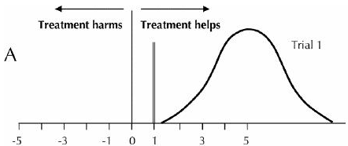
SIGNIFICANCE
If CI encloses no effect, difference is non significant

Slide 18

LEVEL OF SIGNIFICANCE

Slide 19
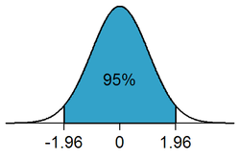
Level of significance
The significance level, also denoted as alpha or α, is the probability of rejecting the null hypothesis when it is true. For example, a significance level of 0.05 indicates a 5% risk of concluding that a difference exists when there is no actual difference.

Slide 20
By definition, the level of significance represents the chance of making a mistake when deciding to reject the null hypothesis

