Slide 1

Growth &
Development
Of
An INFANT
Presented By,
Mr. Rajesh P Joseph
Assistant Professor
Department of Child Health Nursing, SNC

Slide 2
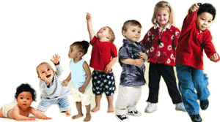
GROWTH &
DEVELOPMENT
INFANT

Slide 3
ONE MONTH

Slide 4
PHYSICAL OR BIOLOGICAL
WEIGHT :- 4.4 ± 0.8 kg
LENGHT :- approximately 53 ± 2.5 cm, 1 inch in a month.
HEAD CIRCUMFERENCE :- 35 ± 2 CM, increase 2 cm per two month till 3month.

Slide 5
Cont…
PULSE :- 130 ± 20 beats / min.
RESPIRATION :-35 ± 10 beats pr min.
BLOOD PRESSURE :- 80 / 50 ± 20/10 MMHg
REFLEXES :- baby has well develop of rooting, sucking, swallowing, moro reflexes etc.

Slide 6
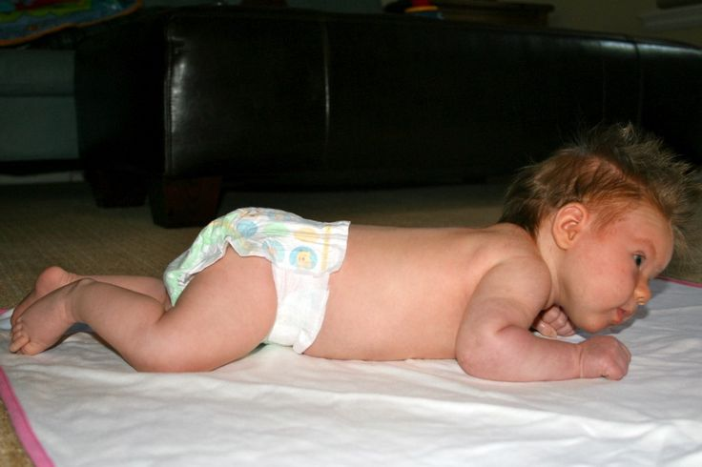
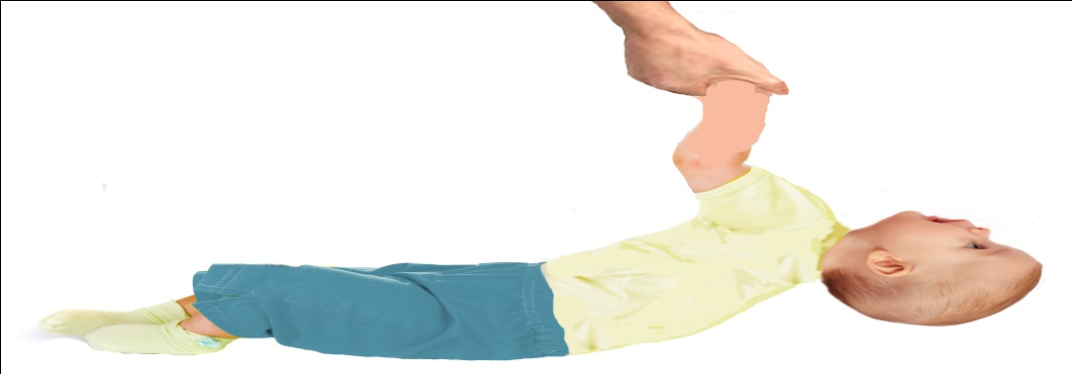

GROSS MOTOR
Lies in flexed position. When prone, pelvis is elevated but knees are not beneath abdomen as they were after birth .
Head lags when baby pulled from a supine to sitting position.
Head sags forward when baby is held in sitting position.

Slide 7

Cont…
May lift head periodically when held over adult’s shoulder or placed in prone position. Cervical curve begin to develop as infant learns to hold head erect.

Slide 8
Cont….
Turns head to the side when prone.
Make crawling movements when prone on flat surface
Pushes with the feet against a hard surface to move forward.

Slide 9
FINE MOTOR
Hold hands in tight fists
Can grasp an object placed in the hand( palmar grasp reflex),but drops it immediately.

Slide 10
SENSORY
Startled by sounds(Moro reflex)
Attentive to speech of others
Indefinite stare at surroundings
Fixates on objects brought in front of eyes. Notices faces especially and bright objects, but only if they are in the line of vision .

Slide 11
Cont…
Protective blinking in response to bright light.
Follows a bright object to the midline of vision if 6-8 inches from eyes.

Slide 12
PSYCHOSOCIAL
Beginning development of sense of trust. Negative counterpart : mistrust
Total egocentric
Complete dependence on caregivers, usually mother bonding progresses
Shows regards for human face

Slide 13
Cont…
Activity diminishes when a human face can be seen
Establishes eye contact
Smiles briefly
Quiets, cuddles, and melds when held
Perceives self and parents as one

Slide 14
PSYCHOSEXUAL
Oral stage (0-1 year)
Oral- dependent or oral- passive : need for sucking pleasure
SPIRITUAL
Undifferentiated (0-1)
Feeling of trust, warmth, and security form the foundation for the later development of faith.

Slide 15
INTELLELCTUAL
SENSORI-MOTOR STAGE (0-2 YEARS)
sub-stage (i) (birth to 1 month): infant uses reflexes to begin to make association between an act and a sequential response; cannot distinguish self from environment.
Sub-Stage (ii) – primary circular reaction (1-4 month):- begin to repeat action of own body voluntarily ( hand –to – mouth movement permits sucking).

Slide 16
MORAL :- Pre conventional morality stage 0 (0 – 2 years).

Slide 17
RECEPTIVE LANGUAGE
EXPRESSIVE LANGUAGE
Responds to human voices
Opens and closes mouth as adult speaks
Utter small throaty sound
Utter sound of comfort when feeding
Cry patterns developing.
Cries when hungry or uncomfortable

Slide 18
PLAY STIMULATION
Hold, touch and rock infant gently.
Encourage mutual eye contact.
Repeat noises made by infant. Respond to crying signal.
Use soothing lotion when massaging infant’s body.
Provide regular period of affectionate.

Slide 19
GROWTH AND DEVELOPMENT OF 2 MONTH CHILD

Slide 20
PHYSICAL AND BIOLOGICAL
Posterior fontanel closed at 6-8 weeks of age.

Slide 21

GROSS MOTOR
Less fixed prone position :- arms flexed, hip flat, leg extended, head in mid position.
less head lag when pulled from a supine to sitting position.
Lifts head all most 45 degree angle above a flat surface when lying in prone.
Holds head erect in mid position, also when held upright, turns from side to back.

Slide 22
FINE MOTOR
Hands may be open, holds a rattle briefly when placed in the hand.

Slide 23
SENSORY MOTOR
Turns head to side when a sound occurs at ear level.
when on back, follows a dangling object or a moving light beyond the midline of vision.
Beginning binocular fixation and convergence to objects nearby.

Slide 24
PSYCHOSOCIAL
Sense of trust, distinguishes ‘mother’ or primary caregiver from other and is more response to that person
eye- to – contact, and face orientation, smiling and vocalization are the evidence of attachment between infant and parents, especially the mother smiles back in response to another’s smile. This is the beginning of social behaviour. The true social smile may not appear until the 3rd month.
Has learned that crying brings attention.

Slide 25
PSYCHOSEXUAL :- ORAL STAGE (0 -1 YEAR)
SPIRITUAL :- Undifferentiated (0-1year)

Slide 26
INTELLECTAL
Sensory motor stage
Sub-stage ii : primary circular reaction (1-4month).
MORAL
Pre-conventional morality stage 0 (0 -2 years)

Slide 27
RECEPTIVE LANGUAGE
EXPRESSIVE LANGUAGE
Alert expression when listening,
direct definite regard
soothed by care giver’s, mother’s voice
Cry patterns develop, crying become differentiated, varying with the reason for crying.
Pitch and intensity vary
Responds vocally to care giver’s voice.

Slide 28
PLAY STIMULATION
Same as at one month.

Slide 29
GROWTH AND DEVELOPMENT OF THREE MONTH CHILD

Slide 30
PHYSICAL OR BIOLOGICAL
Weight :5.7 ± 0.8 kg
Length :- 60 ± 2 cm
Pulse 130+20
Respiration 35 ± 10
Bp :- 80/50 +20/10

Slide 31
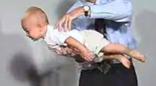
Cont…
Reflexes :-
grasping reflex absent.
Landau reflex appears: are infant suspended in a horizontal prone position with the head flexed, against the chest reflexly draws the legs up against the abdomen.

Slide 32

GROSS MOTOR
Symmetric posture of the head and body
Very slight head lag when pull from supine to sitting position.
Sits, back rounded, knees flexed, when supported in sitting position.
Holds head erect and steady

Slide 33
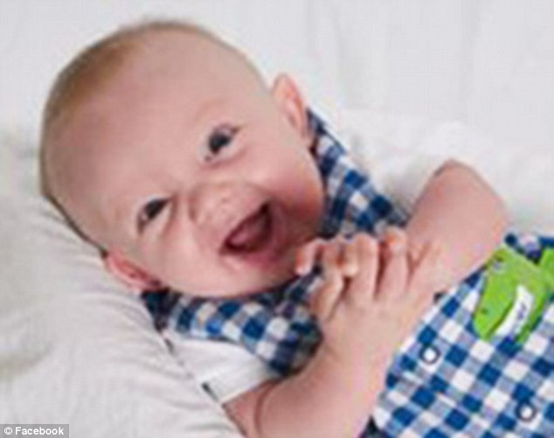
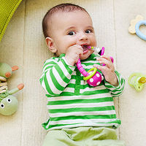
FINE MOTOR
Hands open or closed loosely.
Holds hand in front of face and stares at them.
Holds objects put in hand with active graps.
Carries hand or object to mouth at will.
Reaches for bright object but misses them.

Slide 34

SENSORY MOTOR
Turns head and looks in same direction to locate sound.
When on back turn eyes to a dangling object or moving light to marginal field of vision.
Binocular co-ordination(vertical and horizontal vision)when an object move from right to left and up to down in front of face.

Slide 35
Cont….
Looses interest in object that are suddenly removed from the perceptual field.
Blink at object that threaten the eyes.
Beginning ability to co-ordinate various sensory ability.

Slide 36
PSYSCHOSOCIAL
Sense of trust recognises and smiles in response to care giver (usually the mother’s face)
Stops crying when familiar person approaches
Interested in surroundings

Slide 37
PSYCHOSEXUAL :- Oral stage 0-1 year
SPIRITUAL :- Undifferentiated 0 -1 year
INTELLECTUAL:- SENSORY MOTOR STAGE SUB- STAGE II : Primary circular reaction (1-4 month).
MORAL :- Pre-conventional morality stage 0 (0 -1 year)

Slide 38
RECEPTIVE LANGUAGE
EXPRESSIVE LANGUAGE
Looks in direction of speaker
Cry less
Shows pleasure in making many sound
Vocalizes in responds to other: chuckles
May laugh aloud

Slide 39
PLAY STIMULATION
Same as 1 -2 months
encourage infant to raise head in prone position.
Pull baby in sitting position, thus encourage head control
Hold bright toys in front of infant to encourage teaching
Provide greater variety of toy as baby show interest in play thing .

Slide 40
GROWTH AND DEVELOPMENT OF 4 MONTH BABY

Slide 41
PHYSICAL AND BIOLOGICAL
Drools between 3 – 4 month of age indicating increased production of saliva. Unable to swallow it, therefore, it run from mouth.
REFLEXES :- Tonic neck, moro, sucking and rooting (when awake) reflexes absent; extrusion reflex fading(3 – 4 months).

Slide 42
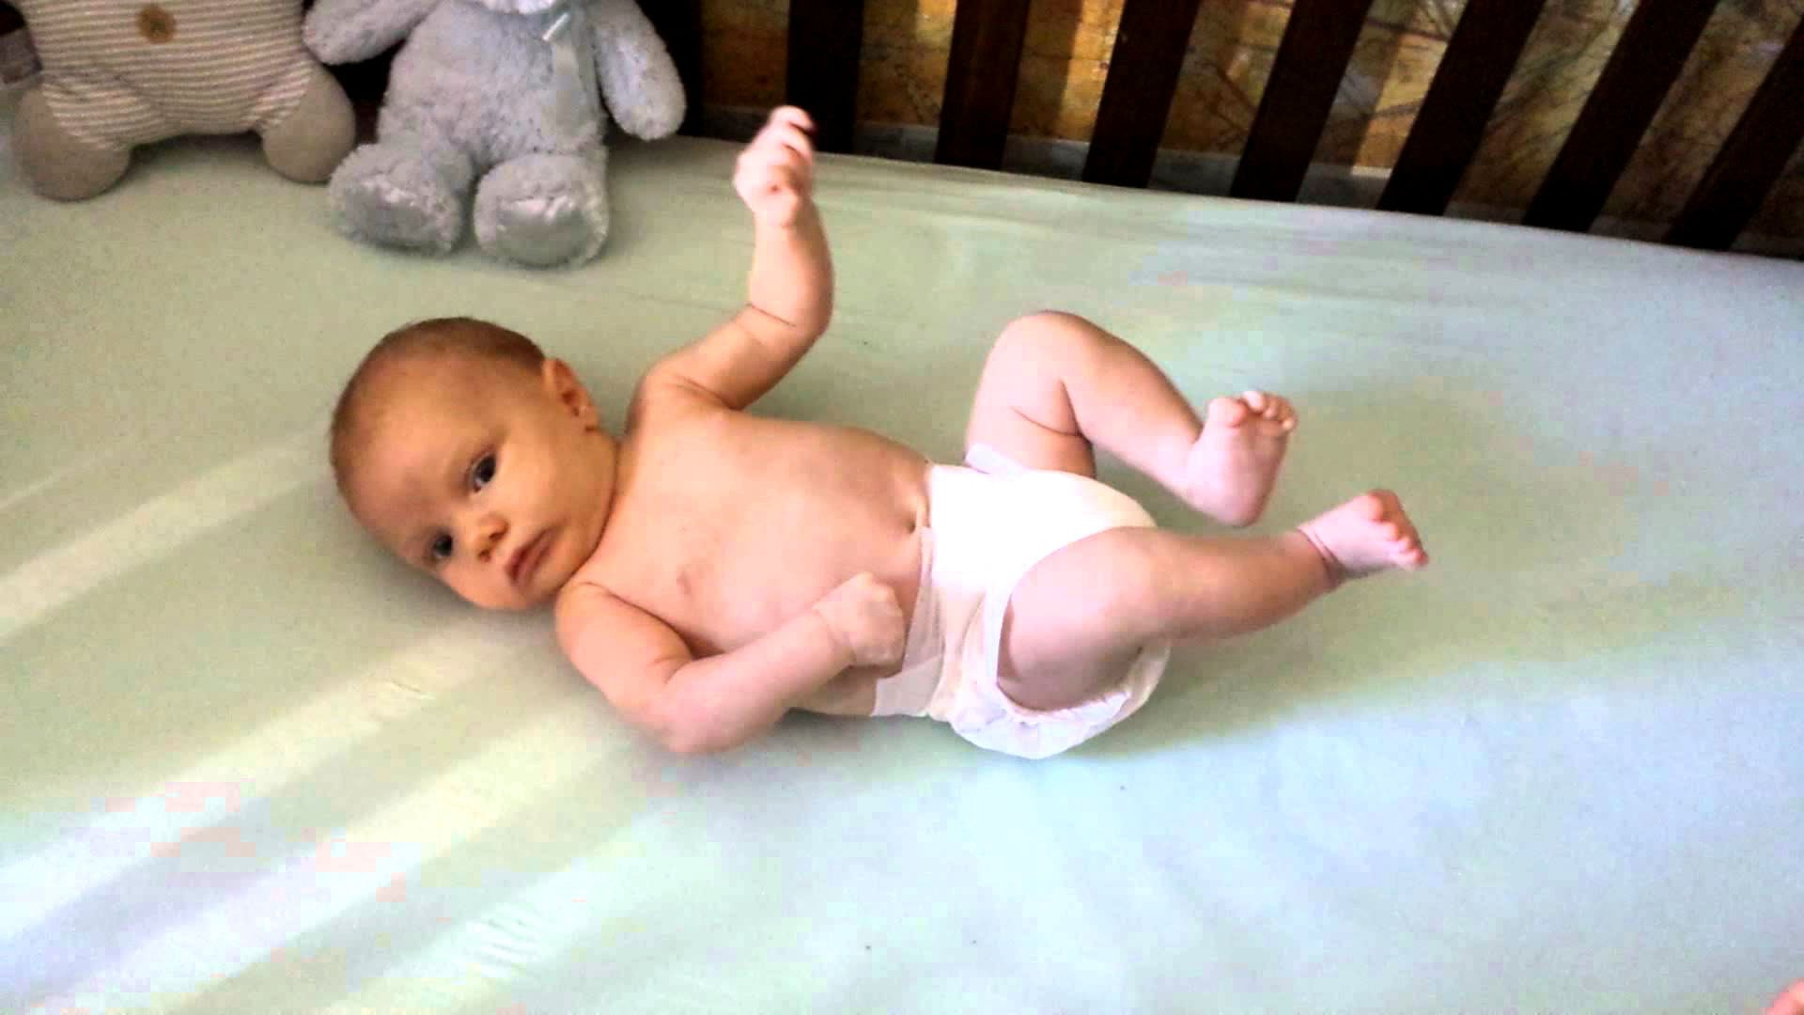
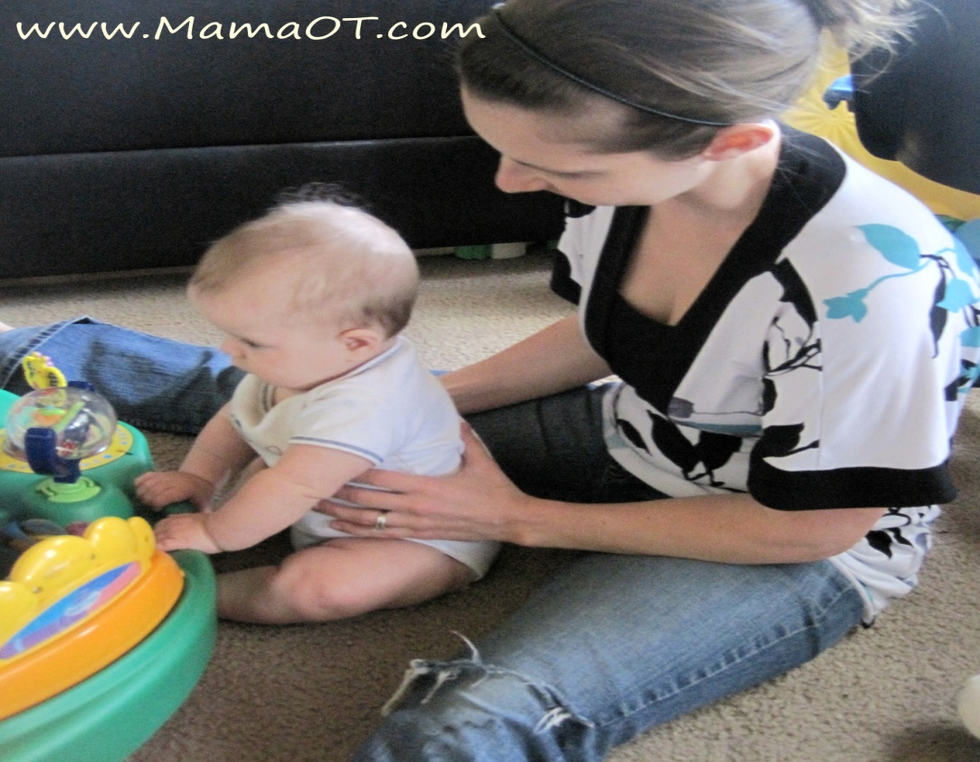
GROSS MOTOR
Symmetric body postures is predominate.
Sits with adequate support.
Holds head erect and steady when placed in sitting position.

Slide 43
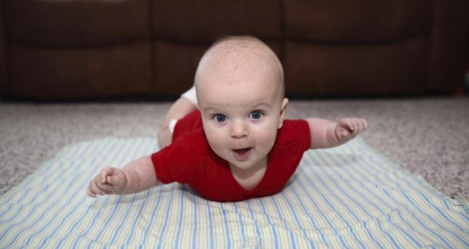
Cont…
Lifts head and shoulders at a 90 degree angle when on abdomen and looks around.
Attempts to roll or actually rolls over from front to back .
Sustains small portion of own weight when held in standing position.

Slide 44
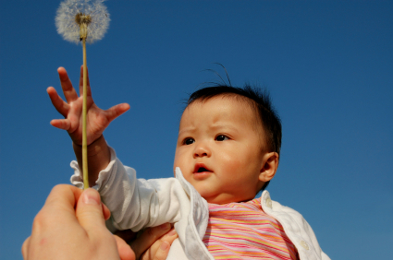
FINE MOTOR
Holds hand predominantly open.
Brings hands together in midline.
Plays with fingers.
Grasps objects held near hand. Cannot pick it up when dropped (grasps object) with both hands.

Slide 45
Cont….
Attempts to reach objects with hands but overshoots them.
Objects are carried to mouth.
Thumb apposition in grasping occurs between third and fourth month.
Fingers and clutches clothing.

Slide 46
SENSORY
Follows moving objects well with eyes.
Fair good binocular vision.
Looks briefly for toy that disappears.
Can focus on small objects.
Recognizes familiar objects.
Comfort by sucking thumb.

Slide 47
PSYCHOSOCIAL
Sense of trust- smile in response to smiles of other.
Shows evidence of wanting social attention and of increasing interest in other family members.
Shows interest in new stimuli.
Shows eagerness when feeding bottle appears,
Breath heavily when excited.
PSYCHOSEXUAL :- Oral stage (0-1 year)
SPIRITUAL :- Undifferentiated (0-1 year)

Slide 48
INTELLECTUAL
Sensorimotor stage
Sub stage ii :- primary circular reaction(0-4 months)
Sub stage iii :-secondary circular reaction (4-8 month)
Repeats actions that affect an object to get a response (shaking a rattle), experiments with old or new response to produce environmental changes or to reach a goal
MORAL :- Pre-conventional morality stage 0 (0-2 years)

Slide 49
SENSORY MOTOR
Follows moving objects well with eyes..
Fairly good binocular vision
Looks briefly for toy that disappears
Accommodation begins to develop. Can accommodate to nearby objects.
Can focus on small objects. Stares at rattle placed in hand and takes it to the month.
Recognizes familiar objects such as feeding bottle and toys beginning hand – eye co-ordination.
Comfort self by sucking thumb or pacifier.

Slide 50
RECEPTIVE LANGUAGE :- Responds differently to pleasant or angry voice, but does not cry when scolded.
EXPRESSIVE LANGUAGE :- Laugh aloud, vocalizes socially :- coos and gurgles when spoken to very ‘talkative’ to self, people, or toys. Can vocalize consonants ‘b,g,h,k,n,p’.

Slide 51
PLAY STIMULATION
Hold , touch and rock gently.
Smile when talking and singing to infant.
Encourage mutual eye contact.
Laugh when infant laugh
Offer toy for grasping.
Provide floating toys for bath.
Provide safe area for periods of solitary play.
Place infant when awake where house hold activities are in progress
Encourage children in viewing television and activity.

Slide 52
GROWTH AND DEVELOPMENT OF 5 MONTH CHILD

Slide 53
PHYSICAL OR BIOLOGICAL
Weight at least twice of the birth weight.
Physical growth become slower down.
Can breath through mouth when nose is obstructed.

Slide 54
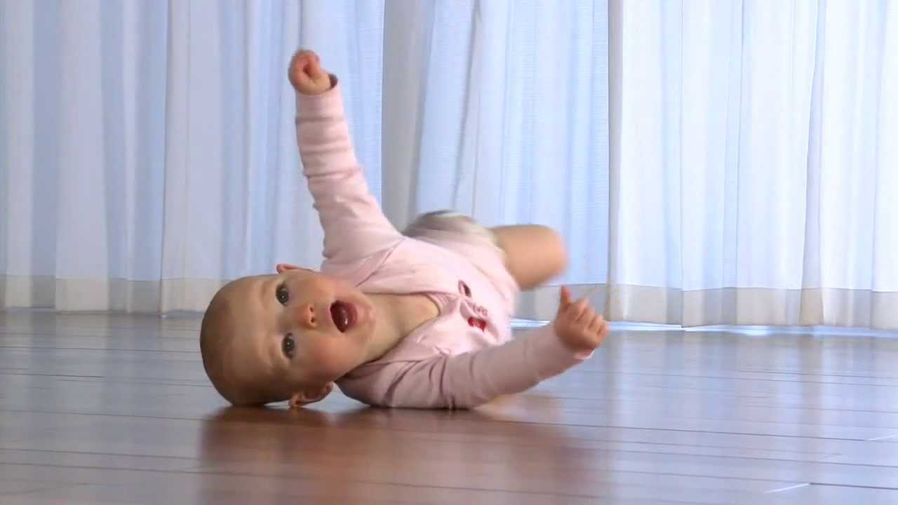
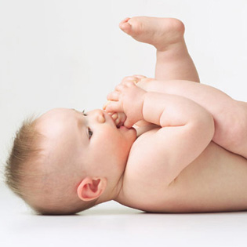
GROSS MOTOR
Sits with slight support.
Balance head well when sitting.
Holdback straight when pulled to a sitting position.
Rolls from back to front.
Sustains more of own weight when held in standing position.
Pulls feet to mouth when supine.

Slide 55
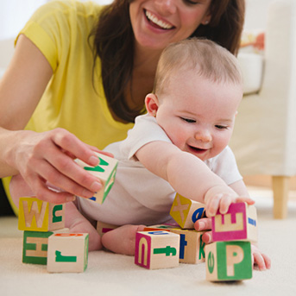


FINE MOTOR
Use thumb in partial apposition to fingers more skilful.
Tries to obtain objects beyond reach.
Grasps object independently of direct stimulation of the palm of the hand.
Grasps object with whole hand, either right or left.
Holds one object while looking at another.

Slide 56
SENSORY
Localizes sounds made below the ear.
Looks after a dropped object.
Inspects objects visually for a lengthening period of time. Can fixate on objects more than 3 feet away.

Slide 57


PSYCHOSOCIAL
Smile at self in mirror.
Begins to discriminate family members from strangers.
Accepts an object from another person.
Play with own feet.

Slide 58
PSYCHOSEXUAL :- Oral stage (0 -1 year)
SPIRITUAL :- Undifferentiated (0 -1year)

Slide 59
INTELLECTUAL :- Sensory motor stage Sub stage iii : secondary circular reaction (4 – 8 month).
MORAL :- Pre-conventional morality stage 0 (0 -2 year)

Slide 60
RECEPTIVE LANGUAGE :- Responds when own mane is spoken.
EXPRESSIVE LANGUAGE
Squeals when happy or excited.
Sound like vowels appears with consonants such as ‘goo’.
Begins to mimic sounds.

Slide 61
PLAY STIMULATION
Provide sufficient different objects for play.
Make various sound near ear.
Hold infant in standing position and bounce to exercise legs and to develop balance.

Slide 62
GROWTH AND DEVELOPMENT OF CHILD IN SIX MONTH

Slide 63
PHYSICAL AND BIOLOGICAL
Weight :-7.5kg
Height:-65cm
Head circumference :-38cm
Teething :- two central incisor erupts. Begins to bite and chew.

Slide 64

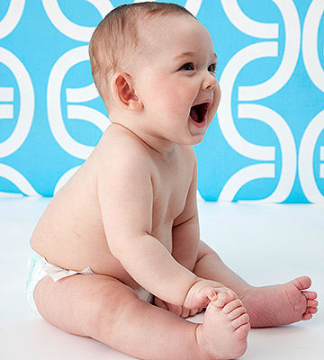
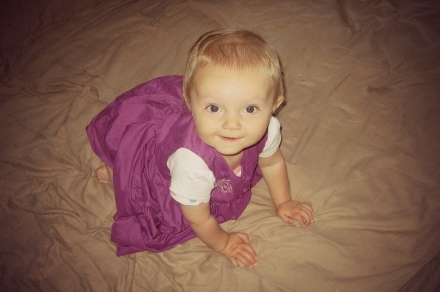
GROSS MOTOR
Sits alone briefly, if placed in a favourable leaning position on hard surface. Holds arm out.
Back is straight when sitting in high chair.
Lifts chest and upper abdomen when prone, putting the weight on the arms and hands.
Sustain most all of own weight when held in standing position.

Slide 65
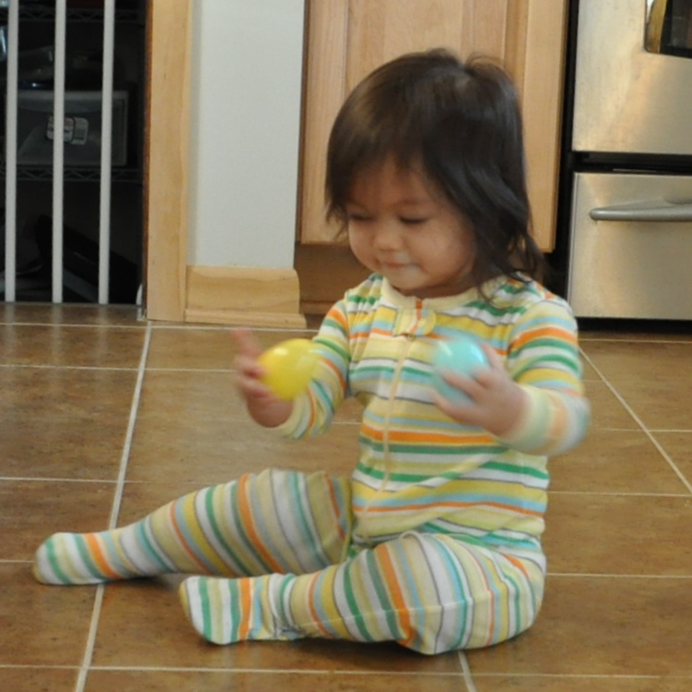
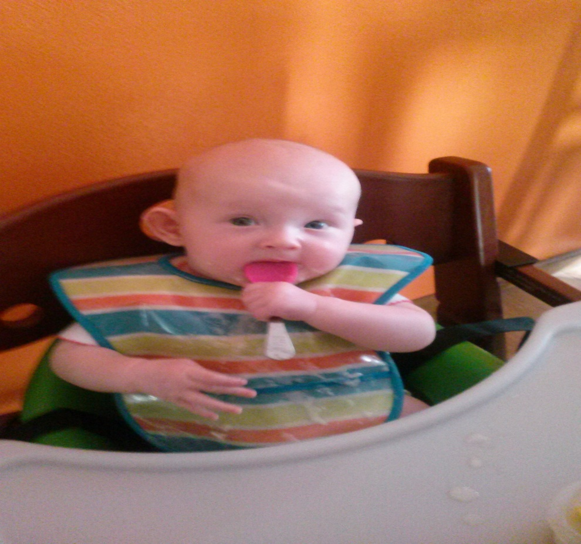
FINE MOTOR
Grasps with simultaneous flexion of fingers : begins to use fingers to feed self a cracker.
Retains transient hold on two objects, one in each hand.
Manipulates small objects.

Slide 66
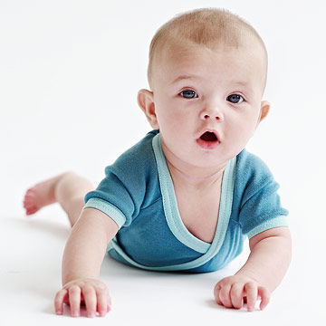
SENSORY
Localized sounds made above the ear
Retrieve a dropped object that can be seen and reached.
Enjoy more complex visual stimuli.
Moves in order to see an object.

Slide 67

PSYCHOSOCIAL
Recognizes strangers as different from family members.
Begins to extend arms to picked up.
Thrashes arm and legs when frustrated.
Sticking tongue out.
Knows what is liked and disliked.
PSYCHOSEXUAL
Oral stage ( 0 -1 year)
SPIRITUAL
Undifferentiated ( 0 -1year).

Slide 68
INTELLECTUAL
Sensory motor stage
Sub stage iii : secondary circular reaction (4 – 8 month), beginning of object permanence when infant briefly searches for a dropped object.
MORAL
Pre-conventional morality stage 0 (0-2 years)

Slide 69
RECEPTIVE LANGUAGE
Recognize familiar words.
EXPRESSIVE LANGUAGE
Cries easily on slight or no provocation.
Vocalized several well defined syllables.
Shows enjoyment in hearing own vocalization.
Talks to mirror image.

Slide 70
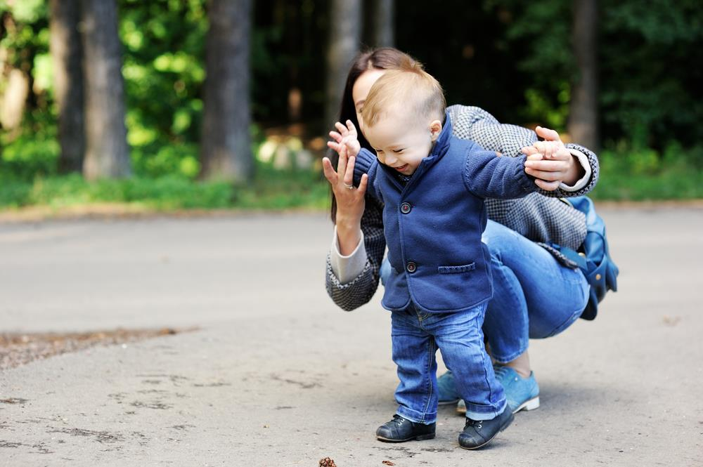
PLAY STIMULATION
Make funny face for infant.
Point out people, food, objects and surrounding activities.
Repeats infant’s name.
Provides more complex soft toy cuddly toy.
Provide sound making toys.
Begin to place infant in walker.

Slide 71
GROWTH AND DEVELOPMENT OF SEVEN MONTH CHILD

Slide 72
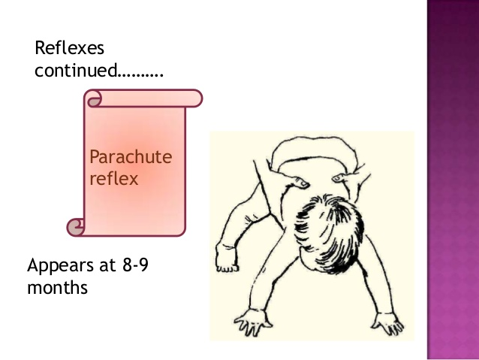
PHYSICAL AND BIOLOGICAL
Reflexes :- “sucking and rooting reflexes disappears at 7-8 month when asleep’’.
“parachute reflex appears between 7- 9 month, infant suspended in a horizontal prone position and lowered suddenly will extend the hand forwards to protection from falling.

Slide 73
Cont..
Teething :- upper central incisor erupts(7.5 ±2 month), lower lateral incisors erupts (7 ± 2 month),
Ultimate colour of iris is established.

Slide 74
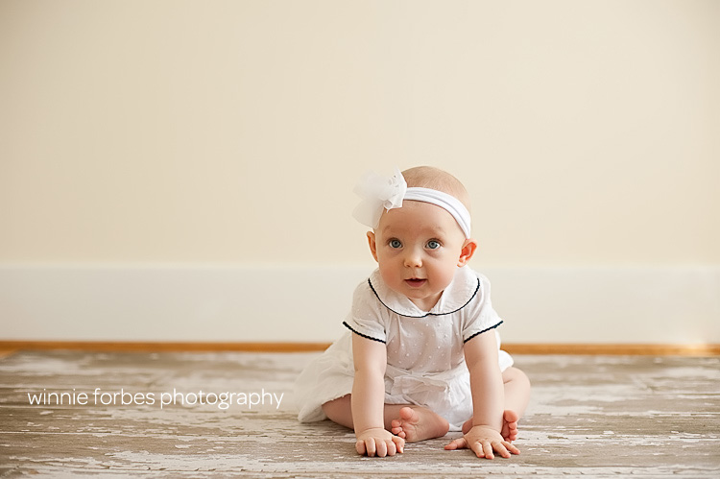
GROSS MOTOR
Sits alone on hard surface, learning forward on hands.
Lifts head as if trying to sit up when supine position.
Control of trunk is more advance.
Sustain all of weight on feet when held in standing position.

Slide 75
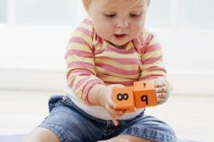
FINE MOTOR
Hold two toys at once.
Approaches a toy and grasps it with one hand.
Transfers a toy and form one hand to the other, usually successfully.
Uses a raking motion to try to obtain small objects.
Hold cup.

Slide 76
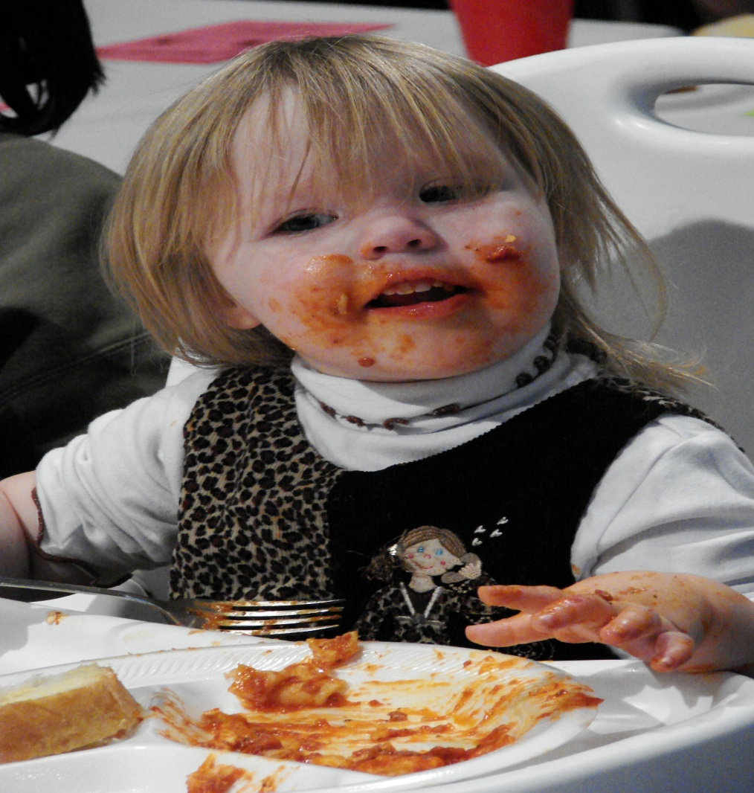
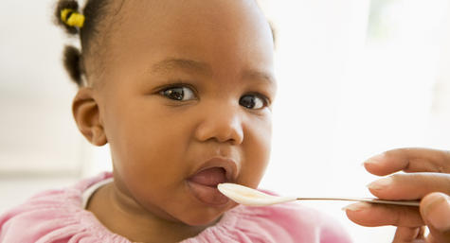
SENSORY
Head turns in curving arch to localize sounds.
Depth perception beginning to develop.
Fixate on very small object and details.
Has preference in taste for food.

Slide 77
PSYCHOSOCIAL
Shows increasing fear of strangers.
Actively clings to familiar person when distressed.
Unhappy when primary care giver absent, especially mother.
Responds socially to own name.
Close lips when offered dislike food.
PSYCHOSEXUAL
Oral stage (0 -1 year)
Oral aggressiveness is evidenced by biting and chewing.
Discovers genitalia.
SPIRITUAL
Undifferentiated (0 – 1 year)

Slide 78
INTELLECTUAL
Sensory motor stage
Sub stage iii :- secondary circular reaction (4-8 month)
MORAL
Pre conventional morality 0 (0-2 years).

Slide 79
RECEPTIVE LANGUAGE
Recognize own name.
Respond with gesture to words such as ‘come’.
EXPRESSIVE LANGUAGE
Imitate simple noise sound and speech.
Makes polysyllabic vowel sounds, vocalizes ‘da’ ‘ma’ ‘ba’.
Babbling decrease.

Slide 80
PLAY STIMULATION
Place toy under the blanket and encourage to find it.
Repeat simple sound like ‘dada’ ‘mama’.
Provide object or food that can be bitten and chewed safely.
Continue to encourage playing in water and perhaps ‘swimming’ in shallow tub or pool.
Continue to help infant learn balance.

Slide 81

GROWTH AND DEVELOPMENT OF 8 MONTH CHILD
PHYSICAL OR BIOLOGICAL
Beginning the training of bowel and bladder eliminations.

Slide 82
GROSS MOTOR
Sit alone steadily.
Pulls self into standing position with help.
Hand eye co-ordination is perfect.

Slide 83

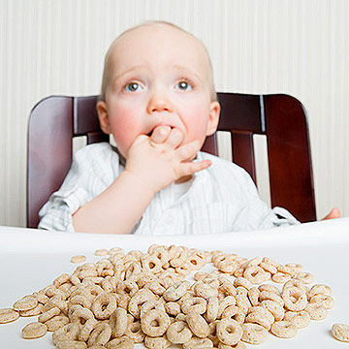
FINE MOTOR
Hold two object and look for third.
Release object from hand voluntarily.
Complete thumb apposition.
Eat finger foods, such as crackers.
Drink from cup with assistance.

Slide 84
SENSORY
Recognise familiar words and sounds.

Slide 85
PSYCHOSOCIAL
Refuse to play with strangers or even accept toy from them.
Stretch arms to loved family members.
Increased anxiety over loss of parents, especially mother.
Emotional instability still evident.
Dislike changing clothing and diapers.
PSYCHOSEXUAL
Oral stage (0-1 year).
MORAL
Undifferentiated (0-1 year)

Slide 86
INTELLECTUAL
Sensory motor stage
SUB STAGE iii :-
    Secondary circular reaction (4-8 month).
    Knows that object separate from self.
    Searches briefly for object being placed elsewhere.
    Action to produce a result have been memorized.
SUB STAGE IV :-
  Secondary schemas (8 -12 month)
  Behaviour and perceptual patterns are co-ordinated and applied to new situations.
  Beginning perception of cause and effect relationship.
  Early beginning of anticipatory and intentional behaviour.
  Problem solving beginning to develop.
MORAL :- Pre- conventional morality stage 0 (0 -2 years).

Slide 87
RECEPTIVE LANGUAGE
  Stops activity when own name is spoken.
  Beginning to understand meaning of ‘no’.
EXPRESSIVE LANGUAGE
  Shout for attention.
  Imitates sound sequences.
  Continues syllables : ‘da-da’, ‘ma-ma’.

Slide 88

PLAY STIMULATION
  Hold, touch , rock infant gentry.
  Talk and sing to infant.
  Place infant in sitting position against a wall and encourage learning away from the wall to improve balance.
  Gently push infant from a sitting position to improve balance.

Slide 89
GROWTH AND DEVELOPMENT OF 9 MONTH CHILD
PHYSICAL AND BIOLOGICAL
Reflexes :- plantar grasps absent.
Teething :- upper lateral incisor erupts (9±2 months).

Slide 90
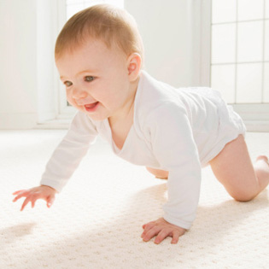
GROSS MOTOR
  Raises to a sitting position alone with good co-ordination.
  Sits steadily for longer time.
  Recover balance when forwards.
  Crawls instead of hitching. When crawling the infant is prone. The abdomen touches the floor. The head and shoulder is supported by hands.
  Creeping- advance type of locomotion. Infant uses both hands and knees in moving.
  Beginning to pull self to standing position alone while holding on to furniture.

Slide 91
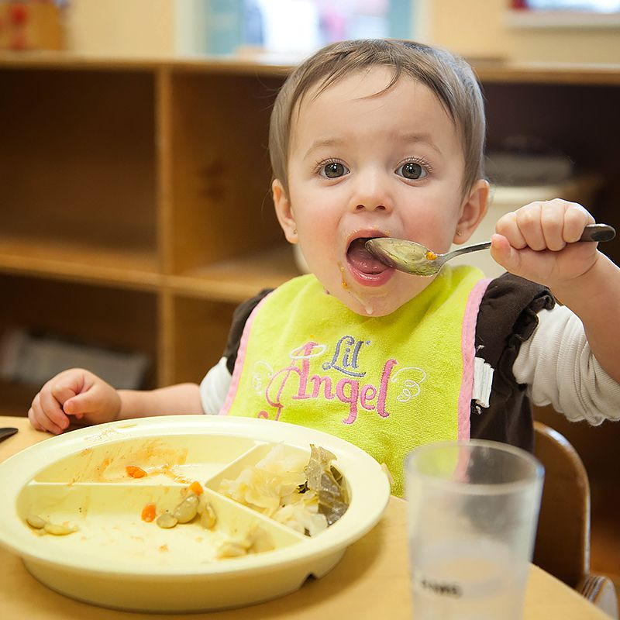
FINE MOTOR
  Bangs two objects together.
  Pokes objects with two hands.
  Holds own bottle with own hand, good hand mouth co-ordination.
  Has preference the use of the dominant hand.
  Put nipple in and withdraw from mouth as will.
  Attempt to use the spoon, but the content spills down.
  Use thumb and index finger in early pincer grasps.

Slide 92
SENSORY
Head turns directly to the source of sound.
Recognise the familiar objects.
Able to follow the object through transition from one place to another.
Increase depth perception.

Slide 93
PSYCHOSOCIAL
Knows what ‘no’ means.
Beginning to play simple games with adult such as ‘so big’, ‘bye- bye’.
Mother is most important in between the care givers.
Dislike having face washed, so cover the face with hand and arms.
PSYCHOSEXUAL :- oral stage (0-1 year).
SPIRITUAL :- Undifferentiated (0-1 year).

Slide 94
INTELLECTUAL
Sensory motor stage
sub stage iv :- co- ordination of secondary schemas (8-12 months).
Able to follow the objects through transition from one place to another.
MORAL :- Pre-conventional morality stage 0 (0-2year).

Slide 95
RECEPTIV ELANGUAGE
Stop activity in response to ‘no’.
Beginning to response to simple commands given verbally.
Responds to adult anger.
EXPRESSIVE LANGUAGE
Cries when scolded.
Association of words with persons or objects.
Intonation beginning to become patterned through imitation.

Slide 96
PLAY STIMULATION
Show large picture in books.
Encourage to bang two toys together.
Continue to vocalize with infant.
Provide large environment for infant to crawling, creeping, cruising.

Slide 97
GROWTH AND DEVELOPMENT 10 MONTH CHILD
PHYSICAL AND BIOLOGICAL
Macula is well developed so that fine visual discriminations can be made.

Slide 98
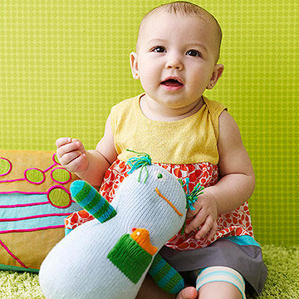
GROSS MOTOR
Move from prone to sitting position.
May sit by falling down from standing position.
Sits steadily for indefinite periods.
Pulls to standing position well, holding to the crib rail or other support.
Make stepping movement forward when two hands are held.

Slide 99
FINE MOTOR
Pick small object up with index finger and thumbs.
Release an object after holding the object.
Bring the hands together.

Slide 100
SENSORY
Make interest in small objects.
Search the lost toy with greater persistence.

Slide 101
PSYCHOSOCIAL
Expresses the several beginning recognizable emotions such as anger, sadness, anxiety, pleasure etc. .
May object to bring away from parent.
Show preference for one toy over another.
Offers toy to another but will not release or give it up.
Attract the attention of other by pulling the cloth of other.
PSYCHOSEXUAL :- Oral stage (0-1 year).
SPIRITUAL :- Undifferentiated (0-1 year)

Slide 102
INTELLECTUAL :- Sensory motor stage sub-stage iv :- co-ordination of secondary schemas(8-12 month)
MORAL :- Pre- conventional morality stage 0 (0-2 years).

Slide 103
RECEPTIVE LANGUAGE :-
understand simple commands.
EXPRESSIVE LANGUAGE :-
May speak one word besides ‘ma-ma’, ‘da-da’.
Understand the meaning of ‘bye-bye’.
Imitates sound of animals.

Slide 104
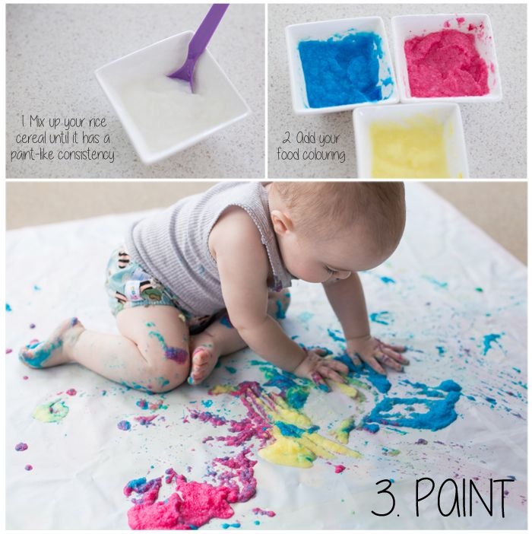
PLAY STIMULATION
Make facial expression and sound that infant can imitate.
Show infant a cardboard or cloth picture book.
Continue infant games.
Provide opportunities for holding and releasing the toy.
Encourage the infant to bounce in a standing position by holding the hands for support.
Place infant in jumper seat to encourage standing and jumping.

Slide 105
GROWTH AND DEVELOPMENT OF 11 MONTH CHILD
PHYSICAL AND BIOLOGICAL
WEIGHT :- 10 kg
HEIGHT :- 75 cm
HEAD CIRCUMFERENCE :-41 cm

Slide 106
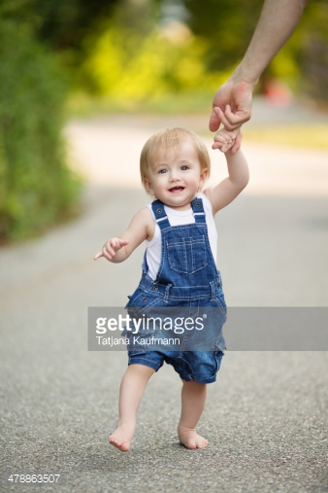
GROSS MOTOR
Stands erect with minimal support and lifts one foot to take a step.
Cruses : walks holding on to furniture
FINE MOTOR
Explore toys and other object more carefully.
Removes cover from the box.
Puts toy inside box or cup but may not let go yet.
SENSORY
Tilts head backward to see upward.

Slide 107

PSYCHOSOCIAL
Become frustrated when activities are restricted.
Asserts self among family members seeks approval, avoids disapproval.
Shows pleasure when a desired act is accomplished.
PSYCHOSEXUAL :- oral stage (0-1year)
SPIRITUAL :- undifferentiated (0-1YEAR)

Slide 108
INTELLECTUAL :- Sensory motor stage sub-stage iv :- co-ordination of secondary schemas (8-12month).
MORAL :- pre-conventional morality stage 0(0-2 year).
RECEPTIVE LANGUAGE
Respond to simple question. Ex :- ‘where is kitty ? by pointing shows towards the object.’
EXPRESSIVE LANGUAGE
Imitates specific speech sounds of other jargon well established.

Slide 109

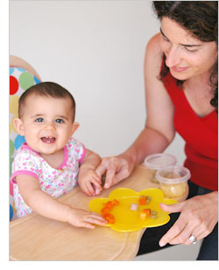
PLAY STIMULATION
Encourage play with other persons.
Encourage infant to stand alone by gradually decreasing the supports.
Provide opportunity to placing small object in large objects and for taking them.
Shows infant how to throw.

Slide 110
GROWTH AND DEVELOPMENT OF 12MONTH / ONE YEAR CHILD
PHYSICAL AND BIOLOGICAL
Weight :- 10 ± 1.5kg
Height :- 74.5 ± 3 cm
Head circumference :- 42cm
Brain weight increased rapidly since birth.
Head and chest circumference are equal .

Slide 111
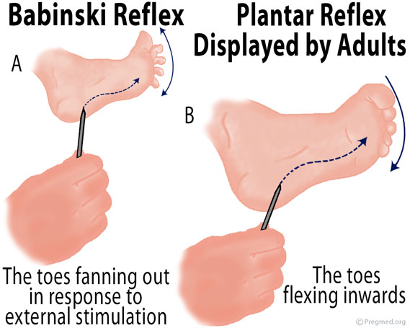
Cont…..
Anterior fontanel closed between 12 -24 month.
Pulse :- 115±20
Resp. :-30 ± 10
B.P. :- 96/66 ±30/24
REFLEX :- babinski reflexes and landau reflex disappears.
TEETHING :- 6-8 deciduous teeth
Physical stability achieved and maintained during first year.

Slide 112
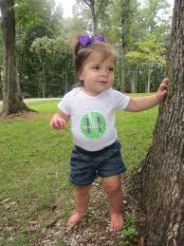
GROSS MOTOR
Stands alone for long period.
Sits down from standing position alone.
Walk a few steps with help or alone.
Improve competence in motor skill through practice.
FINE MOTOR
Good pincer grasps.
Picks up small bits of food and transfer them to mouth.
Attempt to put a small pellet into a narrow necked bottle but does not success.
Drinks from a cup and eat from a spoon but still requires some help.

Slide 113
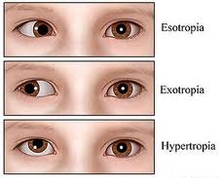
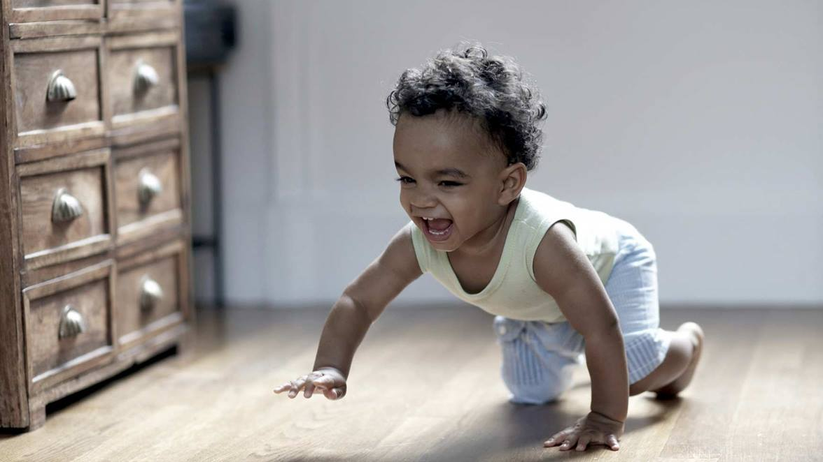
SENSORY
Listen for the recurring sounds.
Full binocular vision well established.
Amblyopia may be develop with eyes.
Follows fast moving objects.

Slide 114
PSYCHOSOCIAL
Infant’s emotion clearly interpreted.
Attachment developed to primary care giver.
Explore away from care giver if secure.
Take off socks.
Drops object on purpose so someone can pick them up.
PSYCHOSEXUAL :- oral stage (0-1 year)
SPIRITUAL :- undifferentiated (0-1 year)

Slide 115
INTELLECTUAL
sensory motor stage sub-stage iv :- co-ordination of secondary schemas(8-12 month)
Beginning perception of cause and effect relationship.
Early beginning of anticipatory and intentional behaviour.
Problem solving beginning to develop.
MORAL :- pre-conventional morality stage 0 (0-2 years).

Slide 116
RECEPTIVE LANGUAGE
Respond with gesture or action to more complex verbal request.
EXPRESSIVE LANGUAGE
May speak two or more words.
Understand the meaning of many word can be spoken.
Beginning the control over respond to sound.
Vocalization decrease as walking increase.

Slide 117

PLAY STIMULATION
Provide large crayons for drawing.
Provide push and pull toy to increase walking.
Encourage infant to walk, eventually holding one hand.
Provide rough house activity.
Provide increasing visual, auditory, tactile and kinetic stimulation.

Slide 118
SUMMARIZATION

Slide 119
BIBLIOGRAPHY
Dutta prul, “pediatric Nursing ‘’ second edition, Jaypee brothers medical publishers(p) ltd. Page-182.
Marlow Dorothy R., Redding Barbara A.,”marlow’s text book of pediatric nursing’’south asian edition,2013,ELSEVIER a division of reed Elsevier India private limited. Page- 428 -451.
Sharma Rimple, “ Essentials of pediatric nursing” , first edition- 2013, , Jaypee brothers medical publishers(p) ltd. Page (71 -83).

Slide 120
THANK YOU

