Slide 1

Nursing Management of Patient
WITH WILM TUMOR
Presented By,
Mr. Nirmal Raj E V
Assistant Professor
Department of Child Health Nursing, SNC
Presented By,
Mr. Nirmal Raj E V
Assistant Professor
Department of Child Health Nursing, SNC

Slide 2

WILM’S TUMOR

Slide 3
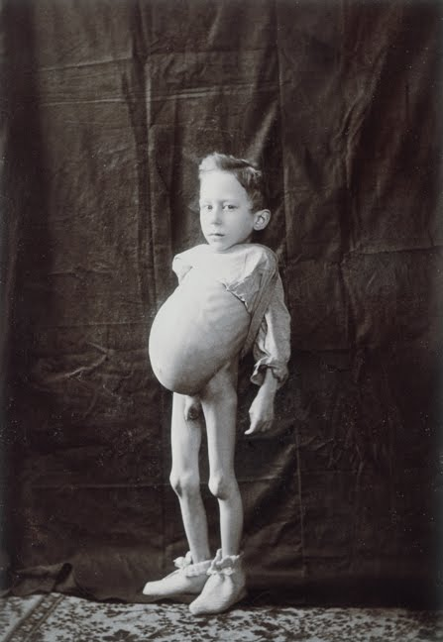
INTRODUCTION
wilms tumour is a rare type of kidney cancer most often diagnosed in children the condition is named for a 19th century German surgeon, who recognized that the cancedevelops from immature kidney cells. Its cause a tumor on one or both kidney.

Slide 4
DEFINITION
Wilm’s tumor is rapidly developing highly malignant tumor of kidney, usually diagnosed within 3 years of age or it is a cancer of the kidney.
It is also called a nephroblastoma.

Slide 5
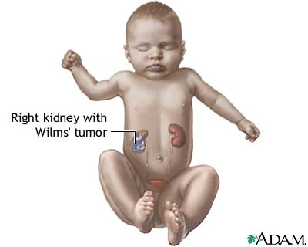

Slide 6
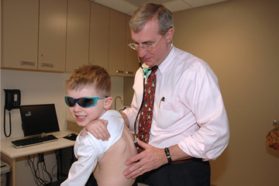
INCIDENCE
It is most common neoplasm in children with anual incidence of 7-8 per million children. It commonly occurs under 7 years of age there is a equal incidence in boy and girl.
usually affects newborns and the very young fortunately most kids with mostly seen in children less than 5 years of age.

Slide 7
RISK FACTORS
Factors that may increase the risk of Wilms' tumor include:
Being female. Girls are slightly more likely to develop Wilms' tumor than are boys.
Being black. Black children have a slightly higher risk of developing Wilms' tumor than do children of other races. Children of Asian descent appear to have a lower risk than do children of other races.

Slide 8
Contd…
Having a family history of Wilms' tumor. If someone in child's family has had Wilms' tumor, then child has an increased risk of developing the disease.

Slide 9
CAUSES
Unknown
Congenital malformations
Lack of an iris in the eyes (aniridia)
Abnormalities of the genitals
Hemihypertrophy

Slide 10
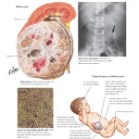
PATHOPHYSIOLOGY
  Wilms tumor are generally large rapidly growing lesions that may reach considerable size before they are detected.
  They develop in the renal parenchyma in either the central or the polar location.
  Entire renal parenchyma may appear replaced by tumour.

Slide 11
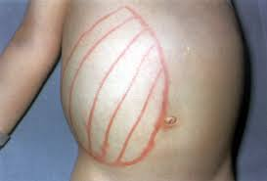
SIGN AND SYMPTOMS
Abnormally large abdomen
Abdominal pain
Fever
Nausea
Vomiting
Blood in the urine
High blood pressure in some cases
Pallor
Superficial venous engorgement

Slide 12
STAGES OF WILM’S TUMOR
STAGE 1
The cancer is found only in one kidney, and generally can be completely removed with surgery.
STAGE 2
The cancer has spread to the tissues and structures near the affected kidney, such as fat or blood vessels, but it can still be completely removed by surgery.

Slide 13
STAGE 3
The cancer has spread beyond the kidney area to nearby lymph nodes or other structures within the abdomen, and it may not be completely removed by surgery.
STAGE 4
The cancer has spread to distant structures, such as the lungs, liver, bones or brain.

Slide 14
Cancer cells are found in both kidneys.
STAGE 5

Slide 15
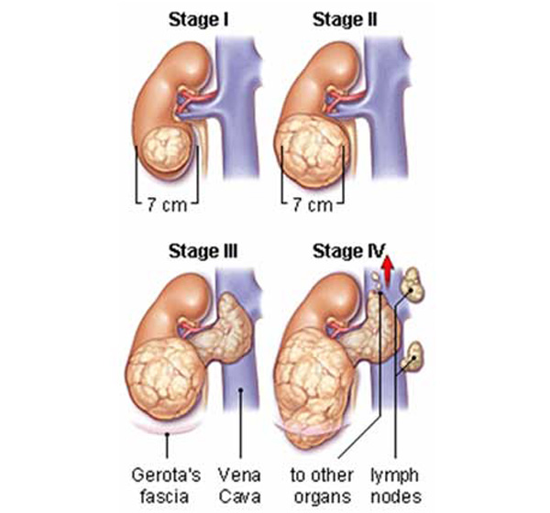

Slide 16
DIAGNOSTIC EVALUATION
History of illness
Physical examination
X-ray abdomen
Chest X-ray
IVP
USG

Slide 17
Contd….
CT Scan
MRI
Renal function test
Urine analysis
Liver function test
Bone marrow study

Slide 18
MEDICAL MANAGEMENT
Pharmacological management
Pre-operative Chemotherapy
Large tumors that involve vital structures make resection difficult.
The complication rate is high, and the incidence of tumor spillage also is high.
Bilateral WT
The chemotherapeutic drugs are
  Inj. vincristine
  Inj. actinomycin D

Slide 19
Post-operative Chemotherapy and Radiotherapy
Postoperative chemotherapy and radiotherapy includes
  Inj. vincristine
  Inj. actinomycin D
  Inj. doxorubicin
  Abdominal radiation
  Abdominal irradiation according to local stage

Slide 20
SURGICAL TREATMENT
The initial recommands is radial Nephrectomy. In case of bilateral tumors considered operable first surgery should receive 4-6 weeks of chemotherapy. In some cases chemotherapy may have to enable partial Nephrectomy to be done.

Slide 21
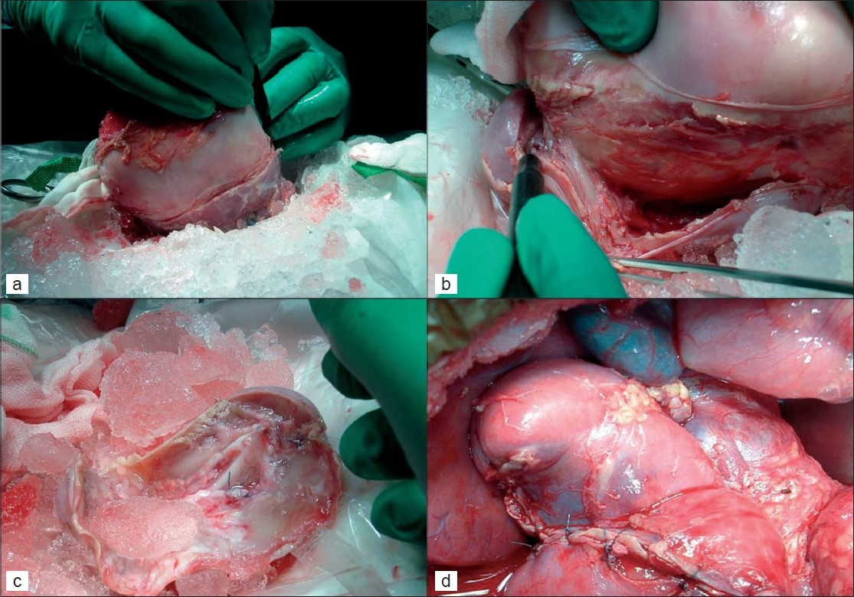
SURGICAL TREATMENT :-

Slide 22
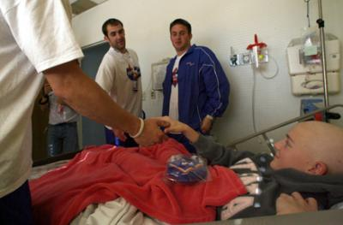
RADIOTHERAPY
TO treat all cells which are escaped after surgery.

Slide 23

CHEMOTHERAPY
NAME OF DUGE :-
Cytoxan
Taxol
Adriamycin
Oncovin
Cosmegen

Slide 24
NUTRITIONAL THERAPY
Any vegitable
Fruites
Low carb foods
Apples, spinach, grains, bananas ,mangos , oranges , black berries.

Slide 25
NURSING MANAGEMENT
Special care during nephrectomy, radiotherapy and chemotherapy
Reducing anxiety of the parents by explanations.
Involvement in child care and teaching long-term home based care are important nursing interventions to help the family to cope with the situations.

Slide 26
NURSING DIAGNOSIS
    Pain acute related to abdominal swelling secondary to growth of tumor.
    Nutrition imbalanced less than body requirement related to anorexia secondary to compression of tumor.
    Parental anxiety related to hospitalization of the child.
    Knowledge deficit of parents regarding the chemotherapy and nutritional management of the child.
    Risk for infection related to leukocytopenia secondary to chemotherapy.

Slide 27
NURSING INTERVENTION
  Asses the condition of the child
  Collect the complete history.
  Monitor the vital signs
  Provide comfort and diversional therapy to relieve pain.
  Provide cold compress
  Prepare the menu plan for the client based on the likes and dislikes of the clients.

Slide 28
  Advice the family members regarding client condition
  Prepare the client for chemotherapy
  Prepare the client for surgery if needed
  Provide comfort to the client after surgery
  Educate the family members regarding the prognosis of the client.
  Educate family members regarding the importance follow-up.

Slide 29
COMPLICATION
    Small bowel obstruction
    Hemorrhage
    Wound infection, hernia
    Vascular complications
    Splenic and intestinal injury

Slide 30
LONG TERM COMPLICATIONS
Renal function: The rate of chronic renal failure (CRF) is 1% overall.
Cardiac function: The overall incidence rate of some form of cardiac damage is 25% in those treated with Doxorubicin.
Pulmonary function: Radiation pneumonitis is encountered in 20% of the cases receiving total pulmonary radiation.
Hepatic function: Actinomycin D and radiation may damage the liver, with an overall incidence rate of 10%.

Slide 31
P | I | C | O
Additional patients were identified by a query through the Pediatric Blood and Marrow Transplant Consortium. Treatment of Hepatoblastoma With High-dose Chemotherapy and Stem Cell Rescue | All cases were categorized as undergoing HDC as part of their initial treatment or for relapsed disease. Overall survival (OS) and event-free survival (EFS) proportions were calculated for each group. | ----------------- | Forty-two patients were identified. Thirty-one patients received HDC as part of their initial treatment and 55% were long-term survivors with 48% event-free.

Slide 32


