Slide 1

NURSING THEORIES
KEVIN CHRISTIAN
Assistant Professor
Sumandeep Nursing College
Sumandeep Vidyapeeth Deemed to be University

Slide 2
PARADIGM
A paradigm is a pattern of thought that is useful in describing
the domain of a discipline. A paradigm links the knowledge of
science, philosophy, and theories accepted and applied by the discipline.

Slide 3
The paradigm of nursing includes four links:
The person,
Health
Environment situation
Nursing

Slide 4
Person
Person is the recipient of nursing care, including individual patients, groups, families, and communities

Slide 5
HEALTH
Health has different meanings for each patient, the clinical setting, and the health care profession. It is dynamic and continuously changing.

Slide 6
ENVIRONMENT
Environment/situation includes all possible conditions affecting patients and the settings in which their health care needs occur.
There is a continuous interaction between a patient and the environment.

Slide 7
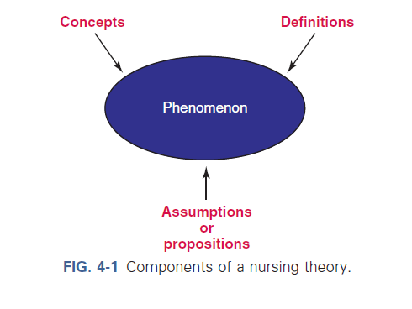

Slide 8
THEORY
A theory contains a set of concepts, definitions, and assumptions or propositions that explain a phenomenon.

Slide 9
NURSING THEORY
A nursing theory is a conceptualization of some aspect of nursing that describes, explains, predicts, or prescribes nursing care

Slide 10
PHENEMENON
A phenomenon is the term, description, or label given to describe an idea or responses about an event, a situation, a process, a group of events, or a group of situations

Slide 11
ASSUMPTIONS
Assumptions are the “taken-for-granted” statements that explain the nature of the concepts, definitions, purpose, relationships, and structure of a theory

Slide 12
TYPES OF THEORIES
Grand theories are systematic and broad in scope, complex, and therefore require further specification through research.
A grand theory does not provide guidance for specific nursing interventions; but it provides the structural framework for broad, abstract ideas about nursing.

Slide 13
Middle-range theories are more limited in scope and less abstract. They address a specific phenomenon and reflect practice

Slide 14
Descriptive theories are the first level of theory development.
They describe phenomena, speculate on why they occur, and
describe their consequences. These theories explain, relate, and in
some situations predict nursing phenomena

Slide 15
Prescriptive theories address nursing interventions for a phenomenon, describe the conditions under which the prescription (i.e., nursing interventions) occurs, and predict the consequences

Slide 16
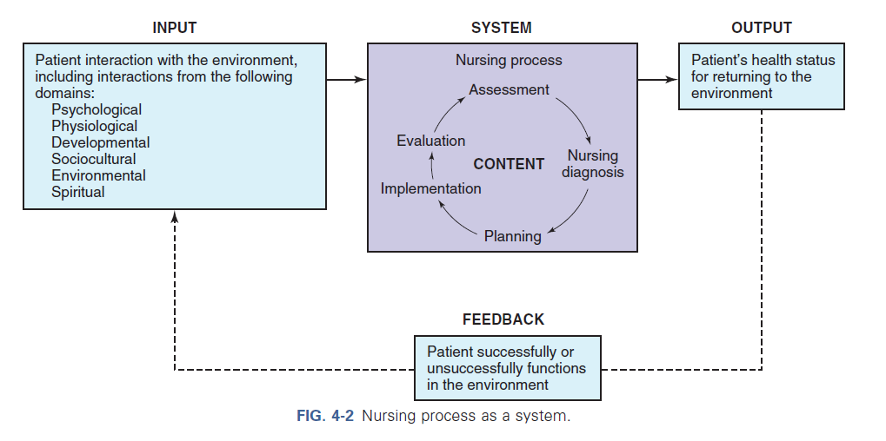

Slide 17
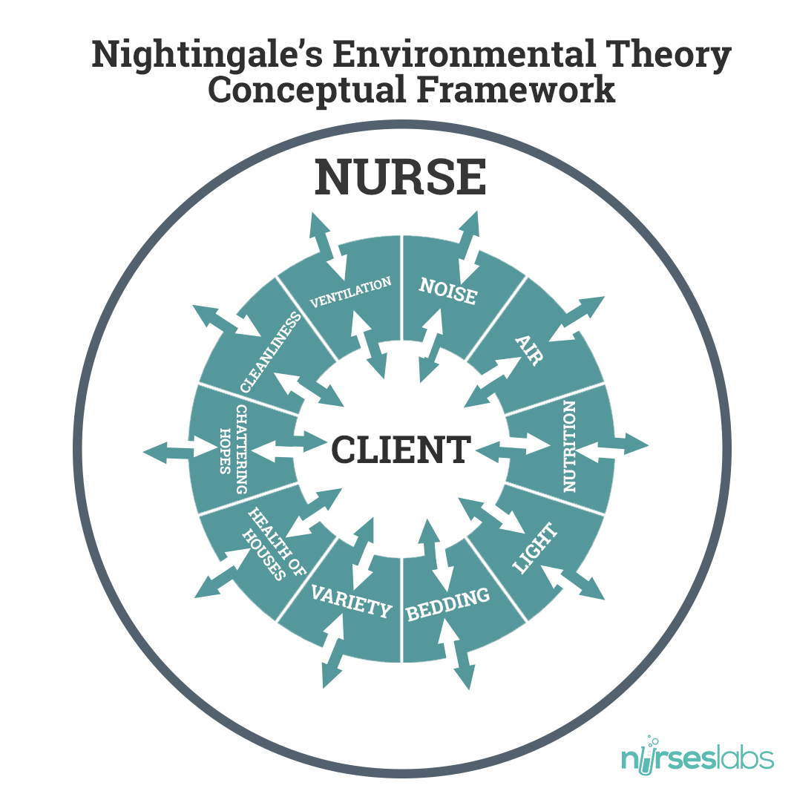
Florence Nightingale’s theory

Slide 18
The Environmental Theory by Florence Nightingale defined Nursing as “the act of utilizing the environment of the patient to assist him in his recovery.” It involves the nurse’s initiative to configure environmental settings appropriate for the gradual restoration of the patient’s health, and that external factors associated with the patient’s surroundings affect life or biologic and physiologic processes, and his development.

Slide 20
KEY CONCEPTS
Nightingale 1860:
To facilitate “the body’s reparative processes” by manipulating client’s environment
Peplau 1952:
Nursing is; therapeutic interpersonal process.
Henderson 1955:
The needs often called Henderson’s 14 basic needs

Slide 21
Abdellah 1960:
delivering nursing care for the whole person to meet the physical, emotional, intellectual, social, and spiritual needs of the client and family.
Orlando 1962:
the client is an individual; with a need; that, when met, diminishes distress, increases adequacy, or enhances well-being.
Johnson’s Theory 1968:
focuses on how the client adapts to illness and how actual or potential stress can affect the ability to adapt. The goal of nursing to reduce stress so that; the client can move more easily through recovery.

Slide 22
Rogers 1970:
maintain and promote health, prevent illness, and care for and rehabilitate ill and disabled client through “humanistic science of nursing”
Orem1971:
self-care deficit theory. Nursing care becomes necessary when client is unable to fulfill biological, psychological, developmental, or social needs.
King 1971:
use communication to help client reestablish positive adaptation to environment.

Slide 23
Neuman 1972:
Stress reduction is goal of system model of nursing practice
Roy 1979:
This adaptation model is based on the physiological, psychological, sociological and dependence-independence adaptive modes.
Watson’s Theory 1979:
defines the outcome of nursing activity in regard to the; humanistic aspects of life.

Slide 24
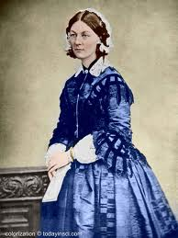
FLORENCE NIGHTINGALE
MODERN NURSING and ENVIRONMENTAL THEORY
Nursing “is an act of utilizing the environment of the patient to assist him in his recovery.”

Slide 25

ENVIRONMENTAL
THEORY

Slide 26
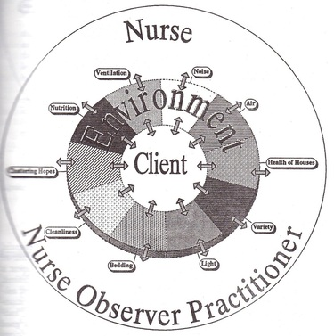

Slide 27
Ventilation and warming
Light and noise
Health of houses
Bed and bedding
Personal cleanliness
Variety
Chattering hope and advices
Food

Slide 28

VENTILATION AND WARMING
“ Keep the air he breathes as pure as the external air, without chilling him.”
Recognized this environmental component as a source of disease and recovery.

Slide 29
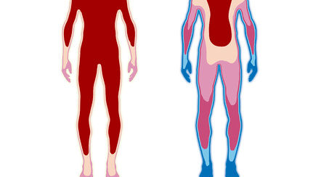
Provided description for measuring the patient’s body temperature through palpation of extremities.
Nurses were instructed to manipulate the environment to maintain both ventilation and patient warm by good fire, opening windows and properly positioning the patient in the room.

Slide 30

LIGHT
“Light has quite as real and tangible effects upon the human body…who has not observed the purifying effect of light, and especially of direct sunlight, upon the air of the room?”

Slide 31
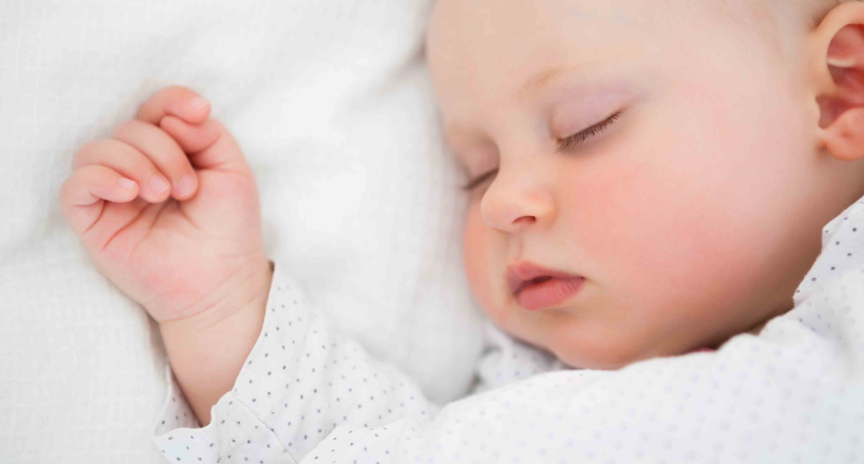
NOISE
Noises created by physical activities in the environment (room) was to be avoided by the nurse.

Slide 32
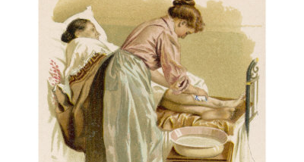
CLEANLINESS
Bathing of patients on a frequent, even daily, basis.
Nurses should wash their hands regularly.

Slide 33
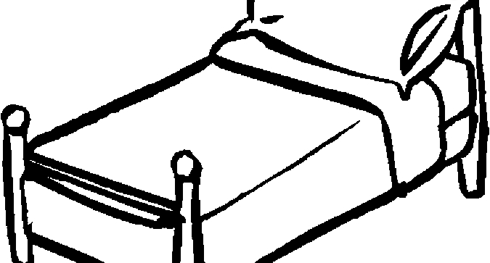
BED AND BEDDINGS
Noted that a dirty environment (floors, carpets, walls and bed linens) was a source of infection through the organic matter it contained.
The appropriate handling and disposal of bodily excretions and sewage was required to prevent contamination of the environment.

Slide 34
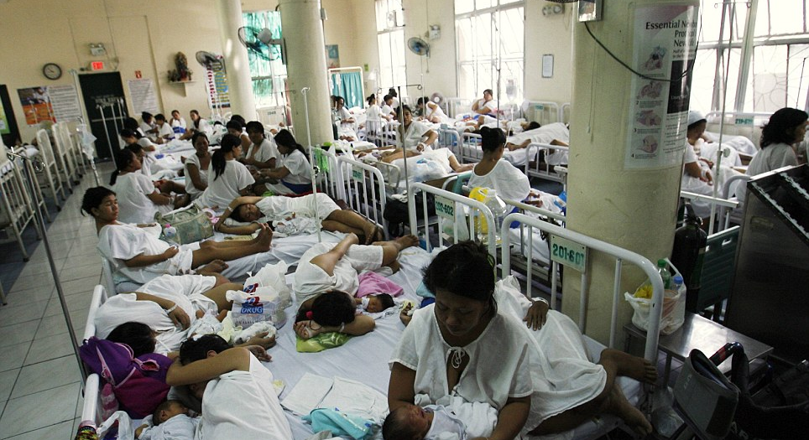
HEALTH OF HOUSES
“Badly constructed houses do for the healthy what badly constructed hospitals do for the sick.”

Slide 35

VARIETY
“To any but an old nurse, or an old patient, the degree would be quite inconceivable to which the nerves of the sick suffer from seeing the same walls, the same ceiling, the same surroundings during a long confinement to one or two rooms”

Slide 36

FOOD
Instructed nurses to assess dietary intake , meal schedules and its effect on the patient.

Slide 37

Chattering of Hope and Advices
Protects patient from receiving upsetting new, seeing visitors who can affect the patient’s recovery negatively and from suddenly receiving disruptions from sleep.

Slide 38
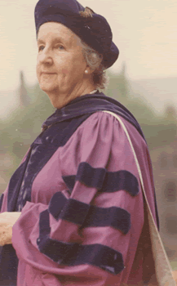
VIRGINIA HENDERSON
THE PRINCIPLES AND PRACTICE OF NURSING
“I believe that the function the nurse performs is primarily an independent one – that of acting for the patient when he lacks knowledge , physical strength, or the will to act for himself as he would ordinarily act in health, or in carrying out prescribed therapy. This function is seen as complex and creative, as offering unlimited opportunity for the application of the physical, biological, and social sciences and the development of skills based on them.” (Henderson, 1960)

Slide 39
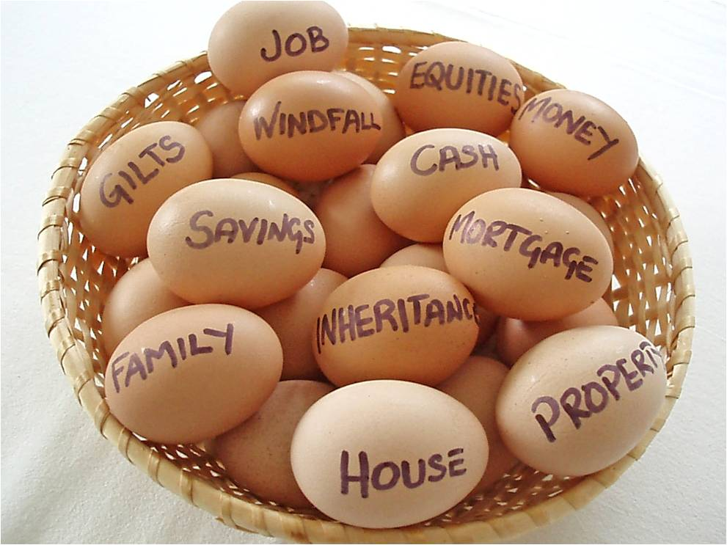
NURSING NEED THEORY

Slide 40
14 Activities for Client Assistance
Physiological
Psychological Aspects of Communicating and Learning
Spiritual and Moral
Sociologically Oriented to Occupation and Recreation

Slide 41
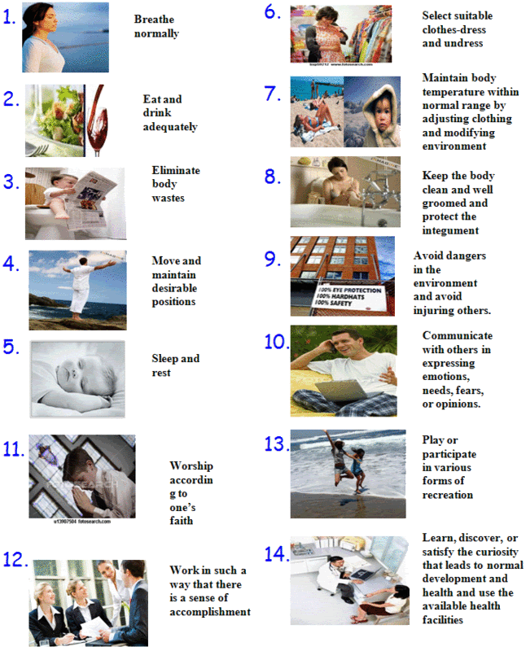

Slide 42
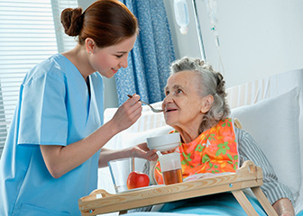
THE NURSE-PATIENT RELATIONSHIP
Three Levels of Relationship:
  Nurse as a substitute for the patient
  Nurse as a helper to the patient
  Nurse as a partner with the patient
“The nurse is a substitute for what the patient lacks to make him ‘complete’, ‘whole’, or ‘independent’, by the lack of physical strength, will or knowledge”

Slide 43
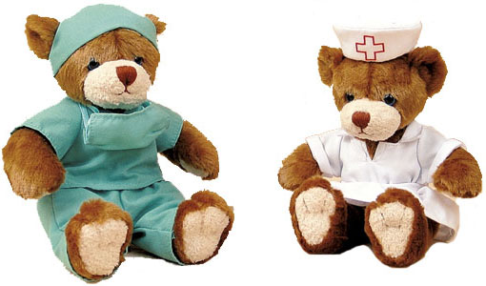
NURSE-PHYSICIAN RELATIONSHIP
Unique distinction from the Physician’s function
– the CARE PLAN
Nursing Care Plan – promotes the physician’s therapeutic plan.

Slide 44
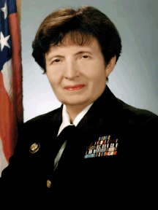
FAY ABDELLAH
PATIENT-CENTERED APPROACHES TO NURSING
"Nursing is based on an art and science that moulds the attitudes, intellectual competencies, and technical skills of the individual nurse into the desire and ability to help people, sick or well, cope with their health needs."

Slide 45
21 Nursing Problems
1. To maintain good hygiene and physical comfort.
2. To promote optimal activity: exercise, rest, and sleep.
3. To promote safety through the prevention of accidents, injury, or other trauma and through the prevention of the spread of infection.

Slide 46
4. To maintain good body mechanics and prevent and correct deformities.
5. To facilitate the maintenance of a supply of oxygen to all body cells.
6. To facilitate the maintenance of nutrition of all body cells.
7. To facilitate the maintenance of elimination.

Slide 47
8. To facilitate the maintenance of fluid and electrolyte balance.
9. To recognize the physiological responses of the body to disease conditions – pathological, physiological, and compensatory.
10. To facilitate the maintenance of regulatory mechanisms and functions.
11. To facilitate the maintenance of sensory functions.

Slide 48
12. To identify and accept positive and negative expressions, feelings, and reactions.
13. To identify and accept the interrelatedness of emotions and organic illness.
14. To facilitate the maintenance of effective verbal and nonverbal communication.
15. To promote the development of productive interpersonal relationships.

Slide 49
16. To facilitate progress toward achievement of personal spiritual goals.
17. To create and/or maintain a therapeutic environment.
18. To facilitate awareness of self as an individual with varying physical, emotional, and developmental needs.

Slide 50
19. To accept the optimum possible goals in the light of limitations, physical and emotional.
20. To use community resources as an aid in resolving problems arising from illness.
21. To understand the role of social problems as influencing factors in the case of illness.

Slide 51
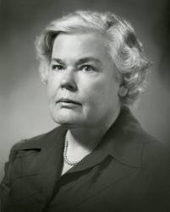
DOROTHEA OREM
OREM’S MODEL OF NURSING

Slide 52
THEORY OF SELF-CARE
Self-care is the performance or practice of activities that individuals initiate and perform on their own behalf to maintain life, health and well-being.
Self-care agency is the human’s ability or power to engage in self-care and is affected by basic conditioning factors.

Slide 53
Basic conditioning factors:
  age
  Gender
  Developmental state
  Health state,
  Socio-cultural orientation
  Health care system factors
  Family system factors
  Patterns of living
  Environmental factors
  Resource adequacy and availability.

Slide 54
Therapeutic Self-care Demand is the totality of “self-care actions to be performed for some duration in order to meet known self-care requisites by using valid methods and related sets of actions and operations.”
Self-care Deficit delineates when nursing is needed. Nursing is required when an adult (or in the case of a dependent, the parent or guardian) is incapable of or limited in the provision of continuous effective self-care.

Slide 55
Nursing Agency is a complex property or attribute of people educated and trained as nurses that enables them to act, to know, and to help others meet their therapeutic self-care demands by exercising or developing their own self-care agency.
Nursing System is the product of a series of relations between the persons: legitimate nurse and legitimate client. This system is activated when the client’s therapeutic self-care demand exceeds available self-care agency, leading to the need for nursing.

Slide 56
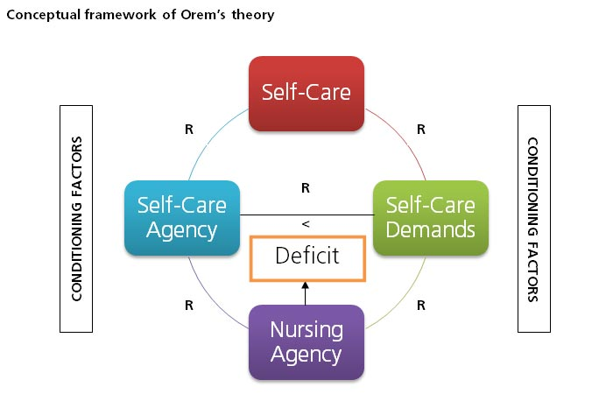

Slide 57
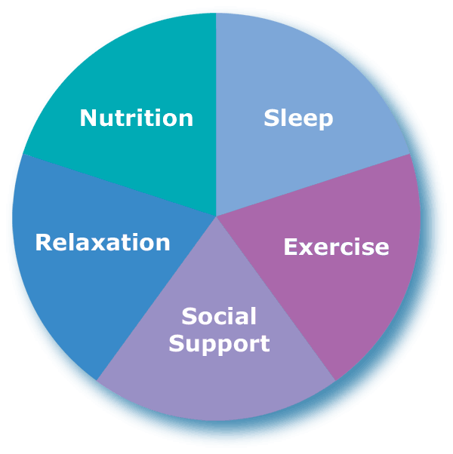
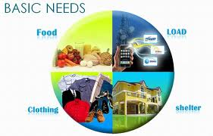
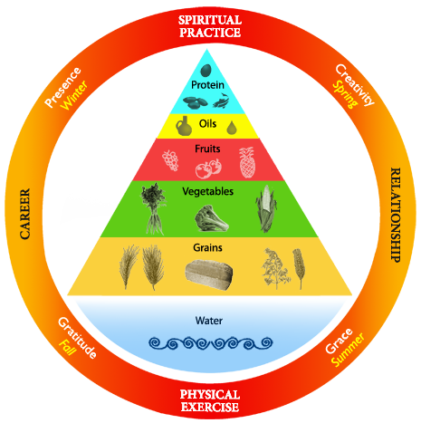
SELF-CARE REQUISITES or requirements can be defined as actions directed toward the provision of self-care.
  Universal self-care requisites
  Developmental self-care requisites
  Health deviation self-care requisites

Slide 58
Universal self-care requisites are associated with life processes and the maintenance of the integrity of human structure and functioning.
  1. The maintenance of a sufficient intake of air
  2. The maintenance of a sufficient intake of water
  3. The maintenance of a sufficient intake of food
  4. The provision of care associated with elimination process and excrements

Slide 59
5. The maintenance of a balance between activity and rest
6. The maintenance of a balance between solitude and social interaction
7. The prevention of hazards to human life, human functioning, and human well-being
8. The promotion of human functioning and development within social groups in accord with human potential, known human limitations, and the human desire to be normal

Slide 60

Developmental self-care requisites are “either specialized expressions of universal self-care requisites that have been particularized for developmental processes or they are new requisites derived from a condition or associated with an event.”

Slide 61
Health deviation self-care requisites are required in conditions of illness, injury, or disease or may result from medical measures required to diagnose and correct the condition.
  1. Seeking and securing appropriate medical assistance
  2. Being aware of and attending to the effects and results of pathologic conditions and states
  3. Effectively carrying out medically prescribed diagnostic, therapeutic, and rehabilitative measures

Slide 62

4. Being aware of and attending to or regulating the discomforting or deleterious effects of prescribed medical measures
5. Modifying the self-concept (and self-image) in accepting oneself as being in a particular state of health and in need of specific forms of health care
6. Learning to live with the effects of pathologic conditions and states and the effects of medical diagnostic and treatment measures in a life-style that promotes continued personal development

Slide 63
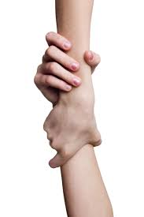
THEORY OF SELF-CARE DEFICIT
According to Orem, nursing is required when an adult is incapable or limited in the provision of continuous, effective self-care.
5 METHODS OF HELPING:
  Acting for and doing for others
  Guiding others
  Supporting another
  Providing an environment promoting personal development in relation to meet future demands
  Teaching another.

Slide 64
THEORY OF NURSING SYSTEMS
Describes how the patient's self-care needs will be met by the nurse, the patient, or by both.
Orem identifies three classifications of nursing system to meet the self-care requisites of the patient:
  wholly compensatory system
  partly compensatory system
  supportive-educative system.

Slide 65
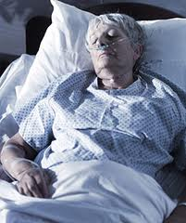
Wholly compensatory nursing system
  represented by a situation in which the individual is unable “to engage in those self-care actions requiring self-directed and controlled ambulation and manipulative movement or the medical prescription to refrain from such activity… Persons with these limitations are socially dependent on others for their continued existence and well-being.”

Slide 66
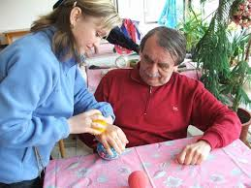
Partly compensatory nursing system
  represented by a situation in which “both nurse and patient perform care measures or other actions involving manipulative tasks or ambulation… [Either] the patient or the nurse may have the major role in the performance of care measures.”

Slide 67
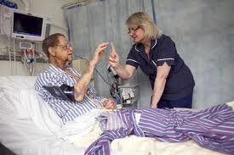
Supportive-educative system
  also known as supportive-developmental system, the person “is able to perform or can and should learn to perform required measures of externally or internally oriented therapeutic self-care but cannot do so without assistance.”

Slide 68
Abraham Maslow
Hierarchy of Needs
Physiologic Needs: breathing, food, water, sex, sleep, homeostasis, excretion.
Safety Needs: security of: body, employment, resources, morality, family, health, property.
Love and Belonging Needs: friendship, sexual intimacy, family
Esteem Needs: self-esteem, confidence, achievement, respect of others, respect by others
Self-actualization Needs: morality, creativity, spontaneity, problem solving, lack of prejudice, acceptance of facts.
Betty Neuman
She developed the Health Care Systems Model.

Slide 69
Dorothea Orem
Developed self-care, self-care deficit and nursing systems theory.
Dorothy Johnson
Conceptualized the Behavioral Systems Model.
Erik Erikson
Psychosocial development of man.
Trust vs Mistrust, Autonomy vs Shame & Doubt, Initiative vs Guilt, Industry vs Inferiority, Identity vs Role Confusion, Intimacy vs Isolation, Generativity vs Stagnation, Ego Integrity vs Despair.
Faye Abdellah
Defined nursing as a service to individuals and families, therefore to society.
Hildegard Peplau
Interpersonal model. Nursing is an interpersonal process of therapeutic interactions between the sick and the nurse
Ida Jean Orlando
Believed that nurses can help patients meet a perceived need that they cannot meet themselves.
Nursing Process theory.

Slide 70
Imogene King
Goal attainment theory
Jean Watson
Human Caring Model.
Nursing is the application of the art and human science through transpersonal caring.
Madeleine Leininger
Transcultural nursing.
Martha Rogers
Science of Unitary Human Beings.
Human beings are more than and different from the sum of their parts.
Sigmund Freud
Psychosexual theory and Psychoanalytic Theory
Sister Calista Roy
Adaptation model.
Virginia Henderson
Identified 14 basic needs.

