Slide 1


ABG
(Arterial Blood Gas) ANALYSIS
By-
Mrs. Gagan Sharma
Assistant professor
Department of Medical Surgical Nursing
Sumandeep Nursing College
2015-16

Slide 2


An arterial blood gas (ABG) is a blood test that is performed using blood from an artery.
It involves puncturing an artery with a thin needle and syringe and drawing a small volume of blood.
The most common puncture site is the radial artery at the wrist, but sometimes the femoral artery in the groin or other sites are used.

Slide 3

The blood can also be drawn from an arterial catheter.
Allen's test is first performed to ensure adequate collateral circulation because arterial puncture in rare cases leads to thrombosis and impaired perfusion of distal tissue.

Slide 4
Aids in establishing a diagnosis
Helps guide treatment plan
Aids in ventilator management
Improvement in acid/base management allows for optimal function of medications
Acid/base status may alter electrolyte levels critical to patient status/care

Slide 5
The arterial blood gas provides the following values:
pH
Measurement of acidity or alkalinity, based on the hydrogen (H+) ions present.
The normal range is 7.35 to 7.45
PaO₂
The partial pressure of oxygen that is dissolved in arterial blood.
The normal range is 80 to 100 mm Hg.

Slide 6
SaO₂
The arterial oxygen saturation.
The normal range is 95% to 100%.
PaCO₂
The amount of carbon dioxide dissolved in arterial blood.
The normal range is 35 to 45 mm Hg.
HCO₃
The calculated value of the
amount of

Slide 7
B.E. (Base Excess)
The base excess indicates the amount of excess or insufficient level of bicarbonate in the system.
The normal range is –2 to +2 mEq/liter.
(A negative base excess indicates a deficit in the blood.)
base

Slide 8









































Normal Blood Gas Values
 | Arterial | Venous | Capillary
pH | 7.35 - 7.45 | 7.31-7.41 | 7.35-7.45
pCO2 | 35 - 45 mm Hg | 40-50 | Same
pO2 | 75 - 100 mm Hg | 36-42 | < than arterial
HCO3 | 22-26 meQ/L | Same | Same
BE | -2 to +2 | Same | Same
Oxygen Saturation | >95% | 60-80 | < than arterial

Slide 9

Respiratory Acidosis
Alveolar hypoventilation
pH < 7.35 mm Hg
pCO₂ > 45 mm Hg

Slide 10
Causes: Respiratory Acidosis
↓ Respiratory drive
Obstruction
↓ pulmonary surface area
Drugs/trauma

Slide 11
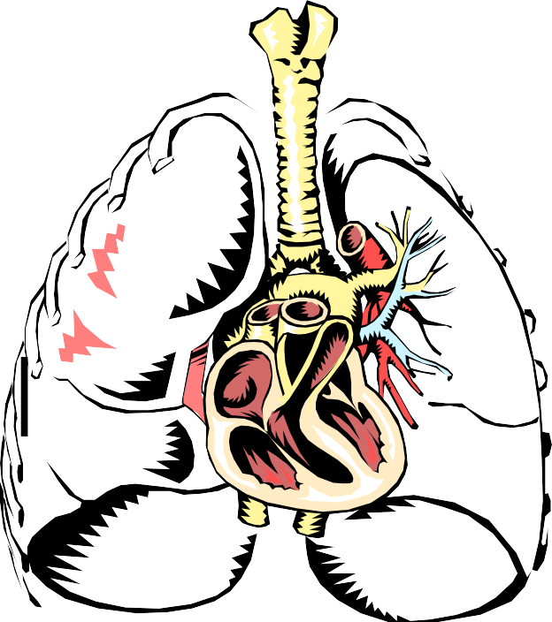
Clinical Signs: Respiratory Acidosis
Variable RR
Altered LOC
Restlessness
Tachycardia
Late signs:
  Cyanosis
  Loss of consciousness

Slide 12
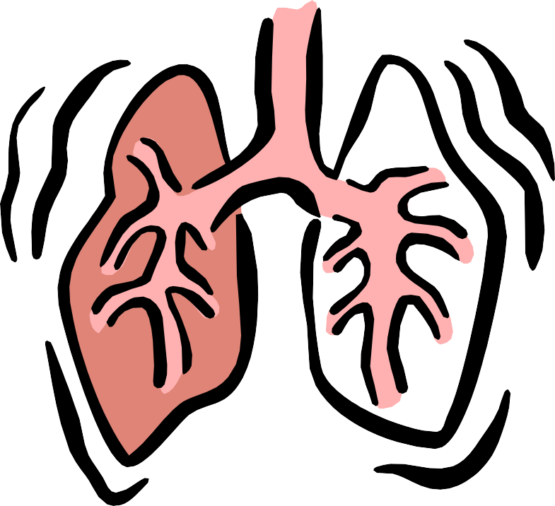
Treatment: Respiratory Acidosis
Improve ventilation
Removal of excess CO₂
Treatment of the underlying cause

Slide 13
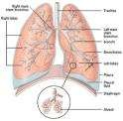
Respiratory Alkalosis
Alveolar hyperventilation
Hypocapnia
pH > 7.45 mmHg
pCO₂ < 35 mm Hg
acute vs. chronic

Slide 14

Causes: Respiratory Alkalosis
Increased respiratory drive
Hyperventilation
Hypoxia
Drugs

Slide 15
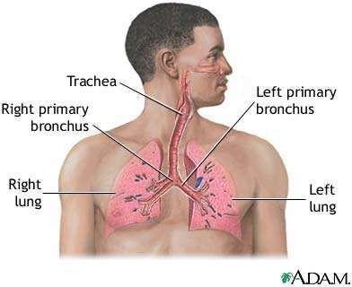
Clinical Signs: Respiratory Alkalosis
Tachypnea
Kussmaul respirations
Anxious
ECG changes
Altered LOC

Slide 16
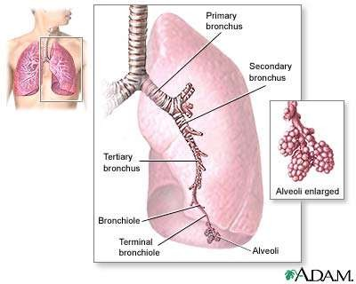
Treatment: Respiratory Alkalosis
Fix the cause
Oxygen therapy
Sedatives
“Brown paper bag” trick
  Rebreath CO2
Adjust vent settings:
  decrease tidal volume
  decrease IMV

Slide 17
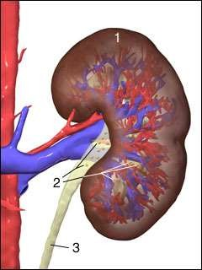
Metabolic Acidosis
pH < 7.35 mm Hg
HCO₃ < 22 mEq/L
results in CNS depression
– DKA

Slide 18
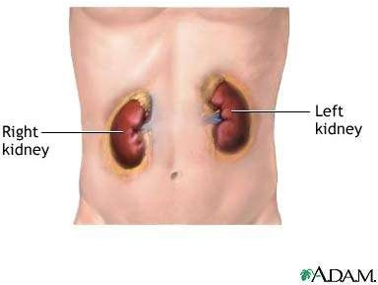
Causes: Metabolic Acidosis
Gain in acid
Loss of base (HCO3) from ECF
Lactic acidosis
Renal failure
Excessive GI losses
Drugs

Slide 19
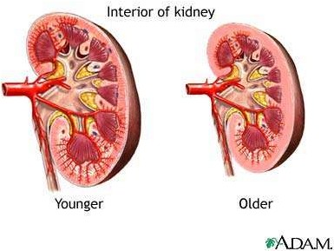
Clinical Signs: Metabolic Acidosis
Hyperventilation
Kussmaul’s respirations
Peripheral vasodilation
Hypotension
Altered LOC
± Hyperkalemia

Slide 20
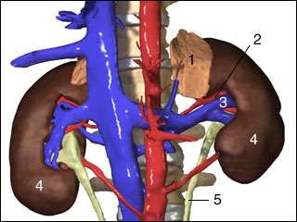
Treatment: Metabolic Acidosis
Treat respiratory symptoms
Replace bicarbonate
Correct potassium

Slide 21
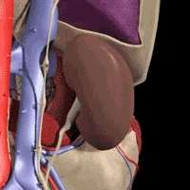
Metabolic Alkalosis
pH > 7.45 mm Hg
HCO₃ > 26 mEq/L

Slide 22
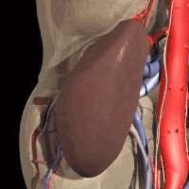
Causes: Metabolic Alkalosis
loss of acid
gain of base
combination of the two
GI losses
Drugs

Slide 23
Clinical Signs: Metabolic Alkalosis
Neuromuscular excitability
± hypoventilation
ECG changes
± hypotension
Anorexia, nausea, vomiting

Slide 24
Treatment: Metabolic Alkalosis
D/C thiazide diuretics (ie., Lasix)
D/C NG suctioning
Antiemetics
Give Diamox

Slide 25
5 Steps for Blood Gas Interpretation
Assess the oxygenation
  Is the patient hypoxic?
  Is there a significant alveolar-arterial gradient?
Determine status of the pH or H+ concentration’
  Alkalemia pH > 7.45
  Acidemia pH < 7.35
Determine respiratory component
  Alkalosis < 35 mmHg
  Acidosis > 45 mmHg
Determine metabolic component
  Acidosis < 22 mmol
  Alkalosis > 26 mmol
  Some clinicians prefer to use the Base Excess/Deficit +/-2 mmol
Combine all of the information and determine if it is primarily respiratory or metabolic related

Slide 26
1. A 42 year old IDDM developed nausea and vomiting for 2 days. He was unable to keep any food down so he stopped taking his insulin. Lab work shows the following:
pH 7.21, pCO2 26, HCO3 10
Na 133, Cl 88, K 5
Q. What is the acid-base disturbance?
METABOLIC ACIDOSIS

Slide 27
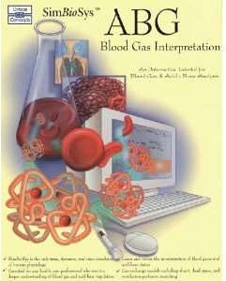
Problem 2
1 month old male presents with projectile emesis x 2 days.
– pH 7.49, pCO₂ 40, HCO3 30
– Na 140, Cl 92, K 2.9
Q. What is the acid-base disturbance?
METABOLIC ALKALOSIS

Slide 28
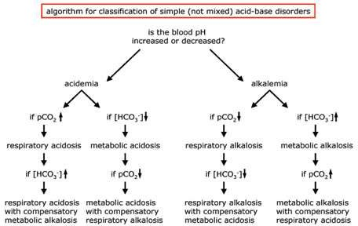

Slide 29
Blood Gas Summary
Blood gases can provide invaluable clinical information
We have to remember that these are static measurements
– May not reflect the changing physiologic status of the patient
Decision-making should be directed while keeping in mind the OVERALL condition of the patient
Blood gas analysis requires critical analysis and evaluation

Slide 30



