Slide 1
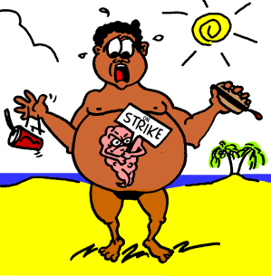
DIABETES MELLITUS
By-
Mrs.Gagan Sharma
Assistant professor
Department of Medical Surgical Nursing
Sumandeep Nursing College
2015-16

Slide 2
PANCREAS
Review of Anatomy and Physiology
HORMONES:
INSULIN BY BETA CELLS
GLUCAGON BY ALPHA CELLS

Slide 3
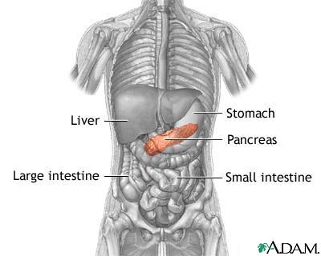
Pancreas secretes 40-50 units of insulin daily in two steps:
  Secreted at low levels during fasting ( basal insulin secretion)
  Increased levels after eating (prandial)
  An early burst of insulin occurs within 10 minutes of eating
  Then proceeds with increasing release as long as hyperglycemia is present

Slide 4
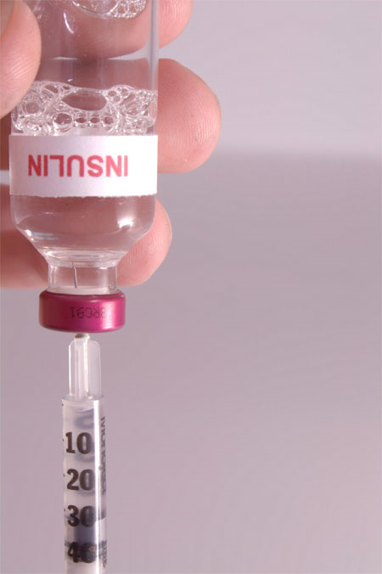
Insulin
Insulin allows glucose to move into cells to make energy
Inhibits glucagon activity

Slide 5
Insulin (normal values)
CPG | <200 mg/dL
FPG | <100 mg/dL
OGTT | <140 mg/dL
HbA1c | <5.7%

Slide 6

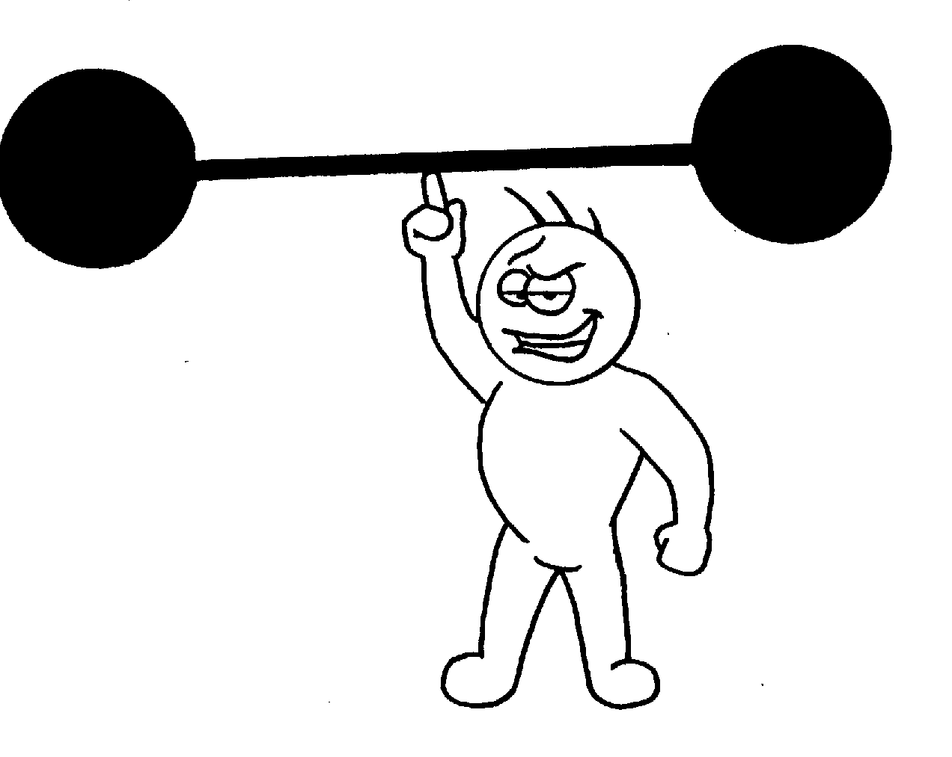
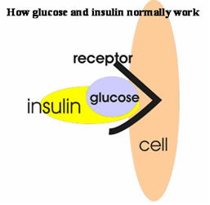
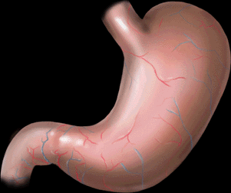
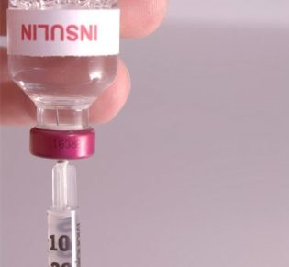
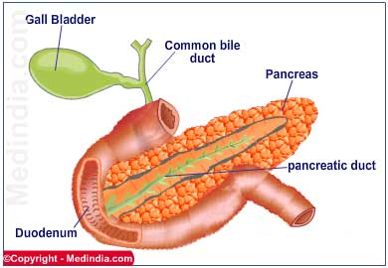
Physiology

Slide 7
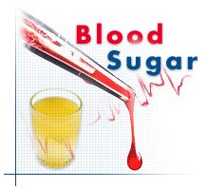
DIABETES MELLITUS
  is a chronic disorder of carbohydrate, protein, and fat metabolism resulting from insulin deficiency or abnormality in the use of insulin

Slide 8
Types
Type I
  formerly known as Insulin – Dependent Diabetes Mellitus (IDDM)
  Autoimmune (Islet cell antibodies)
    Early introduction of cow’s milk and cereals
    Intake of medicine during pregnancy
    Indoor smoking of family members
  destruction of beta cells of the pancreas  little or no insulin production
  requires daily insulin admin.
  may occur at any age, usually appears below age 15

Slide 9
2. Type II
  formerly known as Non Insulin–Dependent Diabetes Mellitus (NIDDM)
  probably caused by:
    disturbance in insulin reception in the cells
    ➲ number of insulin receptors
    loss of beta cell responsiveness to glucose leading to slow or  insulin release by the pancreas
  occurs over age 40 but can occur in children
  common in overweight or obese
  w/ some circulating insulin present, often do not require insulin

Slide 10
Pre-Diabetes
Impaired fasting glucose (IFG)
  FPG- 100-125mg/dL
Impaired glucose tolerance (IGT)
  OGTT 140-199mg/dL
HbA1c 5.7-6.4%

Slide 11
Who are at risk?
?

Slide 12
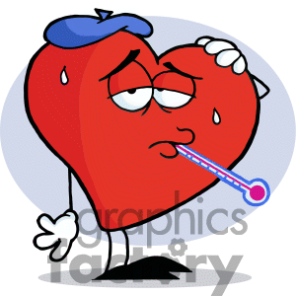



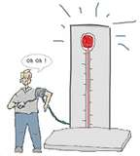
Risk Factors
Obesity
Race
History of CVD
HTN
Physical inactivity
Familial history
Polycystic Ovary Syndrome
Gestational Diabetes
?
?
?
?
?
?
?

Slide 13
Clinical Manifestations ( Signs and Symptoms)
- Polyuria - weakness
- Polydipsia - fatigue
- Polyphagia -  blood sugar / glucose level
- weight loss - (+) glucose in urine (glycosuria)
nausea / vomiting
- changes in LOC (severe hyperglycemia)
(sleepiness, drowsiness → coma)
- recurrent infection, prolonged wound healing
altered immune and inflammatory response, prone to
infection (glucose inhibits the phagocytic action of WBC 
resistance)
genital pruritus – (hyperglycemia and glycosuria favor fungal
growth : candidal infection – resulting in pruritus, common
presenting symptom in women)

Slide 14

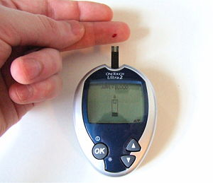
Diagnostics

Slide 15
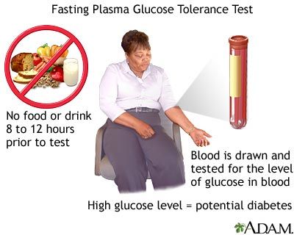
Fasting Plasma Glucose

Slide 16
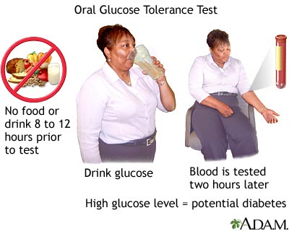
Oral Glucose Tolerance Test
(OGTT)

Slide 17
Glycoselated Hemoglobin (HbA1c)
HbA1c is a test that measures the amount of glycated hemoglobin in your blood. Glycated hemoglobin is a substance in red blood cells that is formed when blood sugar (glucose) attaches to hemoglobin.

Slide 18
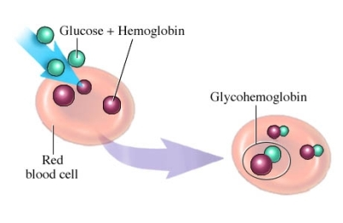
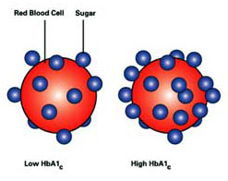
(HbA1c)

Slide 19
Glycoselated Hemoglobin (HbA1c)
Immediate past month | 50%
2nd month | 25%
3rd month | 15%
4th month | 10%

Slide 20
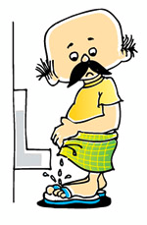
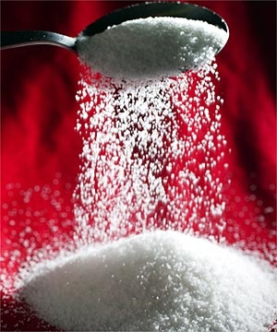
Urinalysis
Glycosuria
Ketone bodies

Slide 21

Diagnostic Criteria
Classic signs of HYPERGLYSEMIA with CPG ≥200mg/dL
OGTT ≥200mg/dL
FPG ≥126mg/dL
A1C ≥ 6.5%

Slide 22
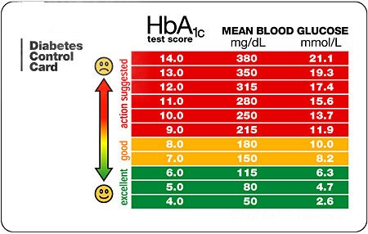

Slide 23
Interventions for Diabetes Mellitus
A.Dietary Management
  Follow individualized meal plan and snacks as scheduled
    Balanced diabetic diet – 50% CHO, 30% fats, 20% CHON, vitamins and minerals
    diet based on pts. size, wt., age, occupation and activity
  2. Pt. must have adequate CHO intake to correspond to the time when insulin is most effective
  Routine blood glucose testing before each meal and at bedtime is necessary during initial control, during illness and in unstable pts.
  Do not skip meals
  Measure foods accurately, do not estimate
  Less added fat, fewer fatty foods and low-cholesterol

Slide 24
Interventions for Diabetes Mellitus
A.Dietary Management
  Advise use of complex carbohydrates to help stabilize blood sugar. Meal should include more fiber and starch and fewer simple or refined sugars.
  Avoid concentrated sweets, high in sugar (jellies, jams, cakes, ice cream)
  If taking insulin, eat extra food before periods of vigorous exercise
  Avoid periods of fasting and feasting
  Keep weight at normal level, obese diabetics should be on a strict weight control program and should lose weight.

Slide 25
B. Teach pt. on correct administration of insulin and other hypoglycemic agents.
  insulin in current use may be stored at room temp., all others in ref. or cool area
  avoid injecting cold insulin  lead to tissue reaction
  roll insulin vial to mix, do not shake, remove air bubbles from syringe
  press (do not rub) the site after injection (rubbing may alter the rate of absorption of insulin)
  avoid smoking for 30 mins. after injection (cigarette smoking absorption)

Slide 26
  6. Rotate sites
  Failure to rotate sites may lead to Lipodystrophy
  Lipodystrophy – localized disturbance of fat metabolism
  Ex. Lipohypertrophy – thickening of subcutaneous tissue at injection site, feel lumpy or hard, spongy
     result to  absorption of insulin → making it difficult to control the pt.’s blood glucose

Slide 27
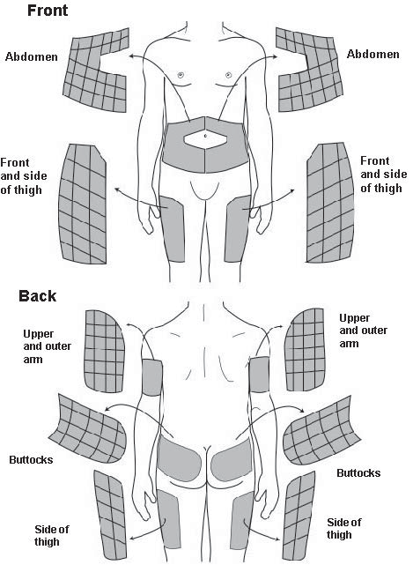
Insulin injection sites

Slide 28
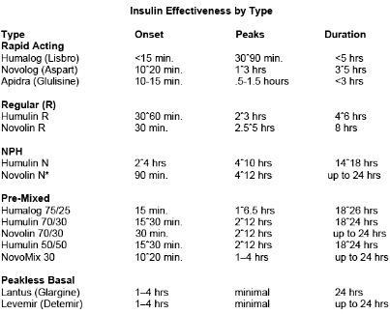

Slide 29
INSULIN | ROUTE
Ultra rapid acting Insulin analog/ Short- Acting (Humalog) | IV/SC | PRANDIAL/ SUPPLEMENTAL
Rapid acting: Regular (Semilente) | IV/SC | PRANDIAL/ SUPPLEMENTAL
Intermediate: NPH (Lente) | SC | BASAL
Long acting: Protamine Zinc (Ultralente) | SC | BASAL

Slide 30
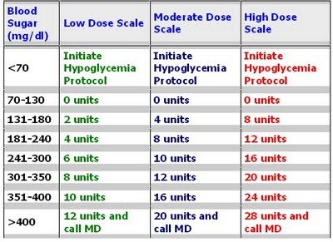
SLIDING SCALE

Slide 31
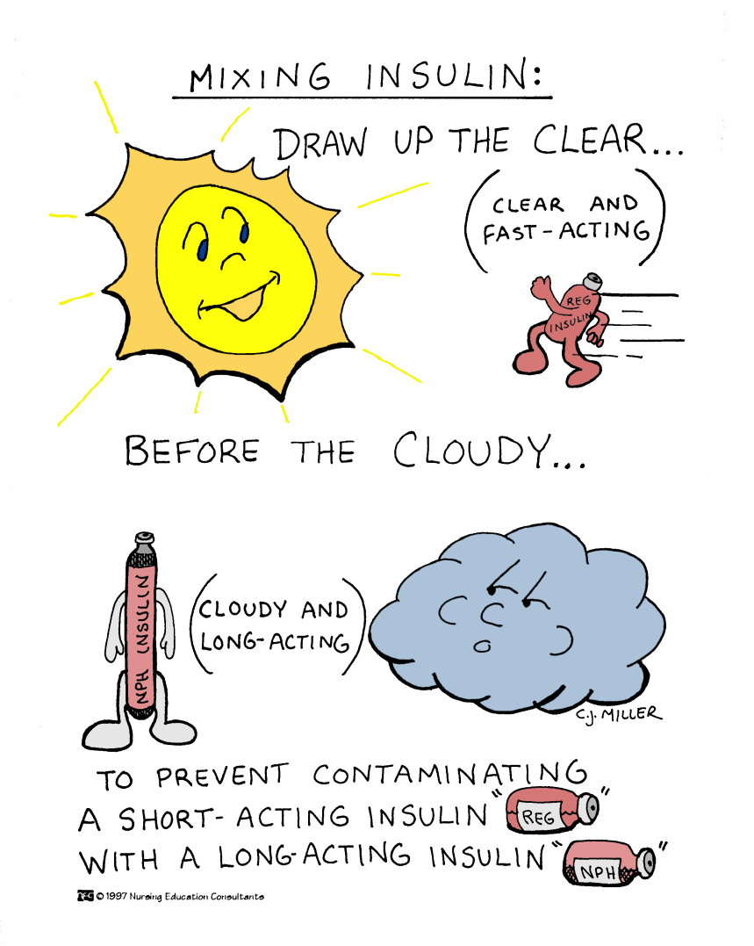

Slide 32
Factors that influence the body’s need for insulin
 need : trauma, infection, fever, severe psychological or physical stress, other illnesses
➲ need : active exercise

Slide 33
Hypoglycemia
  low blood glucose (usually below 60mg/dl)
  results from too much insulin, not enough food, and/or excessive physical activity
  may occur 1-3 hrs after regular insulin injection
S/Sx:
Sweating, tremor, pallor, tachycardia, palpitations and nervousness
  caused by release of epinephrine from the CNS when blood glucose falls rapidly
Headache, light-headedness, confusion, numbness of lips and tongue, slurred speech, drowsiness, convulsions and coma
  caused by depression of the CNS because of glucose supply of brain cells

Slide 34
Management of Hypoglycemia
Give simple sugar orally if pt. is conscious and can swallow – orange juice, candy, glucose tablets, lump of sugar
Give Glucagon (SQ or IM) if pt. is unconscious or cannot take sugar by mouth
As soon as pt. regains consciousness, he should be given carbohydrate by mouth
If pt. does not respond to the above measures, he is given 50 ml of 50% glucose I.V. or 1000 ml of 5%-10% glucose in water I.V.

Slide 35
ACUTE COMPLICATIONS OF DIABETES MILLETUS
DIABETIC KETO-ACIDOSIS (DKA)
INSULIN SHOCK
HYPERGLYCEMIC, HYPEROSMOLAR,
NONKETOTIC (HHONK) COMA
DAWN PHENOMENON
SOMOGYI EFFECT

Slide 36
D.K.A.
PATHOPHYSIOLOGY
NO INSULIN
OSMOTIC
DEHYDRATION
MARKED HYPERGLYCEMIA
LIPOLYSIS
GLUCOSURIA
CELLULAR
HUNGER
OSMOTIC
DIURESIS
WEIGHT
LOSS
KETOACIDOSIS
POLYPHAGIA
POLYURIA
POLYDIPSIA

Slide 37
D.K.A.
S/SX:
S/SX OF DM +
KETONURIA
METABOLIC ACIDOSIS
KUSSMAUL’S RESPIRATION
ACETONE BREATH
DHN
FLUSHED FACE
TACHYCARDIA
CIRCULATORY COLLAPSE COMA DEATH

Slide 38
D.K.A.
MANAGEMENT:
ADEQUATE VENTILATION
FLUID REPLACEMENT
INSULIN – RAPID ACTING
ECG – ELEC IMB

Slide 39
INSULIN SHOCK
LOW BLOOD SUGAR
CAUSE:
OVERDOSE OF EXOGENOUS INSULIN
EATING LESS
OVEREXERTION WITHOUT ADDITIONAL CALORIE INTAKE

Slide 40
INSULIN SHOCK
S/SX:
PARASYMPATHETIC
  HUNGER
  NAUSEA
  HYPOTENSION
  BRADYCARDIA
CEREBRAL
  LETHARGY,
  YAWNING
  SENSORIUM CHANGES
SYMPATHETIC
  IRRITABILITY
  SWEATING
  TREMBLING
  TACHYCARDIA
  PALLOR
CLINICAL FINDING :
BLOOD GLUCOSE BELOW 55-60 mg%

Slide 41
Preventing Hypoglycemic Reactions Due to Insulin
Instruct the pt. as follows:
Hypoglycemia may be prevented by maintaining regular exercise, diet and insulin
Early symptoms of hypoglycemia should by recognized and treated
Carry at all times some form of simple carbohydrate (orange juice, sugar, candy)
Extra food should be taken before unusual physical activity or prolonged periods of exercise
Between-meal and bedtime snacks may be necessary to maintain a normal glucose level.

Slide 42
Oral Antidiabetic Agents
Classification & Examples | Mechanism of Action
Sulfonylureas Tolbutamide (Orinase) Chlorpropamide (Diabinese) Glipizide (Glucatrol) Glimepiride (Amaryl) Glibenclamide | stimulate beta cells of the pancreas to secrete insulin improve binding bet. insulin and insulin receptors  no. of insulin receptors
Biguanides Metformin (Glucophage) |  body tissues’ sensitivity to insulin   glucose uptake inhibit glucose prod. by the liver
Alpha-Glucosidase Inhibitors Acarbose (Precose) Miglitol (Glyset) | delay absorption of glucose in the intestine
Thiazolidinediones Rosiglitazone (Avandia) Pioglitazone (Actos) | enhance insulin action at the receptor sites

Slide 43
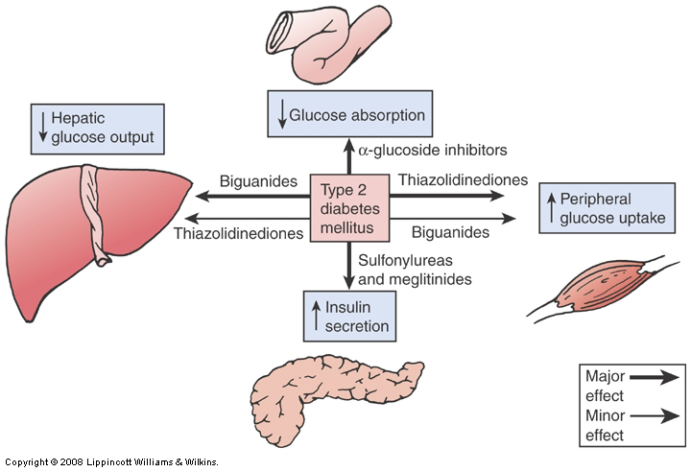
Oral Antidiabetic Agents

Slide 44
Teach pt. to estabilish and maintain a pattern of regular exercise
Benefits of exercise :
  promotes use of CHO & enhances action of insulin
  ➲ blood glucose levels
  ➲ need for insulin
   the no. of functioning receptor sites for insulin
perform exercise after meals to ensure an adequate level of blood glucose
carry a rapid-acting source of glucose during exercise
excessive or unplanned exercise may trigger hypoglycemia
take insulin and food before active exercise

Slide 45
Teach pt. to practice good personal hygiene and positive health promotion to avoid diabetic complications
teach pt. about diabetic foot care
teach pt. the adjustments that must be made in the event of minor illness (e.g. colds, flu)
  continue taking insulin or oral hypoglycemic agents
  maintain fluid intake
   frequency of blood testing or urine testing
help pt. identify stressful situations in lifestyle that might interfere with good diabetic control
encourage good daily hygiene
advise regular eye exams
teach aggressive care for minor skin cuts and abrasions

Slide 46
Hyperglycemic, Hyperosmolar, Non-Ketotic Coma (HHNC)
  can occur when the action of insulin is severely inhibited
  seen in pts. w/ NIDDM, elderly persons w/ NIDDM
Precipitating factors:
infection, renal failure, MI, CVA, GI hemorrhage, pancreatitis, CHF, TPN, surgery, dialysis, steroids
S/Sx:
polyuria  oliguria (renal insufficiency)
lethargy
temp, PR, BP, signs of severe fluid deficit
Confusion, seizure, coma
Blood glucose level > 600 mg/100 ml.

Slide 47
HHONK
PATHOPHYSIOLOGY
Very insufficient INSULIN
SEVERE
OSMOTIC
DEHYDRATION
MARKED HYPERGLYCEMIA
LIPOLYSIS
Without
KETOSIS
GLUCOSURIA
CELLULAR
HUNGER
OSMOTIC
DIURESIS
WEIGHT
LOSS
POLYPHAGIA
POLYURIA
POLYDIPSIA

Slide 48
Interventions for DKA and Hyperosmolar Coma
Regular insulin IV push or IV drip
0.9% NaCl IV – 1 L during the 1st hr, 2-8 L over 24 hrs.
administer sodium bicarbonate IV to correct acidosis
Monitor electrolyte levels, esp. serum K+ levels
administer K+, monitor UO hourly (30ml/hr)

Slide 49
SOMOGYI EFFECT
TOO MUCH INSULIN
HYPOGLYCEMIA
GLUCAGON IS RELEASED
REBOUND
HYPERGLYCEMIA
+
KETOSIS
LIPOLYSIS
GLUCONEOGENESIS
GLYCOGENOLYSIS

Slide 50
DAWN PHENOMENON
The "dawn effect," also called the "dawn phenomenon," is the term used to describe an abnormal early-morning increase in blood sugar (glucose) — usually between 2 a.m. and 8 a.m. in people with diabetes.

Slide 51
CHRONIC COMPLICATIONS OF DIABETES MILLETUS
DEGENERATIVE CHANGES IN THE VASCULAR SYSTEM
  UNDERNOURISHMENT
  ATHEROSCLEROSIS
NEUROPATHY FROM:
  VASCULAR INSUFFICIENCY
  HYPERGLYCEMIA
EYE COMPLICATIONS FROM ANOXIA
  CATARACT
  DIABETIC RETINOPATHY
  RETINAL DETACHMENT

Slide 52
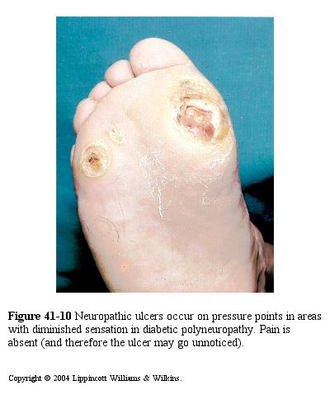

Slide 53
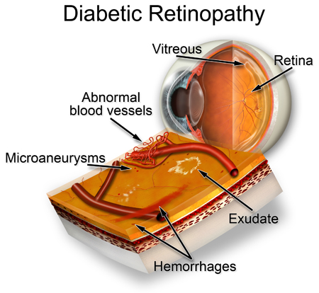
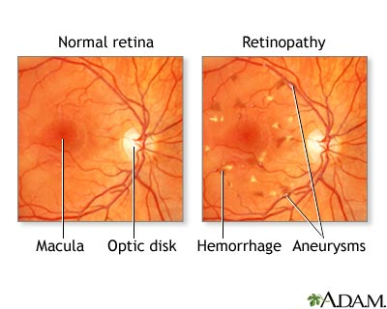

Slide 54
CHRONIC COMPLICATIONS OF DIABETES MILLETUS
NEPHROPATHY
  DAMAGE & OBLITERATION OF CAPILLARIES SUPPLYING THE KIDNEY
HEART DISEASE
  MI FROM ATHEROSCLEROSIS
SKIN CHANGES
  DIABETIC DERMOPATHY – HYPERPIGMENTED & SCALY PRETIBIAL AREAS (Acanthosis Nigricans)
LIVER CHANGES
  ENLARGEMENT & FATTY INFILTRATION

Slide 55
Diabetes Mellitus
Nursing Process
Assessment – Medicines, Allergies, Symptoms, Family Hx
Nursing Diagnosis- Anxiety and Fear, Altered Nutrition, Pain, Fluid Volume Deficit
Planning – Address the nursing diagnosis
Implementation – Prevent complications, monitor blood sugars, administer meds and diet, teach diet and meds, Asess , Assess, Assess
Evaluation- Goals, EOC’s
Notes:
New research – growth hormone, ACTH, epinephrine, glucagon cortisol – look up

Slide 56
Risk for Injury Related to Sensory Alterations
Interventions and foot care practices:
  Cleanse and inspect the feet daily.
  Wear properly fitting shoes.
  Avoid walking barefoot.
  Trim toenails properly.
  Report nonhealing breaks in the skin.

Slide 57
Risk for Impaired Skin Integrity
Wound Care
Wound environment
Debridement
Elimination of pressure on infected area
Growth factors applied to wounds
Notes:
S&P

Slide 58
Chronic Pain
Interventions include:
  Maintenance of normal blood glucose levels
  Analgesics
  Capsaicin cream

Slide 59
Risk for Injury Related to Disturbed Sensory Perception: Visual
Interventions include:
  Blood glucose control
  Environmental management
    Incandescent lamp
    Coding objects
    Syringes with magnifiers
    Use of adaptive devices

Slide 60
Ineffective Tissue Perfusion: Renal
Interventions include:
  Control of blood glucose levels
  Yearly evaluation of kidney function
  Control of blood pressure levels
  Prompt treatment of UTIs
  Avoidance of nephrotoxic drugs
  Diet therapy
  Fluid and electrolyte management

Slide 61

Health Teaching
Assessing learning needs
Assessing physical, cognitive, and emotional limitations
Explaining survival skills
Counseling
Psychosocial preparation
Home care management
Health care resources

Slide 62

Diabetes Mellitus
Summary
Treatable, but not curable.
Preventable in obesity, adult client.
Controllable- DIET and EXERCISE
Diagnostic Tests
Signs and symptoms of hypoglycemia and hyperglycemia.
Treatment of hypoglycemia and hyperglycemia – diet and oral hypoglycemics.
Nursing implications – monitoring, teaching and assessing for complications.

Slide 63
Any Questions???

Slide 64
Case Analysis:
CPG | Humulin R
<140 | -
140-160 mg/dL | 2 “U”
161-180 mg/dL | 4 “U”
181-200 mg/dL | 6 “U”
201-220 mg/dL | 8 “U”
240-260 mg/dL | 10 “U”
Betty, 45y/o, a known Type 2 diabetic patient was admitted for debridement of infected wound at her right foot. She is on maintenance Lantus 6 “u” OD. Her AP then still provided a sliding scale for her prandial insulin and additional Humalog 2 “u” supplemental insulin.

Slide 65
Betty’s surgery is scheduled at 4pm. She is then placed in NPO for 8H in preparation for surgery. Betty’s CPG at 8am is 130 mg/dL.
Should the nurse administer
  Lantus?
  Humulin R?
  Humalog?

Slide 66

“Of course too much is bad for you”

