Slide 1


Mr. Ravindra H.N.
Professor & Principal
Dept of Medical Surgical Nursing
Sumandeep Nursing College
HEALTH INFORMATICS

Slide 2
OVERVIEW OF TOPIC
Records & reports
Telemedicine
Tele nursing
Electronic health records

Slide 3
RECORDS
All professional persons need to be accountable for the performance of their duties to the public. Since nursing has been considered as profession, nurses need to record their work on completion.

Slide 4
A record is a clinical, scientific, administrative and legal document relating to the nursing care given to individual family or community
Health record refers to forms on which information about clients, i.e. socio-economic, psychological and environmental factors are maintained

Slide 5
DEFINITION:
A record is a permanent written communication that documents information relevant to a client’s health care management.
(B. T. Basavanthappa)

Slide 6
VALUES AND USES OF RECORDS
1.
2.
3.
4.
Records show the health condition of patients
short and long term planning
Helps the nurse organize her work
To judge the quality and quantity of work done

Slide 7
5.
6.
7.
8.
guide for diagnosis, treatment and evaluation of services.
Used in research
legal evidence of the services
Administrator assess the health assets and needs of the village or area.

Slide 8
TYPES OF RECORDS
1. Cumulative or continuing records
2.Family records
3.Departmental Records
Notes:
1. it is helpful to review the total history of an individual and evaluate the progress of a long period. (e.g.) child’s record should provide space for newborn,
, infant and preschool data.
The system of using one record for home and clinic services in which home visits are recorded in blue and clinic visit in red ink helps coordinate the services and saves the time.
2. The basic unit of service is the family. All records, which relate to members of family, should be placed in a single family folder. This gives the picture of the total services and helps to give effective, economic service to the family as a whole.
Separate record forms may be needed for different types of service such as TB, maternity etc. all such individual records which relate to members of one family should be placed in a single family folder.
3. The patient’s clinical record
Records of nurses’ observations- nurses’ notes
Records of orders carried out
Records of treatment
Records of admission and discharge
Records of equipment loss and replacement
Records of personal performance

Slide 9
RECORDS IN NURSING EDUCATION PROGRAMME
1. CONCERNING THE STUDENT
2. CONCERNING THE STAFF
3. RECORDS IN RHTC/FWTC
4. RECORDS IN PHC
5. RECORDS IN SUB-CENTER
6. RECORDS IN HOSPITALS
Notes:
Application form
Record of students clinical experience
Health record
Progress report
Cumulative record
Internal assessment register
2. Job description.
Records of staff members educational qualification, experience.
Leave record
Health record
Attendance register
Confidential records
3.

Slide 10
CARE OF RECORDS
The records are kept under safe custody of nurse in each ward
No individual sheet is separated from complete record
Records are kept in a place, not accessible to the clients and visitors
No stranger is ever permitted to read the records
Records are not hand over to legal advisors without the written permission of administration
All records are to be handled carefully

Slide 11




FILLING OF RECORDS
1
2
3
4
ALPHABATECALLY
NEUMERICAL
INDEX NUMBER
GEOGRAPHICALLY
Notes:
Different systems may be adopted depending on the purposes of the records and on the merits of a system. The records could be arranged

Slide 12
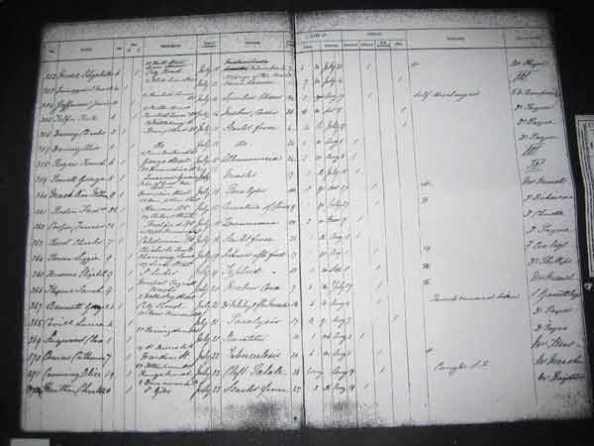
REGISTERS
It provides indication of the total volume of service and type of cases seen.
varied types such as immunization register, clinic attendance register, family planning register, birth register and death register.

Slide 13
IMPORTANCE OF RECORDS IN HOSPITAL OR HEALTH CENTRES
A medical record should furnish all health care providers with concise, accurate, written picture of patients medical and nursing problems, care planned and given, and the patient’s response to treatments.

Slide 14
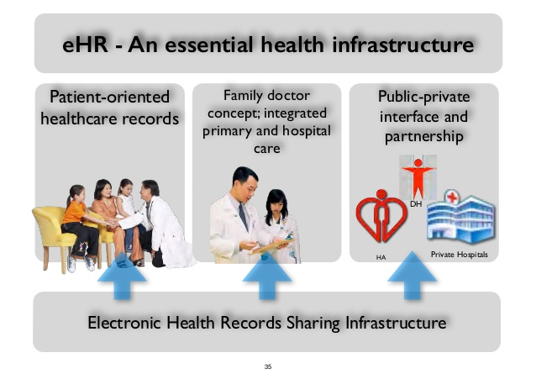
ADVANTAGES OF RECORD
1.For the individual and family:-
2. For the Doctor:-
3. For the Nurse:-
4. For Authority:-
Notes:
1. Records serve to document the history of the client.
Records assist in continuity of care.
Record serves as an evidence to support the legal questions that arise.
Records serves to recognize the health needs and can be used as a research and teaching tools
2. Records serve as guide for diagnosis, treatment, follow-up and evaluation of services.
It indicates progress and continuity of care.
It helps self-evaluation of medical practice.
It protects the doctor in case of legal issues.
It may be used for teaching and research.
3. The records provides with documentation of services rendered, i.e. shows health condition of the client.
Records provide data essential for planning and evaluation of services for further improvement.
It serves as a guide for professional growth.
It enables to judge the quality and quantity of work done.
It serves as communication tool between the staff and other members involved in care.
It indicates plan for the future.
4. Records provides management with statistical information necessary for decision in regard to utilization of resources, planning for administrative control and future references.
Records furnish documentary evidence for proposal of evaluation of care in terms of quality, quantity and adequacy.
The records help the supervisor evaluate the services rendered, teaching done and a person’s action and reactions.
It helps the administrator assess the health assets and the need of the community.
It protects the organization in the event of legal questions.

Slide 15

reports

Slide 16

INTRODUCTION
Reports can be compiled daily, weekly, monthly, quarterly and annually. Report summarizes the services of the nurse and/ or the agency. Reports may be in the form of an analysis of some aspect of a service.

Slide 17
DEFINITION
Reports are oral or written exchanges of information shared between caregivers or workers in a number of ways.
(B. T. Basavanthappa)
A report summarizes the services of the nurse, person or personnel and of the agency.
(S. Kamalam)

Slide 18
PURPOSES OF WRITING REPORTS
Quantity of service rendered over to a specific period.
reaching goals.
studying health conditions
aid in planning.

Slide 19
TYPES OF REPORTS
REPORTS
1.ORAL REPORTS
2.WRITTEN REPORTS
Notes:
Oral reports are given when the information is for immediate use and not for a permanency. Eg: - oral reports are made by the nurse who is assigned to patient care, to another nurse who is planning to relieve her and some of the oral reports may be made to charge nurses and nurse supervisors and also doctors.
Written Reports:- reports are to be written when the information is to be used by several personel, which is more or less of permanent value, Eg:- day and night reports, interdepartmental reports and other special reports, needed according to situation, event and conditions.

Slide 20
Reports used in hospital setting are as follows:
Change of shift reports
Transfer reports
Incident reports
Legal reports

Slide 21
NURSES RESPONSIBILITIES FOR RECORD KEEPING AND REPORTING.
How to keep good records:
Use a standardized form
Ensure the record begins with an identification sheet
Date and sign each entry
Write in dark ink (preferably black ink), never in pencil
Notes:
Ensure a supply of continuation sheets is available.
Date and sign each entry, giving your full name. Give the time, using the 24-hour clock system. For example, write 14:00 instead of 2 pm.
Write in dark ink (preferably black ink), never in pencil, and keep records out of direct sunlight. This will help to ensure they do not fade and cannot be erased.
State the diagnosis clearly, as well as any other problem the patient is currently experiencing.
Record all medication given to the patient and sign the prescription sheet.
Record all relevant observations in the patient’s nursing record, as well as on any charts, e.g., blood pressure charts or intraocular pressure phasing charts. File the charts in the medical notes when the patient is discharged.
Ensure that the consent form for surgery, signed clearly by the patient, is included in the patient’s records.
Include a nursing checklist to ensure the patient is prepared for any scheduled surgery.

Slide 22
Record all medication given to the patient
Record all relevant observations
Include a nursing checklist
Note all plans made for the patient’s discharge

Slide 23
Writing tips:
consecutive order,
Do not use jargon, meaningless phrases
Do not use an abbreviation
If you make an error, cross it out with one clear
line through it, and sign.
Notes:
the patient’s vision appears blurred” or “the patient’s vision appears to be improving”).

Slide 24
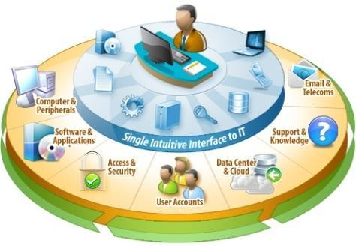
`
MANAGEMENT INFORMARTION SYSTEM
Notes:
The information is a product of an analysis of data. This concept is similar to a raw material and the finished product. What are needed are information and not a mass of data. However, the data can be analyzed in a number of ways, producing different shades and specifications of the information as a product. It was, therefore, demanded that the system concept be an individual- oriented, as each individual may have a different orientation

Slide 25
MIES
Management information system is a planned system of collecting, processing, storing and disseminating data in the form of information needed to carry out the functions of management
(Philip Kotler)
The MIS is defined as a system which provides information support for decision making in the organization.

Slide 26

TERMINOLOGIES
Information:-
Facts about situation, persons, and events are called as information.
MIS:
It is a formal system that provides timely and necessary information to the managers for making decisions.

Slide 27
Health information:
It is an integral part of the national health system. It is a basic tool of management and a key input for the progress of any society.

Slide 28
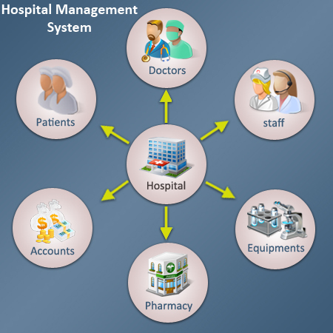
Hospital management information system (HMIS)
It is a part of MIS and a formal system that supplies timely and necessary health information to the health planners through surveillance for monitoring and making decisions in the area of health care delivery system.

Slide 29
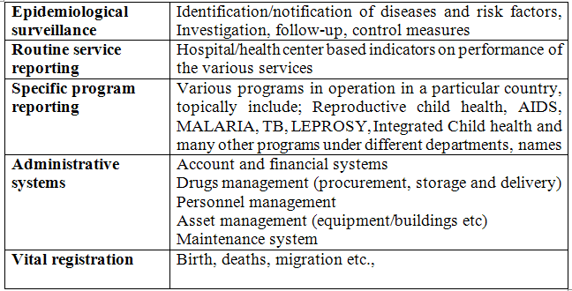

Slide 30
ORGANIZATIONAL ARRANGEMENTS FOR THE HMIS IN INDIA
A. Central level
1. Central Bureau Of Health Intelligence (CBHI)
2. Statistics Division in the Department Of Health and Family Welfare
3. The Sample Registration System (Srs)
B. State Level Organization
C. Organization at the District Level

Slide 31
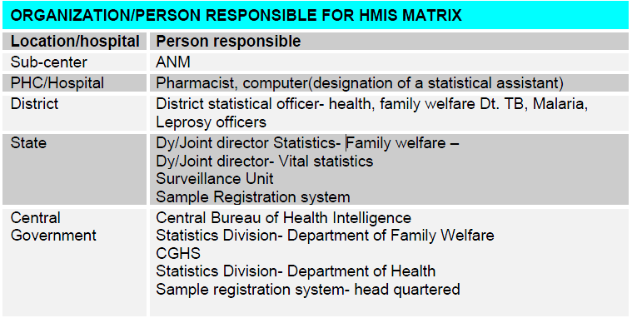

Slide 32
Types of Health Information Systems
Clinical (Hospital) Health Information Systems:
2.Routine Health Information Systems:
Notes:
1. They are typically large and complex hospital information systems that focus on patient specific data.
These sophisticated health information systems that are often large hospital systems have proven to be difficult to develop both in developed and developing countries.
About three quarters of these systems have failed.
2. Information that is derived at regular intervals of a year or less through mechanisms designed to meet predictable information needs
Examples:
Health service statistics for routine services reporting and special program reporting
(malaria, TB, and HIV/AIDS)
Administrative data (revenue and costs, drugs, personnel, training, research, and documentation)
Epidemiological and surveillance data
Data on community-based health actions
Data on vital events (births, deaths and migrations).
An important strength of routine HISs is that decision makers and managers at all levels of the health system have direct access to data.
Useful in health planning and management.
Empowers practitioners and managers to identify problems as they arise and solve them.

Slide 33
CONSTITUTES OF HIS
Primary Health Care Information Systems
Hospital Information Systems
Public Health Information Systems
Other information systems that are connected to HIS: Health insurance funds information systems
Notes:
1. Administration
• Patient care
• Research
• Quality control
• Medical education
2. ➢ Material Services
➢ Accumulate payments
➢ Recharge
➢ Budgeting
➢ General ledger
➢ Patient data/Billing/Account receivable
➢ Payroll
➢ Cost accounting

Slide 34
IMPORTANCE OF MIS
HIS is essential for strengthening the information management practices within the Primary Health Care (PHC) sector with the larger aim to improve processes concerning health care delivery for the rural community.
To develop capacity of the health staff to better deal with computers, health information systems, and health indicators and targets.
Notes:
It helps in maintaining patients and business information and it can be available at your fingertips.
It helps in improved health care delivery by providing medical personal with better data access.
Helps in improving efficiency both on cost and the clinical care.
It helps for the standardization of the patients records and procedures in the clinical area.
Helps as a good managerial tool for accurate patient care data.
It helps in gathering information to meet management challenges.
It helps to educate patients for diseases

Slide 35
FUNCTION OF HMIS
OPD, IPD and Investigation Cases
Receipts and Refunds
(CPR)
6
Patient registration
4
Patient Admission
2
Research
5
1
3

Slide 36
FUNCTIONS OF HMIS
Better documented work
Ward Allocation
Follow up of expenses
Reducing number of employees
9
7
10
8

