Slide 1


NURSING PROCESS APPROCH
NURSING PROCESS
APPROCH
Mr. Ravindra H.N.
Professor & Principal
Dept of Medical Surgical Nursing
Sumandeep Nursing College

Slide 2
INTRODUCTION
Nursing process is a systematic problem-solving approach used to identify, prevent and treat actual or potential health problems and promte wellness. A systematic way to plan, implement and evaluate care for individuals, families, groups, and communitie.

Slide 3
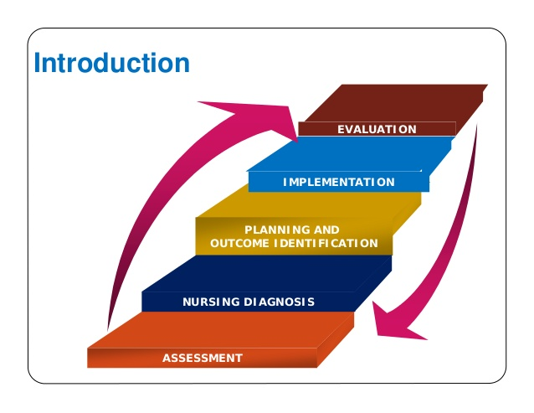
STEPS IN NURSING PROCESS

Slide 4
NURSING DIAGNOSIS & ANALYSIS OF DATA

Slide 5
DEFINITION
According to NANDA defines nursing diagnosis as “a clinical judgment about individuals or community responses to actual or potential health problems /life processes.

Slide 6
Steps in diagnostic process
1. Analyzing data
Compare data against standards
Cluster clues
2. Identify gaps & inconsistencies
3. Identifying health problems risk and strength
4. Making diagnostic statement

Slide 7
NSG DX VS MEDICAL DX
Within the scope Within the scope
of nursing practice of medical practice
Identify responses to focusing on curing
health and illness pathology
Can change from stays same as
day to day diseases is long term
present.

Slide 8
Types of nursing diagnosis
Actual nursing diagnosis
Risk nursing diagnosis
Wellness or Health promotion diagnosis
Syndrome nursing diagnosis

Slide 9
Actual Nursing diagnosis
This statement includes diagnostic label, related factors & defining characteristics.
e.g: Acute pain related to surgical trauma as evidence by pain scale.

Slide 10
Risk Nursing diagnosis
This statement includes diagnostic labels, risk factors.
e.g. Risk for infection related to surgery & immunosuppressant.

Slide 11
Possible risk factors
This statement includes diagnostic labels & risk factors (unknown).
e.g.: possible self esteem disturbance related to unknown etiology.

Slide 12
Syndrome nursing diagnosis
It is a diagnosis that is associated with a cluster of other diagnoses.
Example : Rape trauma syndrome

Slide 13
NANDA DOMAINS OF NURSING DIAGNOSIS
Health promotion
Nutrition
Elimination & exchange
Activity & rest
Perception/cognition
Self – perception
Role relationships
Sexuality
Coping / stress tolerance
Life principles
Safety / protection
Comfort
Growth & development

Slide 14

PLANNING
planning

Slide 15
Planning is the third phase of the nursing process refers to the development of nursing intervention to solve the client problems. The nursing plan of care is a written summary of the care that client as to receive.

Slide 16
PURPOSES OF PLANNING
Direct client care activities
Promote continuity care
Encourage for specific activities

Slide 17
Phases of planning
Setting priorities
Selecting nursing statergies & plan of care
Establising client goals /expected outcomes

Slide 18
Setting priorities
Priority setting is a process of establishing a preference order for nursing strategies. the nurse and client begins planning by deciding which nursing diagnosis requires attention first, which is second & so on.

Slide 19
Instead of rank diagnosis nurses can group them as having high , medium , & low priority.
Life threatening condition such as a loss of respiratory & cardiac problems designated as high priority e.g.: high risk for aspiration

Slide 20
Health threatening condition such as acute illness and decreased coping abilities may result in delayed development or cause physical & emotional changes they are designed medium priority. E.g.: impaired physical mobility.

Slide 21
A low priority problem is one that arises from normal development needs or that requires minimal nursing support.

Slide 22
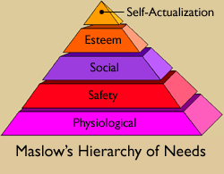
Prioritize list of client’s nursing diagnoses using Maslow
Rank as high, intermediate or low
Client specific
Priorities can change

Slide 23
ESTABLISHING CLIENT GOALS /OUTCOMES
After establishing priorities ,the nurse sets goals for each nursing diagnosis.
A goal is desired outcome or change in client behavior.
On a , care plan ,the goal describes in terms of observable client responses.

Slide 24
PURPOSES OF GOALS /EXPECTED OUTCOMES
Provide direction for planning nursing interventions that will desired changes in client .
Motivate the client & nurse by providing sense of achievement.
Provide time span for planned activities.

Slide 25
TYPES OF GOALS
LONG TERM GOALS
It requires more times weeks , months.
SHORT TERM GOALS
It meets relatively short time like some days

Slide 26
Components of goals/EO
Subject - Patient
Verb – an action the client is to perform
Conditions or modifiers
Criterion of desired performance

Slide 27
3.Nursing strategies
Criteria for choosing nursing strategies
Safe and appropriate for the individual‘s age, health, and so on.
Congruent with the client‘s values and beliefs.
Based on nursing knowledge and experience or knowledge from relevant sciences (based on rationale).
With in established standards of care as determined by state laws, professional associations, and the policies of the institution

Slide 28
Types of nursing strategies
Independent intervention
Dependent intervention
Collaborative interventions

Slide 29
1.INDEPENDENT INTERVENTIONS
physical care
ongoing assessment
emotional support and comfort
teaching
counselling
environmental management
making referrals to other health care professionals

Slide 30
2.Dependent Interventions: are those activities carried out under the physician‘s order or supervision, or according to specific routines
3.Collaborative Interventions: are actions the nurse carries out in collaboration with other health team members, such as physical therapists, social workers, dieticians, and physicians

Slide 31
IMPLIMENTATION

Slide 32
Implementation refers to the action phase of nursing process in which nursing care is provided .it is the actual initiation of plan & recording of nursing actions. its purpose is to provide to technical & therapeutic nursing care requires to help the client achive an optimal level of health.

Slide 33
Steps of implimentation
1.Reassesing
2.Setting priorities
3.Nursing activities
4.Recording nursing intervention

Slide 34
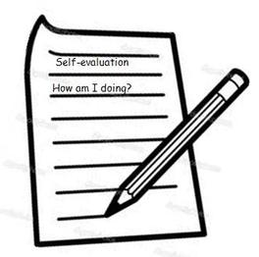
EVALUATION

Slide 35


Slide 36



Slide 37


