Slide 1
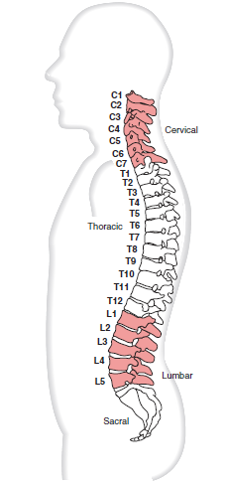
Spine
Dr. Purvi Patel

Slide 2
Introduction
33 vertebrae & 23 IV Discs.
  7 cervical
  12 thoracic
  5 lumbar
  5 of the vertebrae fuse to form sacrum
  4 constitute the coccygeal.

Slide 3
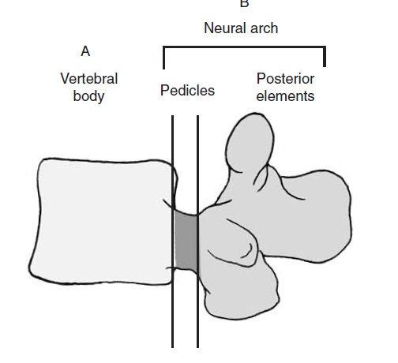
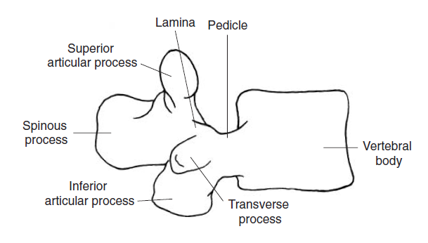
Structure of Vertebrae…
Typical vertebra-Anterior portion
-Posterior portion

Slide 4
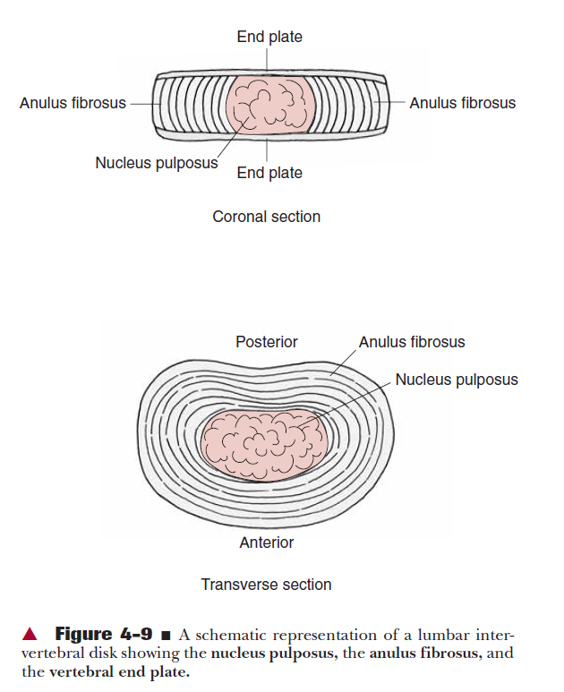
Intervertebral Disk
Function-
Thickness
Composed of 3 parts -Nucleus pulposus
-Annulus Fibrosis
-Vertebral end plates

Slide 5
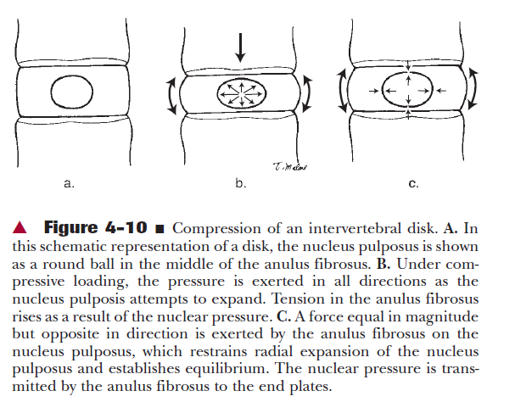

Slide 6
Ligaments
Anterior longitudinal lig
Posterior longitudinal ligament
Ligamentum flavum
Interspinous lig
Supraspinous lig
Intertransverse lig

Slide 7
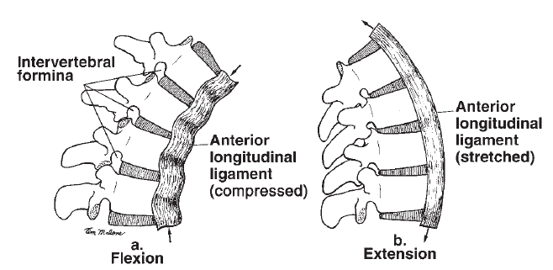
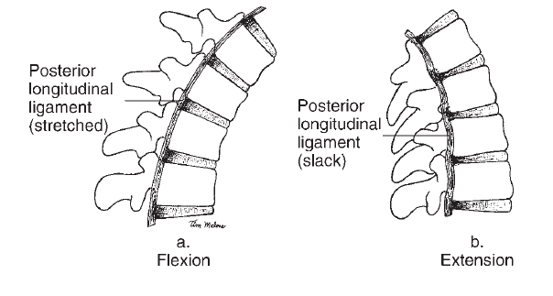
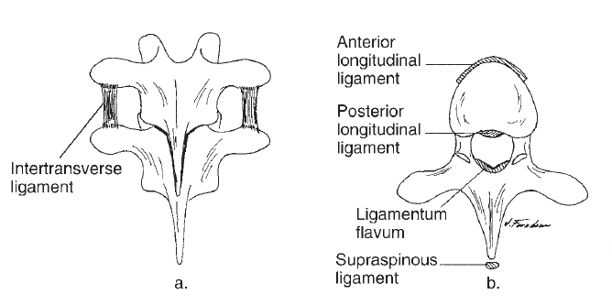

Slide 8
Function of the
vertebral column

Slide 9
Kinematics
The spinal joints are having 3⁰ freedom of motion with the following motions –
  Flexion and extension
  Lateral flexion and
  Rotation
These motions appear to occur independently of each other; however, at the level of the individual motion segment, these motions are often coupled motions.

Slide 10
Kinematics cont…
Coupling motion –
  It is defined as the consistent association of one motion about an axis with another motion around a different axis.
  Pure lateral flexion and pure rotation do not occur in any region of the spine

Slide 11
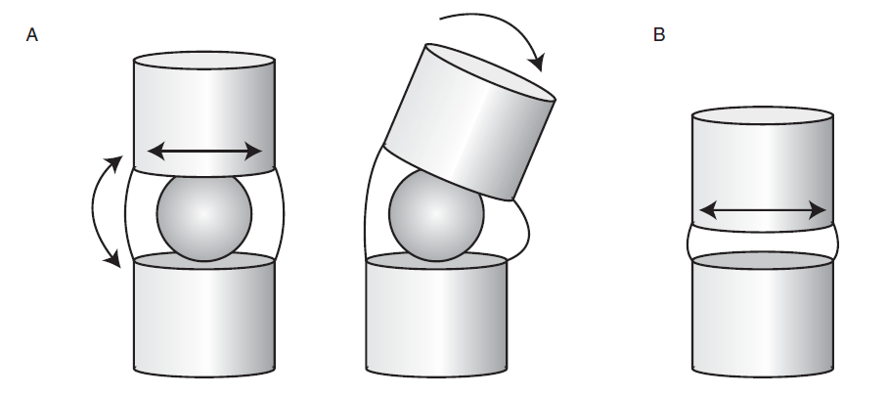
Kinematics cont…
IV disks increase movement between 2 adjacent vertebrae.
The vertebrae are also allowed to rock or tilt on each other because the soft, deformable disk is between them

Slide 12
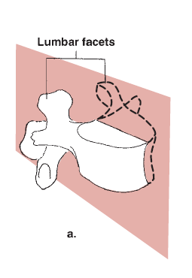
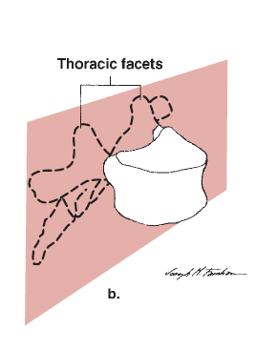
Flexion & extension
Plane – sagittal
Axis – frontal
Tilting & gliding of superior vertebrae over inferior vertebrae.
Gliding motion in –
  Inter-body & zygapophyseal joints
    Vertebral body tilts over the disk at the inter-body joint.

Slide 13
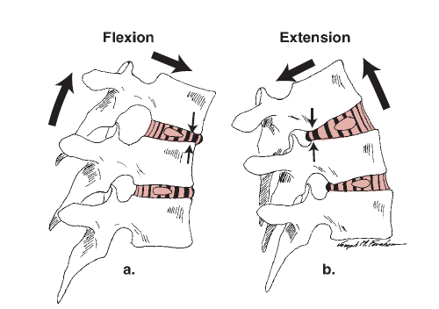
Vertebral Flexion
Anterior tilting and gliding of the superior vertebra occur and cause widening of the IV foramen and separation of the spinous process.

Slide 14
Extension
Herein, the post. Tilting & gliding narrowing of the IV foramen, spinous process move close together.

Slide 15
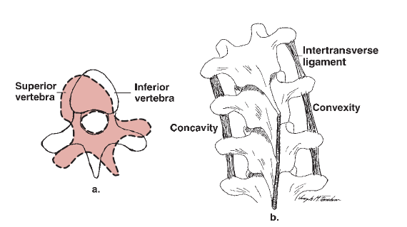
LATERAL FLEXION
The superior vertebra laterally tilts, rotates, and translates over the adjacent vertebra below.

Slide 16
Kinetics
The vertebral column is subjected to
Axial compression
Tension
Bending
Torsion
Shear stress not only during normal functional activities but also at rest.

Slide 17
AXIAL COMPRESSION
Axial compression –
  Force of gravity
  Ground reaction force (GRFv)
  Forces by ligaments & muscle contraction
  The compressive load is transmitted from the superior end plate to the inferior end plate through the trabecular bone of the vertebral body and the cortical shell.

Slide 18
AXIAL COMPRESSION cont…
The nucleus pulposus as ball of fluid
deformed by compression force.
The pressure created > force of load applied.
As the nucleus attempts to distribute the pressure in all directions, stress is created in the annulus fibrosus

Slide 19
Bending
Bending causes both compression and tension on the structures of the spine.
In forward flexion the anterior structures are subjected to compression; the posterior structures are subjected to tension.
In extension……

Slide 20
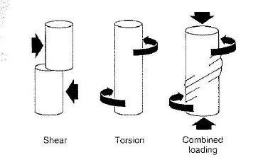
Torsion
Torsional forces are created during axial rotation that occurs as a part of the coupled motions that take place in the spine.

Slide 21
Shear
Shear forces act on the mid-plane of the disk and tend to cause each vertebra to undergo translation (move anteriorly, posteriorly, or from side to side in relation to the inferior vertebra).

Slide 22
Regional structure & function

Slide 23
Cervical Region

Slide 24
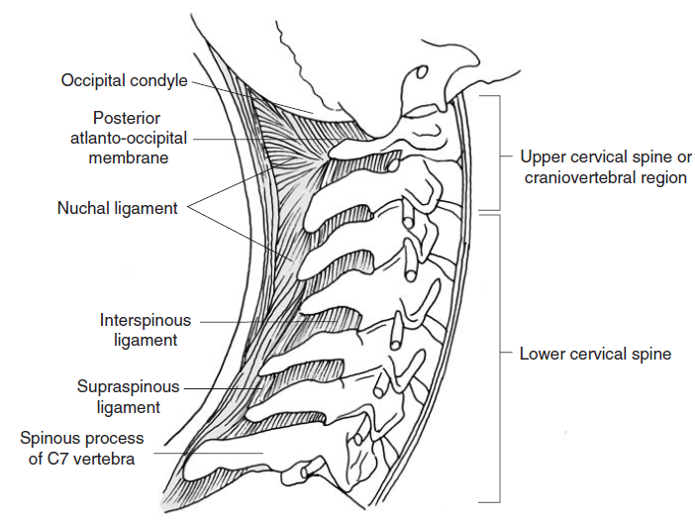
Structure of Cervical Region
7 vertebrae in total.
Morphologically, divided into 2 regions:
  Upper cervical/ craniovertebral (1-2)
  Lower cervical spine (3-7).

Slide 25
Craniovertebral region include:~
Lower cervical spine include:~
The vertebrae from C3 to C7-typical cervical vertebrae.
The atlas, axis,exhibit unique characteristics and are considered the atypical cervical vertebrae.

Slide 26
Craniovertebral Region

Slide 27
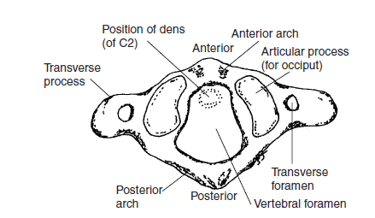
Atlas
Function:-
  Craddle the occiput & transmits force from the occiput to the lower cervical region.

Slide 28
The lateral masses include 4 articulating facets: 2 superior & 2 inferior.
Also has a facet on internal surface of anterior arch for dens of Axis.

Slide 29
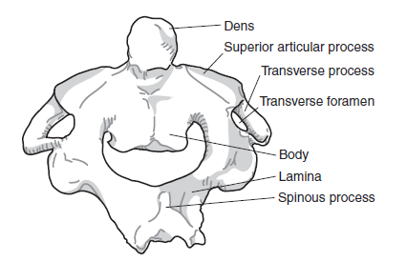
Axis
Function:-
  To transmit the combined load of the head and atlas to the remainder of the cervical spine and to provide motion into axial rotation of the head and atlas.
  The spinous process of axis is large and elongated with a bifid tip.

Slide 30
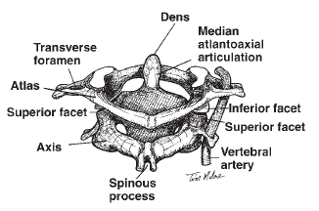
Articulations
There are three synovial joints that compose the atlantoaxial joints: the median atlantoaxial jt. and two lateral jts.
The two atlanto-occipital joints

Slide 31
Craniovertebral Ligaments
Four of the ligaments are continuations of the longitudinal tract system; the four remaining ligaments are specific to the cervical area.
  The posterior atlanto-occipital & atlantoaxial membrane- ligamentum flavum.
  The anterior atlanto-occipital & atlantoaxial membranes- anterior longitudinal ligament.
  The thick ligamentum nuchae is an evolution of the supraspinous ligament.

Slide 32
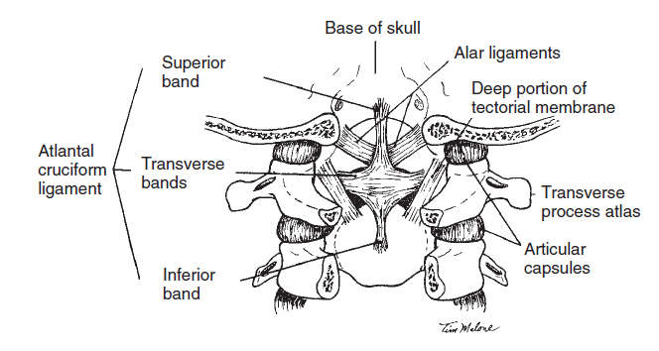
Transverse ligament
The transverse ligament and its longitudinal bands are sometimes referred to as the Atlantal Cruciform Ligament.
Main role is to prevent ant displacement of C1 on C2 and maintaining stability.

Slide 33
Alar ligaments
The two alar ligaments are specific to the cervical region.

Slide 34
Lower Cervical Region

Slide 35
Typical cervical vertebrae
Body:-
  small, transverse diameter more then antero-posterior & ht.
  The upper and lower end plates from C2 to C7 also have transverse diameters (widths) that are greater than the corresponding anteroposterior diameters.
  The transverse and anteroposterior diameters increase from C2 to C7 with a significant increase in both diameters in the upper end plate of C7.

Slide 36
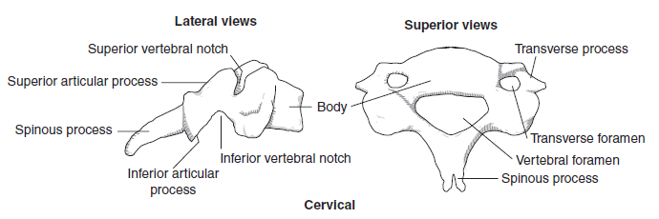
Arches:~
  Pedicles:-.
  Laminae:-
  Transverse process:~
  Spinous process:~

Slide 37
Interbody jts. Of lower cervical region
The interbody joints of the lower cervical region are saddle joints, and motion therefore occurs in only two planes.
In the frontal plane, the inferior surface of the cranial vertebra is convex and sits in the concave surface of the caudal vertebra created by the uncinate processes.
In the sagittal plane, the inferior surface of the cranial vertebra is concave and the superior surface of the caudal vertebra is convex because of the uncinate processes.

Slide 38
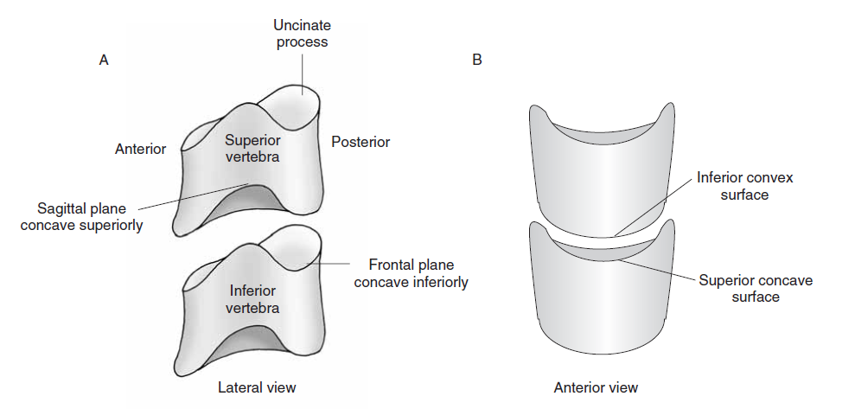

Slide 39
Function of the Cervical Region

Slide 40
Kinematics
The cervical spine is designed for a relatively large amount of mobility.
The motions of flexion and extension, lateral flexion, and rotation are permitted in the cervical region.
The atlanto-occipital joints allow for only nodding movements between the head and the atlas.

Slide 41
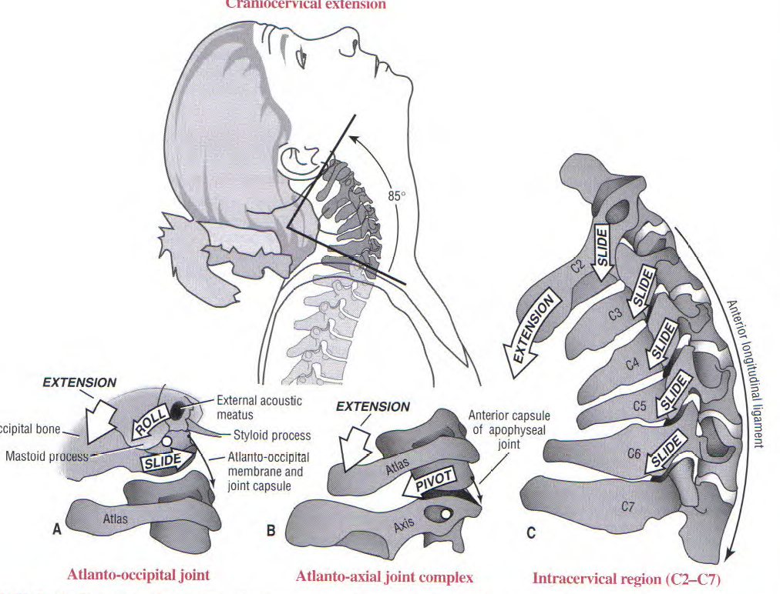

Slide 42
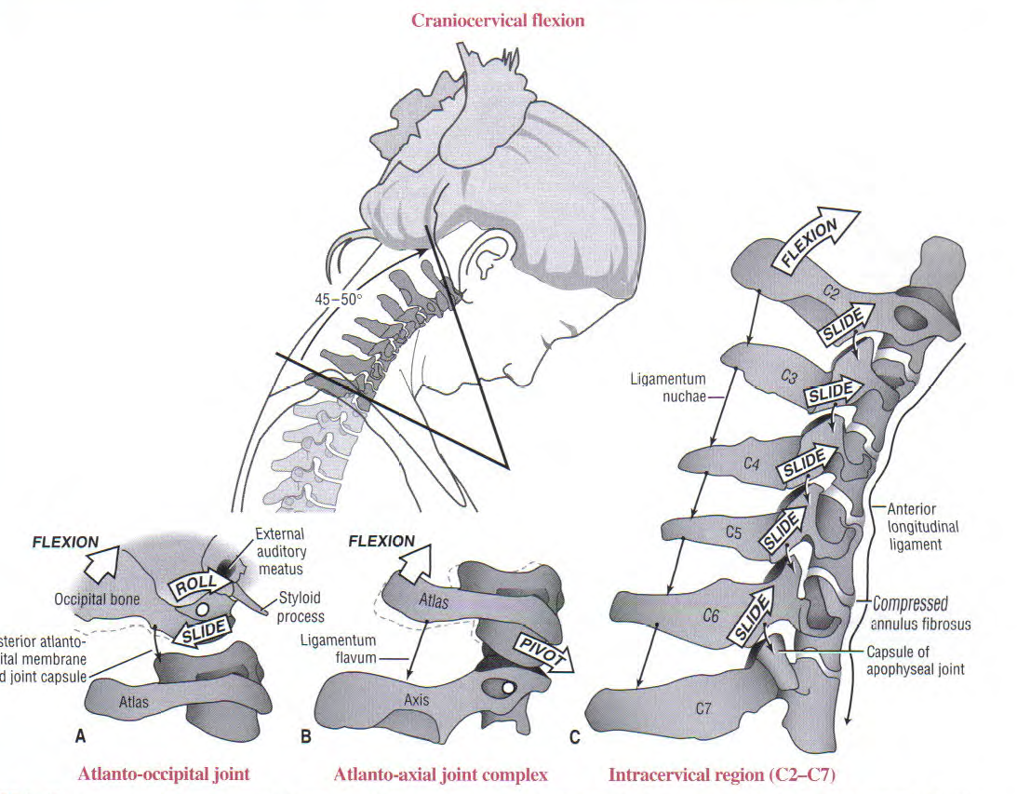

Slide 43
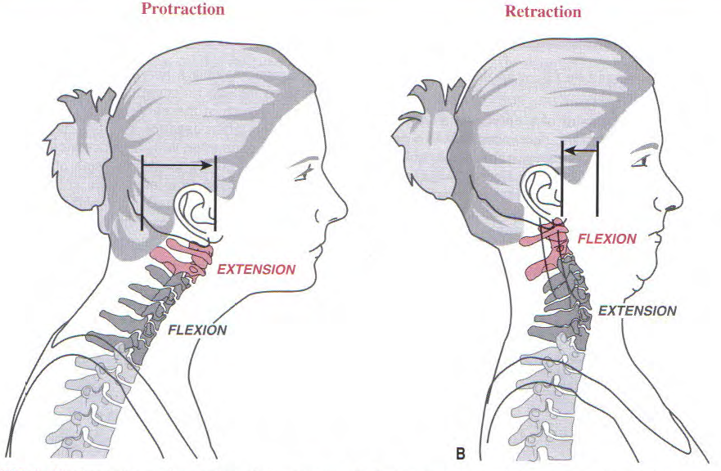

Slide 44
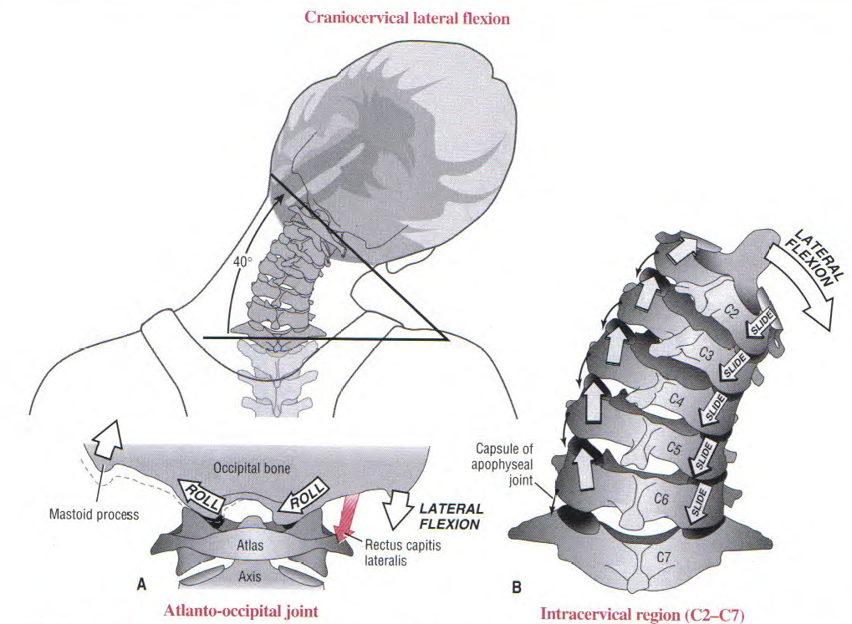

Slide 45
Muscles
The splenius capitis and splenius cervicis muscles are deep to the levator scapulae. The splenius muscles are large, flat muscles running from the spinous processes of the cervical and thoracic spine and the ligamentum nuchae to the superior nuchal line, the mastoid process, and the cervical transverse processes.
These muscles serve as prime movers of the head and neck as a result of their large cross-sectional area and the large moment arm.
They produce extension when working bilaterally and ipsilateral rotation when working unilaterally.

Slide 46
The semispinalis capitis and semispinalis cervicis muscles are deep to the splenius group. These muscles have the most optimal line of pull and a large moment arm to produce extension of the head and neck and an increase in the cervical lordosis. They run from the occiput to the cervical spinous processes (semispinalis capitis) and the thoracic transverse processes to the cervical spinous processes (semispinalis cervicis).
These muscles together form the cordlike bundle of muscles palpated laterally to the cervical spinous processes.

Slide 47
The longissimus capitis and longissimus cervicis are deep and lateral to the semispinalis group. Their deep position places them close to the axis of rotation for flexion and extension, rendering them ineffective extensors because of the small moment arm.
They do, however, produce compression of the cervical segments. The lateral position allows them to produce ipsilateral lateral flexion when working unilaterally, and when working bilaterally, they serve as frontal plane stabilizers of the cervical spine.

Slide 48
The suboccipital muscles are the deepest posterior muscles and consist of the rectus capitus posterior minor and major, inferior oblique, and superior oblique muscles. As a group, they run between the occiput and C2, allowing independent movement of the craniovertebral region on the lower cervical spine.
Together, they produce occipital extension. Unilaterally, they produce ipsilateral rotation and lateral flexion

Slide 49
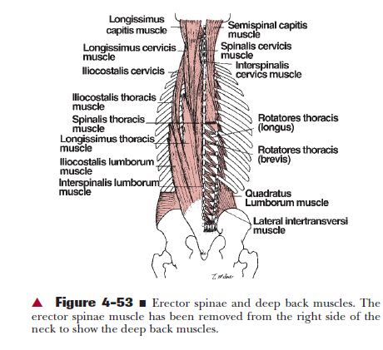

Slide 50
Lateral Muscles
The scalene muscles are located on the lateral aspect of the cervical spine and serve as frontal plane stabilizers along with the longissimus muscles posteriorly when they are acting as a group. In the sagittal plane, the anterior scalene muscles, which run from the first rib to the anterior tubercles of the transverse processes of C3 to C6, work with the levator scapulae to provide stability.
The anterior scalene muscles, when working bilaterally, will flex the cervical spine and produce an anterior shear. Unilaterally, the anterior scalene muscles will produce ipsilateral lateral flexion and contralateral rotation to the cervical spine.
The middle scalene muscles run from the first rib to the anterior tubercles of the transverse processes of C3 to C7.

Slide 51
The middle scalene muscles are more laterally placed than are the anterior scalene muscles, and their line of pull makes them excellent frontal plane stabilizers.The posterior scalene muscles run from the second rib to the posterior tubercles of the transverse processes of C3 to C7. The posterior scalene muscles predominantly laterally flex the neck.
The anterior and middle scalene muscles form a triangle through which the brachial plexus and the subclavian artery and vein pass.
This can be a site for compression on the neurovascular structures by the anterior scalene muscle.

Slide 52
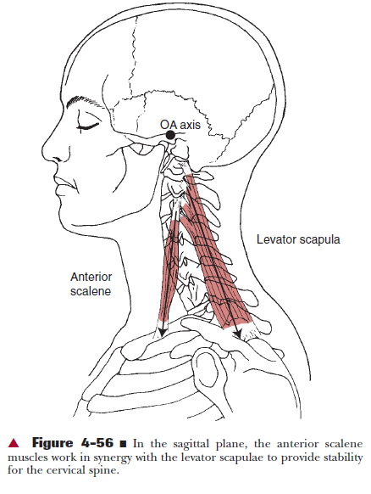
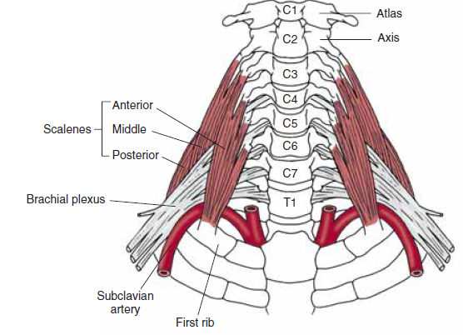


Slide 53
Anterior Muscles
The longus capitis run from the anterior tubercles of the cervical transverse processes to the occiput. The longus colli run from the thoracic vertebral bodies to the anterior tubercles of the cervical transverse processes and cranially from the anterior tubercles of the transverse processes to the atlas. These two muscles lie close to the vertebral bodies and therefore are relatively close to the axis of rotation. Although they do have sufficient moment arm to produce flexion, they also produce a fair amount of compression. The longus capitis and longus colli work in synergy with the trapezius to stabilize the head and neck to allow the trapezius to upwardly rotate the scapula.

Slide 54
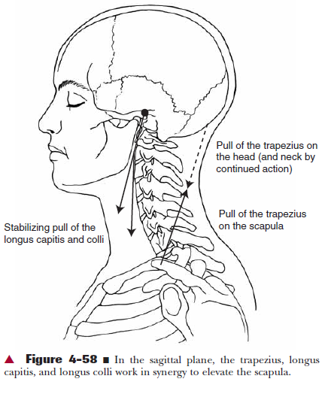

Slide 55
Cervical spondylosis
In cervical spondylosis, degenerative changes start in the intervertebral discs with osteophyte formation and involvement of adjacent soft tissue structures. Many people over 30 show similar abnormalities on plain radiographs of the cervical spine.

Slide 56
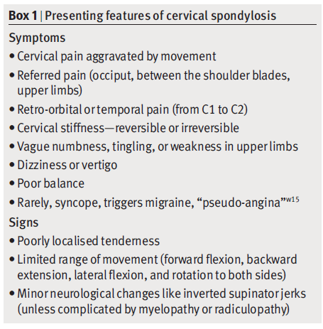

Slide 57
REFERENCES
Joint structure and function-A Comprehensive Analysis, Fourth Edition by Cynthia C. Norkin and Pamela K. Levangie.
Kinesiology of Musculoskeletal system by Donald Neumann.
The physiology of Joints by I.A.Kapanji.

Slide 58
MCQs
Cervical curve is lordotic
True
False

Slide 59
Amount of flexion-extension possible at lower cervical joint
0
60-70
10-30

Slide 60
Deepest muscle on posterior aspect of cervical spine
Semispinalis capitis
Splenius capitis
Longissimus capitis
Suboccipital muscles

Slide 61
Cervical spondylosis shows all the abnormalities except
Degeneration of disc
Osteophyte formation
Reduction of intervertebral space
Fracture of vertebrae

Slide 62
Which is the ineffective extensor of cervical spine?
Splenius capitis
Semispinalis capitis
Longissimus capitis
N one of above

