Slide 1
Endocrine System
Kevin Christian
Assistant Professor

Slide 2
OGTT
The oral glucose tolerance test (OGTT) evaluates insulin response to glucose loading. FBS is obtained before the ingestion of a 50- to 200-g glucose load (usual amount is 75 g), and blood samples are drawn at ½, 1, 2, and 3 hours (may be 4- or 5-hour sampling).

Slide 3
Glycated Hemoglobin (Glycohemoglobin, HbA_{1c})
Measures glycemic control over a 60- to 120-day period by measuring the irreversible reaction of glucose to hemoglobin through freely permeable erythrocytes during their 120-day lifecycle.

Slide 4
Complications of DM
Acute
  Hypoglycemia
  Diabetic ketoacidosis (DKA)
  Hyperosmolar hyperglycemic nonketotic syndrome (HHNKS)

Slide 5
Complications of DM
Chronic
  Microangiopathy
  CAD
  Peripheral vascular disease
  Retinopathy
  Nephropathy
  Peripheral neuropathy
  Sexual dysfunction

Slide 6
Water Deprivation Test
Functional test of the adequacy of posterior pituitary secretion of antidiuretic hormone (ADH) and its ability to concentrate urine and to maintain serum osmolality in the face of water deprivation.
Useful to determine the diagnosis and etiology of diabetes insipidus (DI).

Slide 7
Hypothyroidism
Tab. Levothyroxine 25/50/75/100 mcg
Tab. Atorvastatin drug to reduce chances of high cholesterol

Slide 8
Hyperthyroidism
Nodular toxic goiter - surgery or use of radioiodine is preferred.
Thyroid carcinoma - surgery or radiation is used.
Goal of therapy is to bring the metabolic rate to normal as soon as possible and to maintain it at this level.
propylthiouracil (PTU) inhibits formation of hormones

Slide 9
Hyperparathyroidism
Hyper secretion of parathyroid hormone

Slide 10
Clinical manifestations
Decalcification of bones.
  Skeletal pain, backache, pain on weight-bearing, pathologic fractures, deformities, formation of bony cysts.
  Formation of bone tumors
  Formation of calcium-containing kidney stones.
Depression of neuromuscular function.
  The patient may trip, drop objects, show general fatigue, lose memory for recent events, experience emotional instability, have changes in level of consciousness and coma.
  Cardiac arrhythmias, hypertension

Slide 11
Diagnostic Evaluation
Persistently elevated serum calcium (11 mg/100 mL)
PTH levels are increased.
Serum calcium and alkaline phosphatase levels are elevated
Skeletal changes are revealed by X-ray

Slide 12
Management
Hydration (I.V. saline) and diuretics-furosemide (Lasix) - to increase urinary excretion of calcium in patients not in renal failure.
Oral phosphate may be used as an antihypercalcemic agent.
Pamidronate (Aredia), calcitonin (Cibacalcin), or etidronate disodium (Didronel) are effective in treating hypercalcemia by inhibiting bone resorption.
Dietary calcium is restricted, and all drugs that might cause hypercalcemia (thiazides, vitamin D) are discontinued.

Slide 13
Hypoparathyroidism
Hypoparathyroidism results from a deficiency of PTH and is characterized by hypocalcemia and neuromuscular hyperexcitability

Slide 14
Clinical manifestations
Tetany - general muscular hypertonia;
  Chvostek's sign - a spasm of facial muscles that occurs when muscles or branches of facial nerve are tapped.
  Trousseau's sign - carpopedal spasm within 3 minutes after a BP cuff is inflated 20 mm Hg above the patient's systolic pressure.
  Laryngeal spasm.

Slide 15
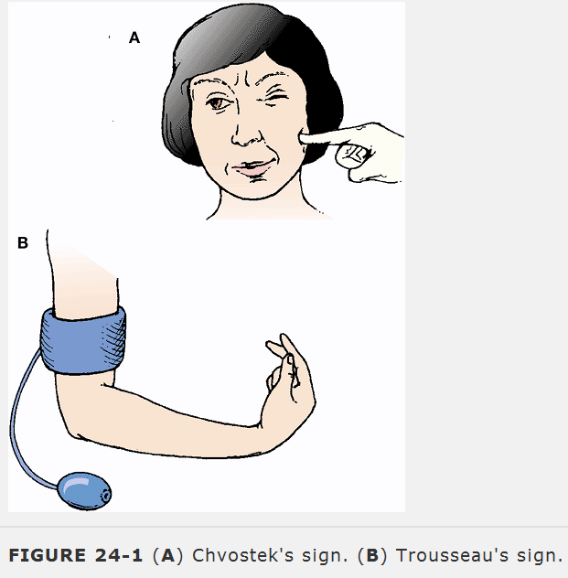

Slide 16
Diagnostic evaluation
Phosphorus level in blood is elevated.
Decrease in serum calcium level to a low level (7.5 mg/100 mL or less).
PTH levels are low

Slide 17
Management
A syringe and an ampule of a calcium solution (calcium chloride, calcium gluceptate, calcium gluconate) are to be kept at the bedside at all times.
Most rapidly effective calcium solution is ionized calcium chloride (10%).
For rapid use to relieve severe tetany, infusion carried out every 10 minutes.

Slide 18
Primary Aldosteronism
Primary aldosteronism refers to excessive secretion of aldosterone by the adrenal cortex.

Slide 19
Management
Removal of adrenal tumor - unilateral adrenalectomy.
Management of underlying cause of secondary aldosteronism.
Spironolactone (Aldactone) to treat both hypertension and potassium-depleted stages; therapy is needed 4 to 6 weeks before the full effect on BP is seen.

Slide 20
Cushing Syndrome
Cushing's syndrome is a condition in which the plasma cortisol levels are elevated

Slide 21
Management
Tumor (adrenal or pituitary) is removed or treated with irradiation.
The most recent development in the management of pituitary Cushing's syndrome in adults is transsphenoidal adenomectomy or hypophysectomy (pituitary removal)
Transfrontal craniotomy may be necessary when pituitary tumor has enlarged beyond sella turcica
Hyperplasia of adrenals - bilateral adrenalectomy.
Mitotane, an agent toxic to the adrenal cortex (DDT derivative) - known as medical adrenalectomy

Slide 22
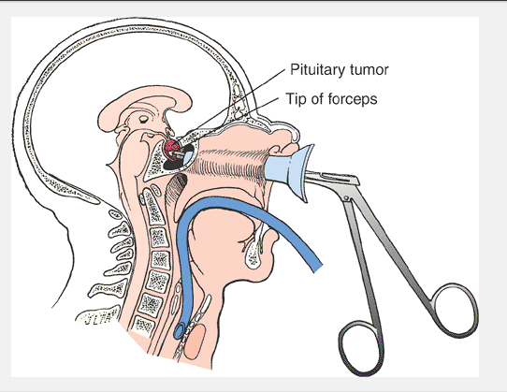

Slide 23
ADRENOCORTICAL INSUFFICIENCY
Adrenocortical insufficiency occurs with inadequate secretion of the hormones of the adrenal cortex, primarily the glucocorticoids and mineralocorticoids

Slide 24
Sign/symptoms
Hyponatremia and hyperkalemia.
Water loss, dehydration, and hypovolemia.
Muscular weakness, fatigue, weight loss.
GI problems - anorexia, nausea, vomiting, diarrhea, constipation, abdominal pain.
Hypotension, hypoglycemia, low basal metabolic rate, increased insulin sensitivity.
Mental changes - depression, irritability, anxiety, apprehension caused by hypoglycemia and hypovolemia.
Hyperpigmentation.

Slide 25
Diagnostic evaluation
Blood chemistry - decreased glucose, decreased sodium, increased potassium.
Increased lymphocytes on complete blood count.
Low fasting plasma cortisol levels; low aldosterone levels.

Slide 26
Management
Restoration of normal fluid and electrolyte balance: high-sodium, low-potassium diet and fluids.
Treatment of glucocorticoid deficiency with such agent as hydrocortisone (Cortef) or prednisone (Orasone). Patients with chronic obstructive pulmonary disease and heart failure may require preparations with low mineralocorticoid activity, such as methylprednisolone (Solu-Medrol), to prevent fluid retention

Slide 27
Pheochromocytoma
Pheochromocytoma is a catecholamine-secreting neoplasm associated with hyperfunction of the adrenal medulla

Slide 28
Diagnostic Evaluation
VMA and metanephrine (metabolites of epinephrine and norepinephrine) are elevated in 24-hour urine sample

Slide 29
Management
Alpha-adrenergic blocking agents, such as
  Effective control of BP and blood volume may take 1 or 2 weeks.
  Surgery is delayed until BP is controlled and blood volume has been expanded.
Catecholamine synthesis inhibitors, such as metyrosine (Demser), may be used preoperatively or for long-term management of inoperable tumors.
Unilateral or bilateral adrenalectomy or other tumor removal.

Slide 30
Diabetes insipidus
DI is a disorder of water metabolism caused by deficiency of ADH, also called vasopressin, secreted by the posterior pituitary or by inability of the kidneys to respond to ADH

Slide 31
Etiology
Primary: idiopathic.
Secondary: head trauma, neurosurgery, tumors (intracranial or metastatic), vascular disease (aneurysms, infarct), infection (meningitis, encephalitis).
Nephrogenic DI: long-standing renal disease, hypokalemia, some medications.

Slide 32
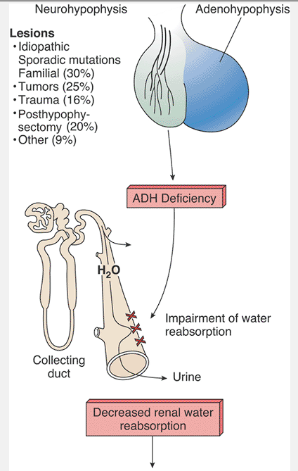

Slide 33
Management
Administration of ADH or its derivative.
  Desmopressin acetate (DDAVP)â€”vasopressin derivative administered into the nose through a soft, flexible nasal tube or by nasal spray.
  Chlorpropamide - potentiates action of vasopressin on renal-concentrating mechanism.
  Carbamazepine (Tegretol) - potentiates action of endogenous vasopressin.
For patients with nephrogenic - chlorpropamide or thiazide diuretics may be of value. Reversible by discontinuing causative medication if cause is drug related.

Slide 34
DKA Management
I.V. fluids to replace losses from osmotic diuresis, vomiting.
I.V. insulin dripâ€”regular insulin infused only to increase glucose utilization and decrease lipolysis.
Electrolyte replacementâ€”sodium chloride and phosphate as required, potassium chloride and bicarbonate based on laboratory results.

Slide 35
HHNKS Management
Correct fluid and electrolyte imbalances with I.V. fluids.
Provide insulin via I.V. drip to lower plasma glucose.
Evaluate complications, such as stupor, seizures, or shock, and treat appropriately.
Identify and treat underlying illnesses or events that precipitated HHNS.

Slide 36
Metabolic Syndrome
Metabolic syndrome (also known as syndrome X, insulin resistance syndrome, and dysmetabolic syndrome) has been used to characterize a state of insulin resistance believed to be a major contributing factor to the development of a variety of significant health problems.

Slide 37
Management
Treatment of metabolic syndrome involves measures directed at treating any diagnosed disease resulting from insulin resistance (diabetes, hypertension, hypercholesterolemia) as well as the underlying insulin resistance. This is accomplished by interventions that improve insulin sensitivity.
Nonpharmacologic interventions effective in reducing insulin resistance include lifestyle changes that can have a direct impact on insulin sensitivity and include regular physical activity and nutritional management designed to reduce body weight.

