Slide 1
ACUTE RESPIRATORY DISTRESS SYNDROME

Slide 2
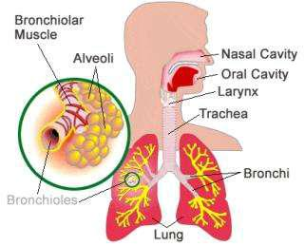
ANATOMY AND PHYSIOLOGY OF LUNGS

Slide 3
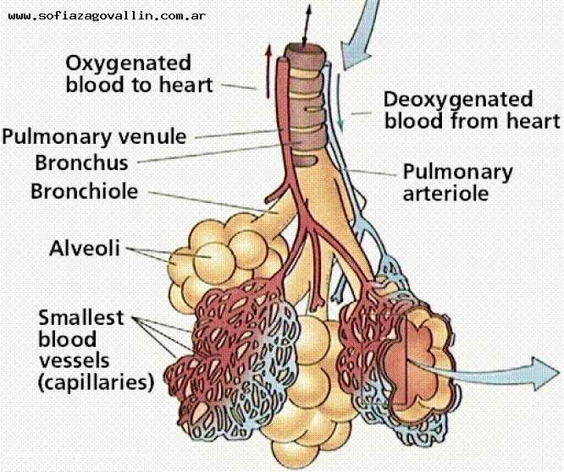

Slide 4
INTRODUCTION
Acute respiratory distress syndrome (ARDS) is a sudden and progressive form of acute respiratory failure in which the alveolar capillary membrane becomes damaged and more permeable to intravascular fluid resulting in severe dyspnea, hypoxemia and diffuse pulmonary infiltrates.

Slide 5
Acute respiratory distress syndrome (ARDS) occurs when fluid builds up in the tiny, elastic air sacs (alveoli) in your lungs. The fluid keeps your lungs from filling with enough air, which means less oxygen reaches your bloodstream. This deprives your organs of the oxygen they need to function.

Slide 6
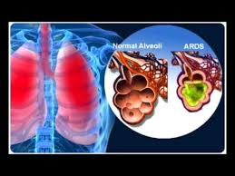

Slide 7
CAUSES
Direct injury to the lungs:
Chest trauma, such as a heavy blow
Breathing vomit
Breathing smoke, chemicals, or salt water
Burns
Indirect injury to the lungs:
Severe infection(Sepsis)
Chronic Alcoholism
Massive blood transfusion
Pancreatitis (inflammation of the pancreas)
Severe Pneumonia

Slide 8
PATHOPHYSIOLOGY
Phase 1
Injury reduces normal blood flow to the lungs. Platelets aggregates and release histamine, serotonin and bradykinin.
Phase 2
Those substances especially histamine inflame and damage the alveocapillary membrane increasing capillary permeability. Fluids then shifts into the interstitial space.
Phase 3
As capillary permeability increases proteins and fluids leaks out, increasing interstitial osmotic pressure and causing pulmonary oedema.

Slide 9
Phase 4
Decreased blood flow and fluids in the alveoli damage surfactant and impair the cell’s ability to produce more. As a result alveoli collapse, impeding gas exchange and decresing lung compliance.
Phase 5
Sufficient oxygen can’t cross the alveolocapillary membrane, but carbon dioxide can and is lost with every exhalation. Oxygen and carbon dioxide levels decrease in the blood.
Phase 6
Pulmonary oedema worsens, inflammation leads to fibrosis and gas exchange is further impeded.

Slide 10
SYMPTOMS
Severe shortness of breath
Laboured and unusually rapid breathing
Low blood pressure
Confusion and extreme tiredness

Slide 11
DIAGNOSIS
Chest x-ray
Computerized tomography (CT)
Echocardiogram
ABG (Arterial Blood Gas) analysis
Blood tests show a low level of oxygen in the blood
Blood pressure check
Levels of BNP (brain natriuretic peptide)
Electrocardiogram
Analysis of coughed-up matter
Pulmonary artery catheterization taid in diagnostic work-up
Bronchoscopy to analyze airways.
Open lung biopsy

Slide 12
TREATMENT
Oxygen
Supplemental oxygen.
Mechanical ventilation.
Fluids
Carefully managing the amount of intravenous fluids is crucial. Too much fluid can increase fluid buildup in the lungs. Too little fluid can put a strain on your heart and other organs and lead to shock.

Slide 13
Medication
People with ARDS usually are given medication to:
Prevent and treat infections
Relieve pain and discomfort
Prevent blood clots in the legs and lungs
Minimize gastric reflux
Sedate
Lifestyle and home remedies
Quit smoking.
Get vaccinated.

Slide 14
NURSING MANAGEMENT
NURSING DIAGNOSIS
1)Ineffective breathing pattern related to decreased lung compliance
2)Impaired gas exchange related to diffusion defect as characterized by hypoxia
3)Risk for decreased Cardiac output related to positive pressure ventilation
4)Impaired physical mobility related to monitoring devices, mechanical ventilation & medications.
5)Risk for impaired skin integrity related to prolonged bed rest, prolonged intubation & immobility.
6)Knowledge deficit related to health condition, new equipment & hospitalization.

Slide 15
NURSING INTERVENTIONS
Identify and treat cause of the Acute respiratory distress syndrome
Administer oxygen as prescribed.
Position client in high fowler’s position.
Restrict fluid intake as prescribed.
Provide respiratory treatment as prescribed.
Administer diuretics, anticoagulants or corticosteroids as prescribed.
Prepare the client for intubation and mechanical ventilation.

Slide 16
COMPLICATIONS
Blood clots.
Collapsed lung (pneumothorax).
Infections
Scarring (pulmonary fibrosis).
Breathing problems
Depression
Problems with memory and thinking
Tiredness and muscle weakness.

Slide 17
THANK YOU

