Slide 1
MECHANICS OF JOINT MOTION:
STRUCTURE OF JOINT,
TYPES OF JOINT MOVEMENT
DR PURVI PATEL

Slide 2
MATERIALS USED IN HUMAN JOINTS
Bones
Bursae
Capsule
Cartilage
Disk
Fat pads
Labra
Plates
Tendons

Slide 3
CLASSIFICATION OF JOINTS
Joint designs in humans vary from simple to complex
Simple human joints usually have stability as a primary function
More complex joints usually have mobility as a primary function
Most joints have to serve a dual mobility-stability function to provide dynamic stability

Slide 4
Two broad categories:
Synarthroses
(non-synovial joints)
Diarthroses
(synovial joints)

Slide 5
SYNARTHROSES (NON-SYNOVIAL JOINTS)
Material used in synarthrodial joints is interosseus connective tissue (fibrous &/or cartilaginous)
Grouped into two divisions according to type of connective tissue used
Fibrous joints
Cartilaginous joints
Connective tissue directly unites one bone to another creating a bone-connective tissue-bone interface

Slide 6
FIBROUS JOINTS
In fibrous joints, fibrous tissue directly unites bone to bone
Three different types of fibrous joints are found in human body:
  Sutures
  Gomphoses
  Syndesmoses

Slide 7
Suture joint is one in which two bony components are united by a collagenous sutural ligament or membrane
Ends of bony components are shaped so that edges interlock or overlap one another
Found only in skull and, early in life, allows a small amount of movement
Fusion of two opposing bones in suture joints occurs later in life and leads to formation of a bony union called a synostosis

Slide 8
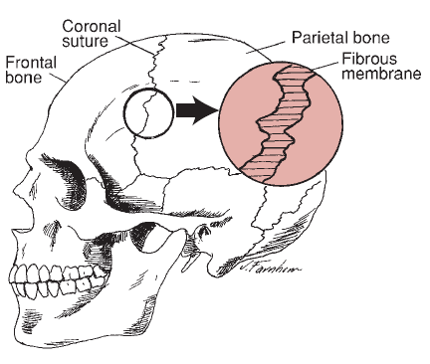
SUTURE JOINT

Slide 9
Gomphosis joint is a joint in which surfaces of bony components are adapted to each other like a peg in a hole
In this type of joint, the component parts are connected by fibrous tissue
Only gomphosis joint that exists in humans is the joint found between a tooth and either the mandible or maxilla

Slide 10
Syndesmosis is a type of fibrous joint in which two bony components are joined directly by an interosseous ligament, a fibrous cord, or an aponeurotic membrane
These joints usually allow a small amount of motion

Slide 11
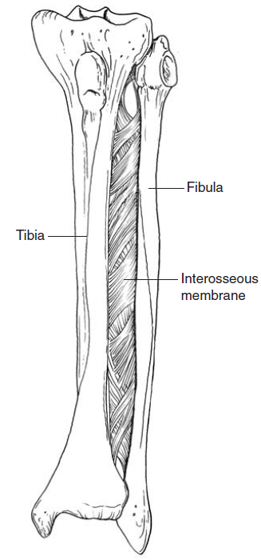
SYNDESMOSIS JOINT

Slide 12
CARTILAGINOUS JOINTS
Materials used to connect bony components in cartilaginous joints are fibrocartilage &/or hyaline cartilage
These materials are used to directly unite one bony surface to another, creating a bone-cartilage-bone interface
Two types of cartilaginous joints are:
  Symphyses
  Synchondroses

Slide 13
Symphysis joint (secondary cartilaginous joint)
Bony components are covered with a thin lamina of hyaline cartilage & directly joined by fibrocartilage in the form of disks or pads
Examples include
  Intervertebral joints b/w vertebral bodies
  Joint between manubrium & sternal body
  Symphysis pubis in pelvis

Slide 14
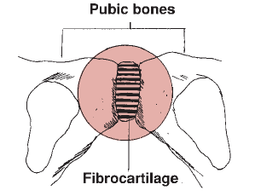
SYMPHYSIS JOINT

Slide 15
Synchondrosis (primary cartilaginous joint)
It is a type of joint in which material used for connecting two components is hyaline cartilage
Cartilage forms a bond between two ossifying centers of bone
Function of this type of joint is to permit bone growth while also providing stability & small amount of mobility

Slide 16
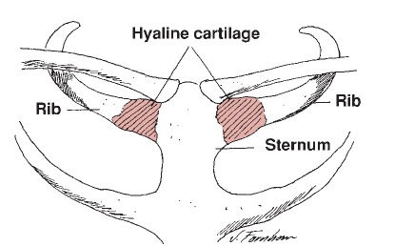
SYNCHONDROSIS JOINT

Slide 17
DIARTHROSES (SYNOVIAL JOINTS)
In synovial joints, ends of bony components are free to move in relation to one another
Bony components are indirectly connected to one another by means of a joint capsule that encloses joint

Slide 18
All synovial joints are constructed in a similar manner and have following features:
  Joint capsule that is composed of two layers
  Joint cavity that is enclosed by joint capsule
  Synovial tissue lines inner surface of capsule
  Synovial fluid forms a film over joint surfaces
  Hyaline cartilage covers surfaces of enclosed contiguous bones

Slide 19
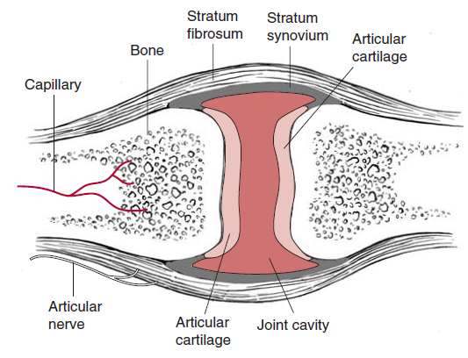
SYNOVIAL JOINT

Slide 20
SUBCLASSIFICATION OF SYNOVIAL JOINTS
Uniaxial
Biaxial
Triaxial

Slide 21
UNIAXIAL JOINTS
Uniaxial joint is constructed so that visible motion is allowed in one plane around a single axis
Axis of motion usually is located near or in center of joint or in one of bony components
Described as having one degree freedom of motion

Slide 22
Two types of uniaxial diarthrodial joints found in humans are:
  Hinge joints
  Pivot (trochoid) joints
Hinge joint is a type of joint that resembles a door hinge
Motion can occur only in sagittal plane (flexion and extension) around a coronal axis

Slide 23
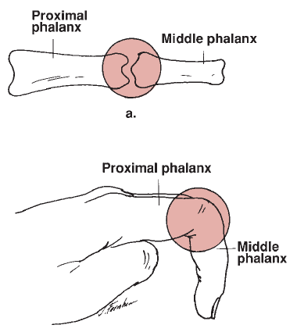
HINGE JOINT

Slide 24
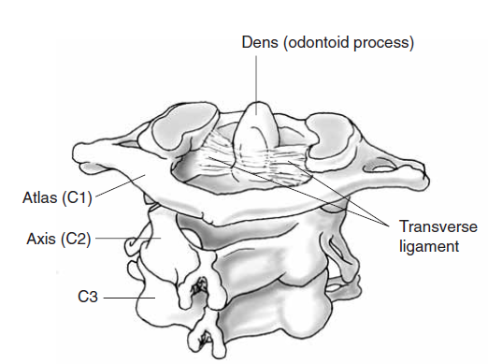
Pivot (trochoid) joint is a type of joint in which one component is shaped like a ring and other one is shaped so that it can rotate within ring

Slide 25
BIAXIAL JOINTS
These are joints in which bony components are free to move in 2 planes around two axes
Therefore, these joints have two degrees of freedom
There are two types of biaxial joints in body:
  Condyloid
  Saddle

Slide 26
Condyloid joint
Joint surfaces in a condyloid joint are shaped so that concave surface of one bony component is allowed to slide over convex surface of another component in two directions

Slide 27
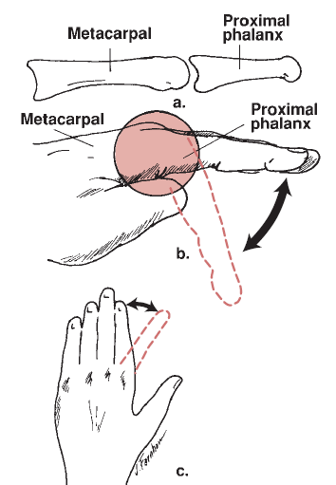
CONDYLOID JOINT

Slide 28
Saddle joint
It is a joint in which each joint surface is both convex in one plane and concave in the other, and these surfaces fit together like a rider on a saddle

Slide 29
TRIAXIAL JOINTS
Triaxial or multiaxial diarthrodial joints are joints in which bony components are free to move in three planes around three axes
Three degrees of freedom
2 types of joints in this category are:
  Plane joints
  Ball-and-socket joints

Slide 30
Plane joints have a variety of surface configurations and permit gliding between two or more bones
These joints are found between adjacent surfaces of carpal bones
Adjacent surfaces may glide on one another or rotate with regard to one another in any plane

Slide 31
Ball-and-socket joints are formed by a ball-like convex surface being fitted into a concave socket
Motions permitted are:
  Flexion/extension
  Abduction/adduction
  Rotation

Slide 32
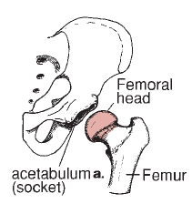
BALL AND SOCKET JOINT

Slide 33
JOINT FUNCTION
Synarthrodial joints are relatively simple in design and function primarily as stability joints, although some motion does occur
Diarthrodial joints are complex and are designed primarily for mobility, although all of these joints must also provide some variable measure of stability

Slide 34
KINEMATIC CHAINS
Kinematic chains are composed of a series of rigid links that are interconnected by a series of pin-centered joints
System of joints and links is constructed so that motion of one link at one joint will produce motion at other joints in system in a predictable manner

Slide 35
Kinematic chain can be:
  Open or
  Closed
In an open kinematic chain, one joint can move independently of others in chain
When one end of chain remains fixed, it creates a closed kinematic chain
Under these conditions, movement at one joint automatically creates movement in other joints in chain

Slide 36
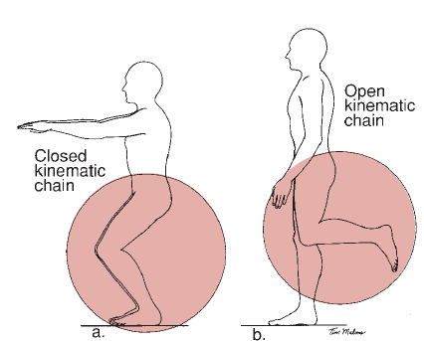
KINEMATIC CHAINS

Slide 37
JOINT MOTION
OSTEOKINEMATICS
ARTHROKINEMATICS
Osteokinematics refers to movement of bones in space during physiologic joint motion
These movements occur in sagittal, frontal, & transverse planes
Movements are typically described by plane in which they occur, axis about which they occur, and direction of movement

Slide 38
ARTHROKINEMATICS
The term arthrokinematics is used to refer to movement of joint surfaces in relation to one another
These movements accompany voluntary movement but cannot be independently produced voluntarily under normal conditions
Usually one joint surface is relatively stable and serves as a base for motion, whereas other surface moves on this relatively fixed base

Slide 39
Terms roll, slide, and spin are used to describe type of motion that moving part performs
A roll refers to rolling of one joint surface on another
In knee ,femoral condyles roll on fixed tibial surface during knee flexion or extension in standing

Slide 40
Direction of rolling is described by direction of movement of bone; thus, femur rolls forward during knee extension in standing
During a pure rolling motion, a progression of points of contact between surfaces occurs

Slide 41
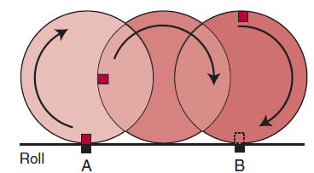
ROLL

Slide 42
Sliding, which is a pure translatory motion, refers to gliding of one component over another, as when a braked wheel skids
Point of contact changes in fixed component as sliding component moves over it
In hand, proximal phalanx slides over fixed end of metacarpal during flexion and extension

Slide 43
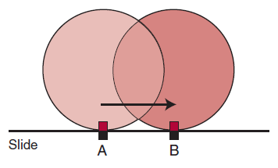
SLIDING

Slide 44
spin refers to a rotation of movable component, as when a top spins
Spin is a pure rotatory motion
Same points remain in contact on both moving and stationary components
At elbow, the head of radius spins on capitulum of humerus during supination and pronation of forearm

Slide 45
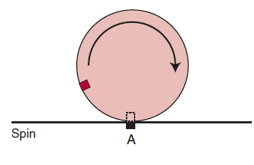
SPIN

Slide 46
CONVEX-CONCAVE RULE
Convex joint surfaces roll and glide in opposite directions
Concave joint surfaces roll and slide in the same direction

Slide 47
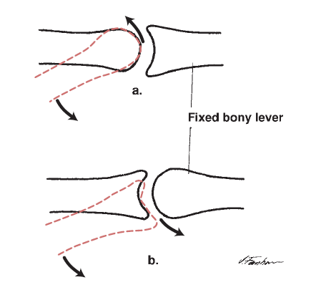
CONVEX-CONCAVE RULE

Slide 48
MULTIPLE CHOICE QUESTIONS
  1. Which of the following is an example of ball and socket joint
  a)Shoulder b)wrist c)hip d) a and c
  2. Squatting is an example of
  a) Close chain kinematics
  b) Open chain kinematics

Slide 49
  3. Hinge joint is a uniaxial joint
  a) True b) false
  4. Other name for synovial joints is diarthrodial joint
  a) False b) true
  5. Example of plane joint
  a) MCP b)carpal joints c)Radio-ulnar joint d) IP joint

Slide 50
6. Concave joint surfaces roll and slide in same direction
a) True
b) False
7. Terms roll, slide and spin are used to describe which of the following motion.
a) Arthrokinematics
b) Osteokinematics

Slide 51
8. Convex joint surfaces roll and glide in opposite direction
a) False
b) True
9. A person travelling in a bike suddenly applies a brake, and his bike tire skids, is an example of which type of motion
a) Rolling
b) Spinning
c) Sliding
d) None of the above

Slide 52
10. Which type of movement occurs between head of radius and capitulum of humerus during supination
a) Sliding
b) Spinning
c) Rolling
d) Traction

Slide 53
Answers
1-d
2-a
3-a
4-b
5-b
6-a
7-a
8-b
9-c
10-b

