Slide 1
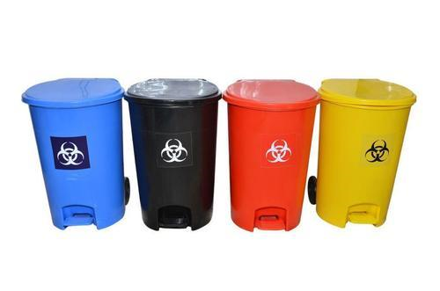
BIO MEDICAL WASTE MANAGEMENT

Slide 2
DEFINITION
According to the bio medical waste rules, 1998 of India “Bio-medical waste means any waste which is generated during the diagnosis, treatment or immunization of human beings or animals or in research activities pertaining there to or in the production or testing of bio medicals.”
“Any unwanted residual material which cannot be discharged directly, or after suitable treatment can be discharged in the atmosphere or to a receiving water source, or used for landfill is waste.” (Wilson, 1981)

Slide 3
HISTORY
In India seriousness about the bio medical waste management came into lime light only after 1990’s.
According to the WHO estimation in 2000 injections with contaminated syringes caused:
21 million hepatitis B virus (HBV)
infections (32% of all new infections);
Two million hepatitis C virus (HCV)
infections (40% of all new infections);
260 000 HIV infections (5% of all new)

Slide 4
LAWS OF BIOMEDICAL WASTE MANAGEMENT
On 20th July, 1998 Ministry of Environment and Forests (MoEF), Govt. of India, Framed a rule known as ‘Bio-medical Waste (Management and Handling) Rules, 1998.
Provides uniform guidelines and code of practice for Bio-medical waste management.

Slide 5
BIOMEDICAL WASTE STATISTICS
In India, 1-2 kg/bed/day waste are generated with variation among Govt. and Private establishments.
Approximately 506.74 tons/ day wastes generated out of which only 57% waste undergoes proper disposal.

Slide 6
SOURCES OF BIO-MEDICAL WASTE
Hospitals
Nursing Homes
Clinics
Dispensaries
Veterinary Institutes/Animal Houses
Pathological Laboratories
Blood Banks
Ayush Hospitals
Clinical Establishment
Research/Educational Institute/Research Labs
Health Camps
Medical or Surgical Camps
Vaccination Camps
Blood Donation Camps
First Aid Rooms of Schools
Forensic Laboratories

Slide 7
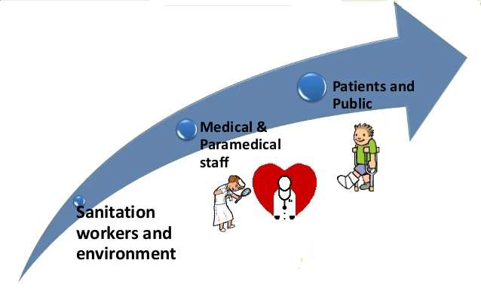

PEOPLE AT RISK

Slide 8

BIOMEDICAL WASTE CHARACTERIZATION
BIOMEDICAL WASTE
75 – 85 %
NON INFECTIOUS
10 – 15 %
INFECTIOUS
5 – 10 %
HAZARDOUS

Slide 9
HEALTH HAZARDS OF HOSPITAL WASTE
Injury from sharps.
Risk of infection outside the hospital for waste handlers/scavengers & eventually general public.
Proliferation of rodents.
Breeding of flies and insects.
Air pollution, Land pollution and Water pollution.
Transmission of infections like HIV, Hepatitis-B and other microbes.
Occupational risk associated with hazardous chemicals, drugs etc.
Unauthorized repackaging & sale of disposable items & unused / expired drugs.
Bad odour.

Slide 10
BENEFITS OF BIOMEDICAL WASTE MANAGEMENT
Cleaner and healthier surroundings.
Reduction in the incidence of hospital acquired and general infections.
Reduction in the cost of infection control within the hospital.
Reduction in the possibility of disease and death due to reuse and repackaging of infectious disposables.
Low incidence of community and occupational health hazards.
Reduction in the cost of waste management and generation of revenue through appropriate treatment and disposal of waste.
Improved image of the healthcare establishment and increase the quality of life.

Slide 11
CATEGORIES OF BIOMEDICAL WASTE SCHEDULE
WASTE CATEGORY | TYPE OF WASTE | TREATMENT AND DISPOSAL OPTION
Category No. 1 | Human Anatomical Waste (Human tissues, organs, body parts) | Incineration / Deep Burial
Category No. 2 | Animal Waste (Animal tissues, organs, body parts, carcasses, bleeding parts, fluid, blood and experimental animals used in research) | Incineration / Deep Burial

Slide 12
Category No. 3 | Microbiology & Biotechnology Waste (Wastes from laboratory cultures, stocks or specimen of live micro organisms or attenuated vaccines) | Local autoclaving/ microwaving / Incineration
Category No. 4 | Waste Sharps (Needles, syringes, scalpels, blades, glass, etc.) | Disinfecting (chemical Treatment /autoclaving / microwaving and mutilation / shredding
Category No. 5 | Discarded Medicine and Cytotoxic drugs (Wastes comprising of outdated, contaminated and discarded medicines) | Incineration / destruction and drugs disposal in secured landfills

Slide 13
Category No. 6 | Soiled Waste (Items contaminated with body fluids including cotton, dressings, soiled plaster casts, lines, bedding and other materials contaminated with blood.) | Incineration / autoclaving / microwaving
Category No. 7 | Solid Waste (Waste generated from disposable items other than the waste sharps such as tubing, catheters, intravenous sets, etc.) | Disinfecting by chemical treatment / autoclaving / microwaving and mutilation / shredding
Category No. 8 | Liquid Waste (Waste generated from laboratory washing, cleaning and disinfecting activities) | Disinfecting by chemical treatment and discharge into drains

Slide 14
Category No. 9 | Incineration Ash (Ash from incineration of any biomedical waste) | Disposal in municipal Landfill
Category No.10 | Chemical Waste (Chemicals used in production of biologicals, chemicals used in disinfecting, as insecticides, etc.) | Chemical treatment and discharge into drains for liquids and secured landfill for solids.

Slide 15
COLOUR CODING FOR THE DISPOSAL OF BIOMEDICAL WASTE
Hospital waste management is a part of hospital hygiene and maintenance activities. In fact only 5-10 % of hospital waste / Biomedical waste is hazardous, not the complete.
But when hazardous waste is not segregated at the source of generation and mixed with nonhazardous waste, then 100% waste becomes hazardous, so colour coding is must for the disposal of hospital waste.

Slide 16
COLOUR | WASTE | TREATMENT
YELLOW | Human & Animal anatomical waste / Micro-biology waste and soiled cotton /dressings /linen / beddings, etc. | Incineration / Deep burial
RED | Tubings, Catheters, IV sets. | Autoclaving / Microwaving / Chemical treatment
BLUE | Waste sharps (Glass items, Scalpels, blades etc.) | Autoclaving / Microwaving / Chemical treatment & Destruction / Shredding
BLACK | Discarded medicines / cytotoxic drugs, Incineration ash, Chemical waste. | Disposal in secured landfill
GREEN | Paper and plastic packing, Unsoiled plaster caster, kitchen waste. | Disposal in secured landfill

Slide 17

STEPS OF BIOMEDICAL WASTE MANAGEMENT
SURVEY OF WASTE GENERATED
SEGREGATION OF HOSPITAL WASTE
COLLECTION & CATEGORIZATION OF WASTE
STORAGE OF WASTE ( NOT BEYOND 48 HRS )
TRANSPORTATION OF WASTE
TREATMENT OF WASTE

Slide 18
ROLE OF NURSE IN BIOMEDICAL
WASTE MANAGEMENT
Regular visit to all wards and high risk units.
Ensuring that samples (blood, stool, urine, etc) are collected and dispose safely.
Monitoring and supervising the staff weather they are doing safe disposal of waste according to the colour code.
Prevention of hospital acquired infections by following universal precautions.
Communicate about workplace hazards.
Make sure that every hospital staff should immunize with hepatitis B vaccine.

Slide 19
PRECAUTIONS TAKEN DURING BIO
MEDICAL WASTE MANAGEMENT
Wash your hands thoroughly using 7 steps of hand washing for 60 seconds.

Slide 20
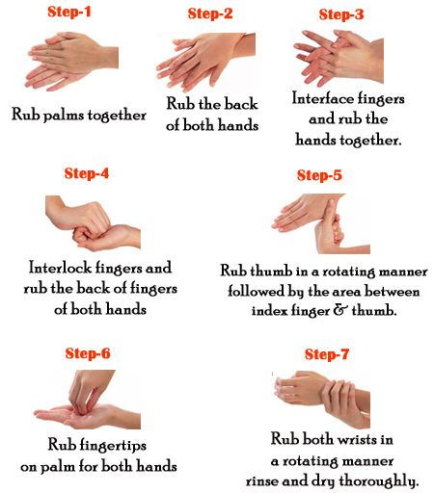

Slide 21

Use personal protective equipment while handling waste.

Slide 22

Never overload bins used for storing Bio Medical Waste. Collect waste when the bin is 3/4th full.

Slide 23
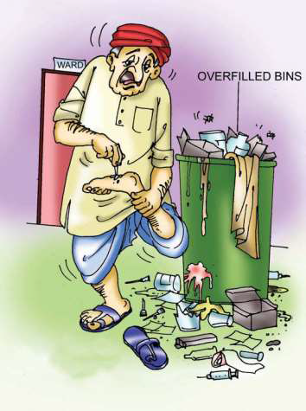
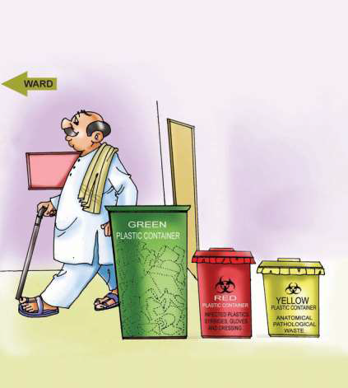

Slide 24
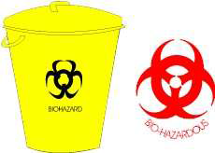
Display the Bio-Hazardous Symbol and the types of waste to be put in each container as per Schedule

Slide 25
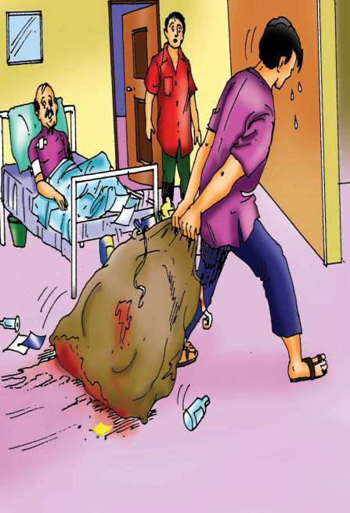
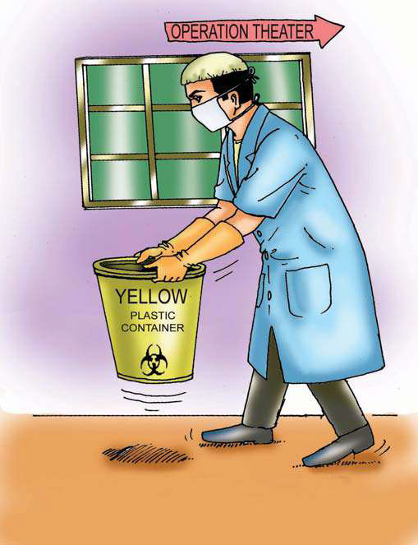
Collection of waste should be done properly.

Slide 26

Never transfer sharps directly from person to person
Avoid needle stick injuries.
Avoid using common lift to move waste.
Avoid spillage.
Clean spills with disinfectant.

Slide 27

Do not inhale chemicals directly. Always use mask.

Slide 28
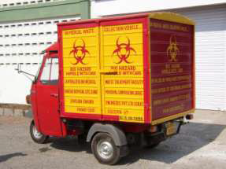
Separate biomedical waste transportation vehicle should be there.

Slide 29
summary
Definition and History of biomedical waste & its management
Laws of biomedical waste management
Biomedical waste statistics
Sources of biomedical waste
People at risk
Biomedical waste characterization
Health hazards of biomedical waste
Benefits of biomedical waste management
Categories of biomedical waste schedule
Colour coding
Steps of biomedical waste management
Role of Nurse
Precautions taken during biomedical waste management

Slide 30


Slide 31
Thank you

