Slide 1
Peripheral Joint Mobilization
Lecture Conducted by
Dr. Noel (PT)

Slide 2
Mobilization- Joint mobilization:
Manipulation-glides-rolling-spin,
types of joint shapes,
Methods of Application,
Indications, Contraindications and Precaution.

Slide 3
Contents
Introduction
Joint Shapes
Types of Motion
Indication
Limitations
Contra indication
Precautions
Grades or Dosages of Movement for Non-Thrust Oscillation and Sustained Techniques
High Velocity Thrust
Suggested Sequence of Treatment to Gain and Reinforce Functional Mobility

Slide 4
Introduction
Also known as manipulation.
Manual therapy techniques that are used to modulate pain and treat joint impairments that limit range of motion (ROM) by specifically addressing the altered mechanics of the joint.
The altered joint mechanics may be due to pain and muscle guarding, joint effusion, contractures or adhesions in the joint capsules or supporting ligaments, or aberrant joint motion.

Slide 5
Joint shapes
The type of motion occurring between bony partners in a joint is influenced by the shape of the joint surfaces. The shape may be described as ovoid or sellar.
In ovoid joints one surface is convex, and the other is concave.
In sellar (saddle) joints, one surface is concave in one direction and convex in the other, with the opposing surface convex and concave, respectively—similar to a horseback rider being in complementary opposition to the shape of a saddle.

Slide 6
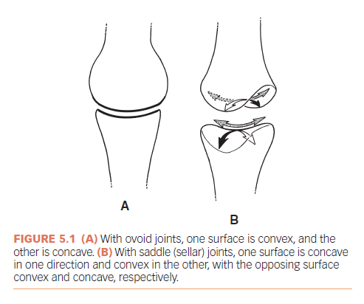
Joint shapes Contd.

Slide 7
Types of Motion
The movement of the bony lever is called swing and is classically described as flexion, extension, abduction, adduction, and rotation.
The amount of movement can be measured in degrees with a goniometer and is called ROM.
Motion of the bone surfaces in the joint is a variable combination of rolling and sliding, or spinning.
These accessory motions allow greater angulation of the bone as it swings.
For the rolling, sliding, or spinning to occur, there must be adequate capsule laxity or joint play.

Slide 8
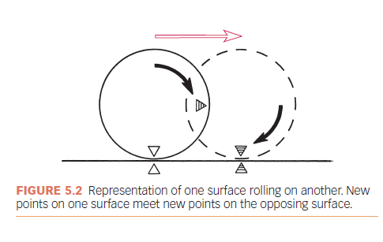
Roll

Slide 9
Roll
Characteristics :
The surfaces are incongruent.
New points on one surface meet new points on the opposing surface.
Rolling results in angular motion of the bone (swing).
Rolling is always in the same direction as the swinging bone motion whether the surface is convex or concave.

Slide 10
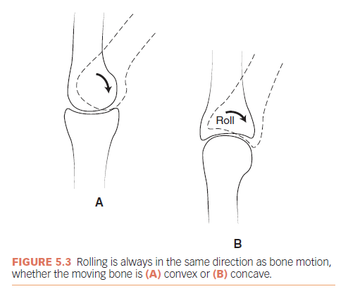
Roll contd.

Slide 11
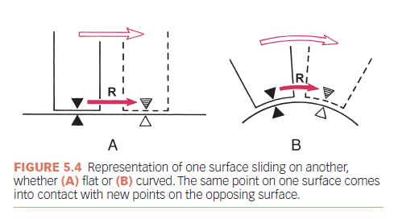
Sliding

Slide 12
For a pure slide, the surfaces must be congruent, either flat (Fig. 5.4 A) or curved (Fig. 5.4 B).
The same point on one surface comes into contact with the new points on the opposing surface.
Pure sliding does not occur in joints, because the surfaces are not completely congruent.

Slide 13
Concave Convex Rule
The direction in which sliding occurs depends on whether the moving surface is concave or convex.
Sliding is in the opposite direction of the angular movement of the bone if the moving joint surface is convex (Fig. 5.5 A).
Sliding is in the same direction as the angular movement of the bone if the moving surface is concave

Slide 14
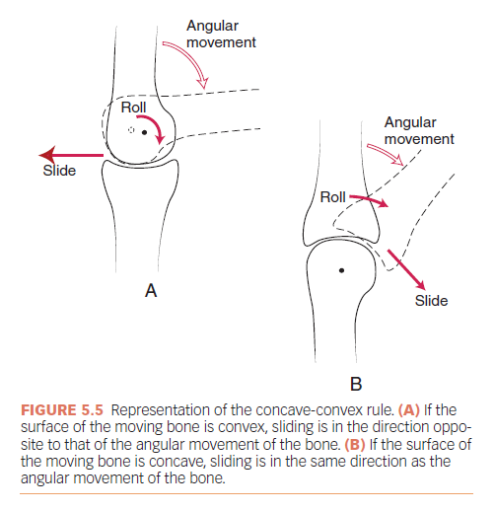
Concave Convex Rule

Slide 15
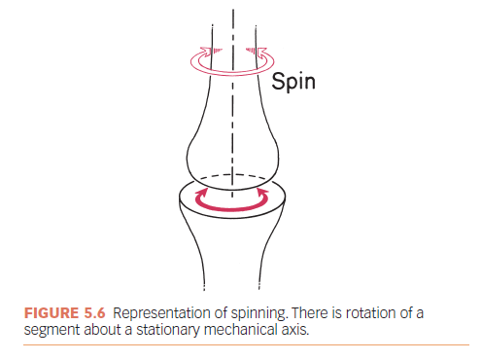
Spin

Slide 16
Spin
There is rotation of a segment about a stationary mechanical axis (Fig. 5.6).
The same point on the moving surface creates an arc of a circle as the bone spins.
Spinning rarely occurs alone in joints but in combination with rolling and sliding.
Three examples of spin occurring in joints of the body are the shoulder with flexion/extension, the hip with flexion/extension, and the radiohumeral joint with pronation/supination (Fig. 5.7).

Slide 17
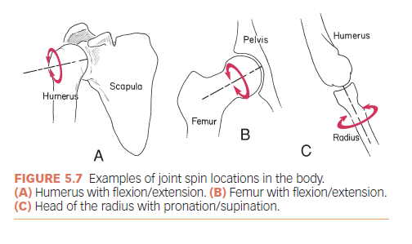
Joint spin in the Body

Slide 18
Other Accessory Motions
Compression is the decrease in the joint space between bony partners.
Compression normally occurs in the extremity and spinal joints when weight bearing.
Some compression occurs as muscles contract, which provides stability to the joints.
As one bone rolls on the other (see Fig. 5.3), some compression also occurs on the side to which the bone is angulating.
Normal intermittent compressive loads help move synovial fluid and, thus, help maintain cartilage health.
Abnormally high compression loads may lead to articular cartilage changes and deterioration

Slide 19
Other Accessory Motions Contd.
Traction/Distraction
Whenever there is pulling on the long axis of a bone, the term long-axis traction is used.
Whenever the surfaces are to be separated, the term distraction, joint traction, or joint separation is used.

Slide 20
Indication
Pain, Muscle Guarding, and Spasm
Reversible Joint Hypomobility
Positional Faults/Subluxations
Progressive Limitation
Functional Immobility

Slide 21
Limitation
It cannot change the disease process of disorders such as rheumatoid arthritis or the inflammatory process of injury.
skill of the therapist affects the outcome.
If the maneuvers are applied too vigorously for the condition, joint trauma or hypermobility may result.

Slide 22
Contra indication
The only true contraindications to mobilization/manipulation stretching techniques are hypermobility, joint effusion, and inflammation.

Slide 23
Precaution
Mobilization may be used with extreme care in the following conditions if the signs and the patient’s response are favorable.
Malignancy.
Bone disease detectable on radiographs.
Unhealed fracture.
Excessive pain.
Hypermobility in associated joints.
Total joint replacements
Newly formed or weakened connective tissue such as immediately after injury, surgery, or disuse or when the patient is taking certain medications such as corticosteroids.

Slide 24
Systemic connective tissue diseases such as rheumatoid arthritis, in which the disease weakens the connective tissue.
Elderly individuals with weakened connective tissue and diminished circulation.

Slide 25
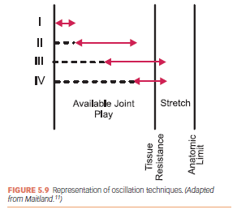
Grades or Dosages of Movement for
Non-Thrust Oscillation Techniques

Slide 26
Grade I. Small-amplitude rhythmic oscillations are performed at the beginning of the range. They are usually rapid oscillations, like manual vibrations.
Grade II. Large-amplitude rhythmic oscillations are performed within the range, not reaching the limit. They are usually performed at 2 or 3 per second for 1 to 2 minutes.
Grade III. Large-amplitude rhythmic oscillations are performed up to the limit of the available motion and are stressed into the tissue resistance. They are usually performed at 2 or 3 per second for 1 to 2 minutes.
Grade IV. Small-amplitude rhythmic oscillations are performed at the limit of the available motion and stressed into

Slide 27
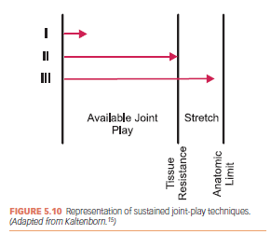
Grades or Dosages of Movement for
Non Thrust Sustained Techniques

Slide 28
As indicated by the name, rate of application is slow and sustained for several seconds followed by partial relaxation and then repeated depending on the indications.
Grade I (loosen). Small-amplitude distraction is applied when no stress is placed on the capsule. It equalizes cohesive forces, muscle tension, and atmospheric pressure acting on the joint.
Grade II (tighten). Enough distraction or glide is applied to tighten the tissues around the joint. Kaltenborn15 called this “taking up the slack.”
Grade III (stretch). A distraction or glide is applied with an amplitude large enough to place stretch on the joint capsule and surrounding periarticular structures.

Slide 29
Thrust Manipulation/High Velocity
Thrust (HVT)
HVT is a small-amplitude, high-velocity technique.
Prior to application, the joint is moved to the limit of the motion so that all slack is taken out of the tissue, then a quick thrust is applied to the restricting tissue. It is important to keep the amplitude of the thrust small so as not to damage unrelated tissues or lose control of the maneuver.
HVT is applied with one repetition only.
HVT is used to snap adhesions or is applied to a dislocated structure to reposition the joint surfaces.

Slide 30
Suggested Sequence of Treatment to Gain and Reinforce Functional Mobility
1. Warm the tissues.
2. Relax the muscles.
■ Hold-relax inhibition technique
■ Grade I or II joint oscillation techniques
3. Joint mobilization stretches.
■ Position and dosage for level of tissue tolerance
4. Passive stretch periarticular tissues.

Slide 31
5. Patient actively uses new range.
■ Reciprocal inhibition
■ Active ROM
■ Functional activities
6. Maintain new range; patient instruction.
■ Self-stretching
■ Auto-mobilization
■ Active, resistive ROM
■ Functional activities using the new range

