Slide 1
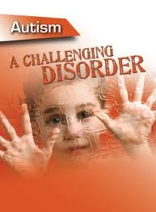

Prepared by:
Mr. Suresh V.
Associate Professor
Department of Mental health nursing
Sumandeep Nursing college

Slide 2
INTRODUCTION
This condition was originally described by Kanner in 1943.
He called it as ‘Infantile Autism’.
The children with autism often have extreme difficulty in developing normal relationship with others.
It is a life long disease.

Slide 3
CONCEPT
A pervasive development disorder.
Autistic disorder is characterized by inappropriate responses to the environment & pronounced impairments in language, communication, & social interaction.
It begins during childhood & lasts throughout life.
Typically, the autistic child has disordered thinking.
He may have severe learning difficulties, impaired intelligence, & difficulty understanding & using language.

Slide 4
Count…
He has trouble understanding the feelings of others & the world around him.
Also, he may demonstrate repetitive, self-injurious, or other abnormal behaviors.
An autistic child appears aloof from others & lacks interested in social interactions
Autistic disorder occurs in 10 t012 of every 10,000 children & is up to five times more common in boys than girls.

Slide 5
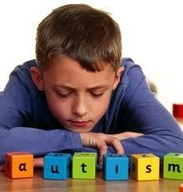
definition
Autistic disorder
known also infantile autism childhood disorder almost always develops before the age of 3yrs and is characterized by impaired verbal and non-verbal communication, social interaction, some form of repetitive and restricted stereotyped ritual or other behavior.

Slide 6

incidence
Identified a relatively homogenous group of children with onset of psychosis in the 1st and 2nd yr of life.
Autism affects males four times more often than females.

Slide 7
CLASSIFICATION
F84 - Pervasive developmental disorders
F84.0 - Childhood autism
F84.1 - Atypical autism
F84.2 - Rett's syndrome
F84.3 - Other childhood disintegrative disorder
F84.4 - Over active disorder associated with mental retardation and stereotyped movements
F84.5 - Asperger's syndrome
F84.8 - Other pervasive developmental disorders
F84.9 - Pervasive developmental disorder, unspecified

Slide 8
TERMINOLOGY
High functioning autism
A sub-area of the autistic spectrum, characterized by less severe symptoms and/or higher intellectual level.
Continuum:
A dimension of continuous variation, without breaks or discreet steps.
Cognitive phenotype for autism:
A distinctive profile of cognitive skills or strategies characteristic of the autistic spectrum that is the outward (phenotypic) expression of genetic attributes (genotype), in interaction with environment.

Slide 9
Cont…
Asperger's syndrome:
A sub-type of autistic spectrum disorder similar or identical to High Functioning Autism. Clinicians disagree about whether it involves language difficulties, and how far it is qualitatively distinct from other autistic spectrum disorders.
Expressive language:
Competence in the production of language.
Receptive language:
Competence in understanding language produced by others.

Slide 10




Slide 11
Etiology
No known single cause for autistic exist, but some studies suggest it may stem from abnormalities in brain structure or function. Brain scans show differences in brain shape & structure in autistic children.
Other possible causes of autistic disorder include medical problems & a genetic predisposition. Couples with one autistic child have roughly a 7% chance of having another.

Slide 12
Count…
Researchers are also investigating possible links between autism and:
Pregnancy or delivery complications
Environmental factors, such as viral infections, infant vaccines, metabolic imbalances, & exposure to environmental chemicals.

Slide 13
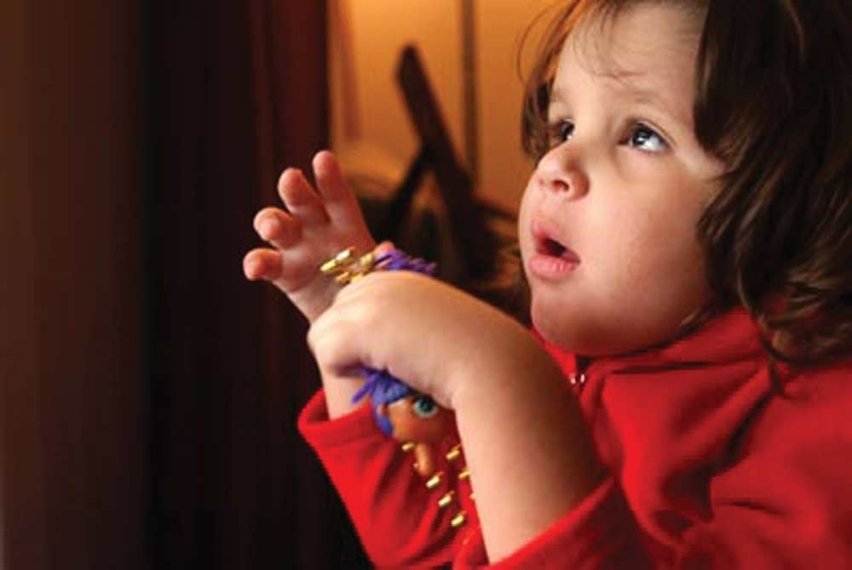
Genetic factors
Biochemical
factors
Medical factors
Psychodynamic
Parenting
influences
Social env.
Theory-of-mind in
autism
Neuroanatomical
studies

Slide 14
clinical features…..
Behavioral characteristics:
autistic aloofness
lack of eye to eye contact
disliked being touched or kissed
failure to play with the peer groups
failure to develop empathy
marked lack of awareness of the existence
anger or fear without apparent reason and absence of fear in the presence of danger

Slide 15
(B ) Communication and language:
Gross deficit and deviances in language development
No mode of communication
Absence of imaginative activity
Marked abnormalities in the form of speech
Marked abnormalities in the production of speech

Slide 16
(C) SOCIAL RELATIONSHIP
Fail to seek comfort
fail to develop relationship with peers
no social smile or eye contact
do not like to mingle with other children
unable to relate to parents or other people.

Slide 17
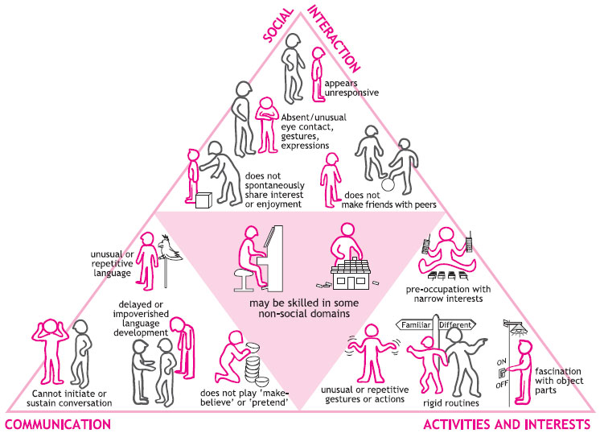

Slide 18
OTHER FEATURES
Hyperkinesis
aggression
temportantrums
self-injurious behaviour
head banging
biting
hair pulling

Slide 19
DIAGNOSIS
Usually, autistic disorder is diagnosed by age 3.
After ruling out other disorders (such as neurological disorders, hearing loss, speech problem, & mental retardation), the pediatrician typically refers the child to an autism specialist. The professional may be a child psychiatrist, child psychologist, developmental pediatrician, or pediatric neurologist.
The autism specialist used various methods to identify the disorder, including a standardized rating scale to help evaluate the child’s social behavior & language.

Slide 20
Count…
Developmental screening may reveal behaviors that suggest autism, such as:
Failure to babble or coo by age 12 months
Failure to gesture (point, wave, or grasp) by age 12 months
Failure to say single words by age 16 months
Failure to say two-word phrases on his own by age 24 months
Loss of language or social skills at any age.

Slide 21
Count…
After evaluation & testing, the autism specialist diagnosed autistic disorder based on clear evidence of:
Poor or limited social relationships
Underdeveloped communication skills
Repetitive behaviors, activities, & interests.

Slide 22

Treatment
Anti-psychotics
Anti-depressents
Other drugs….
anti-convulscants
mood-stabilizers

Slide 23
PSYCHOTHERAPY:
Behavior methods:
Contingency management may control some of the abnormal behavior of autistic children. Contingency management refers to a group of procedures based on the principle that,, if any behavior persists, certain of its consequences can be altered, the behavior will change.
Group therapy
Individual therapy
Family therapy
Play therapy
Individual therapy
Supportive therapy

Slide 24
COURSE AND PROGNOSIS
Autistic disorder has a long course and guarded prognosis.
About 10% to 20% autistic children begin to improve between 4 and 6 age and eventually attend on ordinary school and obtain work.
10% to 20 % can live at home, but need to attend a special school or training center and cannot work.
60% improve little and are unable to lead an independent life, mostly needing long-term residential care.
Those who improve may continue to show language problem, emotional coldness and odd behavior.

Slide 25

NURSING DIAGNOSIS
Risk for self-mutilation related to neurological alterations.
Impaired social interaction related to inability to trust; neurological alterations.
Impaired verbal communication related to withdrawal into the self; inadequate sensory stimulation; neurological alterations.
Disturbed personal identity related to inadequate sensory stimulation; neurological alterations.

Slide 26
NURSING INTERVENTION
Choose your words carefully when speaking to a verbal autistics child. The child is likely to interpret words concretely & may interpret a harmless request as a threat.
Offer emotional support & information to the parents. Suggest they meet with parents of other autistic children for advice on coping with tantrums, toilet training, & other problems.
To promote communication, advice the parents to have close, face-to-face contact with child.

Slide 27
Count…
Teach the parents to maintain a regular, predictable daily routine, with consistent times for waking up, dressing, eating, attending school, & going to bed.
Suggest that the parents use a picture board showing the activities that will occur during the day to help the child make transitions more easily.
If the child’s routine must changed, instruct the parents to prepare the child for the changes.
Advise the parents to avoid situations known to trigger out bursts.

Slide 28
Count…
Teach the parents how to recognize the behaviors that precede temper tantrums, such as increased hand flapping. Instruct them to intervene before a tantrum occurs.
Instruct the parents on ways to make the home safer- for instance, by installing locks & gates so the child can’t wander unsupervised.
If the child’s behavior is self-injurious, advise the parents on ways to prevent injury.
Inform the parents that punishment may worsen self-injurious behavior
Help the parents devise a plan to improve behavior by giving tangible rewards for desired behavior.

Slide 29
Thank you …

