Slide 1

NERVOUS SYSTEM
Prepared by:
Mr. Suresh V.
Associate Professor
Department of Mental health nursing
Sumandeep Nursing college

Slide 2
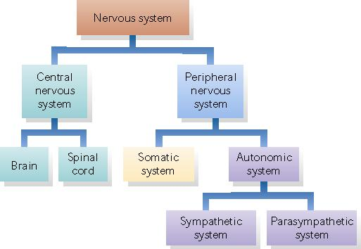
Nervous system can be divided into two parts

Slide 3
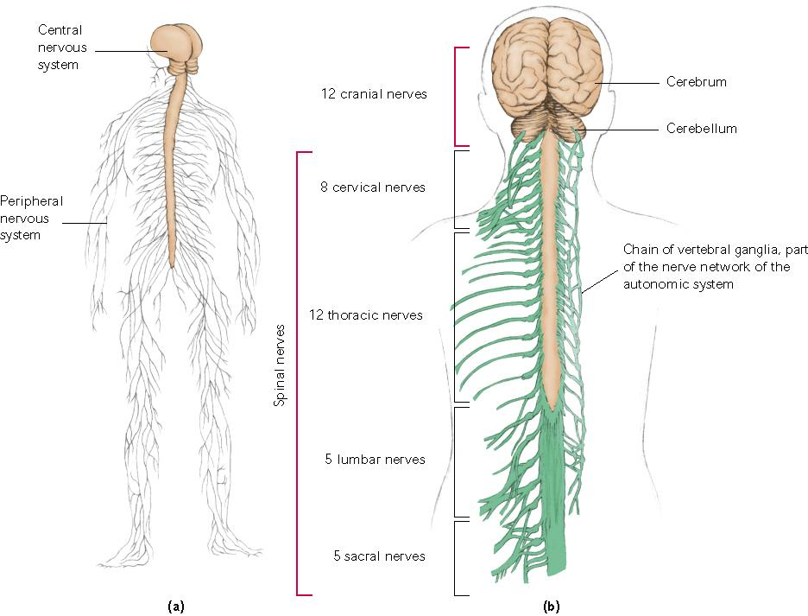

Slide 4
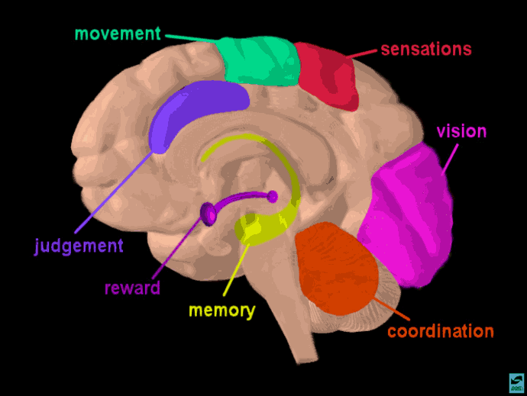

Slide 5
Central nervous system
It consist of brain and spinal cord
Brain composed of 3 main division.
  FORE BRAIN
  MID BRAIN
  HIND BRAIN

Slide 6
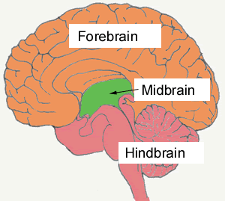

Slide 7
  FORE BRAIN
Consist of following parts
  Thalamus
  Hypothalamus
  Limbic system
  Cerebral cortex

Slide 8
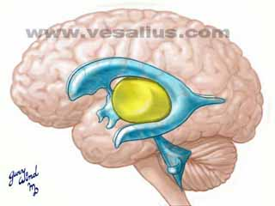
  Thalamus
As you'll remember, the thalamus is that central yellow structure.

Slide 9
The "hypo-thalamus" (literally, the under-thalamus) However, these structures are right in the very center of the brain.
All the sensory impulses pass through thalamus to higher centers, its act as a relay station. And has control over the autonomic nervous system and also plays a role in the control of sleep and alertness.

Slide 10
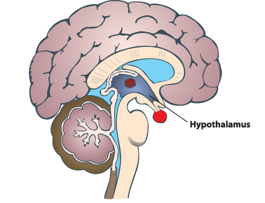
Hypothalamus

Slide 11
Hypothalamus just lies below the thalamus and above the mid brain.
Its act as key influence on all kind of emotional as well as motivational behaviors.
hypothalamus controls body temperature, hunger, thirst, sleep and sex.
And also it controls the activity of pituitary gland.

Slide 12
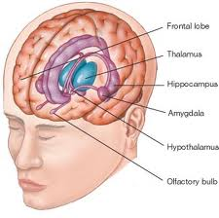
Limbic system

Slide 13
The limbic system is comprised main structures: the amygdala, the hippocampus and the olfactory bulb.
These structures form connections between the limbic system and the hypothalamus, thalamus and cerebral cortex.
The hippocampus is important in memory and learning, while the limbic system itself is central in the control of emotional responses.

Slide 14
Limbic System function
Amygdala - almond shaped mass of nuclei involved in emotional responses, hormonal secretions, and memory.
Hippocampus - a tiny nub that acts as a memory indexer -- sending memories out to the appropriate part of the cerebral hemisphere for long-term storage and retrieving them when necessary.
Sexual behavior.
Emotional behavior.

Slide 15
The Cerebrum
The cerebrum or cortex is the largest part of the human brain, associated with higher brain function such as thought and action.
The cerebral cortex is divided into four sections, called "lobes": the frontal lobe, parietal lobe, occipital lobe, and temporal lobe.

Slide 16
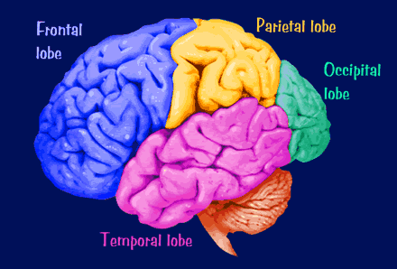
Here is a visual representation of the cortex

Slide 17
What do each of these lobes do?
Frontal Lobe- associated with reasoning, planning, parts of speech, movement, emotions, and problem solving.
Parietal Lobe- associated with movement, orientation, recognition, perception of stimuli

Slide 18
Occipital Lobe- associated with visual processing.
Temporal Lobe- associated with perception and recognition of auditory stimuli, memory, and speech

Slide 19
A deep furrow divides the cerebrum into two halves, known as the left and right hemispheres. The two hemispheres look mostly symmetrical yet it has been shown that each side functions slightly different than the other.
Sometimes the right hemisphere is associated with creativity and the left hemispheres is associated with logic abilities. The corpus callosum is a bundle of axons which connects these two hemispheres.

Slide 20
midbrain
The midbrain is the smallest region of the brain that acts as a sort of relay station for auditory and visual information.
The midbrain controls many important functions such as the visual and auditory systems as well as eye movement. Portions of the midbrain called the red nucleus and the substantia nigra are involved in the control of body movement. The darkly pigmented substantia nigra contains a large number of dopamine-producing neurons are located.

Slide 21
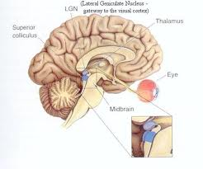

Slide 22
hindbrain
The hindbrain is located in lower portion of a person’s brain. It is responsible for controlling a number of important body functions and process, including respiration and heart rate. The brain stem is an important part of the hindbrain, controlling functions that are critical to life, such as breathing and swallowing. The cerebellum is also part of the hindbrain, playing a role in physical ability.
The brain stem is a structure that connects the brain to the spinal cord. Damage to this structure can be catastrophic, as the brain stem controls such things as blood pressure, heartbeat, and swallowing. The brain stem consists of three parts of the hindbrain, including the medulla, pons and reticular formation.

Slide 23
The medulla is the part of the hindbrain that controls how and when a person’s heart beats, as well as his blood pressure, breathing, and even his ability to swallow or cough. This part of a person’s brain stem functions by itself, without relying on the person’s thoughts. It is the reason a person’s heart beats without him making it do so.

Slide 24
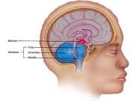
hindbrain

Slide 25
The reticular formation is also part of the brain stem. It is a network of nerves important to a person’s attention or focus, as well as his response to stimuli. This part of the brain helps a person focus on just one important thing even if he’s faced with several types of stimuli at once. The reticular formation blocks less important stimuli when a person needs to focus on one thing. For example, if a person is almost in an accident, the reticular formation blocks other stimuli, allowing him to focus solely on preventing the accident.
Interestingly, the reticular formation slows down when a person goes to sleep

Slide 26
The pons is the part of the hindbrain located above the medulla. This structure forms a kind of bridge between the medulla and another part of the hindbrain called the cerebellum. It relays messages between the cerebellum and the cerebrum, which is part of the forebrain. It helps control movement and plays a role in sleep.
The cerebellum is located to the rear of the brain stem. Its role involves muscle tone and posture. It influences motor control and helps a person to perform smooth, controlled movements. It’s also important in coordinating movements people make without thinking or concentrating first, such as walking forward.

Slide 27
Spinal cord
It works as a channel of communication.
Rope like structure have long nerve fibers.

Slide 28
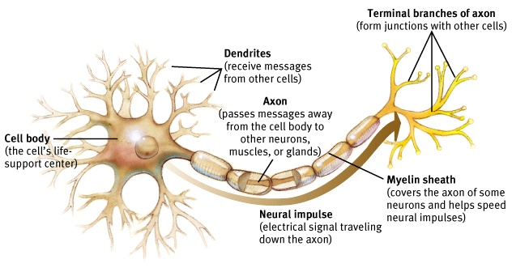
Neuron Structure
Neurons do NOT touch each other- the space in between is call the synapse.

Slide 29
While there are as many as 10,000 specific types of neurons in the human brain, generally speaking, there are three kinds of neurons.

Slide 30
Types of Neurons
Sensory Neurons
Motor Neurons
Inter Neurons

Slide 31
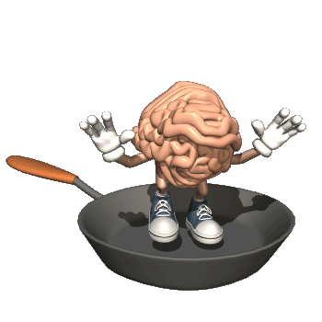
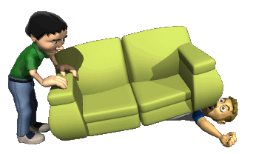
Sensory Neurons
(Afferent Neurons)
Take information from the senses to the brain.

Slide 32
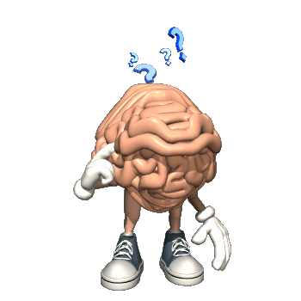
Inter Neurons
Take messages from Sensory Neurons to other parts of the brain or to Motor Neurons.

Slide 33
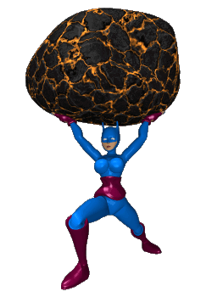
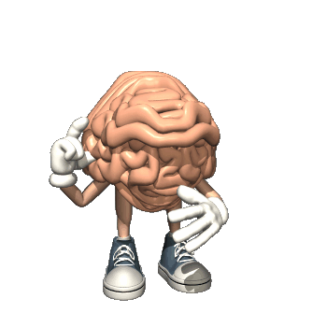
Motor Neurons
(Efferent Neurons)
Take information from brain to the rest of the body.

Slide 34
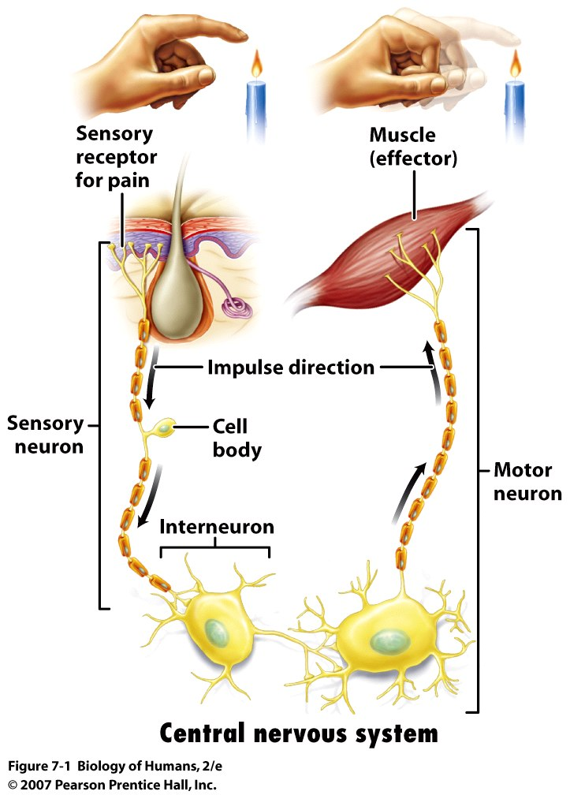
Basic Organization
sensory receptor (sensory input) → integration → (motor output) → effector
Sensory Input triggered by stimuli
  conduction of signals to processing center
Integration
  interpretation of sensory signals within processing centers
Motor output
  conduction of signals to effectors cells (i.e. muscles, gland cells)

Slide 35
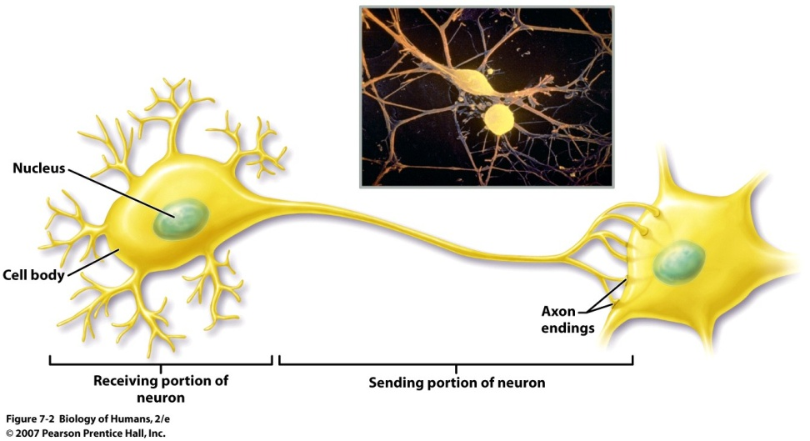
Neuron
Dendrite - conducts “signal” toward the cell body -- [input zone]
  often short, numerous & highly branched
  signal comes from sensory cell or neighboring neuron
Axon - usually a single fiber -- [conducting zone]
  conducts signal away from cell body to another neuron or effector cell
Axon Ending
  a cluster of branches (100’s to 1000’s)
  each with a bulblike synaptic knob
  relays signal to next neuron / effectors cell

Slide 36
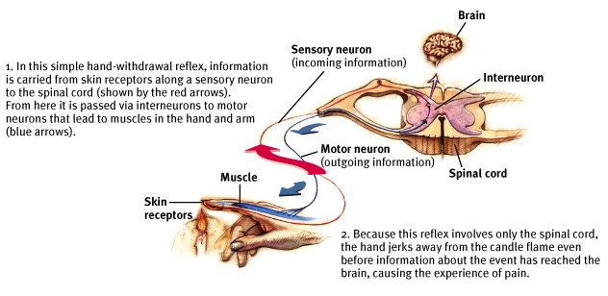
A Simple Reflex

Slide 37
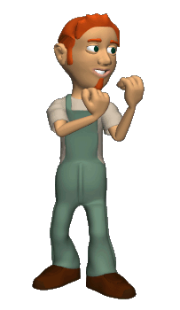
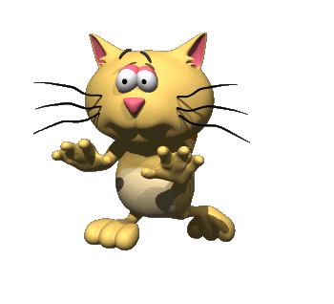
Sympathetic Nervous System
Flight or Fight Response

Slide 38
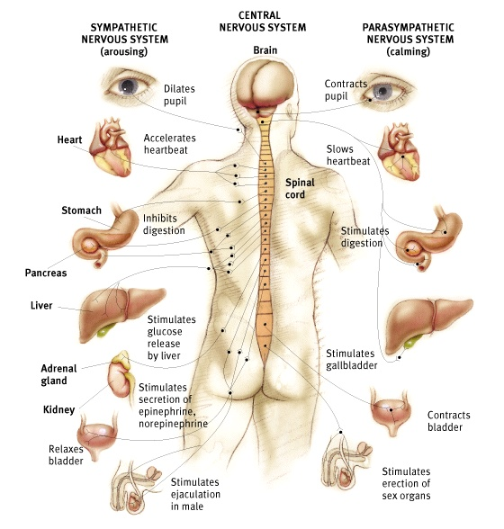

Slide 39
Neurotransmission
Neurotransmission (or synaptic transmission) is communication between neurons as accomplished by the movement of chemicals or electrical signals across a synapse. For any interneuron, its function is to receive INPUT "information" from other neurons through synapses, to process that information, then to send "information" as OUTPUT to other neurons through synapses.
http://www.mind.ilstu.edu/curriculum/neurons_intro/neurons_intro.php

Slide 40
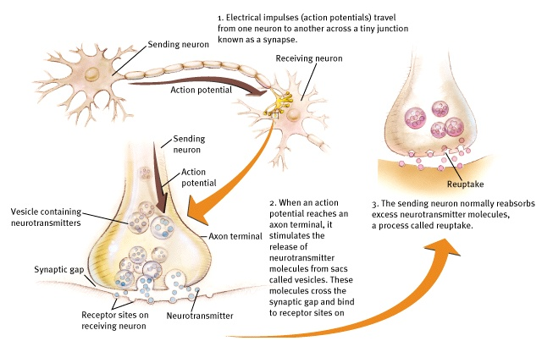
How Neurons Communicate

Slide 41
Overview of Transmission of Nerve Impulse
Action potential
  → synaptic knob
  → opening of Ca⁺ channels
  neurotransmitter vesicles fuse with membrane
  release of neurotransmitter into synaptic cleft
  binding of neurotransmitter to protein receptor molecules on receiving neuron membrane
  opening of ion channels
  triggering of new action potential
Neurotransmitter is broken down by enzymes.

Slide 42
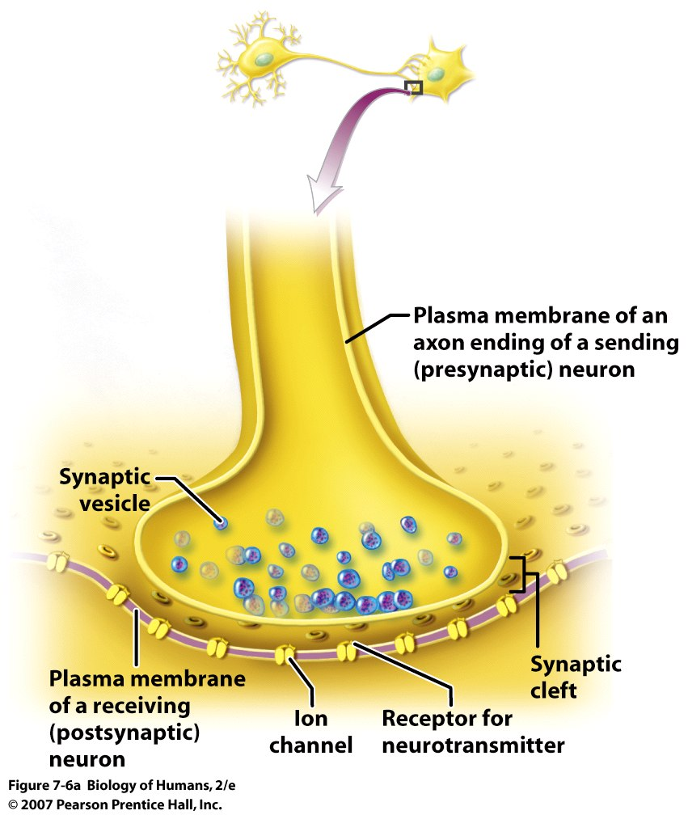
Nerve Impulse
Presynaptic neuron
Vesicles
[Calcium channels]
Synaptic cleft
Postsynaptic neuron
Neurotransmitter receptor

Slide 43
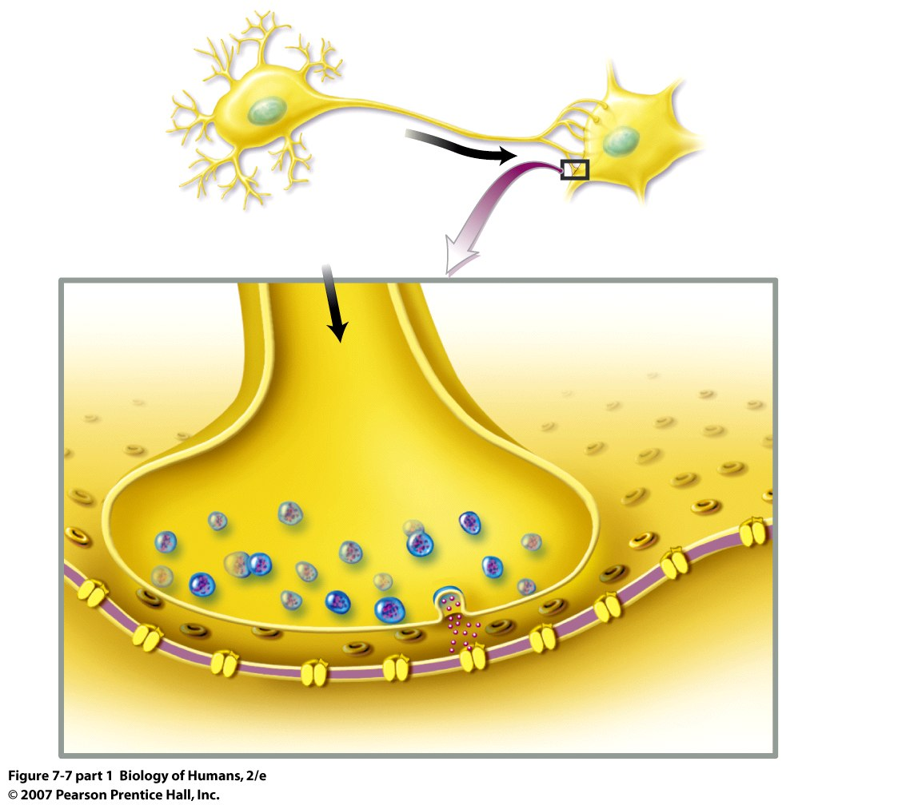
Nerve Impulse
Action potential
  → synaptic knob
  → opening of Ca⁺ channels
  neurotransmitter vesicles fuse with membrane
  release of neurotransmitter into synaptic cleft
Ca²⁺

Slide 44
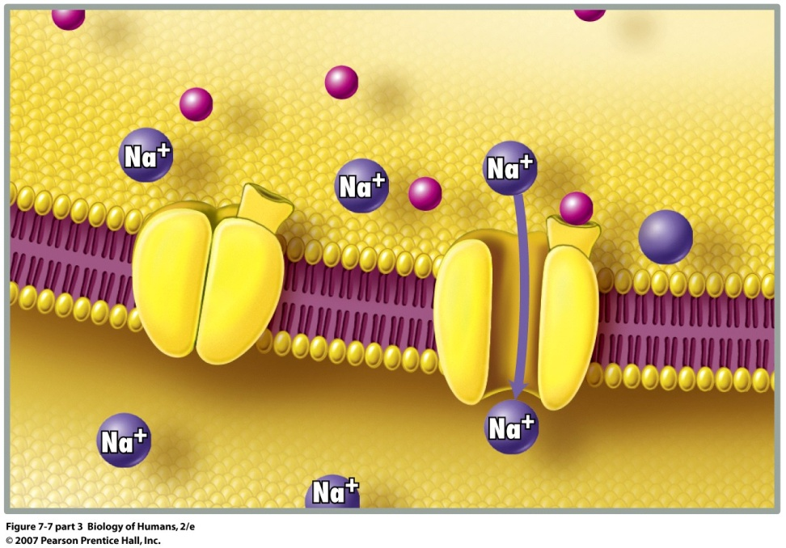
Action potential
  binding of neurotransmitter to protein receptor molecules on receiving neuron membrane
  opening of sodium channels
  triggering of new action potential

Slide 45
Neurotransmitters
Chemical messengers released by terminal buttons through the synapse.
We should know at least 4 types and what they do.

Slide 46
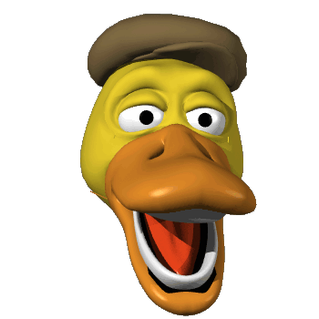
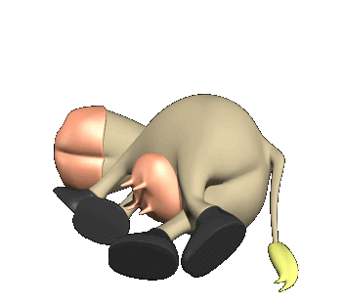
Acetylcholine
Its function is motor movement and maybe memory.
To much and you will….
Not enough and you will….
Lack of ACH has been linked to Alzheimer’s disease.

Slide 47


Dopamine
Its function is motor movement and alertness.
Lack of dopamine is associated with Parkinson’s disease.
Overabundance is associated with schizophrenia.

Slide 48

Serotonin
Function deals with mood control.
Lack of serotonin has been linked to depression.

Slide 49

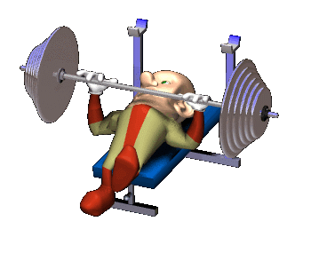
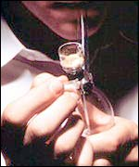
Endorphins
Function deals with pain control.
We become addicted to endorphin causing feelings.

