Slide 1
Posture deviation
By: Dr Saraswati

Slide 3
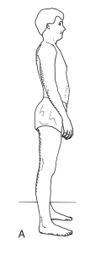
1. Lordotic posture
It characterized by increase in lumbosacral angle and increase in lumber lordosis
Increase in the anterior pelvic tilt and hip flexion
Often seen with increase thoracic kyphosis and forward head: kypholordotic posture

Slide 4
Potential muscle impairment
Common cause: sustained faulty posture, pregnancy, obesity
Mobility impairment(tightness): hip flexors and lumbar extensor
Impaired muscle performance (weakness): due to stretched and weak abdominals

Slide 5

2. Slouched posture
Also known as sway back
usually shifting of the entire pelvic segment anteriorly, resulting hip extension
shifting of thoracic segment posteriorly, resulting in fexion of the thorax on the upper lumbar spine
Increase lordosis in lower lumbar region
Increase khyphosis in thoracic region
Forward head

Slide 6
Potential muscle impairment
Causes: attitudinal, fatigue, muscle weakness
Mobility impairment (tightness): upper abdominal muscles, intercostals, hip extensor and lower lumbar extensors
Impaired muscle performance (weakness): stretched and week lower abdominals, extensor muscles of lower thoracic & hip flexors

Slide 7

3. Flat low back posture
Decreased lumbo sacral angle
Decreased lumbar lordosis , hip extension
Posterior tilt of pelvis
Causes:
continued slouching or flexing in sitting or standing posture
Over emphasis on flexion exercise in general exercise program

Slide 8
Potential muscle impairment
Mobility impairment: trunk flexors
( rectus abdominis, intercostals), hip extensors
Impaired muscle performance: weak lumbar extensor and hip flexors

Slide 9
Cervical & thoracic region
Round back:
Rounded back with forward head posture is characterized by an increased thoracic curve, protected scapulae ( round shoulder) & forward head
Increased flexion of the lower cervical & upper thoracic region

Slide 10
Potential muscle impairment
Mobility impairment: intercostals , muscles of upper limb originating from thorax
( pectoralis major & minor, Latissimus dorsi, serratus anterior)
Impaired muscle performance: lower cervical, upper thoracic erector spine, rhomboids, middle trapezius

Slide 11
2. Flat upper back & neck posture
Decrease thoracic curve, depressed scapulae, depressed clavicles, decrease cervical lordosis with increased flexion of the occiput on atlas
Not common posture deviation
Military posture

Slide 12
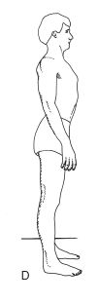
Potential muscle impairment
Mobility impairment: ant neck muscles, thoracic erector spine muscle, scapular retractors, restricted scapular muscle
Impaired muscle performance: scapular protractor, intercostals muscles of the anterior thorax

Slide 13
scoliosis
Lateral curvature of spine
Involves thoracic and lumbar region
S- curve C- curve
In right handed individuals, mild right thoracic, left lumbar S- curve or a mild left thoracolumbar C- curve
Asymmetry in the hips, pelvis and lower extremities

Slide 14
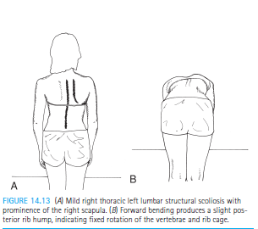

Slide 15
Two types
1 structural scoliosis involve irreversible lateral curvature with fixed rotation of the vertebrae
Rotation towards convexity
2. Nonstructural scoliosis: reversible, can changed with forward flexion and with positional changes as lying supine, realignment of the pelvis by correction of leg length discrepancy
Also known as functional or postural scoliosis

Slide 16
Potential muscle impairment
Mobility impairment: on concave side
Impaired muscle performance: due to weakness of muscles of convex side
With advanced structural scoliosis, cardiopulmonary impairment may restrict function

Slide 17
Intervention
1. Kinesthetic awareness
2. Mobility / flexibility exercise
3. muscle performance: stabilization, muscle endurance & strength training

Slide 18
1. Kinesthetic awareness :
Goal: to develop propreoception of spinal positioning, safe movement & postural control.
Position of symptom relief :
Patient must learn how to move the spine and find the range or position in which symptoms are minimized
The position of symptoms relief is called the position of bias or resting position

Slide 19
Cervical spine
Patient position: supine progress to sitting & other functional postures as tolerated
Passively move the head & neck with gentle nodding motion of head in to flexion and extension & rotation to find the most comfortable position for the patient
Describe the mechanics of what you are doing to the patient

Slide 20
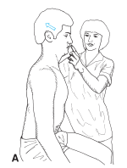
Have the patient identify the change in symptoms as movement occurs in and out of the position of bias
Have the position practice moving in to and out of that position to develop control

Slide 21
Lumbar spine
Patient position and procedure:
Begin supine or hook lying and progress to sitting, standing and quadruped
Teach the patient to move his or her pelvis into an anterior and posterior pelvic tilt through the range that is comfortable
If active movement and control is not possible, teach passive positioning

Slide 22
2. Mobility / flexibility exercise
Goal: to increase ROM of specific structure that affect alignment and mobility in the neck and trunk
Cervical and upper thoracic region- stretching techniques
Techniques to increase thoracic extension:

Slide 23
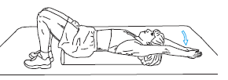
Self stretching :
Patient position: hook lying, with both arm elevated overhead allows gravity to apply the stretch force
Patient attempts to keep the back flat on the mat while inhaling and expanding the anterior thorax

Slide 24
sitting position: sitting on a firm, straight back chair with the hands behind the head or held abducted and externally rotated 90.
Patient then bring the elbows out to the side as the scapulae are adducted and thoracic spine is extended to combine with breathing, have the patient inhale as he or she takes the elbows out to the side & exhale as the elbows are brought in front of the face

Slide 25
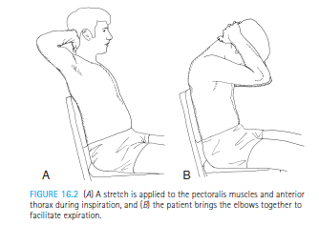

Slide 26
Mid & lower thoracic and lumbar regions- stretching
Techniques to increase lumbar flexion:
Hook lying position
Have the patient first bring one knee and the other towards the chest.
Clasp the hands around the thighs and pull them to the chest, elevating the sacrum off the mat

Slide 27
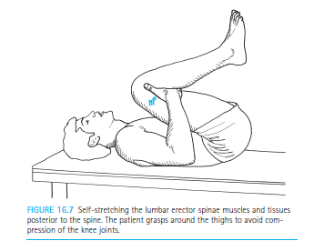
Techniques to increase lumbar flexion:

Slide 28
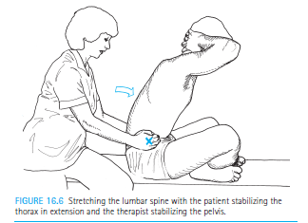
Mid and lower thoracic region stretching

Slide 29
Techniques to increase lumbar extension
Prone press up : Prone, with hands placed under the shoulder. Have the patient extend the elbows and lift the thorax up off the mat but keep the pelvis down on the mat.
This exercise also stretches the hip flexor muscles and soft tissue anterior to the hip

Slide 30
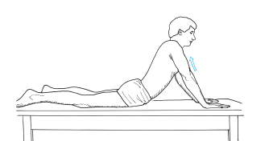
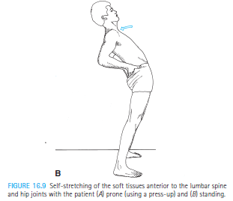
Techniques to increase lumbar extension

Slide 31
Techniques to increase lateral flexibility
Patient position and procedure:
Side lying over the edge of a mat table with rolled towel at the apex of the curve and the top arm stretched overhead.
Stabilize the iliac crest
Hold this head down position as long as possible

Slide 32
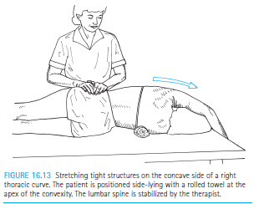
Techniques to increase lateral flexibility

Slide 33
3. Stabilization training
isometric exercise & dynamic exercise
A. Cervical region:
1. Isometric – self resistance
Position of patient: sitting
Have the patient place both hands on forehead and press the forehead into the palms in nodding fashion while not moving

Slide 34
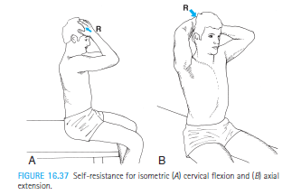
Cervical Isometric – self resistance

Slide 35
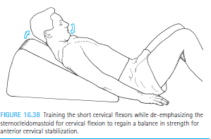
2. Dynamic cervical flexion:
Position of the patient: supine or lying on the wedge
Have the patient practice tucking the chin and curling the head up

Slide 36
Thoracic and lumbar region
Dynamic strengthening :
Trunk flexion:
Supine or hook lying with the lumbar spine neutral
Spine should not be allowed to go into an increased lordosis during exercise

Slide 37
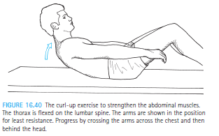
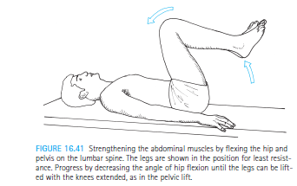
Trunk flexion

Slide 38
Progress to exercise on unstable surface like gym ball
Trunk extension
Thoracic elevation. Begin with the arms at the side , progress to behind the head as strength improves.
Have the patient tuck in the chin and lift the head and thorax.
The lower extremities must be stabilize

Slide 39
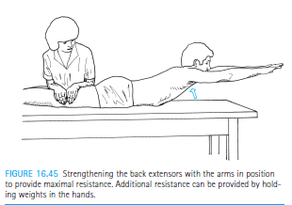
Trunk extension

Slide 40
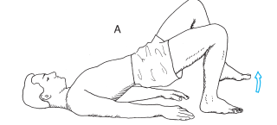
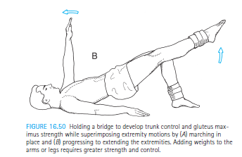
Preparation for functional activities
Modified bridging

Slide 41
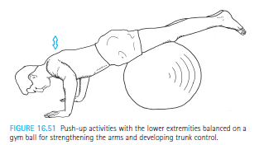
Push ups with trunk stabilization

Slide 42
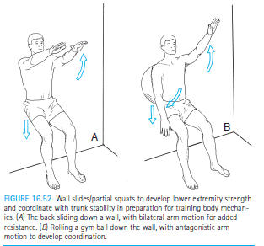
Wall slides

Slide 43
Thank you

Slide 44
MCQs
1. The causes of lordotic posture
Sustained faulty posture
Pregnancy
Obesity
All of the above
2. Non structural scoliosis is irreversible
True
False

Slide 45
3. In which faulty posture entire pelvic segment shifts anterior ?
Flat back
Lordotic posture
Slouched posture
Scoliosis
4. In lordotic posture pelvic is in position
Anterior pelvic tilt
Posterior pelvic tilt
Lateral pelvic tilt
None of the above

Slide 46
5. For correction of faulty posture which exercises are beneficial ?
Kinesthetic awareness
Flexibility exercise
Muscle endurance exercise
Strength training
All of the above

