Slide 1

PERSONALITY
Prepared by:
Mr. Ismail P.A.
Lecturer
Department of Mental health nursing
Sumandeep Nursing college

Slide 2
DEFINITION
Personality refers to individual differences in characteristic patterns of thinking, feeling and behaving.
Personality psychology is a branch of psychology that studies personality and its variation among individuals.

Slide 3
TOPOGRAPHY OF PERSONALITY
One of the most important characteristics of personality is that it is a product of heredity and environment.
The social and cultural factors as well as the varios experiences influence the development of personality.
It includes the cognitive, affective, and psychomotor behaviours and covers all the conscious, sub-conscious and unconscious also.

Slide 4
It is specific and unique for each and every individual.
It is not static but dyanamic in nature.

Slide 5
COMPONENTS OF PERSONALITY
PHYSICAL APPEARANCE
CHARACTER
TEMPERAMENT
INTEREST
ABILITY
SOCIABILITY
EMOTIONALITY

Slide 6
IMPORTANT OF PERSONALITY
It plays a very important role and is an ingredient in contributing to one’s success in life.
Good personality traits not only help the individual to get a good reputation and social standing in the society but also help achieve goals in life.

Slide 7
DIFFERENCE BETWEEN
INTROVERT AND EXTROVERT
 | EXTROVERT | INTROVERT
INTEREST | The extrovert are interested in the world around them. | They are interested in themselves, their own feeling, emotionsand are unable to adjust easily to social situation.
SOCIAL INTERACTION | Involves in social participation. | Socially withdrwal.
ADJUSTMENT | Successful in adjusting to the sociaty and surrounding area. | Prefer to work alone, avoid social contact.
AREA OF OCCUPATION | Politicians, social worker, insurance agents, salesmen, etc | Philosophers, scientists, writers etc.

Slide 8
TYPES OF PERSONALITY
Type A personality :

Slide 9
THEORIES OF PERSONALITY
PSYCHOANALYTICAL THEORY
PSYCHO-SOCIAL THEORY

Slide 10
BASIC CONCEPT OF PSYCHOANALYTICAL MODEL
Structure of personality
Topography of mind
Dynamics of personality
Stages of psychosexual development

Slide 11
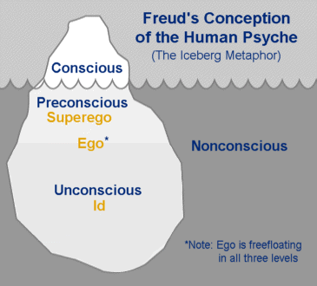
THE STRUCTURAL THEORY OF MIND :
The Id
Biological component
The Ego
controls and regulates the personality.
The Superego
The judicial branch of personality.
moral codes , right or wrong.

Slide 12

ID
Completely unconscious
No contact with reality
illogical
The infant seeks gratification of need without regard for what is possible or what is proper.
Pleasure principle

Slide 13

Ego
The only region of the mind in contact with reality.
Consider unrealistic demands of id and superego. Ego maintains a balance between id and super ego on one hand and the reality on the other.
Reality principle
Develop at 4-6 months

Slide 14

SUPEREGO
Super ego referred to as a perfection principle
The moral and ideal aspects of personality.
Develop at 3- 6 years .
Moralistic/ idealistic principles.
Composed of the conscience and ego- ideal

Slide 15
BEHAVIORAL EXAMPLES
ID | EGO | SUPER EGO
“I found this wallet; I will keep the money.” | – “I already have money. This money doesn’t belong to me. Maybe the person who owns this wallet doesn’t have any money”. | – “It is never right to take something that doesn’t belong to you”.

Slide 16
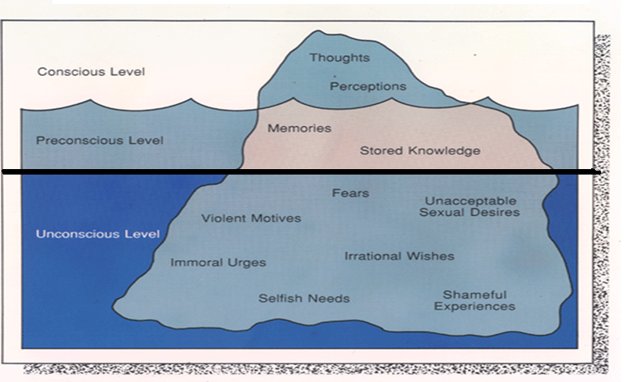
TOPOGRAPHY OF MIND

Slide 17
LEVELS OF MENTAL LIFE
Indicates both a location and a process.
Consciousness
Unconsciousness
Preconsciousness

Slide 18
CONSCIOUSNESS
Freud believed that everything we are aware of is stored in our conscious. Our conscious makes up a very small part of who we are.
This is the aspect of our mental processing that we can think and talk about rationally. A part of this includes our memory, which is not always part of consciousness but can be retrieved easily at any time and brought into our awareness.

Slide 19
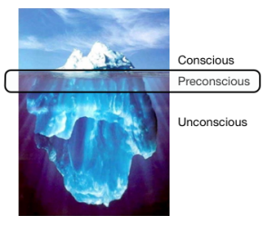
PRECONSCIOUS
Contains all those elements that are not conscious but can become conscious either readily or with difficulty.
Its sources are conscious perception and the unconscious, often transformed or disguised.

Slide 20

UNCONSCIOUS
Drives, urges, instincts beyond awareness but nevertheless motivate most of our words, feelings, and actions.
It explains the meaning behind dreams, slips of tongue, and repression.
Phylogenetic endowment
  Obtained from previous ancestors
  (collective unconscious)

Slide 21
DYNAMICS OF PERSONALITY
Freud believed that psychic energy is the force or impetus required for mental functioning.
Originating in the id, it instinctually fulfills basic physiological needs.
Freud called this psychic energy (or the drive to fulfil basic physiological needs such as hunger, thirst, and sex) the libido.

Slide 22
Freud used the terms cathexis and anticathexis to describe the forces within the id, ego, and superego that are used to invest psychic energy in external sources to satisfy needs.

Slide 23
Cathexis is the process by which the id invests energy into an object in an attempt to achieve gratification.
An example is the individual who instinctively turns to alcohol to relieve stress.
Anticathexis is the use of psychic energy by the ego and the superego to control id impulses.

Slide 24
Freud believed that an imbalance between cathexis and anticathexis resulted in internal conflicts, producing tension and anxiety within the individual.

Slide 25
Freud’s Stages of Personality Development

Slide 26


ORAL STAGE (0-10 months)
mouth is the first organ to provide pleasure.
Infant feels sense of attachment
With the beginning of development of the ego at age 4 to 6 months, the infant starts to view the self as separate from the mothering figure.
A sense of security and the ability to trust others are derived out of gratification from fulfilment of basic needs during this stage

Slide 27
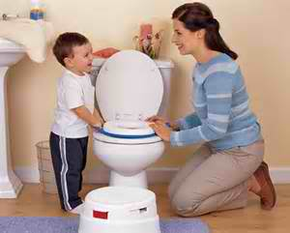
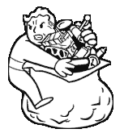
ANAL STAGE (18month-3 years)
anus as the sexually pleasurable zone; toilet training.
A child who had received a strict treatment from his parent during the anal stage could develop into an anal expulsive personality and grow up to be messy and irresponsible. Alternatively, the child could develop into an anal retentive personality, growing up to be obstinate, over-orderly, and righteous.

Slide 28
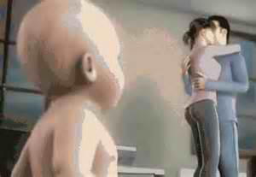
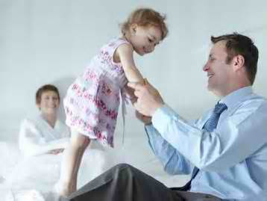
PHALLIC STAGE (3-6 years)
genital area as the sexually pleasurable zone; male and female distinction;
Oedipus Complex (son love his mother)
Elektra complex (daughter love her father)

Slide 29
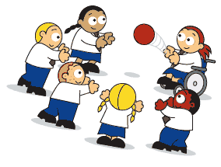

LATENCY STAGE (6-12 years)
During this period the libido interests are suppressed. This stage is defined as a period of calm. At six years old the child enters into school and becomes more interested in developing relationships.
parents punish their children to prevent sexual activity.

Slide 30


GENITAL STAGE (13-20 years)
reawakening of the sexual aim; sexual energy is focused on others; reproductive capability

Slide 31
Erik Erikson’s psycho-social
Theory of
Development

Slide 32
Objectives:
Describe the eight (8) stages of Erikson’s Theory of Development,
differentiate the psychosocial crisis in different life stages and;
value the importance of the virtue and maladaptation /malignancy in every stages of Psycho-social development.

Slide 33
Stage 1. Infancy (birth to 18 months)

Slide 34
Trust Versus Mistrust: Birth to 18 Months
Major Developmental Task
- In this stage, the major task is to develop a basic trust in the mothering figure and be able to generalize it to others.

Slide 35
Achievement of the task results in self-confidence, optimism, faith in the gratification of needs and desires, and hope for the future. The infant learns to trust when basic needs are met consistently.
Non achievement results in emotional dissatisfaction with the self and others, suspiciousness, and difficulty with interpersonal relationships.

Slide 36
Stage 2.
Early Childhood (toddler)
18 months to 3 years

Slide 37
Autonomy Versus Shame and Doubt: 18 Months to 3 Years
Major Developmental Task
- The major task in this stage is to gain some self-control and independence within the environment.

Slide 38
Autonomy is achieved when parents encourage and provide opportunities for independent activities.
Non achievement results in a lack of self-confidence, a lack of pride in the ability to perform, a sense of being controlled by others, and a rage against the self.
The task remains unresolved when primary caregivers restrict independent behaviors, both physically and verbally, or set the child up for failure with unrealistic expectations.

Slide 39
Stage 3. Preschool
3 to 6 years

Slide 40
Initiative Versus Guilt: 3 to 6 Years
Major Developmental Task
- During this stage the goal is to develop a sense of purpose and the ability to initiate and direct one’s own activities.

Slide 41
Initiative is achieved when creativity is encouraged and performance is recognized and positively reinforced.
Guilt is experienced to an excessive degree, even to the point of accepting liability in situations for which one is not responsible

Slide 42
Stage 4.
School Age
(6 to 11 years)

Slide 43
Industry Versus Inferiority: 6 to 12 Years
Major Developmental Task
The major task of this stage is to achieve a sense of self-confidence by learning, competing, performing successfully, and receiving recognition from significant others, peers, and acquaintances.

Slide 44
Industry is achieved when encouragement is given to activities and responsibilities in the school and community, as well as those within the home, and recognition is given for accomplishments.
Non achievement results in difficulty in interpersonal relationships because of feelings of personal inadequacy. The individual can neither cooperate and compromise with others in group activities nor problem solve or complete tasks successfully.

Slide 45
Stage 5.
Adolescence
(12 to 18 years)

Slide 46
Identity Versus Role Confusion:12 to 20 Years
Major Developmental Task
- At this stage, the goal is to integrate the tasks mastered in the previous stages into a secure sense of self.

Slide 47
Identity is achieved when adolescents are allowed to experience independence by making decisions that influence their lives. Parents should be available to offer support when needed.
Non achievement results in a sense of self-consciousness, doubt, and confusion about one’s role in life. Personal values or goals for one’s life are absent.

Slide 48
Stage 6.
Young Adulthood
(19 to 40 years)

Slide 49
Intimacy Versus Isolation: 20 to 30 Years
Major Developmental Task
- The objective during this stage is to form an intense, lasting relationship or a commitment to another person, a cause, an institution, or a creative effort

Slide 50
Intimacy is achieved when an individual has developed the capacity for giving of oneself to another. This is learned when one has been the recipient of this type of giving within the family unit.
Non achievement results in withdrawal, social isolation, and aloneness. The individual is unable to form lasting, intimate relationships, often seeking intimacy through numerous superficial sexual contacts.

Slide 51
Stage 7.
Middle Adulthood
(40 to 65 years)

Slide 52
Generativity Versus Stagnationor Self-Absorption: 30 to 65 Years
major Developmental Task
- The major task of this stage is to achieve the life goals established for oneself while also considering the welfare of future generations.

Slide 53
Generativity is achieved when the individual expresses satisfaction with this stage in life and demonstrates responsibility for leaving the world a better place in which to live.
Non achievement results in lack of concern for the welfare of others and total preoccupation with the self. He or she becomes withdrawn, isolated, and highly self-indulgent, with no capacity for giving of the self to others.

Slide 54
Stage 8. Maturity
(65 to death)

Slide 55
Ego Integrity Versus Despair: 65 Years to Death
Major Developmental Task
- During this stage, the goal is to review one’s life and derive meaning from both positive and negative events, while achieving a positive sense of self.

Slide 56
Ego integrity is achieved when individuals have successfully completed the developmental tasks of the other stages and have little desire to make major changes in the ways their lives have progressed.
Non achievement results in a sense of self-contempt and disgust with how life has progressed. The individual would like to start over and have a second chance at life.

Slide 57
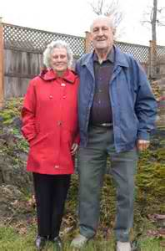
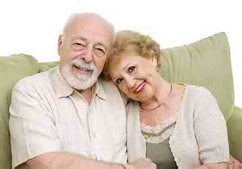

Slide 58


Slide 59


