Slide 1

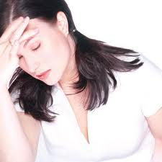
The Stress
And
The Art of Managing it
Prepared by:
Mr. Suresh V.
Associate Professor
Department of Mental health nursing
Sumandeep Nursing college

Slide 2
What is stress?
Stress may be considered as any physical, chemical, or emotional factor that causes bodily or mental unrest and that may be a factor in causing disease.
Stress is a mind-body reaction/response to a situation
  Fight or Flight instinct

Slide 3
since stress is a part of normal life. It's impossible to completely eliminate stress, and it would not be advisable to do so. Instead, we can learn relaxation techniques and other methods to manage stress so that we have control over our stress.

Slide 4
Why Stress Happens?
When a situation/condition is not Acceptable to us
When we want to do/get something but are unable
When ego is hurt (feedback, comments, criticism…)
When we lose something which we feel as important
Stress is mostly due to
  Fear (of Future)
  Worry (about Past)
It is always due to the perception of Mind
  Different people ‘feel’ different stress levels for the same situations

Slide 5
Who is most susceptible to stress?
Teens are under more stress
Since adolescence is a period of significant changes
    physical,
    emotional,
    academic changes
People who are less emotionally stable or have high anxiety.

Slide 6
high-pressured work.
unhappy relationship.
Persistent stress following an automobile accident.
Acute stress accompanying serious illness.

Slide 7
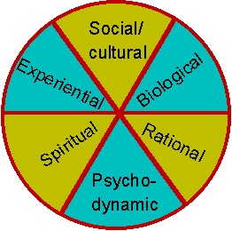
What Are The Causes Of Stress?

Slide 8
Biological
The causes of some stress lie in the biological make up of your body.
Lack of fitness
Genetic disorder
Changes in bodily functions, such as pregnancy, puberty, menopause.

Slide 9
Social/Cultural
Stress can be caused by a whole range of social and cultural pressures, such as:
Change of social circumstances (e.g. marriage)
Conflict in relationships, or an absence of praise and being valued by others
Having a high-pressure job, being unemployed.

Slide 10
Psychodynamic
The term 'psychodynamic' refers to subconscious thoughts and feelings, which often arise from childhood experiences.
Inner conflicts that have not been addressed, but repressed (ie. pushed out of conscious awareness).
Low self-esteem.
Increasing self awareness.

Slide 11
Rational
The rational processes in our minds constantly interpret and evaluate the world around.
Perceiving the consequences of actions as being dangerous or threatening.

Slide 12
What Happens when Stressed?
Psychology of Stress: Emotional impact
  Anxiety
  Fear
  Depression
  Anger
  Sadness
Physiology of Stress
  Acidity
  Ulcers
  Blood Pressure
  Kidney problems
  Diabetes

Slide 13
Chain Reaction of Stress: The Negative Spiral
Triggers animal instinct
of fight or flight
Adrenalin increases
to prepare the body
Mind perceives threat
Heart beat increases to
supply more food & oxygen
to body parts
Breathing becomes
fast & shallow
Blood pressure
increases
Panic
Stomach readies for
processing more food
Acidity* increases
Metabolism
increases
Overloaded Excretory Systems
to clear the toxin
Imbalanced Endocrine Systems
the chemical factories of
hormones, enzymes
Imbalanced Emotions
Fear, Anxiety, Anger, Depression*…
Notes:
*
Acidity : Antacids creates a negative spiral
Depression: lack of excitement leads to depression

Slide 14
Main symptoms
One of the main stress symptoms is the fact that under stress blood is being diverted from parts of our body such as the skin, liver, spleen, kidneys, bones, and muscle to the more important parts of the body like the heart, brain, and adrenals.
In medical terms, this is known as the “diving reflex.” When someone is experiencing this, it is a sign that he/she is stressed. Usually the skin becomes cold and clammy, a loss of appetite, severe muscular pain, a dry throat, and a more frequent passing of bowls.

Slide 15
Respiratory symptoms of stress are common. While someone is stressed the body needs more oxygen from the environment. To do this, the body attempts to elevate the respiratory rate, which helps to gather more oxygen. This usually causes breathlessness.
Another stress symptom is an increase in heart rate.. To provide more nutrients throughout the body, the heart beats faster which results in an increased heart rate and the dilation of the blood vessels. All of this can lead to chest pain, flushing of the skin, a warm sensation, and palpitation.

Slide 16
An increased heart rate leads to an elevated blood pressure level, which can result in a stress headache and in severe cases a heart attack.
Also when someone is stressed, his or her body needs more energy so it creates an extra amount of free glucose in the bloodstream. The glucose is then stored in the liver and muscles as glycogen, using insulin in the process.

Slide 17
There seems to be a clear link between Cortisol and Stress.
Cortisol, an important stress induced hormone, breaks down the glycogen into blood glucose, and insulin tries to counteract this excess of glucose in the blood, converting it back into glycogen.

Slide 18
Signs and Symptoms of Stress
Physical
Poor appetite or overeating
Being tired and fatigued
Various aches and pains ---headache body ache muscle pain
Nausea & abdominal Pain
Sleep problems
Falling sick very often e.g. fever cough cold diarrhea
( because of lowering of immunity due to stress)
Notes:
As
If a boy has gone for a outing with her GF and they met an accident, and girl has broken her leg, now the boy has to inform her parents, his own parents, deal with the police, deal with the local public etc… just imagine the amount of nervousness – specially if his/her parents are like me – who have very fixed ideas about children and talk very little, similarly how impatient a girl or a boy is before his first dating. And if on the first date the girl asks for a dinner in a five star hotel, that too in a taxi to Dr Bansal’s son who hardly has 100 bucks in his pocket – think about his self image – it will certainly go down (does it mean I should keep 1000 in his pocket so that he can entertain many GFs not only one !)
This decreased low self image coupled with nervousness and impatient behavior will lead to frustrations and this can be manifested either by depression when after returning he will not talk to any one – will sit very quite – looking in sky – or to the vacant wall – as if he is trying to count brush marks on the wall. Or he will start reacting violently – throwing objects and taking even the trivial remarks as very serious assaults on his personality.

Slide 19
Mental
Feeling low
Nervousness and Anxiety
Excessive Anger or Depression
Being easily upset
Poor self confidence
Low self esteem
Lack of Concentration
Poor performance in studies

Slide 20
Why Allopathic Medicines and Stimulants are not good for managing Stress
Allopathic medicines directly add chemical to the body and interfere with the internal chemical factories
  E.g. Taking Antacids for Acidity neutralizes the acid in the stomach. Then body thinks that the acid is not sufficient and starts producing more.
  E.g. Anti-depressants suppress the ability of brain cells to generate electric impulses
    People taking such drugs for prolonged time become dull
Stimulants like Tobacco, Coffee, Tea, Alcohol, Drugs etc. temporarily trigger higher activities
  Subsequently body craves for more & more stimulants

Slide 21
What are some effective techniques to cope with stress?
Exercise
Physical exercise not only promotes overall fitness, but it helps you to manage emotional stress and tension as well. Exercise can also aid in relaxation and improve sleep. Being fit and healthy also increases your ability to deal with stress as it arises.

Slide 22
Relaxation techniques
There are many ways to use structured relaxation techniques to help control stress and improve your physical and mental well-being.
Breathing Awareness
  Abdominal Breathing
  deep Breathing
  Progressive Muscle Relaxation

Slide 23
Autogenic training
Autogenic training is a method of reversing the fight-or-flight response by achieving a meditative state and becoming aware of specific body sensations with the goal of relaxation. As it reverses the stress response, it’s been shown to be effective in relieving many stress-related conditions.

Slide 24
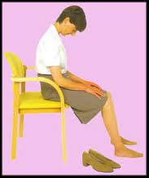
Example of an autogenic training session
"my heartbeat is calm and regular" (repeat 3 times)
"my forehead is cool"
"I am at peace" (repeat 3 times)

Slide 25
Biofeedback
Biofeedback is one method of learning to achieve relaxation, control stress responses, or modify the body's reactions through the use of monitoring equipment that provides information from the body which would normally not be available. For example, instruments can be used to measure heart rate, blood pressure, brain activity, stomach acidity, muscle tension, By receiving this feedback, one can learn to identify the processes that achieve the desired result, such as reduction in heart rate and blood pressure.

Slide 26
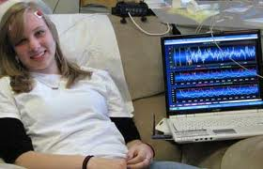

Slide 27
Imagery
Imagery, is the use of pleasant or relaxing images to calm the mind and body. By controlling breathing and visualizing a soothing image, a state of deep relaxation can occur. This method can be learned by anyone and is relatively easy to try out.

Slide 28
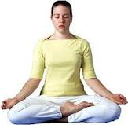
Meditation techniques
Ranging from practices associated with specific religions or beliefs to methods focusing purely on physical relaxation, meditation is one of the most popular techniques to achieve physical and mental relaxation.

Slide 29
Progressive muscle relaxation
Progressive muscle relaxation is a method developed in the 1930s in which muscle groups are tightened and then relaxed. Although muscle activity is involved, this technique requires no special skills or conditioning, and it can be learned by almost anyone. Progressive muscle relaxation is generally practiced for 10-20 minutes a day.

Slide 30
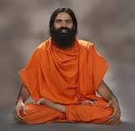
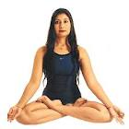
Yoga
There are many forms of yoga, an ancient Indian form of exercise based upon the premise that the body and breathing are connected with the mind. One goal of yoga is to restore balance and harmony to the body and emotions through numerous postural and breathing exercises. No special level of conditioning is required; yoga can be learned by nearly anyone.

Slide 31
Check in with your doctor
Stress can take its toll on your body, increasing your susceptibility to infections and worsening the symptoms of practically any chronic condition. Stress alone can also be a cause of numerous physical symptoms.

Slide 32
Consider counseling
Stress-management counseling is offered by various types of mental-health professionals. Stress counseling and group-discussion therapy have proven benefits in reduction of stress symptoms and improvement in overall health and attitude.

Slide 33
Spend time with those you love
Countless studies show that people with a balanced, happy social support structure (consisting of friends, family, loved ones, or even pets) experience fewer stress-related symptoms.

Slide 34
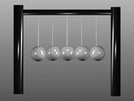
Find the Right Balance

Slide 35
THANK YOU. .

