Slide 1

Therapeutic communication and nurse patient relationship
Prepared by:
Mr. Suresh V.
Associate Professor
Department of Mental health nursing
Sumandeep Nursing college

Slide 2
THERAPEUTIC COMMUNICATION IN NURSING
Therapeutic Communication is a important thing in delivering a care for patient, as well as part of nursing skills to achieves nursing goal as part of nursing care plan.

Slide 3
Definition of communication
Communication is defined as a process of generating and transmitting meaning and it includes verbal and non verbal communication.

Slide 4
Definition of therapeutic communication
A meaningful relationship between the patient and professional helper. The patient-centered approach is influenced and directed by the professional.

Slide 5
Types of Communication
People communicate with each other in a number of ways that depend upon the message and its context in which it is being sent. Choice of communication channel and your style of communicating also affects communication. So, there are variety of types of communication.

Slide 6
Types of communication based on the communication channels used are:
Verbal Communication
Nonverbal Communication

Slide 7
Verbal Communication
Verbal communication refers to the form of communication in which message is transmitted verbally; communication is done by word of mouth and a piece of writing. Objective of every communication is to have people understand what we are trying to convey. In verbal communication remember the acronym KISS(keep it short and simple).

Slide 8
Verbal Communication is further divided into:
Oral Communication
Written Communication
Oral Communication
In oral communication, Spoken words are used. It includes face-to-face conversations, speech, telephonic conversation, video, radio, television, voice over internet. In oral communication, communication is influence by pitch, volume, speed and clarity of speaking.

Slide 9
Written Communication
In written communication, written signs or symbols are used to communicate. A written message may be printed or hand written. In written communication message can be transmitted via email, letter, report, memo etc. Message, in written communication, is influenced by the vocabulary & grammar used, writing style, precision and clarity of the language used.

Slide 10
Nonverbal Communication
Nonverbal communication is the sending or receiving of wordless messages. We can say that communication other than oral and written, such as gesture, body language, posture, tone of voice or facial expressions, is called nonverbal communication. Nonverbal communication is all about the body language of speaker.

Slide 11
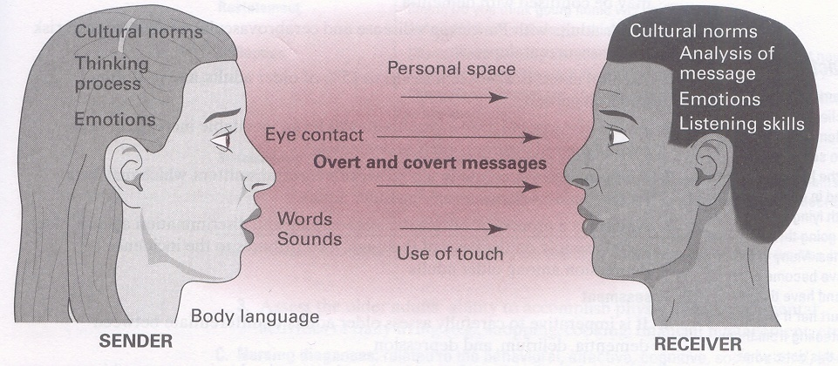
Element of Communication

Slide 12
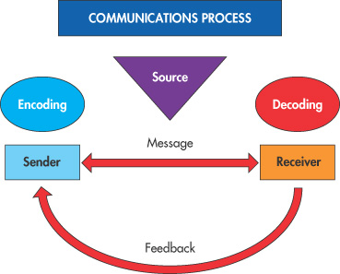
Element of Communication
Sender: originator of information
Message: information being transmitted
Receiver: recipient of information
Channel: mode of communication
Feedback: return response
Context: the setting of
  communication

Slide 13
Techniques of therapeutic communication
Active Listening: being attentive to what client is saying both verbally and nonverbally.
Sharing Observations: conveys concern and interest to the client be taking note of their behavior (how they look, sound or act).
Empathy: ability to understand and accept another person's reality, to accurately perceive feelings, and to communicate this understanding to others.

Slide 14
Sharing Hope: communicating a sense of possibility.
Sharing Humor: to bring hope and joy to the situation.
Sharing Feelings/emotions: assisting clients to share feelings by making observations, acknowledging feelings, encouraging communication, giving permission to express negative feelings and modeling healthy emotional self-expression.
Using Touch: hand to body contact to convey affection, emotional support, encouragement, tenderness, and personal attention.

Slide 15
Using Silence: the therapeutic technique of silence is the deliberate lack of verbal communication for a therapeutic purpose.
Providing Information: telling others what they need or want to know
Clarifying: checking to see if your understanding is accurate.
Focusing: used to center on key elements or concepts of a message; used to guide direction of conversation to an important area.

Slide 16
Paraphrasing: restating another's message more briefly and in your own words; lets another know you are actively seeking understanding of what they are saying.
Asking Relevant Questions: to seek information
Open-ended questions: to allow client to take the lead in the conversation and give information

Slide 17
Focused questions: used when more specific information is needed in an area.
Closed-ended questions: elicit a yes, no, or one word response. Most often they block communication, but can be useful when conversation gets off track.
Summarizing: concise review of key aspects of the communication

Slide 18
Self-Disclosure: sharing personal experience with another to show you understand their experience (Remember this is not intended to be "about " you)
Confrontation: direct confrontation to help person be aware of inconsistencies in his/her feelings, attitudes, beliefs, or behaviors.

Slide 19
There is five steps in therapeutic communication
Assessment, how to gather information
Diagnose
Planning and setting goals
Implementation
Evaluation

Slide 20
Tools for Effective communication
Communication skills
Effective of verbal and non-verbal communication.
Active listening .
Questioning .
Use of simple language .
Reflecting feelings .
Paraphrasing .
Silence .

Slide 21
Characteristics of a successful communication
Communication is successful when the person has a feeling of being understood .
This feeling is the result of and dependent upon the presence of 4 characteristics :
Honesty .
Appropriateness .
Efficiency .
flexibility .

Slide 22
Characteristics of therapeutic communication
Show the professional attitude.
Avoid social relationship.
Assess the patient level of understanding.
Maintain nonjudgmental attitude .
Avoid giving advice.

Slide 23
Barriers of therapeutic communication
Lack of planning by the nurse.
Poor data collection.
Inappropriate Nursing Diagnosis and Outcome criteria.
Lack of regard or respect for the patient.

Slide 24
The Therapeutic Nurse-Patient Relationship

Slide 25
In a therapeutic relationship…
There are specific goals
The patient’s needs are the focus (relationship is client centered)
The nurse makes use of specific communication and relationship skills

Slide 26
In a social relationship…
There are not necessarily specific goals beyond friendship and socializing
The needs of both parties.
The information exchanged may remain superficial
The skills used are the general socialization and communications skills everyone in the culture uses

Slide 27
In an intimate relationship…
Mutual needs are met
Each party usually cares about meeting the needs of the other
The parties have an emotional commitment to each other
Mutual fantasies and desires may be satisfied
Information shared may be personal and intimate

Slide 28
Phases of a Therapeutic Relationship
Preorientation or preinteraction phase
Orientation phase
Working phase
Termination phase

Slide 29
Preinteraction Stage
Self-exploration
Create the setting – comfortable, safe
Prepare for the interaction/relationship –review patient’s history, diagnosis, review nursing theory
Anticipate obstacles, difficulties
Consider the timing of nurse/patient interactions

Slide 30
Orientation or Introductory Stage
Introductions
Discuss nurse’s role
Gives patient information about the purpose, possible goals, and the time frame of the relationship
Include the patient as a partner in the relationship

Slide 31
Assess the patient’s problems and needs
Plan goals and outcomes with the patient
Develop trust and rapport with the patient
Demonstrate caring
Demonstrate that you see the patient as an individual

Slide 32
Working Stage
Implement the plan of care
Evaluate intermediate outcomes
Re-plan if necessary; think of alternative solutions
Implement alternative solutions
Refer patient, if necessary

Slide 33
Termination Stage
Begins during the first interaction with the patient
Occurs when goals have been reached or referral is advisable
Nurse and patient examine meaning and value of the relationship
Feelings are discussed

Slide 34
Termination Stage cont.
Plans for follow-up are made, if necessary
Anticipatory guidance and/or teaching should be done or repeated
Evaluation of outcomes
Summarization of the relationship and the goals achieved
Give this stage adequate time but do not dwell on it

Slide 35
Boundaries (or) therapeutic impasses
Psychological, communication
  Be aware of the nurse’s role
  Limit self-disclosure
  Be aware of over involvement
  Confront/correct sexual innuendos or actions

Slide 36
Boundaries cont.
Physical
  Allow the patient his/her personal space
  Use touch cautiously
  Be aware of patient’s cultural pattern

Slide 37
Transference
Transference – “…a person unconsciously and inappropriately displaces onto individuals in his or her current life those patterns of behavior and emotional reactions that originated with significant figures n childhood.”(Varcarolis, 1998)

Slide 38
Countertransference
Countertransference – “…the tendency of the therapist to displace onto the client feelings caused by people in the therapist’s past.”(Varcarolis,1998)

Slide 39
Component of nurse patient relationship
Rapport
Empathy
Warmth
Genuineness.

Slide 40
Nurses’ roles in nurse-patient relationship
Care giver
Counselor
Educator
Consultant
researcher

Slide 41
Characteristics of good nurse-patient relationship
Relationship is therapeutic
Exist until patent have fulfilled the health care needs
Nurses’ work is to attain, maintain, and restore the patients’ health
Patients are satisfied
Based on nurses’ competent care derived from skills and knowledge

Slide 42
Characteristics of good nurse-patient relationship Cont….
Provide holistic care
Patient/client is an active participant
Nurse uses patients’ knowledge, attitudes, values, and thoughts to plan interventions
Reciprocal relationship influenced by professional and personal characteristics of both parties

Slide 43
Dynamic of therapeutic nurse patient relationship
Therapeutic use of self:
  The ability to use the self to the welfare of others. Peplau described the nurses must clearly understand themselves to promote patients growth.
Self awareness:
  Is the process of understanding one’s own beliefs, thoughts, biases and limitation and recognizing how they affects the others.

Slide 44
The johari window is representation of self and a tool that can be used to increase the self awareness.
In creating johari window, the first step is for the nurses to appraise her own qualities.
The second step is to find out the other perceptions of others by interviewing them.
The third steps to compare the list and assign the qualities.

Slide 45
Johari window
 | Known to self | Unknown to self
Known to others | Behaviors, feelings and thoughts known to individual and others. | Things that others knows but the individual does not know
unknown to others | Private /hidden self. Things about self known only to the self | unknown to self and to others

Slide 46

Thank you

