Slide 1


MANAGEMENT
OF
PUERPARIUM
PRESENTED BY :
  Ms. Rita Thappa
  Asst. Prof. SNC, SVDU

Slide 2
DEFINITION
Puerperium is the period following child birth during which the body tissues, especially the pelvic organs, revert back to the pre-pregnant state both anatomically and physiologically.

Slide 3
DURATION OF PUERPERIUM
FIRST 24 HOURS
IMMEDIATE
UP TO 7 DAYS
EARLY
UP TO 6 WEEKS
REMOTE

Slide 4

MANAGEMENT OF PUERPARIUM

Slide 5
PRINCIPLES
To restore the health of the mother.
To prevent infection.
To take care of the breast.
To motivate the mother for contraceptive acceptance.

Slide 6

GENERAL MANAGEMENT

Slide 7
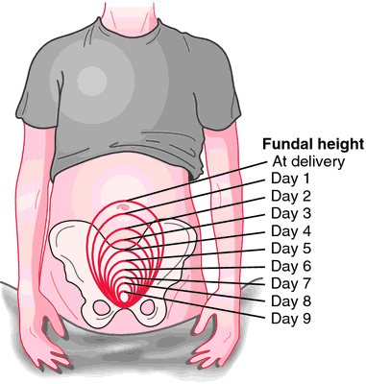
UTERUS
At the end of the 6th week the measurement is almost similar to that of the non-pregnant state and weighs about 60 gm.

Slide 8

REST & AMBULATION
Provides a sense of well being.
Bladder complications and constipation are reduced.
Facilitates uterine drainage and hastens involution of the uterus.
Lessens puerperal venous thrombosis and embolism.

Slide 9
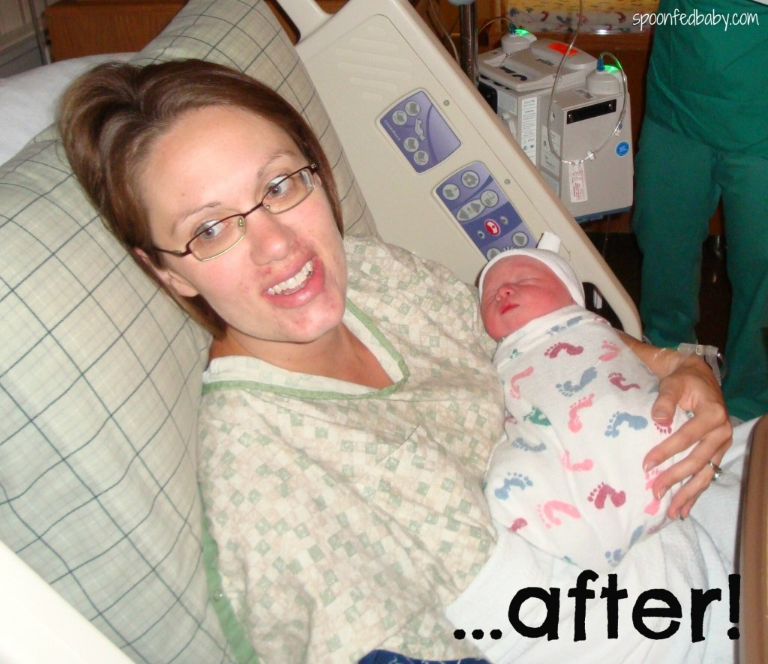
HOSPITAL STAY
A primipara woman leaves hospital after 3 days, multipara after 24 hours.

Slide 10


DIET
Women who breastfeed require high calories, adequate protein, plenty of fluids, minerals and vitamins
Additional daily 700 calories are required during postnatal period so long she breast feeds her baby.

Slide 11

PERINEAL CARE

Slide 12
Washing of the hands before and after perineal care.
Not touching her stitch area with her fingers-if uncomfortable or concerned ,she should call for help.
Wipe with wet cotton or disposable wipe from front to back across the stitches, rinse and pat dry from front to back.
Application of perineal pads snugly enough so it would not move back and forth with movements.
Application and removal of perineal pad from front to back.
Not to touch the sides of the perineal pad that will be warn next to her perineum.

Slide 13
ASEPSIS AND ANTISEPICS
Asepsis must be maintaines especially during the first week of puerparium.
CARE OF THE BLADDER
Necessary attention to the urinary bladder especially in the early pueperium is an important aspect. The women are encouraged to pass urine 6 to 8 hours following delivery and thereafter at 4-6 hours interval.

Slide 14
CARE OF THE BOWEL
A diet containing sufficient roughage and fluids is enough to move the bowel. If necessary mild laxatives such as milk of magnesia may be given at bed time or Igol (isopgol husk) 2 teaspoons may be given at bed time.
SLEEP
Sleep may be ensured by administering diazepam 5 mg or phenobarbitone 30 -60 mg orally at bedtime.

Slide 15
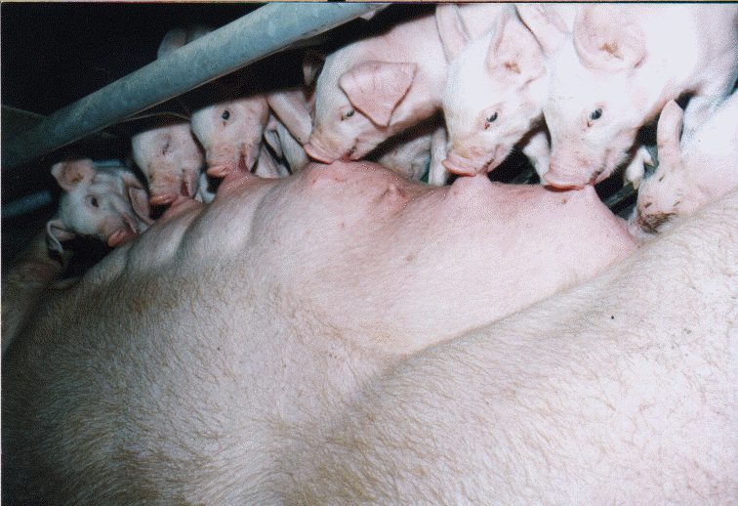
CARE OF THE BREAST

Slide 16
The breast should be examined daily, regardless of the chosen feeding method.
NIPPLE SORENESS is avoided by frequent short feeding rather than the prolonged feeding, keeping the nipples clear and dry. Candida infection may be another cause.
NIPPLE CONFUSION is a situation where the infant accepts the artificial nipple but refuses the mother’s nipple. This is avoided by making the mother’s nipple more protractile and not offering any supplemental fluids to the infant.

Slide 17
IMMUNIZATION
Unimmunized Rh- negative mothers who delivered Rh-positive babies are given anti- D-gamma globulin. The booster dose of TT should be given at the time of discharge, if it is not given during pregnancy.
CARE OF THE BABY
Birth requires that the new born make several psychological changes in adjusting to the extra uterine environment.

Slide 18

POST NATAL BEDDING - IN

Slide 19
BEDDING IN
The baby should be kept with mother in a cot basinet/beside her bed or when the mother is awake in her bed. This not only establishes mother-child relationship but the mother is conversant with the art of baby care so that she can take full care of the baby while at home.

Slide 20
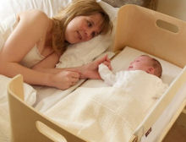
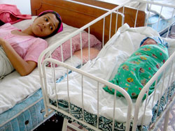
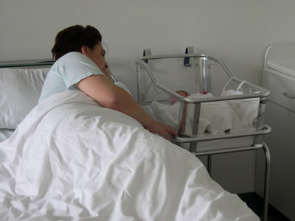
CO-SLEEPER BED NEST

Slide 21


Slide 22


Slide 23

MATERNAL - INFANT BONDING

Slide 24
Bonding refers to the parent baby relationship in the early neonatal period. It starts from the first few moments after birth. This is manifested by fondling, kissing, cuddling, and gazing at the infant. The response of both babies and behavior and response of the mother.

Slide 25
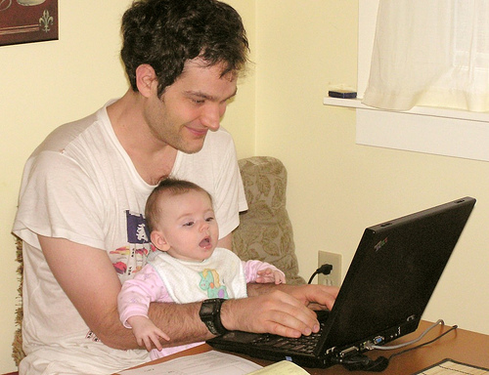






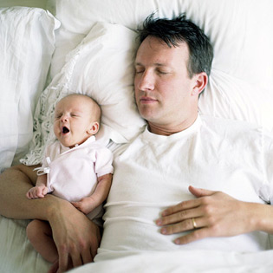

Slide 26
VIDEO ON WARM CHAIN

Slide 27
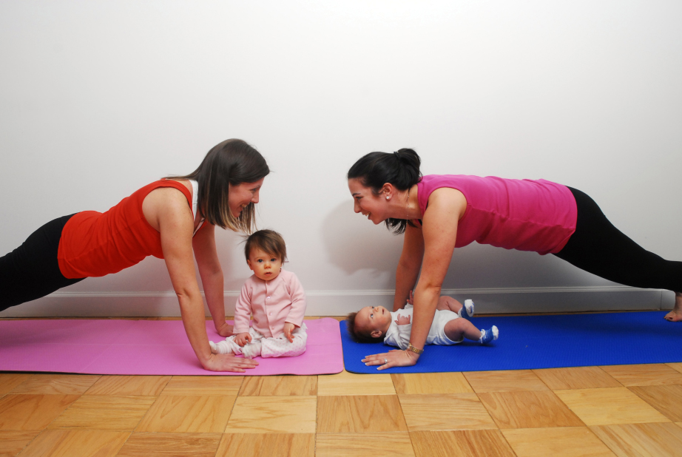
POST-PARTUM EXERCISE

Slide 28
POST-PARTUM EXERCISE
To improve the abdominal and perineal muscles which were stretched during pregnancy and labor.
To educate about correct posture to be attained when the patient is getting up from her bed.
This includes the correct principle of lifting and working positions during day-to-day activities.

Slide 29
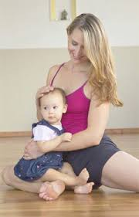
TYPES OF EXERCISES DURING PUERPARIUM

Slide 30
1. CIRCULATORY EXERCISES
These exercises are intended to maintain and improve blood circulation and are advised to be practiced during early mornings and late evenings regularly. The exercise has to be practiced in a half-lying or sitting position with the legs elevated.

Slide 31
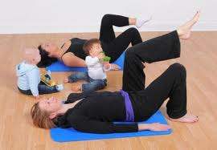
CIRULATORY EXERCISE

Slide 32
2. FOOT EXERCISES
The ankles are bent and stretched briskly while performing this. Further, the ankles can be rotated in a circular direction about 10-12 times.

Slide 33
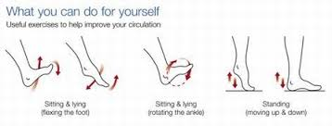
FOOT EXERCISE

Slide 34
3. PELVIC FLOOR EXERCISES
(KEGEL EXERCISES)
To identify the pelvic floor muscles, one has to try squeezing the back passage as though to prevent bowel action and squeeze the middle and front passages as though to prevent the flow of urine.
To perform the pelvic floor exercise, the women has to first empty her bladder, sit or lie down and then
Contract the pelvic floor muscles and lift up all the three passages described before.
Hold the contractions for 3 s and then relax for 3 s.
Repeat the above 10 times.
Once this is achieved, it should be tried for 4 s at a time, alternating muscles contractions with a 4 s rest period.
The women should try and work up to keep the muscles contracted for 10 s at a time, relaxing for 10 s between contractions.

Slide 35

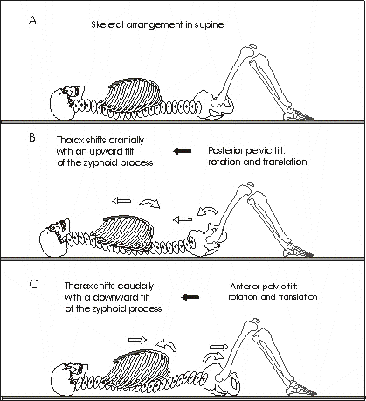
P
E
L
V
I
C
F
L
O
O
R
E
X
E
R
C
I
S
E

Slide 36
4. TRANSVERSUS EXERCISE
The transverses abdominal muscles maintain the integrity of the pelvis and its stability helps in preventing postural and back problems. The transverses exercise can be performed in various positions, such as sitting standing, high-kneeling, prone-kneeling or side-lying. Most comfortable position is kneeling.
After kneeling, the spine should be kept in the mid position and one should breathe in and gently draw in the lower abdominal muscles while breathing out slowly. The contraction should be held for about 10 s while breathing normally and then released slowly. This should be repeated for about 10 times.

Slide 37
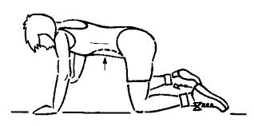
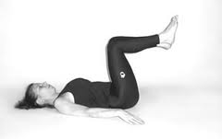
TRANSVERSUS EXERCISE

Slide 38
5. PELVIC TILTING (ROCKING)
Performed in a half-lying position, with the back is supported with pillows, knees bent and feet flat. The abdominal muscles should be pulled in while the muscles of the buttocks tightened and then press the small of the back down on the support. This position should be held on for about 5-10 s while breathing normally and then relaxed. The exercise can be repeated up to 10 times.

Slide 39
P
E
L
V
I
C
T
I
L
T
I
N
G

Slide 40
6. SUPPLE SPINE
Begin on all fours. Inhale; lift the head, keeping the back straight or arising slightly. Then exhale, round the back and tighten abdominals. Repeat the sequence eight times. This exercise strengthens the back and abdominals.

Slide 41
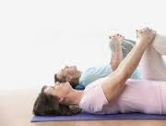
SUPPLE SPINE

Slide 42
7. TIGHTER ABDOMINALS
Lie on the back in a straight line. Then exhale, lowering the back, vertebra by vertebra. Repeat the sequence 5 times. This exercise helps develop a strong back and abdominals.

Slide 43
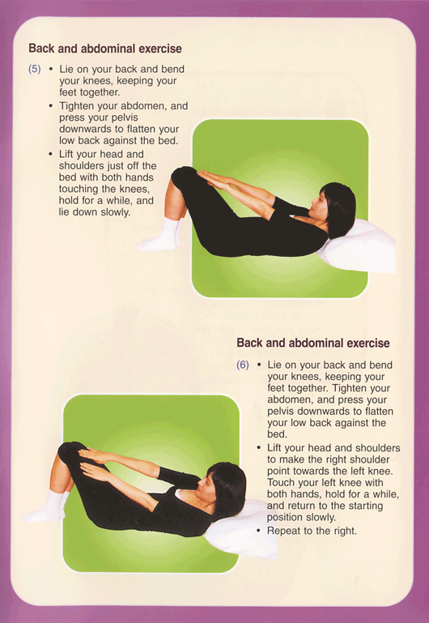
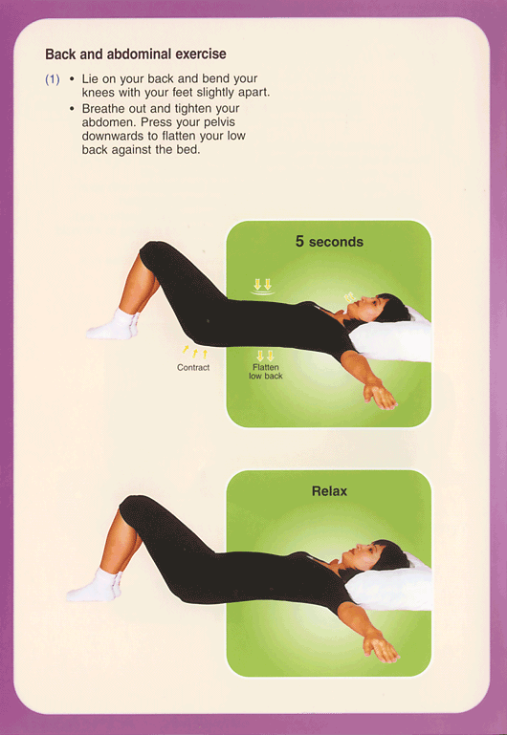

Slide 44
8. STRONGER BACK
Sit upright, knees bent, flat on the floor, back straight, arms forward at shoulder level. Inhale, then exhale, leans back halfway. Inhale again and sit up slowly. Repeat the sequence five times. This exercise strengthens the back and abdominals.

Slide 45
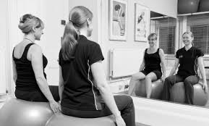
STRONGER BACK

Slide 46
9. FLEXIBLE BODY
Stand upright with hands raised, elbows slightly relaxed. Inhale, then exhale and bend forward, keeping back straight and swinging arms down and back. Relaxing the head, stretch both the arms up behind the body. Inhale while swinging arms up behind the body. Inhale while swinging arms and body up again, returning to the original position. Repeat the sequence 8 times, go carefully and do not strain. This exercise is good for thighs, hips, back, arms, shoulders and neck.

Slide 47
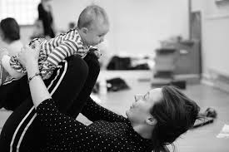
FLEXIBLE BODY

Slide 48
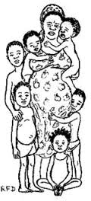
CONTRACEPTIVES

Slide 49
CONTRACEPTIVES
Steroidal contraceptions - Non lactating women and should be started 3 weeks after. In lactating women it is avoided due to its suppressive effects.
Progestin only pill. Other progestins DMPA, Levo norgestrel implants may be used.
Intra Uterine Devices.
Sterlization is suitable for those who have completed their families.

Slide 50
MANAGEMENT OF AILMENTS
Irregular vaginal bleeding
Leucorrhoea
Cervical ectopy (erosion)
Backache
Retroversion
Slight degree of uterine descend

Slide 51


PSYCHIATRIC DISORDERS DURING PUERPARIUM
PUERPERAL BLUES
POSTPARTUM DEPRESSION

Slide 52

SERIOUS MATERNAL HALTH PROBLEMS
POSTNATAL PSYCHOSIS
POST PARTUM HAEMORRHAGE
PUERPERAL PYREXIA
THROMBOEMBOLISM
DEEP VEIN THROMBOSIS
PULMONARY EMBOLISM

Slide 53
CONCLUSION
The postpartum is the period when a women’s physical and psychological functioning following childbirth is restored and the foundation of relationships among the parents, newborn and other family members are being established.

Slide 54

ASSIGNMENT
NURSING PROCESS ON IMMEDIATE PHASE OF PUERPARIUM

Slide 55


