Slide 1


s
PRESENTATION ON
BIOCHEMICAL PROFILE OF PRENATAL SCREENING
PRESENTED BY
MS. RITA THAPPA
ASST. PROFESSOR, SNC,SVDU

Slide 2


Slide 3
PRENATAL SCREENING
INTRODUCTION:
Approximately 3% of live born infants have a major congenital anomaly. Genetic factors are usually responsible. About 50% of first trimester spontaneous abortions and about 5% of still born infants have chromosomal abnormalities. Apart from clinical evaluation, biochemical and biophysical methods have been used for the diagnosis. So prenatal screening of fetal well bieng in early pregnancy is primarily designed to detect fetal congenital anomalies.

Slide 4
DEFINITOIN:
prenatal screening is testing for diseases or conditions in a fetus or embryo before it is born. The aim is to detect birth defects such as neural tube defects, Down syndrome, chromosome abnormalities, genetic diseases and other conditions, such as spina bifida, cleft palate, sickle cell anemia, thalassemia, cystic fibrosis.

Slide 5
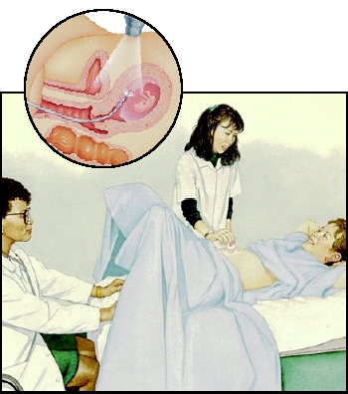
Biochemical methods

Slide 6
MATERNAL SERUM ALPHA FETOPROTIEN: (MSAFP)
Also Known as Alpha-Fetoprotein Test (AFP)
MSAFP is a screening test that examines the level of alpha-fetoprotein in the mother’s blood during pregnancy. This is not a diagnostic test. It is often part of the triple screen test that assesses whether further diagnostic testing may be needed.
How is the MSAFP performed?
Blood is drawn from veins in the mother’s arm and sent off to a laboratory for analysis. Results are usually returned between one and two weeks.

Slide 7
When is MSAFP performed?
MSAFP may be performed between the 14th and 22nd weeks of pregnancy, however it seems to be most accurate during the 16th to 18th week.
A range of potential patients :
All pregnant women should be offered the MSAFP screening, but it is especially recommended for:
Women who have a family history of birth defects
Women who are 35 years or older
Women who used possible harmful medications or drugs during pregnancy
Women who have diabetes

Slide 8
Normal Results
The normal AFP concentration in liquor amni at the 16th week is about 20 mg/L.
What does the MSAFP test look for?
High levels
neural tube defect (85%) such as spina bifida or anencephaly.
Defects with esophagus or a failures of fetus’s abdomen to close.
inaccurate dating of the pregnancy.(most commonly)

Slide 9
Low levels
Trisomy 21( Down syndrome),
Trisomy 18 (Edwards Syndrome)
or another type of chromosome abnormality.
Abnormal levels may also be a result of the following:
A multiples pregnancy
Pregnancies that are more or less advanced than thought
What are the risks and side effects of MSAFP to the mother or baby?
Except for the discomfort of drawing blood, there are no risks or side effects associated with the MSAFPs

Slide 10
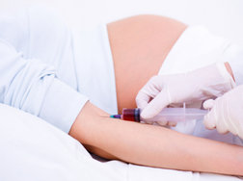
ACETYLCHOLINESTERASE (ACHE) TESTING
AChE is performed on an amniotic fluid sample to diagnose fetal open neural tube defects and some ventral wall defects.
How the Test is Performed
A blood sample is needed.

Slide 11
How the Test Will Feel
Woman may feel slight pain or a sting when the needle is inserted also may feel some throbbing at the site after the blood is drawn.
Why the Test is Performed
This test may be done:
To diagnose neural tube defects
To diagnose liver disease
Normal Results
Typically, normal cholinesterase values range between 8 and 18 units per milliliter (U/ml).

Slide 12
What Abnormal Results Mean
Decreased levels may be due to:
Acute infection
Chronic malnutrition
Heart attack
Liver damage
Metastasis
Obstructive jaundice
Smaller decreases may be due to:
Use of birth control pills
Elevated level maybe due to:
Open neural tube defects (most of cases)

Slide 13
HUMAN ESTRIOL TEST:
Estriol can be measured in maternal blood or urine and can be used as a marker of fetal health and wellbeing
Estriol is only produced in significant amounts during pregnancy as it is made by the placenta.
Why Is it Performed?
Post maturity by dates.
Unsure dates and possibility of post-maturity.
Elderly primigravida
Toxemia/ hypertensive disorder of pregnancy
Diabetes
Intrauterine growth retardation
Suspected fetal death
Suspected fetal abnormality such as anencephaly

Slide 14
Use in screening
A value above 12 mg indicates fetal well-being.
Values between 4 and 12 mg may indicate fetal jeopardy if late in pregnancy, with the probability of jeopardy being higher the closer the value is to 4 mg.
values below 4 mg indicate severe fetal jeopardy or even impending death of fetus.
If levels of "unconjugated estriol" are abnormally low in a pregnant woman, this may indicate chromosomal or congenital anomalies like Down syndrome or Edward's syndrome. It is included as part of the triple test.

Slide 15
TRIPLE TEST
The triple screen test is a maternal blood screening test that looks for three specific substances: AFP, hCG, and Estriol.
AFP: alpha-fetoprotein is a protein that is produced by the fetus.
hCG: human chorionic gonadotropin is a hormone produced within the placenta
Estriol: estriol is an estrogen produced by both the fetus and the placenta
Conditions screened
trisomy 21 (Down syndrome)
open neural tube defects,
increased risk of Turner syndrome, triploidy, trisomy 16 mosaicism, fetal death, Smith-Lemli-Opitz syndrome, and steroid sulfatase deficiency.

Slide 16
How is the triple screen test performed?
The triple screen test involves drawing blood from the mother which takes about 5 to 10 minutes. The blood sample is then sent to the laboratory for testing.
A range of potential patients:
Have a family history of birth defects
Are 35 years or older
Used possible harmful medications or drugs during pregnancy
Have diabetes and use insulin
Had a viral infection during pregnancy
Have been exposed to high levels of radiation
What are the risks and side effects to the mother or baby?

Slide 17
When is the triple screen test performed?
The triple screen test is performed between the 15th and 20th week of pregnancy.
What does the triple screen test look for?
High levels
neural tube defect such as spina bifida or anencephaly.
inaccurate dating of the pregnancy.
Low levels
Trisomy 21( Down syndrome),
Trisomy 18 (Edwards Syndrome) or another type of chromosome abnormality.
A multiples pregnancy
Pregnancies that are more or less advanced than thought

Slide 18
The term “multiple marker screening test”is sometimes used instead. This term can encompass “double test” and “quadruple test”.
Double test: only free beta hCG and AFP are measured, the test is called a double test.
Quadruple test or quad test: the quad test is a prenatal test that measures level of four substances in a pregnant women’s blood.
AFP (a protein made by the developing baby’s)
HCG (a harmone made by the placenta)
E3 (a harmone made by the placenta and the baby’s liver)
INHIBIN A (another harmone made by the placenta)
Other names of quad test are “quad screen” or “tetra screen”. Inhibin A will be found high in cases of Triosmy 21 and low in cases of Trisomy 18.

Slide 19
AMNIOCENTESIS
What Is Amniocentesis?
Amniocentesis is a prenatal test in which a small amount of amniotic fluid is removed from the sac surrounding the fetus for testing. The sample of amniotic fluid (less than one ounce) is removed through a fine needle inserted into the uterus through the abdomen, under ultrasound guidance. The fluid is then sent to a laboratory for analysis.

Slide 20
A range of potential:
Have an abnormal ultrasound
Have a family history of certain birth defects
Have previously had a child or pregnancy with a birth defect
Will be 35 or older at the time of delivery
Why Is an Amniocentesis Performed?
Down syndrome
Sickle cell disease
Cystic fibrosis
Muscular dystrophy
Tay-Sachs and similar diseases
Amniocentesis can also detect certain neural tube defects, such as spina bifida and anencephaly.

Slide 21
When Is Amniocentesis Performed?
It is performed between 14th and 16th weeks under ultrasonographic guidance.
What Happens During an Amniocentesis?
A small area of the abdomen is cleansed with an antiseptic to prepare for the amniocentesis. may receive a local anesthetic (pain-relieving medication) to reduce any discomfort. first locates the position of the fetus and placenta with an ultrasound. Under ultrasound guidance, the doctor inserts a thin, hollow needle through abdomen and uterus, and into the amniotic sac, away from the baby. A small amount of fluid (less than an ounce) is removed through the needle and sent for laboratory analysis.

Slide 22
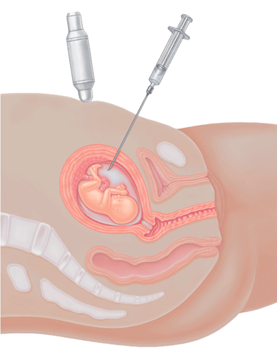

Slide 23
Does Amniocentesis Have Risks?
  - infection
- haemorrhage
- premature rupture of membrane
- premature labour
- Abortion
- Trauma
-Oligohydromnias [due to leakage of amniotic fluid
-That leads to fetal lung hypoplasia, respiratory distress.
Normal Results
The ratio of amniotic fluid to fetus is high in the first trimester, about 3:2 by 20th week of gestation and decreases thereafter as the fetus grows. The average fluid volume during the 3rd trimester is 800 ml; this quantity decreases to around 450 ml by term and further decreases postterm.

Slide 24
CHORIONIC VILLUS SAMPLING
Chorionic villus sampling (CVS) is a pregnancy test that checks the baby for some genetic abnormalities such as Down syndrome or cystic fibrosis. A small sample of the placenta is taken via needle and examined in a laboratory. CVS carries a small risk of miscarriage.
When Is it Performed?
It is carried out transcervically between 10-12th week and transabdominally from 10th weeks to term.
A range of potential patients :

Slide 25
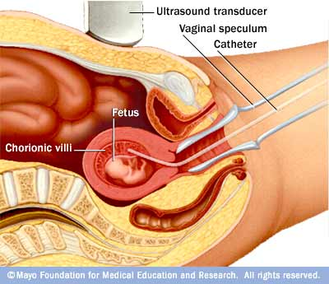
How the Test is Performed
The transcervical procedure is performed by inserting a thin plastic tube through the vagina and cervix to reach the placenta. The provider uses ultrasound images to help guide the tube into the best area and then removes a small sample of chorionic villus tissue.

Slide 26
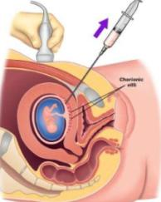
The transabdominal procedure is performed by inserting a needle through the abdomen and uterus and into the placenta. Ultrasound is used to help guide the needle, and a small amount of tissue is drawn into the syringe. The sample is placed in a dish and evaluated in a laboratory. Test results take about 2 weeks.

Slide 27
What Abnormal Results Mean
Down syndrome
Hemoglobinopathies
Tay-Sachs disease
Complications:
The risks of CVS are only slightly higher than those of an amniocentesis.
Possible complications include:
Light-headedness
Abdominal discomfort
Pains that feel similar to menstrual cramps
Haemorrhage

Slide 28
Vaginal Bleeding
Oromandibular limb deformities
Infection
Miscarriage
Rh incompatibility in the mother
Rupture of membrane
Limb reduction defects (LRD) [when CVS was performed at less than 10 weeks of gestation]
Considerations
To a Rh negative women, should administer anti- D immunoglobin 50 microgram to prevent Rh incompatibility.

Slide 29
CORDOCENTESIS: (PERCUTANEOUS UMBILICAL CORD BLOOD SAMPLING)
Percutaneous umbilical cord blood sampling (PUBS), also called cordocentesis, is a diagnostic genetic test that examines blood from the fetal umbilical cord to detect fetal abnormalities.
When is cordocentesis performed?
Cordocentesis is performed after 17 weeks into pregnancy.

Slide 30
What does the cordocentesis test look for?
chromosome abnormalities (i.e. Down syndrome)
blood disorders (i.e.fetal hemolytic disease.).
Malformations of the fetus
Fetal infection (i.e. toxoplasmosis or rubella)
Fetal platelet count in the mother
Fetal anemia

Slide 31
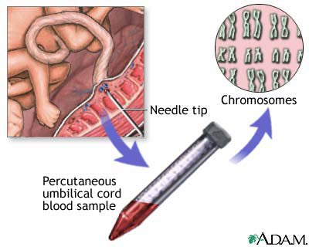
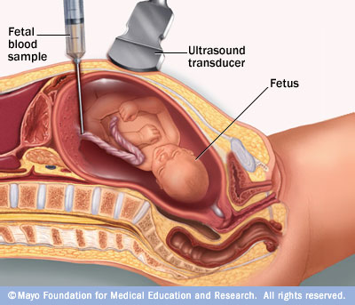
Procedure
PUBS is similar to amniocentesis, but instead of sampling the amniotic fluid which surrounds the fetus, PUBS examines fetal blood. An advanced imaging ultrasound determines the location for needle insertion into the placenta, and the needle is guided through the mother's abdomen and uterine wall into the fetal vein of the umbilical cord, where a fetal blood sample is removed. The sample can then be sent for chromosomal analysis.

Slide 32
What are the risks and side effects to the mother or baby
Miscarriage
Blood loss from the puncture site
Infection
Drop in fetal heart rate
Premature rupture of membrane
During the procedure, the mother may feel discomfort similar to a menstrual cramp.
Leaking of amniotic fluid

Slide 33

THE NURSE'S ROLE :

Slide 34
The nurse is an essential member of the interdisciplinary health care team during prenatal screening.
A primary nursing role during procedure is that of support person and advocate for the pregnant client.
The nurse educating and supporting the client before, during and after the procedure.
The nurse ensures that the client understands the procedure, its significance and the risks and benefits to her and her fetus.
The client undergoing prenatal screening is frequently anxious and fearful about the procedure itself and the results it might yield, and the nurse must be able to anticipate these feelings and respond through both verbal and nonverbal methods.

Slide 35
The nurse may also be responsible for preparing the client and equipments for the procedure and assisting the physician during the procedure.
The client’s vital sings must be monitored before, during and after the procedure.
The nurse implements actions to relieve the client’s physical discomfit, particularly after the amniocentesis and chorionic villous sampling.
The nurse also make sure that the client understands the post-procedure instructions and is able to perform self care practice, such as recognizing and reporting complications and returning for follow up care.
Advanced practice nurses may provide genetic counseling.

Slide 36
CONCLUSION:
A prenatal testing decision aid plays an important role in improving pregnant women’s knowledge of first and second trimester screening tests that are consistent with their values. A pregnant women as well as the family members obtain a considerable amount of information about her unborn fetus. if mothers receive sufficient information and support, fetal investigations any increase autonomy and save long term suffering. This will help parents to cope with the choices and decisions created by the availability of antenatal fetal investigations.

Slide 37
Assignment on
Digramatic representation of the chorionic villi and amniotic fluid in the uterus.

Slide 38


