Slide 1

EXAMINATION OF THE BREAST
Prepared By,
Mrs. Ruhi Varghese
SNC

Slide 2
Objectives
Discuss general guidelines in the clinical breast examination by a physician
Discuss the techniques in doing the following:
  Physical examination of the breast
  Self-breast examination

Slide 3
Discuss the right time for breast examination
Discuss the importance of self breast examination and mammography as screening tool for breast ca

Slide 4
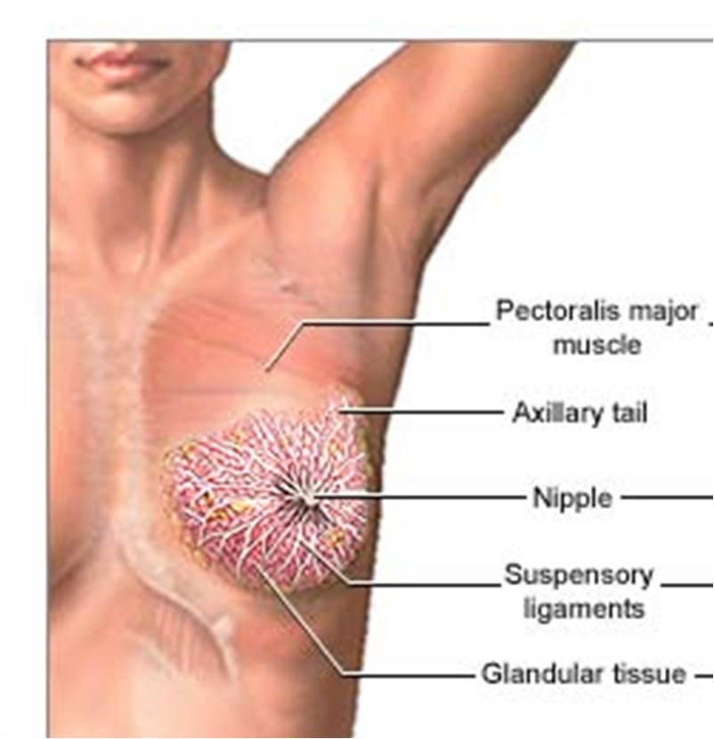

Slide 5
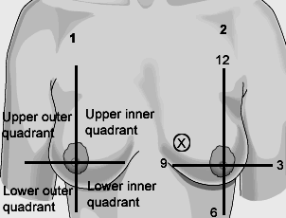

Slide 6
General Guidelines
Texture: smooth to granular
  menstrual cycle and during pregnancy
  Nodularity and tenderness often increase towards the end of the cycle and during menstruation
Asymmetrical so always examine both and compare one to the other

Slide 7
The patient should be undressed to the waist and seated with arms by side
Nipples
everted, flat, or inverted (note if recent change or longstanding
cracking or ‘eczema’
bleeding or discharge
Breast
size
symmetry
shape of breast
skin colour
superficial veins

Slide 8
Nodules
Location (by quadrant or clock)
Size in cm
Shape
Consistency
Delimitation
Tenderness
Mobility

Slide 9
Nipple
Discharge
  Milky (hypothyroidism, prolactinoma, drugs)
  Bloody (papilloma, Paget’s disease)

Slide 10
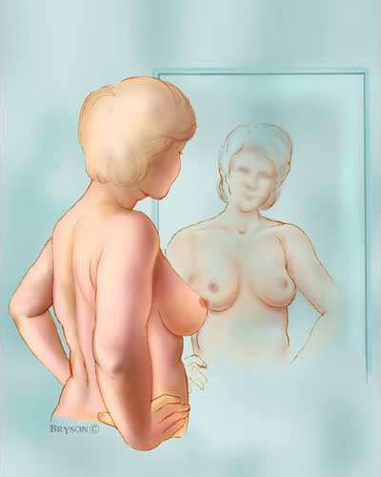
Step 1: Begin by looking at your breasts in the mirror with your shoulders straight and your arms on your hips.

Slide 11
Breasts that are their usual size, shape, and color
Breasts that are evenly shaped without visible distortion or swelling

Slide 12
Dimpling, puckering, or bulging of the skin
A nipple that has changed position or an inverted nipple (pushed inward instead of sticking out)
Redness, soreness, rash, or swelling

Slide 13
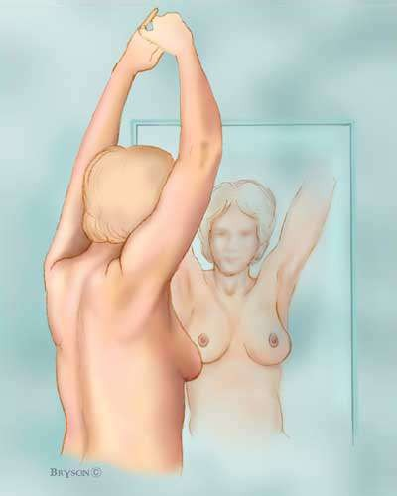
Step 2: Now, raise your arms and look for the same changes.

Slide 14
Step 3: While you're at the mirror, look for any signs of fluid coming out of one or both nipples (this could be a watery, milky, or yellow fluid or blood).

Slide 15
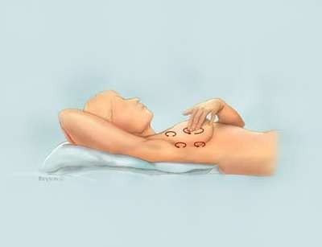
step 4: Next, feel your breasts while lying down, using your right hand to feel your left breast and then your left hand to feel your right breast

Slide 16
Use a firm, smooth touch with the first few finger pads of your hand, keeping the fingers flat and together. Use a circular motion, about the size of a quarterCover the entire breast from top to bottom, side to side — from your collarbone to the top of your abdomen, and from your armpit to your cleavage.

Slide 17
You can begin at the nipple, moving in larger and larger circles until you reach the outer edge of the breast. You can also move your fingers up and down vertically, in rows, This up-and- down approach seems to work best for most women

Slide 18
Finally, feel your breasts while you are standing or sitting. Many women find that the easiest way to feel their breasts is when their skin is wet and slippery, so they like to do this step in the shower.
Cover your entire breast, using the same hand movements described in step 4

Slide 19
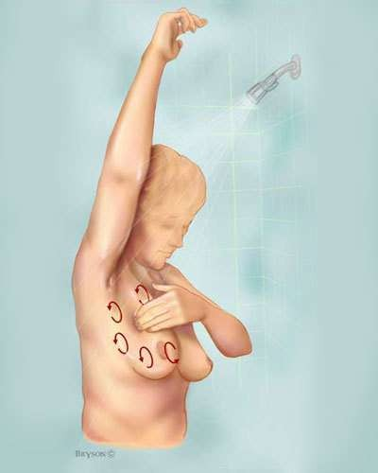

Slide 20
AXILLARY
The patient’s forearm is rested across the examiner’s forearm
An alternative is to ask the patient to rest their hand on the examiner’s shoulder
  The examiner feels for each group of nodes, while steadying the shoulder with the other hand
    apical
    anterior (posterior surface of anterior axillary fold)
    medial (on the chest wall)
    lateral (against the humerus)
    posterior (anterior surface of posterior axillary fold)

Slide 21
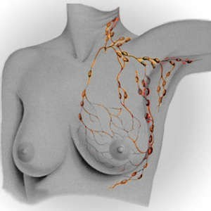

Slide 22
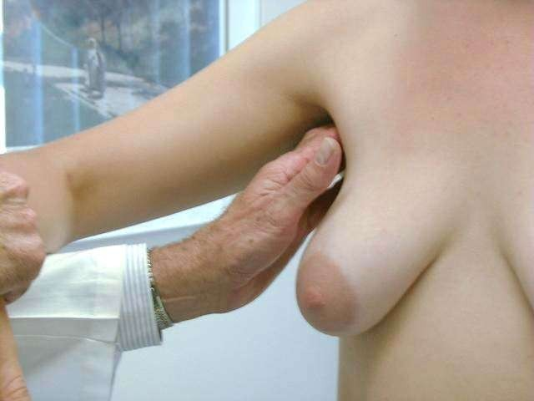

Slide 23
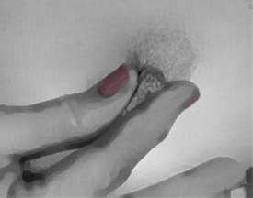

Slide 24
Relative risk of Breast Ca
Personal history of breast abnormalities.
  Two breast tissue abnormalities—ductal carcinoma in situ (DCIS) lobular carcinoma in situ (LCIS)—are associated with increased risk for developing invasive breast cancer.
Age
  The risk of developing breast cancer increases with age
  The majority of breast cancer cases occur in women older than age 50.

Slide 25
Relative risk of Breast Ca
Age at menarche (first menstrual period). Women who had their first menstrual period before age 12 have a slightly increased risk of breast cancer.
Age at first live birth. Risk depends on age at first live birth and family history of breast cancer

Slide 26

A testicular self-exam (TSE) is an easy way for guys to check their own testicles to make sure there aren't any unusual lumps or bumps 􀎵 which can be the first sign of testicular cancer.
Try to do a TSE every month so you become familiar with the size and shape of your testicles. This makes it easier to tell if something feels different or abnormal down there.

Slide 27
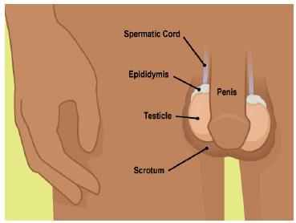
Step 1: Getting Started
Choose the right time to do your exam. It's best to do it during or just after a hot shower or bath.
The scrotum (skin that covers the testicles) is most relaxed then, which makes it easier to feel the testicles for lumps.
Lumps may be as small as a piece of rice or a pea.

Slide 28
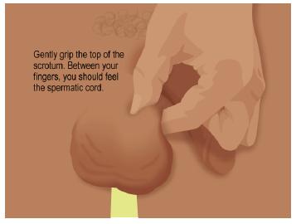
Step 2: Place Your Hand
Examine one testicle at a time.
Start by gently gripping the top of the scrotum, with your thumb on top and your fingers underneath. Pinch gently so that the testicle stays put and won't move during the exam.
Between your fingers, you should feel the spermatic cord. This connects the testicle to the rest of your body.

Slide 29
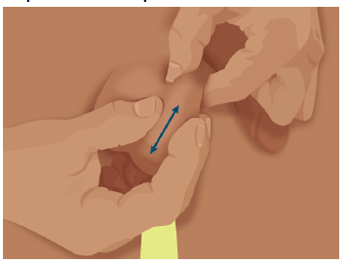
Step 3: Feel for Lumps
With your free hand, glide your thumb and fingers along both sides of the testicle, from top to bottom. Feel for any lumps or bumps.
Then, glide your fingers over the front and back of the testicle.
On the back at the top, you should feel the epididymis, a tube that carries sperm.
This is a normal lump and may feel tender to the touch.

Slide 30
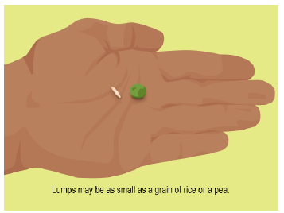
or color of a testicle. Also tell your doctor if you have any pain or achy areas in your groin.
Lumps or swelling may not be cancer, but they should be checked by your doctor as soon as possible.
Testicular cancer is almost always curable if it is caught and treated early.

Slide 31
The Menstrual Cycle

Slide 32
What is the menstrual cycle?
The process in which females ripen or release one mature egg.
The average menstrual cycle will repeat itself about every 28 days, but normal menstrual cycles can range from 21 to 40 days.

Slide 33
Changes in Pituitary Hormones Days 1-14:
During the first half of the cycle (Days 1-14) the pituitary produces FSH, which stimulates egg production.
This hormone also triggers the release of estrogen from the ovaries.

Slide 34
Changes in Pituitary Hormones Days 14-28:
On the 14th day the pituitary begins releasing LH causing ovulation
LH also directs the production of progesterone which maintains the growth of the endometrium.
If the egg is not fertilized upon arrival in the uterus progesterone levels drop causing estrogen levels to drop leading to menstruation.

Slide 35
Changes in the Ovaries:
Stage 1 - An egg is beginning to mature within a cluster of cells called a follicle
Stage 2 - Rapid follicle and egg growth
Stage 3 - Ovulation occurs; fully mature egg bursts out of the follicle (fertile) empty follicle transforms into the corpus luteum
Stage 4 - Egg travels through fallopian tube (7 days) if not fertilized upon arrival in uterus the corpus luteum shrinks triggering menstruation and ripening of new egg.

Slide 36
Changes in Ovarian Hormones:
Estrogen -gradually increases during days 1-14; signals body to thicken the lining of the uterus. Levels drop sharply after ovulation.
Progesterone -Levels remain low during the first half of the cycle and then increase sharplyduring the second half of the cycle. Maintaining the growth of the endometrium lining.

Slide 37
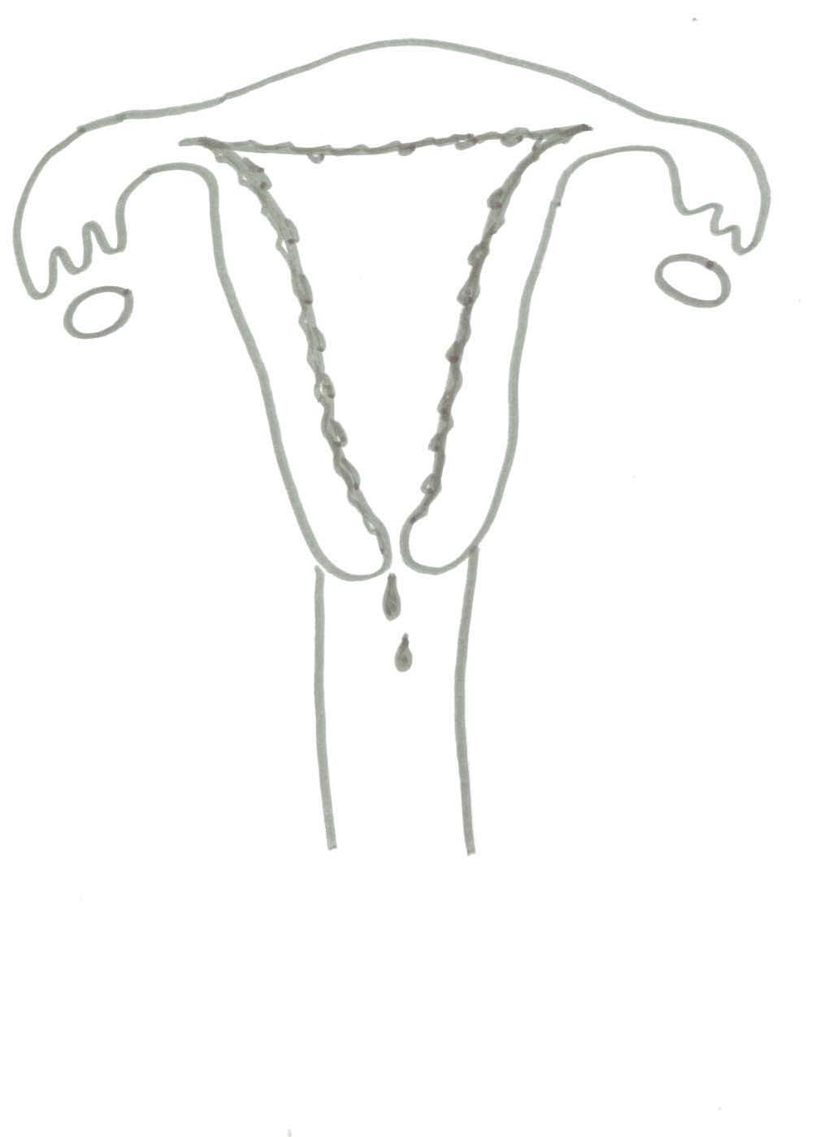
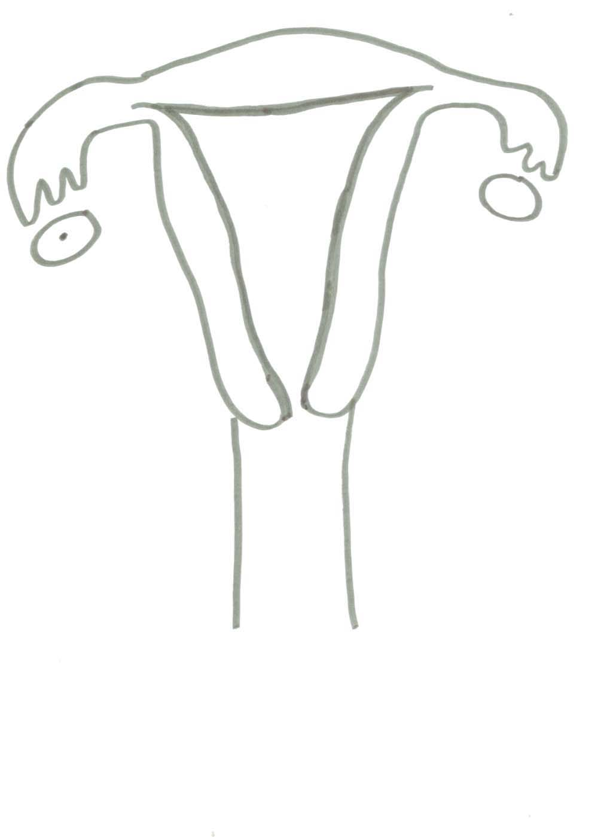
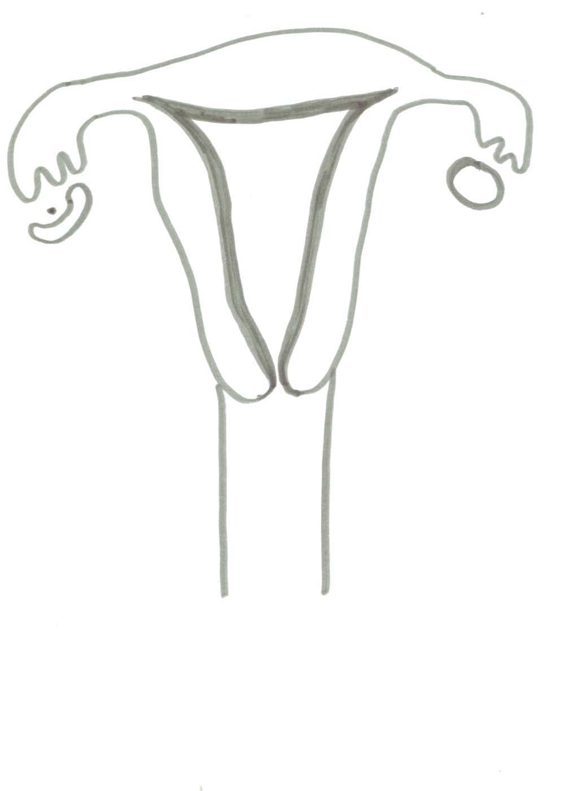
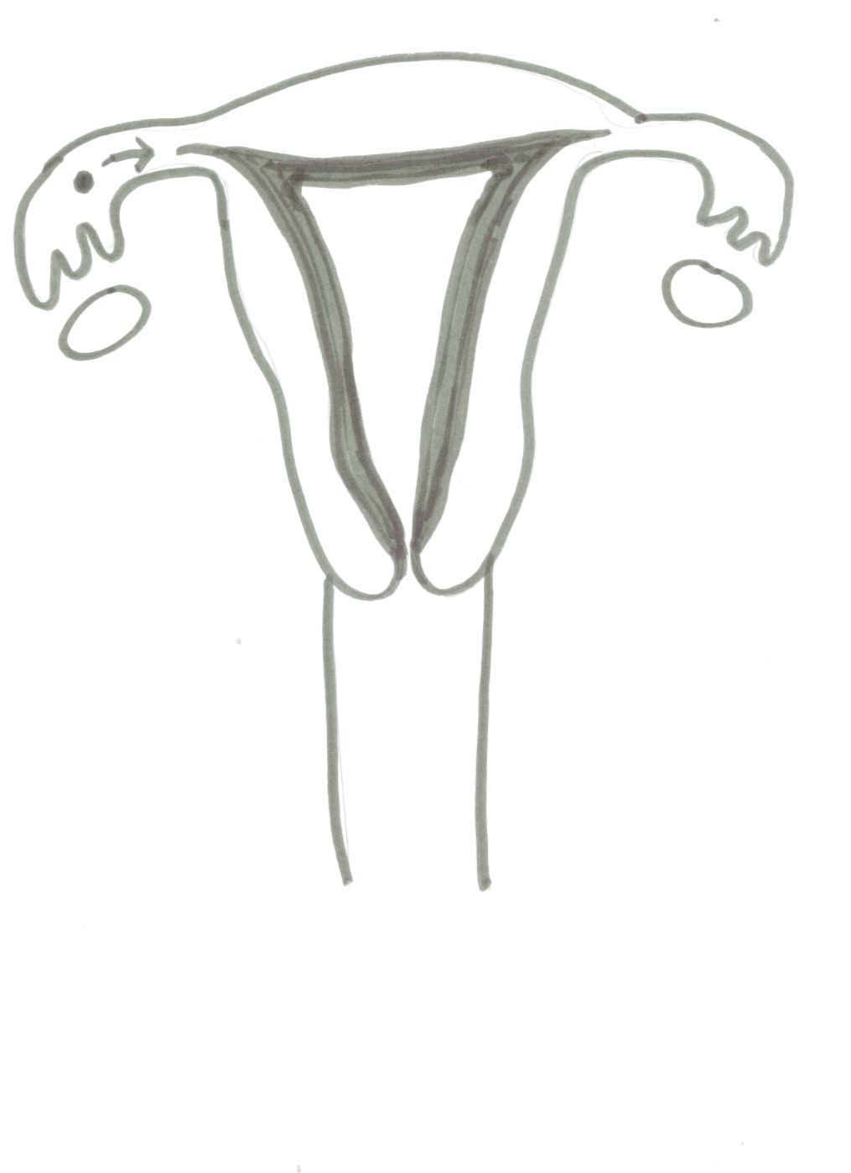
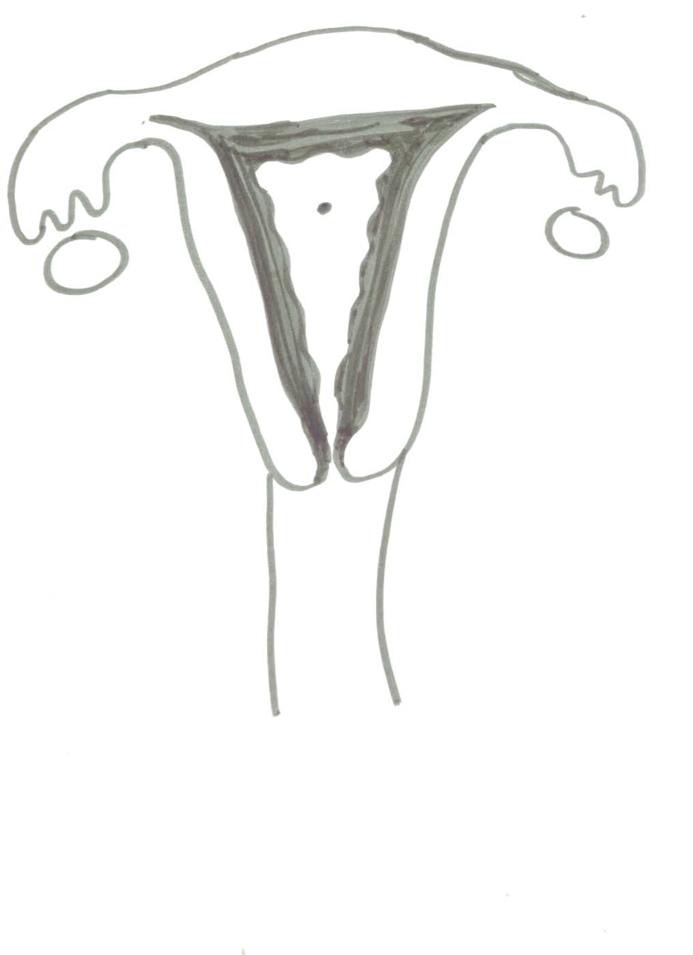
Changes in the Uterus:
Stage 2 Day 5- 13 pre-ovulatory stage
Stage 1- Day 1-5 menstruation
Stage 3 Day 14 Ovulation
Stage 4 Day 15-28 post-ovulatory stage

Slide 38
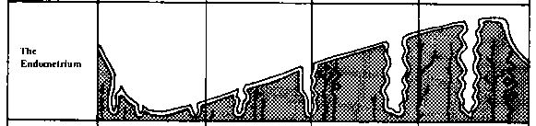
The uterine lining slowly thickens from day 5 through day 28

Slide 39
Changes in the Uterus:
Stage 1- Menstruation- Endometrium breaks down and blood, mucus, tissue, and the egg are shed through the vagina.
Stage 2- Menstrual flow stops & endometrium begins to thicken.
Stage 3- Endometrium continues to thicken.
Stage 4- The endometrium is at it’s thickest point.

Slide 40
Days 1-14

Slide 41
Days 14 - 28

Slide 42
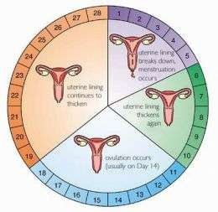
PHYSIOLOGY OF MENSTRUATION
THE UTERUS...
1st PHASE: PROLIFERATIVE
(aka estrogenic/follicular/postmenstr ual)
High levels of estrogen causes thickening and proliferation of endometrium
LH is increased, Estrogen is increased

Slide 43
2nd PHASE: SECRETORY (aka:
progestational/luteal/premenstrual)
Increased levels of progesterone causes glands at endometrium to become cork screw like or twisted in appearance and dilated with quantities of glycogen and mucin
Increased in capillaries making endometrium appear like a rich spongy velvet
Decreased LH, Increased Progesterone

Slide 44
3RD PHASE: ISCHEMIC
Decreased estrogen and progesterone levels causes the degeneration of the endometrium
Capillaries rupture, endometrium sloughs off

Slide 45
4TH PHASE: MENSES/MENSTRUAL
FLOW
menses is composed of:
  Blood from the ruptured capillaries
  Mucin from glands
  Fragments of endometrial tissue
  Microscopic, atrophied, unfertilized ovum
Total blood loss: 30-80ml
Iron loss: 11mg

Slide 46
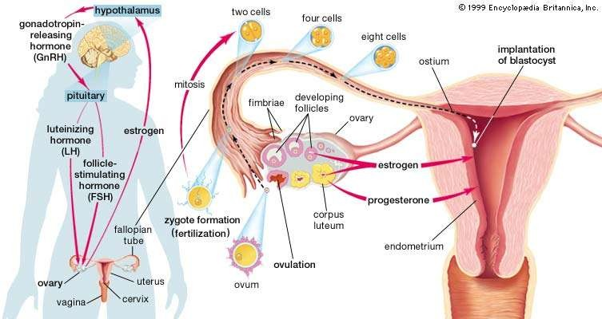

Slide 47


