Slide 1
Parkinson’s disease
BY: DR. TANVI DALVI

Slide 2
Demographic data
Age: increasingly common in patients older age group (55 yrs. - 85 yrs.)
Small % has a young age of onset i.e. 40 yrs.
Gender: males are at a greater risk than females

Slide 3
Chief complaint:
Shaking of hands, feet, tongue, lips & jaw, expression less face.
Heaviness& stiffness with decreased ability to move, difficulty in reaching forwards for objects, walking, accessing staircase, toileting activities.
Difficulty in turning in bed, getting up from sitting position.
Increased forgetfulness or difficulty in remembering recent events etc.

Slide 4
Change in hand writing i.e. abnormally small handwriting.
Increasing slowness while performing routine tasks and difficulty to perform them in a sequential manner like before, slowness or hesitancy during movements.
Difficulty in balancing, frequent falls.
Fatigue or difficulty while sustaining activity, weakness while performing daily activities.
Difficulty in speaking, swallowing.

Slide 5
History:
Onset: insidious
Progression: slowly progressive symptoms
Etiology:
Primary Parkinson’s disease which is due to idiopathic cause, thus 2 subgroups are classified- tremor predominant and postural instability gait disturbed

Slide 6
Post-infectious or definite h/o infection of encephalitis lethargica virus, cryptoccocal meningitis
Toxic parkinsonism- post exposure to toxins like manganese, carbon monoxide, methanol, carbon disulphide (occupational hazard)
Pharmacological parkinsonism- h/o intake of drugs like antidepressants, neuroleptics, antihypertensive

Slide 7
H/o metabolic disorders like hypothyroidism, hyperparathyroidism, hypoparathyroidism, disorders of Ca metabolism.
Parkinson plus syndromes: a group of neurodegenerative diseases that can affect substantianigra and produce parkinsonian symptoms with other neurological symptoms

Slide 8
Patient c/o heaviness & stiffness with decreased ability to move- rigidity, especially in proximal muscles- shoulders, neck progressively involving the face and extremities.
Rigidity & bradykinesia: Slowness experienced in tasks which were prior performed with ease, with h/o freezing episodes, difficulty in initiating an action (akinesia) or movement performed reduced speed, amplitude (hypokinesia). Patients face problems in performing two tasks simultaneously or unable to switch on from one movement to another while performing a transfer sequence

Slide 9
Tremors: h/o tremors which are unilateral later progress bilaterally, aggravated by rest, emotional stress and fatigue, diminished with voluntary activity.
Postural instability: decreased ability to maintain steady posture and decreased ability to maintain balance during activities like reaching, walking, turning, frequent falls due to the same.

Slide 10
Poverty of movements: task complexity deteriorates the quality and increases the difficulty of movements, automatic movements or unconscious movements are impaired, as a result reduced or absent arm swing while walking.
Fatigue: difficulty while sustaining an activity, increasing feeling of lethargy, weakness as the day progresses

Slide 11
On observation:
Mask face
Pill-rolling tremors and postural tremors
Stooped posture, kyphosis/ scoliosis deformity
Sialorrhea and micrographia
Festinating gait with loss of normal heel-toe pattern
Ryle’s tube may be fitted due to difficulty in swallowing

Slide 12
On examination:
Higher mental function: cognitive impairments are mild- severe. Bradyphrenia is a disorder of intellectual function characterized by slowing of thought and information processing. There are problems in selective attention and shifting attention.

Slide 13
Autonomic dysfunction: thermoregulatory dysfunction includes excessive sweating and abnormal sensations of warmth and coldness. Other symptoms include- orthostatic hypotension, seborrhea, GI dysfunction include poor gastric motility, changes in appetite, wt. loss, urinary incontinence; urge incontinence, nocturia, urinary frequency.

Slide 14
Cardiopulmonary dysfunction: orthostatic hypotension is common. Patients with advanced PD exhibit low resting BP. Respiratory impairments due to restrictive lung dysfunction which is linked to reduced chest expansion as a result of trunk rigidity and kyphosis.
Sensory examination: there is no primary sensory loss but paraesthesias and pain including tingling, numbness, coldness, aching pain, burning are experienced.

Slide 15
Motor examination: Two types of rigidity are seen- lead pipe.
-Cogwheel:
Rigidity is asymmetrical initially and more in proximal muscles. Impairments in AROM & PROM are exhibited, especially, hip, knee extension, ankle dorsiflexion, shoulder flexion, elbow extension, dorsal spine and neck extension, axial extensions are restricted.

Slide 16
Balance examination: balance dysfunction is seen in PD patients due to postural instability. Perturbation tasks, functional reach test step tests are used to challenge balance.
Functional assessment: examination of functional status is indicated, including performance in functional mobility skills, BADL and IADL activities. Functional independence measure is commonly administered. The estimation of stage and severity of PD, Hoehn- Yahr classification of disability scale is used.

Slide 17
Problem list:
Decreased ROM
Weakness of movements
Impairment in motor planning, programming, motor learning
Fatigue
Increased dependence in ADLs
Cognitive and emotional issues

Slide 18
Physiotherapy management
Motor learning strategies:
Patients with PD demonstrate problems in motor learning including problems with learning complex and long movement sequences. Simultaneous motor and cognitive tasks and movements depend on internally generated ques v/s externally generated cues.
More no. of repetitions should be given to develop procedural learning.

Slide 19
Complex movements should be broken down into component parts.
Practice tasks in real life environment to achieve effective transfer of training to real life situation.
Avoid dual task initially, practice initially in distraction free environment, as the task gets mastered progress to dual task situations.

Slide 20
Use of structured instructional sets.
External cues are effective in triggering sequential movements characteristics in mild to moderate PDs.
Visual cues- floor markings, subject mounted lights, visual targets.
Auditory cues- multisensory cues, metronomes while walking etc. auditory commands while the patient attempts to walk.

Slide 21
2. Exercise training:
Relaxation exercises to minimize the tone- gentle rocking (rocking chair), slow rhythmic rotational movements for e.g. hook lying, lower trunk rotation or side lying rolling, or upper or lower trunk segmental rotations.
Rhythmic initiation
Diaphragmatic breathing during exercise.

Slide 22
Flexibility exercises- A ROM, P ROM exercises.
Strengthening of weak elongated extensor muscles while lengthening short flexor muscles.
P ROM exercises to maintain range. ROM exercises in physiological patterns of motion e.g. bilateral symmetrical D2 flexion patterns promoting upper trunk extension counteracting kyphosis.

Slide 23
Lower extremity, hip- knee extension should be emphasized.
Stretching exercise to maintain length- tension relationship of the muscle, prevent formation of contractures and deformity. 3 reps of 30 sec hold are enough, however avoid ballistic stretching. Mechanical stretching on tilt table.
Passive positioning in bed to prevent

Slide 24
Development of phantom pillow posture in supine position which is flexion of head and shoulder as if there is a pillow present.
In early stages prone lying position is recommended.
Strength training with elastic resistance or small weight dumbbells should be incorporated.

Slide 25
  Strengthening shows greater improvements in balance and strength using combined program of balance and strength for knee extensors, flexors and ankle plantar flexors.
3. Functional training to improve mobility, by giving sit to stand activity, bed mobility. Bed mobility can be improved through rolling activities.

Slide 26
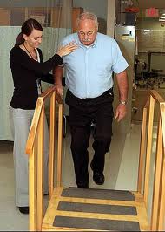
Functional training

Slide 27
Sitting posture is facilitated through exercises designed to improve pelvic mobility- anterior posterior tilt, side to side tilt, pelvic clock exercise.
Sitting activities include wt. shifting emphasizing upper trunk rotations and reaching. Sit to stand transitions.

Slide 28
Strengthening of hip and knee extensors can be achieved using modified wall squats.
Mobilizing facial muscles- massage, stretch, manual contacts, verbal cueing.
Adaptive and supportive devices to-
1. Promote bed mobility- pt. is helped to assume a sitting position by elevating the head end of the bed.

Slide 29
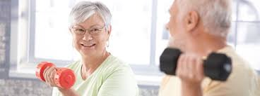
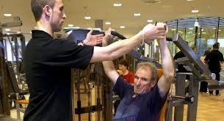
Strengthening program

Slide 30
2. Attaching a knotted rope to the end of the bed to pull on.
3. Stable bed and mattress to allow mobility.
Raised chair seats
Raised toilet seats
Use of assistive aids for walking, use of loose clothing to facilitate self dressing.

Slide 31
Balance training- wt. shifts, reaching, axial rotation of trunk and head, axial rotation with reaching, stepping and marching on place, functional reach.
Loco motor training- focus on primary gait impairments which include slowed speed, shuffling gait pattern, diminished arm swing and trunk movements and overall attitude of flexion while walking.

Slide 32
Training programs aimed at increasing the stride length, broaden BOS, improve stepping, improve heel toe pattern, increase in contralateral trunk and arm swing, increase speed, program of regular walking.
Gait training with over head harness, use of verbal cues, reciprocal arm swing while walking should be reinforced. Practice of changing directions, crossing obstacles while walking.

Slide 33
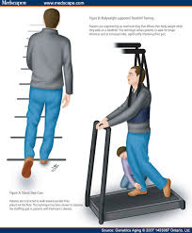
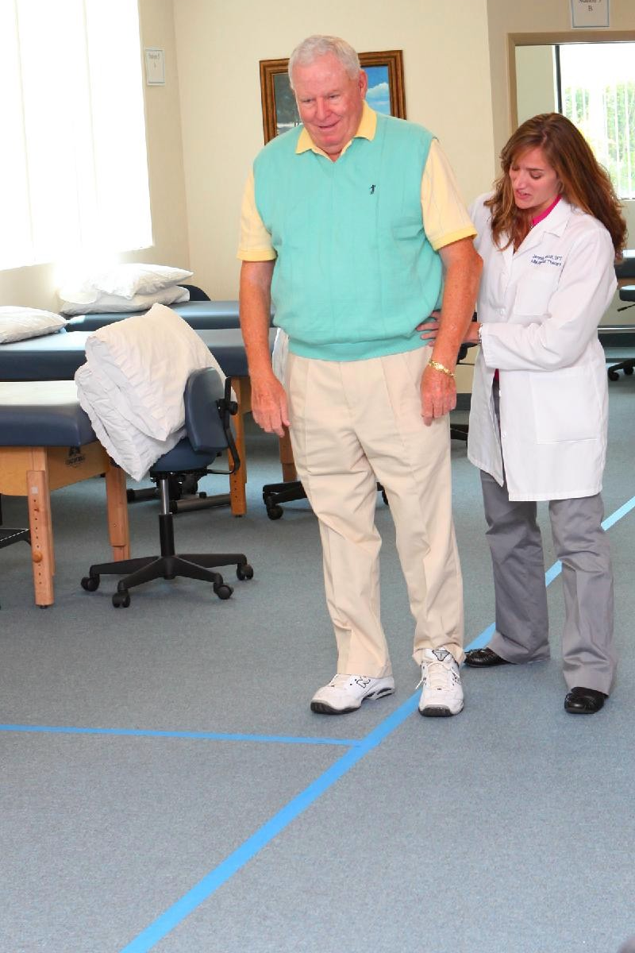
Locomotor training

Slide 34
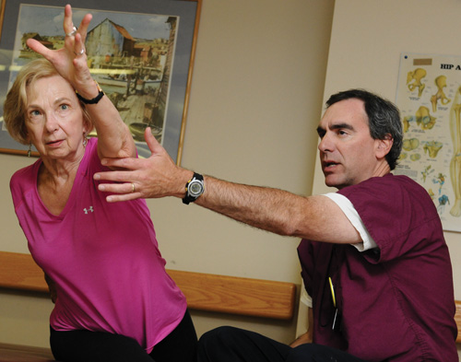
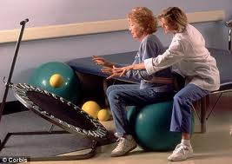
Balance re-training

Slide 35
4. Cardiopulmonary training:
Diaphragmatic breathing, deep breathing to improve thoracic mobility and vital capacity.
Upper limb PNF D2 flexion pattern
Aerobic training to improve cardiorespiratory endurance considering the physical abilities of the individual patient. Both aerobic and strength training have shown to improve physical ability of these patients.

Slide 36
Is aerobic and strength training effective for patients with Parkinson's disease?
P- Reduced strength and endurance
I - aerobic and strength training exercises
C- -----
0 - muscle strength, balance, walking capacity

Slide 37
Effort training in Parkinson's disease: A systematic review.
Ann Phys Rehabil Med. 2014 Mar;57(2):79-104. doi: 10.1016/j.rehab.2014.01.003. Epub 2014 Feb 11 Tambosco L1, Percebois-Macadré L2 etal

Slide 38
The aim of the study was to access the effectiveness and limitations of aerobic and strength training in patients with Parkinson’s disease
Systematic review High level of evidence | Ann Phys Rehabil Med. 2014 Mar;57(2):79-104. doi: 10.1016/j.rehab.2014.01.003. Epub 2014 Feb 11, Tambosco etal | A comprehensive search on Pub Med and cochrane databases was made, 31 RCTs and 5 literature reviews were selected. | Exercise training is shown to improve muscle strength, balance, walking capacity, posture. Exercise program should thus begin as soon as possible and should incorporate strength and endurance training in Rehabilitation program | This review concludes that strength and aerobic training improves phyisical abilities of patients with parkinson’s disease and that the program should be individualized based on the difficulties and physical capacities of each individual patients also considering,intensity and phase ON / OFF timing.

Slide 39
IS EXTERNAL CUING EXERCISE IMPROVE BALANCE IN PARKINSON’S PATIENTS?
P- ALTERD BALANCE
I- EXTERNAL CUING EXERCISES
C-WITHOUT EXTERNAL CUING EXERCISES
O- UPDRS

Slide 40
TYPE OF THE STUDY | RANDOMISED CONTROL TRIAL
YEAR OF PUBLICATION | 2013
LEVEL OF EVIDANCES | HIGH
AUTHOR | Cathy C. Harro Michael J. Shoemaker, Grand Valley State University Oksana Frey April Gamble Kendra Harring
CITATION | Cathy C. Harro, Michael J. Shoemaker, Oksana Frey, April
AIM | Effects of Two Externally-Cued Locomotor Training Protocols on Balance Function and Fall Incidence in Individuals with Idiopathic Parkinson’s Disease:
METHOD | CASE GROUP WITH EXTERNAL CUES AND CONTROL WITHOUT EXTERNAL CUES

Slide 41
WAS META ANALYSIS USED? | NO
CONCLUSION | EXTERNAL CUING EXERCISE ARE EFFECTIVE IN IMPROVING OF BALANCE

