Slide 1

CHOLERA
Prepared By,
Mrs. Ruhi Varghese
SNC

Slide 2
CHOLERA
Cholera is an acute intestinal disease characterized by sudden onset of profuse watery stools, vomiting, rapid dehydration and circulatory collapse. The clinical spectrum includes asymptomatic infection, mild watery diarrhoea and severe watery diarrhoea with vomiting.
Both adults and children are affected but in endemic areas cholera mainly affects children 2-15 years of age and breastfeeding may be protective in the first 2 yrs of life from severe cholera.
A rapidly increasing incidence of acute diarrhoea with dehydration in young population should lead to a suspicion of cholera.
http://en.wikipedia.org/wiki/Cholera

Slide 3
Definition
1. Cholera is a bacterial infection. It is caused by drinking water contaminated with vibrio cholerae bacteria, or by eating food that has been in contact with contaminated water.
2. Any of several diseases of humans and domestic animals usually marked by severe gastrointestinal symptoms; especially: an acute diarrheal disease caused by an enterotoxin produced by a comma-shaped gram-negative bacillus (Vibrio cholerae syn. V. comma) when it is present in large numbers in the proximal part of the human small intestine

Slide 4
Epidemiology
Cholera is caused by Vibrio cholerae, the comma bacillus, a Gram negative, very small curved motile organism. The two biotypes are classified as classic and El Tor, based on hemolysin, haemagglutination, susceptibility to polymyxin B, and susceptibility to bacteriophages. The organism survives in warm salty water with nutrients and oxygen. Direct person-to-person transmission is rare. Because Vibrio cholerae are very sensitive to gastric acid, a large number of the organisms have to be ingested for an infection to set in. For this reason cholera is not a very infectious disease.

Slide 5
Transmission is through the faecal-oral route but almost all cholera infections are water borne. Vibrio cholerae can live in water for 2 weeks and prefer salty water. In sea water they may survive for longer periods. Vibrio cholerae can survive and multiply in shell fish such as crab and shrimp. Vibrios also readily multiply in certain foods such as milk and boiled rice. The reservoir of infection is formed mainly by carriers. These carriers excrete vibrios in smaller numbers than the patients but because of their freedom of movement and the fact that they far outnumber the patients they form the greatest danger to the community.

Slide 6
CON….
Vibrios must colonize the small intestine to establish infection and cause disease. They attach to the intestinal lining and multiply, producing an enterotoxin (cholera toxin). The cholera toxin causes a prolonged elevation of cyclic adenosine monophosphate levels in villous cells and this results into a decrease of the active absorption of sodium and chloride in the villous cells and an increase of the active secretion of chloride by crypt cells. The result is massive fluid secretion into the intestinal lumen and this is what is seen as diarrhoea and vomiting in either end.

Slide 7
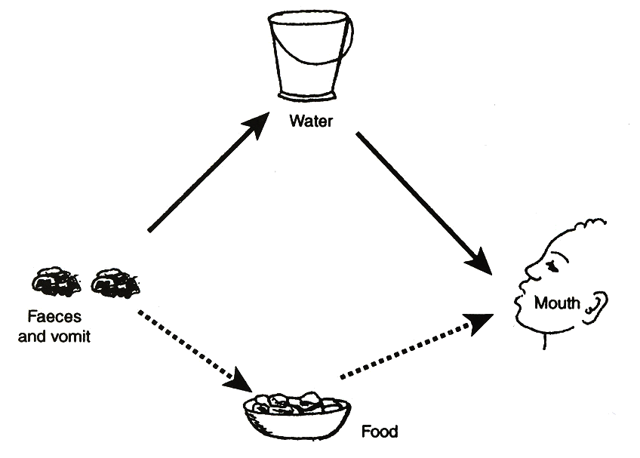
Fig : Transmission of route cholera by the faecal-oral

Slide 8
Clinical Picture
The incubation period is usually 2 - 3 days. Cholera is not a systemic infection, and therefore, fever is generally low grade or absent. The vibrios are confined to the intestinal tract. The clinical syndrome of cholera is caused by water and electrolyte losses.
In typical cases of severe cholera, the disease develops in three stages. The first stage lasts for 3 - 12 hours. Profuse watery stools pour from the patient. Soon faecal matter disappears from the stools which become almost clear fluid with flakes of mucus, giving them the classical rice-water appearance. Vomiting follows the diarrhoea. At first food is vomited but soon only rice water is vomited. Severe cramps in the abdomen and limbs develop from salt loss.

Slide 9
CON……
In the second stage, there is collapse from dehydration. The body becomes cold, the skin is dry and inelastic. The blood pressure is low or unrecordable, the pulse is rapid and feeble. Urine production stops and the patient may die of shock.
The third stage is the stage of recovery, either spontaneously or with treatment. The diarrhoea decreases; the patient is able to take fluids orally and the general condition rapidly improves.
Cholera should be suspected in any outbreak of diarrhoeal disease. The diagnosis is made on clinical grounds. Do not refer patients to confirm diagnosis but send a rectal swab or stool specimen in transport medium if available to the next equipped laboratory. The best transport medium for all enteric bacteria is the Cary Blair.

Slide 10
MANAGEMENT
Patients can be admitted to a temporary hospital such as an adapted school or church. Strict isolation is not necessary as only the vomitus and stools are infective. These should be properly disposed into a pit latrine or a septic tank system or flushed in the toilet. Hospital equipment can be cleaned with a disinfectant while any instruments used should be cleaned in disinfectant or sterilized. The patients should be made comfortable by treating them on cholera beds. These are beds with a central hole through which the continuous stools can pass into a bucket.
The essential cure of cholera is re-hydration, which if started on time, will save many cholera cases even without any drug treatment.

Slide 11
CON……..
Patients of all ages who are strong enough to drink will voluntarily ingest the volumes of ORS needed for re-hydration and maintenance. Patients in shock or too weak to drink, require intravenous fluids until they are able to take orally. Vomiting is caused by acidosis and fluid loss. It may last for a few hours but the volume is usually small and continuous drinking should replace the loss.
Oral re-hydration should be given in frequent small amounts by mouth or by naso-gastric tube in children. Disturbance of electrolyte balance is less common with oral re-hydration and intravenous fluids can be reserved for those with severe dehydration. A mother can give a child a teaspoon of fluid every 1 - 2 minute.

Slide 12
CON……..
. With every vomiting or loose motion passed, the mother should add 5-10ml/kg body weight to the total fluids the child is to take in 4-6 hours. The total fluids are calculated at 50-100ml/kg body weight, depending on the degree of dehydration, as replacement of ongoing losses.
Tetracycline will speed up the cure and prevent the convalescent carrier stage and Co-trimoxazole can also be used with good effect. A stool culture will assist in the selection of the most sensitive antibiotic.

Slide 13
Prevention and Control
Surveillance is the key to a successful cholera control programme. Surveillance is the continuous watching of all aspects of a disease. It includes collection of morbidity and mortality reports, field investigation of epidemics or individual cases and laboratory investigations such as culturing. Once an outbreak of a disease under surveillance is noted in a certain area, immediate action must be taken. Surveillance depends on reporting suspected cases of cholera. It is obligatory to report any case immediately to the District Medical Officer (DMO) by any rapid means.
Three factors influence reporting of new cases by the public. Reporting is greatly inhibited when repressive measures are taken once a case is identified. Repressive measures can be quarantining a family, hospital, community or an area.

Slide 14
CON……
Such measures will increase the hysteria among the people and will hinder surveillance, as people will not come forward to report cases. Saving lives should be the top priority in the control of cholera. Fear and panic occur in the community when deaths occur. If cases are recognized and treatment is given without delay, fear will disappear and families will report their cases. Treatment centres should not be quarantined.
Reluctance to report cases and fear of the disease can be overcome by allowing visits to the patients. A parent should stay with a paediatric case to assist in oral fluid therapy and nursing. These means are important because they stress the relatively benign nature of the disease and show that it is not very infectious.

Slide 15
CON………
As cholera is mainly a water-borne disease, it cannot spread when water is made safe. This can be done by chlorination of the public water supply or by boiling or treating supplies for individuals. In case of emergency, large quantities of water can be treated with chloride or lime.
Only certain foods can transmit cholera, under special circumstances and for a limited period of time. Milk products should be pasteurized. Uncooked food should be avoided or washed in safe water. Left-over food should be protected against contamination by flies. Markets should be inspected.
Improvement of sanitation facilities will result in a lower incidence of all diarrhoeal diseases including cholera. Emergency measures in case of epidemics are impracticable and not the first priority.

Slide 16
CON……..
Tetracycline can prevent cholera in households where there is a cholera case if it is given to close contacts, but administration of tetracycline to the entire population is impracticable and inadvisable. Mass chemoprophylaxis only results in indiscriminate use of drugs and increases the danger of drug-resistance and development of drug reactions.
Cholera vaccine is of low potency. It gives 50 % protection for 3 - 6 months only. The vaccine will give some individual protection against clinical cholera but mass immunization will increase the number of asymptomatic carriers. As a general measure to stop an epidemic from spreading immunization is of no value. The public should be informed of the limited value of immunization because in an epidemic they will demand protection and they may panic when they find that vaccine is not available.

Slide 17
CON……….
On the other hand, pressure may make the authorities start an immunization programme and so neglect the more important protection and purification of the water supply. People who are immunized may have a false sense of security and may be encouraged to consume unsafe water or food. Improved vaccines are under development.
Some funeral ceremonis may be conducive to the spread of the disease. If this is the case, communities need further education about burials.

Slide 18
ABSTRACT
BACKGROUND:
Diarrhea is a major contributor to the burden of morbidity and mortality in children; it accounts for a median of 11% of all deaths among children aged less than 5 years, amounting to approximately 0.8 million deaths per year. Currently there is a dearth of literature exploring the effectiveness of antibiotics for diarrhea due to Cholera, Shigella and cryptosporidiosis in children.

Slide 19
METHODS:
We reviewed the literature reporting the effect of antibiotics for the treatment of diarrhea due to Cholera, Shigella and Cryptosporidium in children fewer than five years. We used a standardized abstraction and grading format and performed meta-analyses to determine the effect of the treatment with various antibiotics on mortality and rates of clinical and bacteriological/parasitological failure. The CHERG Standard Rules were applied to determine the final effect of treatment with antibiotics on diarrhea morbidity and mortality.

Slide 20
RESULTS:
For Cholera; the evidence was weak to recommend any effect on mortality. For
Shigella; there was no data on mortality; either all-cause or cause specific, hence we used clinical failure rates as a proxy for Shigella deaths and propose that treatment of Shigella dysentery with antibiotics can result in a 82% reduction in diarrhea mortality due to Shigella. For cryptosporidiosis; there was data on all-cause mortality but the evidence was weak hence we used clinical failure rates as a proxy for mortality to estimate that antimicrobial treatment of diarrhea due to cryptosporidiosis can result in a 54% reduction in mortality.

Slide 21
CONCLUSIONS:
There is evidence to recommend antibiotic use for reduction of morbidity and mortality due to Cholera, Shigella and Cryptosporidium. We recommend that more clinical trials should be conducted to evaluate the efficacy and safety of first- and second- line drugs currently in use for treatment for diarrhea and dysentery in both developing and developed countries.

Slide 22
LEVEL OF EVIDENCE
Level of evidence is 2.

Slide 23
PICO
P Problem/Population | I Intervention/indicator | C Comparison/control | O Outcome
The importance of folic acid deficiency in the pathogenesis of vascular, mixed and Alzheimer's disease dementia.The study involved 166 people, including 47 people with the diagnosis of Alzheimer's disease (AD), 41 with vascular dementia (VaD) and 36 with mixed dementia (MD). | All patients underwent a general physical, neurological, psychiatric and extensive neuropsychological examination, as well as routine blood and biochemical screening tests and neuroimaging. The level of serum folate (Fol) was measured by electrochemiluminescence immunoassay. To assess the correlation of Fol level with the cognitive impairment neuropsychometric scales: Mini Mental State Examination (MMSE) and Clinical Dementia Rating (CDR) were used. | The control group consisted of 42 persons without cognitive impairment. | In patients with dementia, compared with the control group, there were significantly lower levels of folic acid (p = 0.04). There was no difference in the concentration of Fol in groups of patients (p = 0.0889). In people without cognitive impairment (CDR 0) levels of folic acid were significantly higher compared to the group with moderate dementia (CDR 2, p = 0.0475).

