Slide 1
FEMUR SHAFT, SUPRACONDYLAR FEMUR, PATELLA FRACTURE
PRINCIPLES OF ASSESSMENT AND PHYSIOTHERAPY MANAGEMENT
Niketa Patel
13/8/15

Slide 2
Objectives
After completion of this lecture, you will able to:
Explain mechanism of injury and surgical treatment of Femur shaft fracture.
Discuss physiotherapy assessment and management of Femur shaft fracture.
Explain mechanism of injury and surgical treatment of Supracondylar Femur fracture.
Discuss physiotherapy assessment and management Supracondylar Femur fracture.

Slide 3
Objectives contd…
Explain mechanism of injury and surgical treatment of Patellar fracture.
Discuss physiotherapy assessment and management of Patellar fracture
Apply Evidence based Physiotherapy

Slide 4

FEMUR SHAFT FRACTURE

Slide 5
Mechanism of injury
RTA
Gunshot injury
Fall from a height
Pathological fractures commonly occuring at metaphyseal-diaphyseal jucntion.
Stress fracture (military persons, runners)

Slide 6
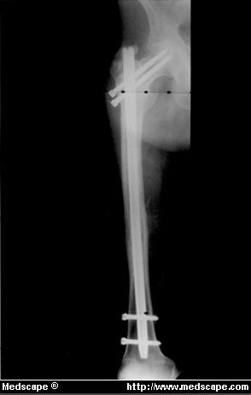
Surgery
Intramedullary nailing: antegrade or retrograde inserted.
Plate and screws

Slide 7
Principals of physiotherapy assessment
Pain
Swelling :
swelling on the thigh
Take girth measurement
Gross deformity if any.

Slide 8
Shortening of the affected limb:
Limb length measurement
Assess hip and knee ranges. It may be impaired due to pain, swelling and spasm.
Isometric strength of the knee muscles will be reduced.

Slide 9
Rehabilitation goals
To restore full ROM or at least functional range of both hip and knee joints
To improve the strength of quadriceps and hamstring muscle

Slide 10
Functional goal
To restore the activities of daily living and gait pattern

Slide 11
Physiotherapy after surgery
Immobilization phase (1st week or 10days):
Adequate chest PT to avoid respiratory complications
Positioning of the limb
Resistive movements to the toes and ankle joint of the fractured limb and other body joints.
Strong isometrics to quadriceps, hamstrings, abductors and adductors to avoid atrophy and weakness.

Slide 12
Mobilization phase (after 1 week to 10 days):
As soon as mobilization is allowed, efforts should be made to achieve maximum possible AROM of hip and knee.
Gradual mobilization of the hip is initiated.
1. Relaxed PROM with totally supporting the limb weight by physiotherapist but in pain-free range.
Any passive movement which causes pain must be stopped.
No over pressure at the end ranges.

Slide 13
2. Progressive self assistive ROM of flexion is achieved by heel drags.
3. Self assisted knee bending → high sitting position.
4. Sitting and transfer from high sitting can be taught → self assisted by patient supporting the affected leg with normal leg.

Slide 14
Partial wt bearing can be initiated by 6-8 weeks.
Full wt bearing by 12 weeks.

Slide 15
Complications
Infection (<1% incidence in closed fractures)
Refracture
Nonunion and delayed union
Fixation device failure
Vasculary injury: due to femoral artery damage. Very rare.

Slide 16
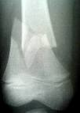
SUPRACONDYLAR FEMUR FRACTURE

Slide 17
Mechanism of injury
Most distal femur fractures are the result of a severe axial load with a varus, valgus, or rotational force.

Slide 18
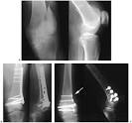
Surgical treatment: The fracture is reduced by operation and fixed by condylar blade-plate

Slide 19
Principles of physiotherapy assessment
Pain
Swelling:
Swelling on the thigh and knee.
So take girth measurement.
ROM: knee ranges will be impaired.

Slide 20
Patellar mobility → reduced due to pain and swelling.
Muscle strength → quadriceps and hamstrings muscles’ strength will be reduced.
Measure limb length for any discrepancy.

Slide 21
Principles of physiotherapy
The common problems with this injuries are:
Gross effusion of the knee
Knee stiffness- due to immobilization and involvement of articular surfaces.
Knee instability- comminuted fracture mostly causes soft tissue injury including ligaments.
Reflex inhibition of quadriceps.

Slide 22
Immobilization phase
Therapeutic measures are applied to reduce knee joint effusion and improve knee ROM as early as possible with early and strong isometrics to quadriceps.
Limb elevation, and strong isometrics of glutei and quadriceps can also be given during immobilization phase as well as in mobilization phase.
Strong ankle and toe movements

Slide 23
Mobilization phase
Post operatively mobilization can be started by 2 weeks.
After a week or 10 days start gradual knee mobilization:
High sitting knee flexion-extension exercises assisted by therapist → to improve knee ranges.

Slide 24
To reduce quadriceps spasm which is hindering in knee flexion → use thermotherapy or cryotherapy .
Self-assisted relaxed knee swinging.
2. Strengthening of knee flexors and extensors in available range and pain free.
3. Non-weight bearing walk with walker, once the patient is allowed to ambulate.

Slide 25
4. By 4to 6 weeks comfortable knee ROM should achieved beyond 90⁰ and full extension.
5. Partial weight bearing should be started by 9 weeks of the surgery.
6. Full weight bearing is permitted by 8-12 weeks .

Slide 26
7. Use parallel bar for proper full weight bearing and to avoid any wrong gait.
8. Stair climbing functional training.

Slide 27
Complications
Malunion
Nonunion
Non-union and knee stiffness
Popliteal artery injury

Slide 28
PATELLAR FRACTURE

Slide 29
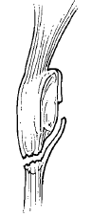
Mechanism of injury
Direct blow e.g. Dashboard injury
Fall
RTA
Indirect blow : jumping

Slide 30
Treatment
Nonoperative treatment: Most vertical fractures which are not displaced as well as with intact extensor mechanism are treated with 4-6 weeks of immobilization in extension in a cast.
Operative treatment: Displaced fractures are operated with open reduction and internal fixation.
Tension band wiring
Partial patellectomy and patellar tendon repair (comminuted bone fracture)

Slide 31
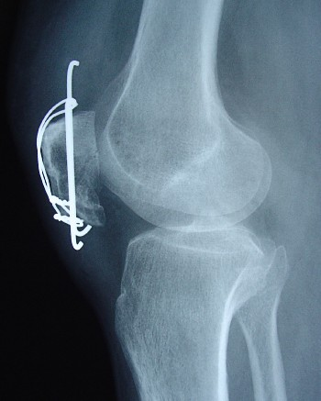
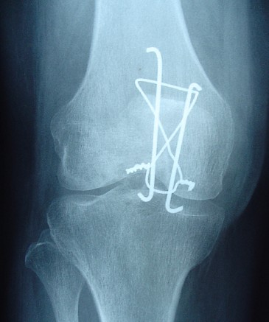

Slide 32
Principles of physiotherapy assessment
Pain
Swelling → girth measurement
Spasm of quadriceps muscle
Tenderness
Knee ranges
Isometrical muscle strength

Slide 33
Principles of Rehabilitation
NON OPERATIVE
Weeks 0-6:
Continue icing until joint effusion is resolves.
Begin quadriceps, hamstrings, glutei sets
SLR in standing and supine
AROM to hip and ankle
Strengthening exercises to hip and ankle

Slide 34
After 3-4 weeks:
gentle patellar mobilization
By 6 weeks:
begin stationary bicycle with seat elevated
No resistance or strengthening applied to knee.

Slide 35
Weeks 6-12:
Closed chain exercises should be begin → mini squat (upto 40⁰)
resisted hip exercises using weigh cuffs or theraband.
Begin lunges by 8-10 weeks.

Slide 36
POSTOPERATIVE REHABILITATION
Postoperative Day 1-7:
Ice application and limb in elevated position → to reduce swelling
Static quadriceps
Ankle pumping exercises to prevent DVT.
Weight bearing as tolerated with the crutches and knee extended (0⁰) in long cast or knee brace.

Slide 37
Weeks 2-6:
begin gentle patellar mobilization exercises
Electrical muscle stimulation for muscle reeducation.
By 5-6 week begin stationary bicycling with eat elevated but no resistance.
Weeks 6:
SLR with weight cuffs
Begin gentle closed chain exercises → 30⁰ mini squats, wall sits,

Slide 38
Hamstring curls with weight cuff at the ankle.
Instruct patient to wear a hinge knee brace until 90⁰ of knee flexion is achieved and a good quadriceps control.

Slide 39
Evidence Based Learning
Randomized controlled trial of quadriceps training after proximal femoral fracture

Slide 40
P | Proximal Femoral Fractures
I | six weeks quadriceps training (40 patients)
C | standard physiotherapy alone (40 patients).
O | 1. Measurements of leg extensor power (Nottingham Power Rig) 2. Functional mobility (elderly mobility score) 3. Disability (Barthel Index) 4. Quality of life (Nottingham Health Profile) were made at baseline, after six weeks (at the end of the intervention) and at 16 weeks.

Slide 41
Journal & Authors | Study design & Level evidence | Aim of the review | Methodology | CONCLUSION
Clinical Rehab Mitchell ST et al | RCT 1 b | whether systematic progressive high-intensity quadriceps training increases leg extensor power and reduces disability in patients rehabilitating after proximal femoral fracture. | The training group exercised twice weekly, with six sets of 12 repetitions of knee extension (both legs), progressing up to 80% of their one-repetition maximum. | Progressive high-intensity quadriceps training in elderly proximal femoral fracture patients increased leg extensor power and reduced disability. This was accompanied by an increase in energy as measured by the Nottingham Health Profile. This intervention may provide a simple practical way of improving outcome in these patients.

Slide 42
MCQs
1. Sitting and transfer with legs hanging over the edge of the bed could be made self assisted by?
patient supporting the unaffected leg with affected leg.
patient supporting the affected leg with normal leg.
None of the above

Slide 43
2. Which of the following exercise is a progressive self assistive ROM of flexion?
Heel drags
Passive ROM
Walking

Slide 44
3. To avoid post operative respiratory complications after femur shaft fracture in immobilization phase which exercises is to be given?
Chest PT
Gait training
Ergocyclometer
Non of the above

Slide 45
4. In which of the following fracture, Tension band wiring is used to fix the fracture?
Femur shaft fracture
Patellar fracture
Supracondylar femur fracture
Intertrochanteric fracture

Slide 46
5. Which of the following therapeutic measures are applied to reduce knee joint effusion and improve knee ROM during immobilization phase of post op supracondylar femur fracture?
strong isometrics to quadriceps
strong isotonics to quadriceps
Stretching to hamstrings
Stretching to calf muscles

