Slide 1
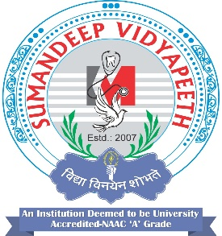
ARTHROPODS AND RODENTS
                PREAPARED BY,
                Mr. Swamy PGN
                SNC

Slide 2
Arthropods : In India, diseases produced by arthropods constitute major health problem in rural and urban. Arthropods comprise varied living things in the surrounding of man.
Arthropods
Help to man - *In fertilisation
No use to man
Harmful to man -
Destroy crops
act as carrier of disease

Slide 3
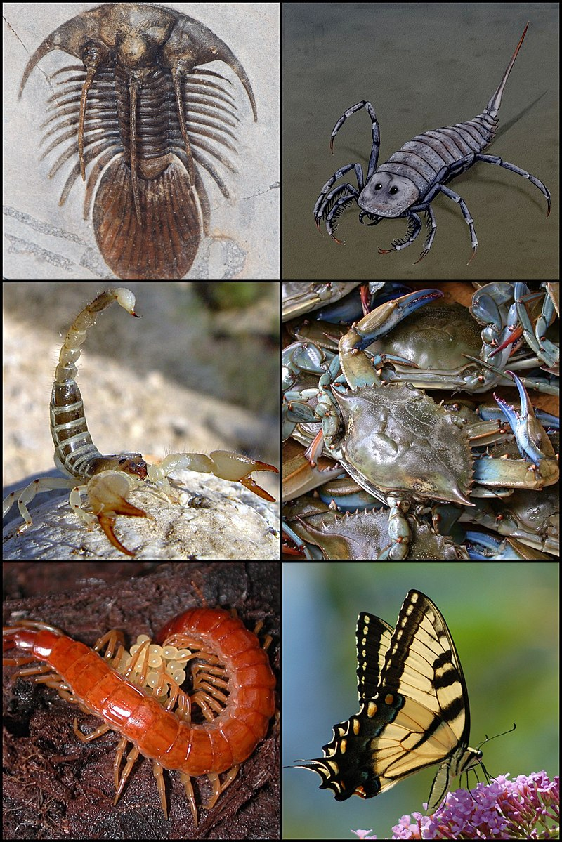

Slide 4
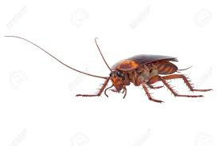
Arthropods have distinctive features such as body, legs, antennae & wings. Body is divided into head, thorax and abdomen and having 3 pairs, 4 pairs or 5 pairs of legs.' Depending upon these distinctive features, arthropods are classified into three classes.
Insecta
Arachinda
Crustacea
(a) Insecta: This class of arthropods have body divided into three parts. Head, thorax and abdomen with 1 pair of antennae, 3 pairs of legs and are found on land. This class is comprised of following categories with examples:-
Mosquitoes
Anapheles
Culicines

Slide 5
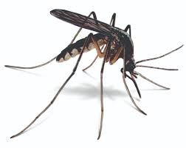
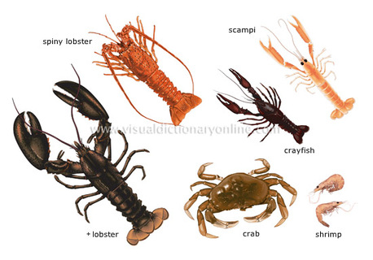
Mosquitoe
Crustacea

Slide 6
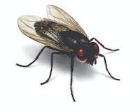
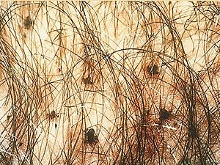
Flies:
House fly
- sand fly
- T setse fly
( TIK- TIK FLIES)
- black fly
Human head lice
Human body lice
Crab lice
Fleas
Rat fleas
Sand fleas

Slide 7
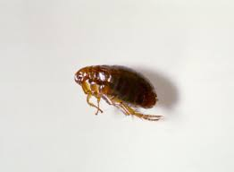
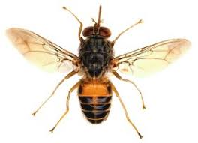
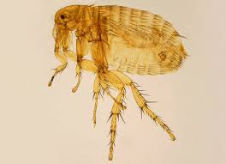
Fleas
T setse fly

Slide 8
Diseases caused by insecta class of arthropods have been discussed below:
Mosquito :
Anopheles : Malaria
Culex : Filaria
Aedes Aegpyti : Yellow fever
Dengue
haemorrhagic fever
Mansonoides : Chikungunya fever
2. Flies :
Housefly : Diarrhoea, dysentry, typhoid, paratyphoid gastro enteritis, cholera, poliomyelitis, conjuctivitis, trachoma, jaws, anthrax, amoebiasis etc.

Slide 9
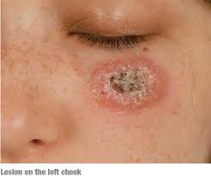
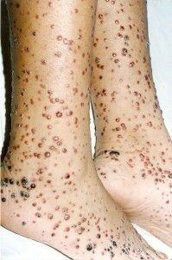
Sand flies
: : : Oriental sore, oraya fever, sand fly fever, kala azar
Tsetse flies :Sleeping sickness
Black flies: Onchocerciasis
3.Human lies
CLASS : INSECTA
CLASS:ARCHIONDA
CLASS:CRUSTACEA

Slide 10
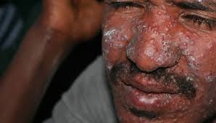
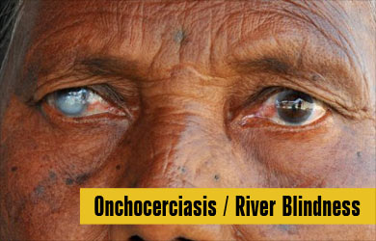

Slide 11
INSECTA
    MOSQUITOES
    FLIES
    HUMANLICE
    FLEAS

Slide 12
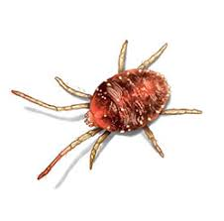
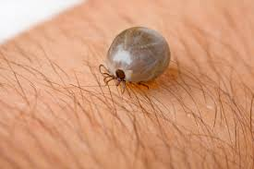
ARACHINDA
TICS
MITES
MITES
TICS

Slide 13
CRUSTACEA
CYCLOPS

Slide 14
Arthropods and Classification
Borrelt recurrents - relapsing fever
Bartonella guintana - Trench fever(five day fever )
Rickettsia Prowazekati - Epidemic typhus
In head, the lice causes pediculosis.

Slide 15
4. Fleas :
Sand fleas • Tetanus and gas gangrene frequently occur due to secondary infection.. - typhus.
Ral fleas : Bubonic plague, hyrnenolepis diminua, endemic
5. Reduviid bugs : Chagas disease
(b) Arachinda : This class of arthropods have body to be divided into cephalothorax of this class have 4 and abdomen and in some cases there is no division. The arthropods pairs of legs and there is no antennae and are found on land. It has main two categories i.e. ticks and mites. —
Ticks - Hard ticks . Soft ticks —
Mites — Chikungunya fever Itchmite Trombiculid Following are the types of diseases caused by this class of arthropods
Ticks : Hard ticks :Viral encephalitis, tick typhus, viral fever, viral haemorrhagic fever, tick paralysis etc.
Soft ticks : Q fever, relapsing fever.

Slide 16
2. Mites
• Itchmite : Scabies
Trombiculid mite : Scrub typhus, Rickettsial-pox.
(c) Crustacea : This class of arthropods have 5 pairs of legs, 2 pairs of antennae and body is divided into cephalothorax and abdomen. Cyclops fall under this class. Diseases caused by cyclops are : Guinea worm disease, fish tape worm.
Transmission : In spread of arthropods borne diseases, following types of transmission is involved :
• Direct contact.
• Mechanical transmission
• Biological transmission
• Direct contact : The diseases such as scabies and pediculosis are transmitted by arthropods that are directly transferred from man to man through close contact.

Slide 17
Transmission of Arthropod-Borne Disease
Direct contact
* Scabies *Pediculosis etc.
Mechanical Contact
*Diarrhoea *Dysentry *Typhoid *Food poisoning etc.
Biological Transmission
*Plague *Malaria *Filaria *Guinea worm etc.

Slide 18
2) Mechanical Transmission : The diseases such as diarrhoea, dysentry, trachoma, typhoid and paratyphoid caused by housefly are transmitted mechanically. In this, the transmission occurs by the mechanical transportation of infectious agents through soiled feet of flying arthropods and passage of organisms through its gastro-intestinal tract. There is no development of infectious agent on or within vector.
(3) Biological Transmission In biological transmission, infectious agents under go replications/multiplication/development in the vector and the vector cannot transmit infection before completion of an incubation period. It is of three types : Propagative : E.g., plague, bacilli in rat fleas. Cyclopropagative : E.g., malaria parasite in anaphelese mosquito. Cyclo development : E.g., filaria in culex. Development changes occurring in three types of Biological transmission

Slide 19
Type of biological transmission
• Propagative • Cyclo propagative • Cyclo developmental
Control Arthropod borne diseases 1. Mosquitoes control measures : An integrated approach i.e. use of combined one or more methods to achieve optimum results with minimum inputs is used to control the mosquitoes borne disease. According to WHO, all airports and seaports are kept free from all kinds of mosquitoes for a distance of 400 meters. Following are the methods used to achieve a control over arthropod borne diseases due to mosquitoes.
• Aritilarval measures.
Antiadult measures.
• Protection against mosquito bites.

Slide 20
(1) Antilarval measures
A)Environmental control:
By enginnering measures : Such as filling, levelling and drainage of breeding places.
- By water management • Such as intermittent irrigation; making water unsuitable for mosquitoes by changing the salinity of water.
- Adequate and proper collection, removal and disposal of sewage and waste water. Environmental control is the most important in reducing the number of mosquitoes at the source point.
(B) Chemical control : The commonly larvicides (to kill larvae)
- Mineral oils : Mineral oils such as diesel oil, fuel oil, kerosene etc. is spread over applied on water to form a thin film. This film of oil cuts off the air supply for larvae and pupae. Oil also has a specific toxic action. It is applied once a week on all breeding places

Slide 21
Requirements : 40-90 litres per hectare. The main disadvantage associated with application of mineral oil is that it makes the water unfit for drinking purposes.
- Paris green : Paris green is prepared by mixing 2 kg of paris green and 98 kg of soapstone powder or slaked lime. It is mixed in a rotary mixer. In this way, the prepared paris green is 2 percent and is applied as dust. The dusting is achieved by hand blowers or rotary blowers
. Requirement : 1 kg of actual paris green per hectare of water surface. Paris green has not any harmful effect to man, domestic animals or fish.
- Synthetic insecticides : Organo phosphorous compounds such as fenthion, abate, malathion etc. are used as these quickly dissolve in water.

Slide 22
Requirement
Fenthion - 22-112 g/hectare
Abate - 56 - 112 g/hectare
Malathion - 224 - 672 g/hectare Organo chlorine compounds such as PDT etc. are not used because of risk of water contamination.
(C) Biological control : Gambusia affinis and lebister reticulatus feed on and therefore used as biological control measures. mosquito larvae The fish is used in pits as to eat all the mosquitoes larvae borne in water. 'ponds cisterns so
(2) Anti adult measures ; Anti adult measures used to control the mosquitoes are also considered as an effective mean of control.
A) Residual sprays - DDT, malathion, Linclane and CMS - 33 are most commonly used widespread

Slide 23
Requirements : DDT : 1-2 g/m2 Lindane : 0.5 g/m2 Malathion : 2 g/m2 OMS —33 : 2 g/m2
Average duration of effectiveness of DDT is 6 to 12 months and for lindane, malathion and OMS - 33 is 3 months.
B) Space sprays : The space sprays used are : — Pyrethrum extract Residual insecticide Pyrethrum is sprayed and doors and windows are kept closed for half an hour. At small scale i.e. for houses handgun with five nozzle is used and on a large scale — power sprayers are used.
Requirement : One oz of spray solution per 1000 c.ft of space. Residual insecticides such as malathion and fenitrothion for fogging is used as insecticides.
(C) Genetic control : Genetic control measures given below can be used to achieve genetic control. — Male sterile technique — Cytoplasmic incompatibility — Chromosomal translocations 110 — Sex distortion — Gene replacement
(3) Protection against mosquito bites :— • Nets

Slide 24
CONTROL OF SANDFLIES
Environmental control - Sanitary measures such as removal of shrubs and vegetation within 50 yards of human residential area. - Engineering measures such as filling crackers, crevices in walls, floors and doors. - Location of poultry houses or cattle sheds far away from human living places.
Chemical control : -
Insecticides : Insecticides such as DDT is found to be effective for a period of 1-2 year if applied at a rate of 1-2 gm/m2.

Slide 25
CONTROL OF TSETSE FLIES
Environmental control Environmental measures include : - Cleaning of vegetation places where tsetse flies live and breed.
B) Chemical control : Twenty five percent of DDT is most commonly used pesticide.
C) Genetic control : Genetic control of tsetse fly can be achieved by - Male sterile technique.

Slide 26
HUMAN LICE CONTROL MEASURES
- Personal hygiene
- Chemical control
Personal Hygiene : An improvement in personal occurrence of lice on body or hairs.
- Daily bath with soap and water
. - Frequent washing of long hairs.
- Change and launder clothes
- Autoclaving of clothes and bedding in case of body lice.
- Improving living standards.
Chemical control : Insecticides are also used to control the lice.
Head lice used to control the lice.

Slide 27
  Head lice used to control the lice.
  Melathion solution (0.5%) is used and kept for 12-24 hours after that the
  hairs are washed, melathion kills the nits and lice.
Body lice : One percent melathion is applied in powder form to the inner surface of clothings. One application of 1% malathion is enough to eradicate infestations but a second application is required after 7 days. The required amount is about 50g (2 ozs.) of insecticidal powder

Slide 28
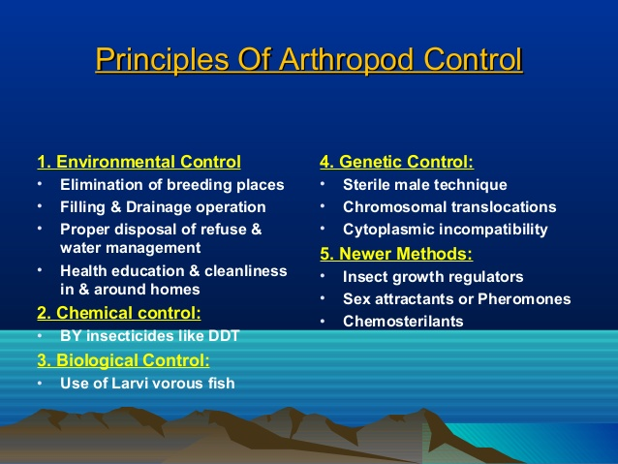

Slide 29
Rodents :
Rodents live in close proximity to man and form a part of man's environment. The rodents act as reservoirs for certain diseases such as plague and typhus. Thus, they are responsible for causing health hazards in human beings so there is need to achieve control by damaging buildings. over rodents. These not only cause health hazards but also cause substantial economic loss by demaging building.

Slide 30
Classification :- Rodents are classified into two groups
Domestic Rodents
• Wild Rodent
• Domestic Rodents: Domestic rodents such as black rat and house mouse are of chief public concern as these rodents live in close association with man
• Wild Rodents Tatera indica and B Indica are common wild rodents fours Rodents transmitted disease in India. Tatera indica is the natural reservoir of plague.

Slide 31
Rodents transmitted disease in India.
(1) Bacterial : Salmonellosis, tularaemia, plague
(2) Viral : Haemorrhagic fever, encephalitis
(3) Rickettsial : Murine typhus, rickettsial pox and scrub typhus.
(4) Parasitic : Leishmaniasis, arnoebiasis, chagas disease, trichinosis & hymenolepsis diminuata.
(5) Others : Histoplasmosis, ring worm and leptospirosis.(by infected animal urine )
Transmission of rodent borne diseases
• Direct contact : By rat bite such as rat bite fever.
• Mechanical transmission :
a) Through contaminated water and food such as salmonellosis and leptospirosis
b) Through rat fleas such as plague and typhus.

Slide 32
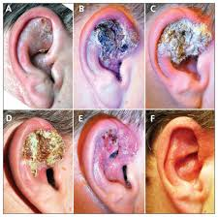
Leishmaniasis

Slide 33
Rodent control measures
• Environmental control :
In environmental control measure, sanitary measures are the most important weapon in controlling the rodents. There are three things which are basically required such as food, shelter and water. With the decrease in these things to rodents, reduction will naturally occur among rodent borne diseases. These environmental measures comprise :-
a) Proper storage of food and food stuff.
b) Disposing left over food stuff appropriately.

Slide 34
c) Collection and storage of garbage in a proper way.
d) Utilising good engineering measures such as constructing rat proof buildings and blocking of rat burrow with concrete.
• Chemical control : Rodenticides are used to kill the rodents. These are two types :-
• Single dose rodenticides
• Multiple dose rodenticides
a) Single dose rodenticides :- These rodenticides have been grouped as 'acute' rodenticides and have lethal effect in one single dose.

