Slide 1
Femur Neck Fracture
PRINCIPLES OF ASSESSMENT AND PHYSIOTHERAPY
Dr. Niketa Patel
6/8/2015

Slide 2
Objectives
After completion of this lecture, you will able to:
Explain principles of physiotherapy assessment
Discuss principles of physiotherapy management
Apply evidence based Physiotherapy

Slide 3
Principles of Assessment

Slide 4
History
Mechanism of injury →
Patient was able to move limb?
Patient was able to bear weight on the injured limb?
Position of limb after trauma
swelling

Slide 5
On observation
Affected extremity: shortened & externally rotated (displaced)
Swelling: at the gluteal and proximal thigh region
Gait: patient wont be able bear weight on the affected limb.

Slide 6
On examination
Pain examination:
Site: hip joint, groin area
Type: dull aching
Frequency: continuous
A/F: Movement
R/F: medications and rest

Slide 7
Active range of motion of affected hip will be affected due to pain.
Groin tenderness

Slide 8
Principles of physiotherapy management

Slide 9
The ultimate goal of surgical intervention and postoperative care →to return a patient to his or her pre-injury level of function.
During the initial phase of postoperative rehabilitation → to prevent or minimize the adverse effects of prolonged bed rest, including thromboemboli and pulmonary complications.

Slide 10
Impaired joint mobility, ROM, muscle performance, and balance are the most common impairments after open reduction and internal fixation (ORIF) of hip fracture.
Hip and even knee motions are quite painful.

Slide 11
Soft tissue healing (approximately 6 weeks) and bone healing (10 to 16 weeks).
Exercises begin on the 1st postoperative day (patient’s level of comfort) → prevent postoperative complications.

Slide 12
Goals and exercise-related interventions for the initial phase of postoperative rehabilitation

Slide 13
1. Prevent vascular and pulmonary complications:
Active ankle pumping exercises→to maintain circulation and reduce the risk of DVTs and thromboemboli.
Deep breathing exercises and airway clearance to prevent pulmonary complications.

Slide 14
Exercises (contd…)
2. Improve strength in the upper and sound lower extremities.
• Crutch muscle strengthening → to lift body weight during bed mobility, standing transfers, and ambulation with assistive devices.
• Sound lower limb strengthening exercises.

Slide 15
3. Prevent postoperative reflex inhibition of hip and knee musculature.
Low-intensity isometric (setting) exercises of the hip and knee musculature of the operated extremity.
Depending on the fracture site and its stability, perform gluteal, abductor, quadriceps and hamstring setting exercises.

Slide 16
4. Restore active mobility and dynamic control of the involved hip and adjacent joints.
Assisted, progressing to active ROM of the involved hip and knee → progress as pain and fracture healing permit.
For example, in the supine position, perform heel slides before straight leg raises (SLRs). The shorter moment arm when the knee is flexed → lower rotational loads on the fracture site than a long moment arm.

Slide 17
Unassisted SLRs (flexion, abduction, extension) while standing on the sound leg and holding onto a stable surface for balance before progressing to SLRs in a horizontal position.
Pelvic tilts and knee-to-chest movements with the uninvolved leg to prevent stiffness in the low back region.

Slide 18
By 2 to 4 weeks postoperatively → achieve 80 to 90 of active hip flexion with the knee flexed.

Slide 19
Low-intensity resistance exercises of the operated hip often are delayed until 4 to 6 weeks postoperatively to allow time for the hip muscles incised during surgery to heal.
Resistance exercises of knee and ankle musculature may be initiated sooner.

Slide 20
By 6 weeks soft tissues are healed; and by 8 to 12 weeks, depending on the age and health of the patient, some degree of bone healing has occurred.
By the sixth week of rehabilitation, except in unusual situations, at least partial weight bearing or full weight bearing as tolerated, if not initiated previously, now is permissible.

Slide 21
By 8 to 12 weeks, although a patient gradually can be weaned from use of an assistive device during ambulation, most continue to use at least a cane well beyond this time frame.

Slide 22
Weight bearing considerations
The amount of weight bearing permissible during early ambulation and transfers → surgeon.
Factors that influence the decision → patient’s age and bone quality, the fracture location and pattern, the type of fixation used to stabilize the fracture site, and the degree of intraoperative stability achieved

Slide 23
Recommendations range from non-weight-bearing→ toe-touch, or touch-down weight bearing→weight bearing as tolerated.

Slide 24
Intermediate and Functional phase

Slide 25
GOALS:
Increasing strength and functional control of the involved lower extremity
Gradually increase the patient’s level of functional activities.

Slide 26
During the past few years the findings of several studies have demonstrated that after a standard course of postoperative rehabilitation and with clearance from the patient’s surgeon, an extended program of properly supervised, carefully progressed resistance exercises for strength training, begun 6 to 19 weeks postoperatively, is safe and effective.

Slide 27
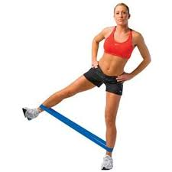
The equipment used for resistance training can ranged from elastic resistance products to weight machines.
The following goals and exercises are appropriate during the intermediate
and advanced phases of rehabilitation.

Slide 28
Increase flexibility of any chronically shortened muscles.
Muscles typically involved include the ankle plantar flexors, hip flexors and hamstrings.
Stretching techniques include:
a. Heel cord stretching with a towel while sitting on a bed with the knee straight.

Slide 29
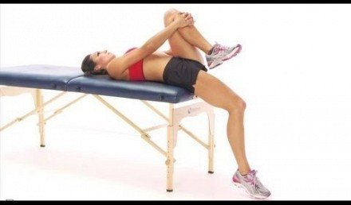
b. Hip flexor stretching in the supine/Thomas test position.

Slide 30
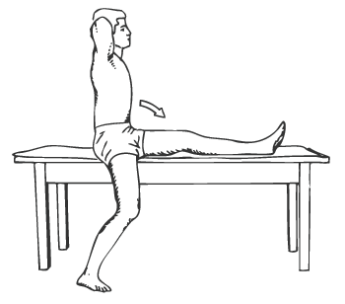
c. Hamstring stretching by sitting on the edge of a table with one leg supported in hip flexion and knee extension and the other in extension over the side of the support surface.

Slide 31
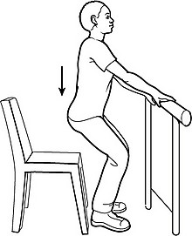
2. Improve strength and muscular endurance in the lower extremities for functional activities.
mini-squats and heel raises using a
table or walker for support and
balance and body weight as the
of resistance as soon as partial-
weight bearing on the operated
lower extremity is permissible.

Slide 32
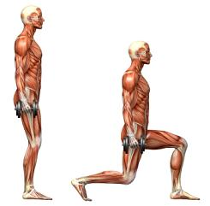
b. Lunges and forward and lateral step-ups.

Slide 33
c. Open-chain hip and knee exercises initially against light to moderate resistance with elastic resistance or cuff weights. Emphasize hip extension and abduction for a positive impact on ambulation.

Slide 34
d. Task-specific training, such as stair-climbing or carrying small loads while ambulating.

Slide 35
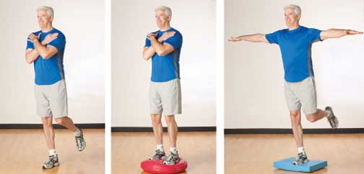
3. Improve postural stability and standing balance.
a. Progression of balance activities appropriate for the patient’s age and desired activity level.

Slide 36
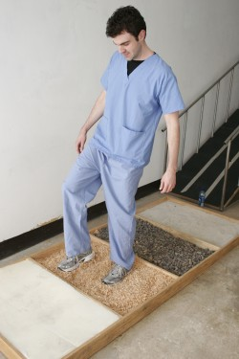
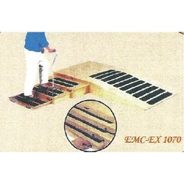
b. Progressive ambulation on various surfaces.

Slide 37
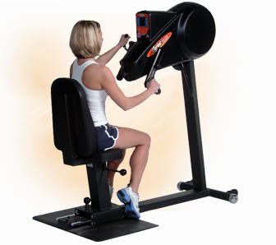
4. Increase aerobic capacity/cardiopulmonary endurance.
a. Stationary bicycling, upper body ergometry, or treadmill walking.

Slide 38
EVIDENCE BASED PRACTICE
Title
Effects of Resistance Training on Lower-Extremity Impairments in Older People With Hip Fracture

Slide 39
PICO format of the title
P | 60- to 85-year-old community-dwelling men and women 0.5 to 7.0 years after hip fracture
I | Twelve-week intensive progressive strength power training (n24)
C | no intervention (n22)
O | Isometric knee extension torque (KET) leg extension power (LEP) measured in the weaker and stronger leg the asymmetric deficit ([weak/sum both legs] 100%), 10-m walking speed, dynamic balance test, self-reported outdoor mobility.

Slide 40
Evidence Based Practice
Journal & Authors | Study Design & Level of Evidence | AIMS | METHODOLOGY | CONCLUSION
Arch Phys Med Rehabil Erja et al | Randomized Control Trial 1b | To study the effects of resistance training on muscle strength parameters, mobility, and balance. | Of the 25 men and 54 women participating in the baseline assessments, were randomized into the training group (Twelve-week intensive progressive strength power Training) and control group (no intervention) | Intensive resistance training is feasible for people with a hip fracture and improved muscle strength and power. More intensive training especially for the weaker leg may be needed to obtain more marked effects on asymmetric deficit, mobility, and balance. Also, the timing and duration of training program should be considered.

Slide 41
References
1. Campbells Operative Orthopedics
2. Turek’s Orthopedics 6th Edition
3. Therapeutic Exercise by Carolyn kisner. 5th Edition

Slide 42
MCQ (contd…)
1. It is reasonable to expect to achieve 80⁰ to 90º of active hip flexion ______________by 2 to 4 weeks postoperatively.
Along with SLR
With knee flexion
None of the above

Slide 43
MCQ (contd…)
2. To prevent postoperative reflex inhibition of hip and knee musculature which exercise is given?
Isometrics
High resistive exercises
Running
Aerobics

Slide 44
MCQ (contd…)
3. Thomas test position can be used for stretching?
Hip flexors
Knee flexors
Knee extensors
None of the above

Slide 45
MCQ (contd…)
4. Prevent stiffness in the low back which exercises are to be given?
knee-to-chest
Pelvic tilts
Both a and b
None of the above

Slide 46
MCQ (contd…)
5. To increase aerobic capacity/cardiopulmonary endurance which exercises are to be given?
Stationary bicycling
Upper body ergometry
Treadmill walking
All of the above

