Slide 1

Code of ethics
Prepared By,
Mr. Swamy PGN
SNC

Slide 2

DEFINITON
Ethics refers to the moral code of nursing & is based on obligation to service & respect for human life
Melanie & Evelyn
A code of ethics is a set of ethical principles that are accepted by all members of a profession.
Potter & Perry
Code of ethics is a guideline for performance & standards & personal responsibilities.

Slide 3
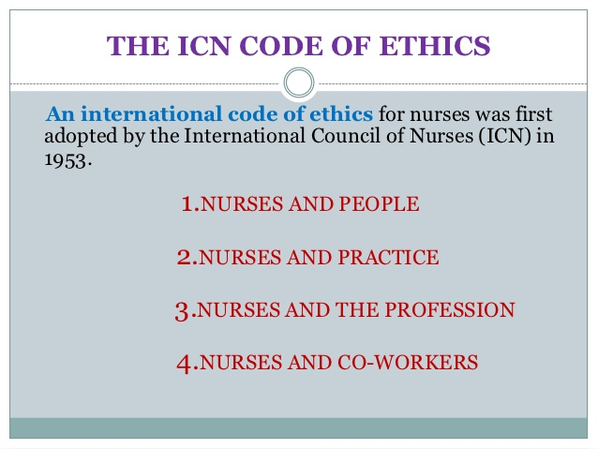

Slide 4
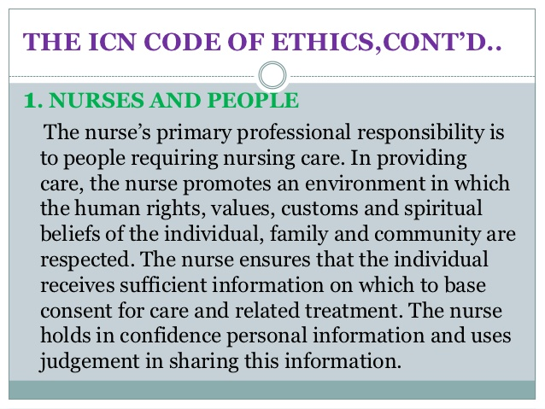

Slide 5
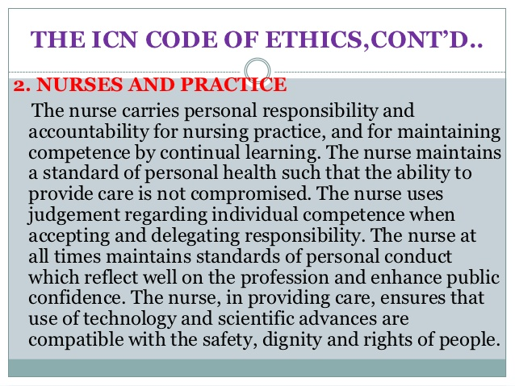

Slide 6
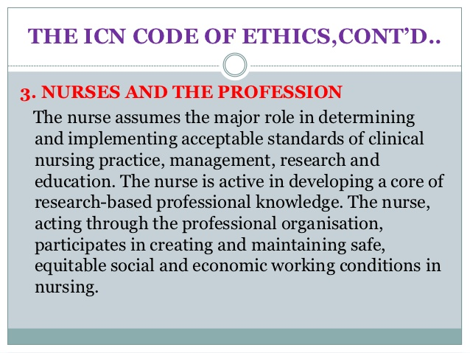

Slide 7
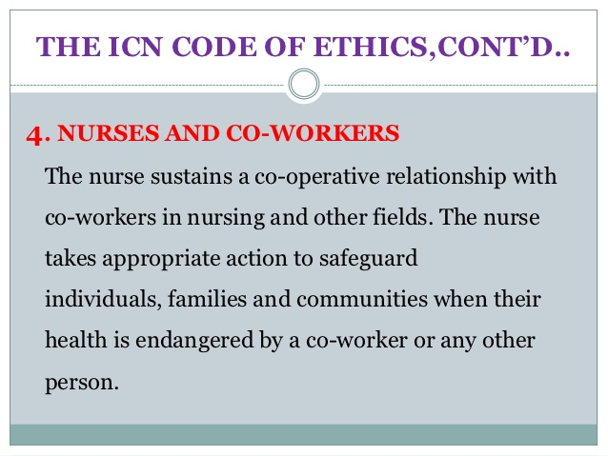

Slide 8
Participate and share responsibility with other citizens & other health professionals.
Recognize and perform the duties of citizenship
Aware of laws and regulations which affect the practice of medicine and nursing.
5. NURSES AND SOCIETY

Slide 9
THANK YOU….

