Slide 1
ACL injury

Slide 2
Objective
At the end of the lecture, the students will:
Revise about Function of ACL
List down common mechanism of injury
Explain Principles of physiotherapy assessment
Describe management of ACL Injury

Slide 3
Relatively high rate of injuries of ACL by athletes and other active individuals..
Attachment:
Attached to the anterior tibial spine where it extends superiorly and posteriorly to attached to the posteromedial aspect of the lateral femoral condyle
It has 2 bands- anteromedial & posterolateral band and each of them have a different role in controlling tibiofemoral motions.

Slide 4
Biomechanics
ACL functions as primary restrain against anterior translation (anterior shear) of the tibia on the femur this role however, belongs to either the AMB or PLB depending on knee flexion angle.
Knee in full extension-PLB is taut, flexion increases- AMB
30 flexion of knee causes maximum excursion because AMB and PLB are lax

Slide 5
ACL is also responsible for resisting hyperextension of the knee. There is no anterior translation of the tibia possible in full extension when many of the supporting passive structure of the knee are taut
ACL can act as secondary restraint either varus or valgus motions

Slide 6
MOI
Anterior cruciate ligament (ACL) injuries occur from both contact and noncontact mechanisms.
The most common contact mechanism is a blow to the lateral side of the knee resulting in a valgus force to the knee.

Slide 7
This mechanism can result in injury not only to the ACL but to the medial collateral ligament (MCL) and the medial meniscus as well. This injury is termed the “unholy triad” injury because of the frequency of these three structures being injured from a common blow.

Slide 8
The most common noncontact mechanism is a rotational mechanism in which the tibia is externally rotated on the planted foot
The forces on the knee include a valgus stress, external rotation of the tibia on the femur, and usually an anterior movement of the tibia on the femur.

Slide 9
A force against the anterior thigh, which can drive the femur backward on the tibia, while the knee is close to full extension, tends to stress the ACL. This is especially true if the tibia is in a position-or forced into a position-of internal rotation with respect to the femur.
Forced internal rotation of the tibia on the femur in itself may tear the ACL.

Slide 10
PT Assessment
Demographic data:
History of present illness:
Mechanism of injury: common mechanism for ACL injury is hyperextension of knee, direct blow to the lateral aspect of knee, rotation of tibia (commonly external rotation) on planted (fixed foot).
Was patient able to weight bear injury?
Was the swelling immediately after injury or after several hours of injury?

Slide 11
Nature of Pain and Disability. In the absence of significant effusion, the pain is described as a continuous, deep, fairly localized pain, which is increased by any movement tending to further stress the ligament (partial tear).
Was there any pop or clicking during injury: suggesting ACL tear
Does the injury occur during acceleration, deceleration or constant speed? Injury during deceleration causes ACL injury.

Slide 12
Does the knee give away
Pain examination
Type of pain
Onset of pain: sudden
VAS
Aggravating factor
Relieving factor

Slide 13
Past medical history:
Previous ACL injury??
Surgical history
Personal history
Medication history
Occupational history- as ACL injury is common in sports population

Slide 14
On observation:
following trauma, the joint usually does not swell for several hours, if blood vessels are torn swelling is usually immediate. There will be swelling in and around the knee.
Observe for intracapsular and extracapsular swelling: intra capsular swelling is evident over entire joint, extra capsular tends to be more localized
Attitude of limb:
Knee may have assumed position of 15-25 of flexion due to swelling
Skin changes: observe for surgical scar( in case of post op assessment of ACL reconstruction)

Slide 15
On palpation:
Tenderness presents surrounding the knee joint. If a medial meniscus is also injured, medial joint line tenderness will also be present.
ROM: (active ROM, passive ROM)
When swollen, motion is restricted, the joint assumes a position of minimum stress (usually flexed 25 degree)

Slide 16
Muscle strength testing: when swollen, inhibition of the quadriceps muscle occurs
MMT of hip, knee and ankle
Upper limb MMT (for assisted walking – walker, crutch, stick)

Slide 17
Sensations
Limb length
Limb girth measurement:
Gait evaluation: when weight bearing is allowed
When acute the knee cannot bear weight, and the person can not ambulate with assistive device.
With a complete tear, there is instability and the knee may give way during weight bearing.
Functional assessment

Slide 18
Special tests:
Lachman test
Anterior drawer test

Slide 19
MANAGEMENT
The approach to management of ligamentous injuries depends on several factors, including the patient's age and desired activity level and the nature of the pathologic process.
It is important to determine the severity of the injury and whether the lesion is acute or chronic. Traditionally, ligamentous lesions have been graded as follows:

Slide 20
Grade I: Minor sprain, minimal damage with some pain and tenderness at the site of injury. Slight swelling with some loss of function is present.
Grade II: Severe Sprain, Swelling is considerable, gradual nature. Pain & Tenderness more acute, Movement limited, unable to bear body weight on Lower limbs. Function very limited.
Grade III: Severe tear or complete rupture of the ligament, Rapid onset of effusion, very considerable pain and tenderness, Joint is unstable, complete loss of function.

Slide 21
Management of ACL injury
Grade 1 Injury: Ice, followed by tubigrip bandage, crepe bandage or other type of support, & limitation of use for the first 24 hours.
Early commencement of static muscle contractions : blood flow is maintained & swelling reduced, developing strong muscles will develop strong ligaments.
Grade II Injury: Use of ice, compression & elevation if appropriate.
To reduce pain doctor may inject a local anaesthetic but activity must be restricted until later when the effects have worn off.

Slide 22
Nonoperative Management: Moderate Protection (Controlled Motion) Through Return to Activity
As the swelling decreases, examine the patient for impairments and functional losses. Initiate joint movement and exercises to improve muscle performance, functional status, and cardiopulmonary conditioning.
Joint mobility. Use supine wall slides, patellar mobilizations, and stationary cycling; encourage as much movement as possible.
Protective bracing. Bracing may be necessary for weight bearing activities to decrease stress to the healing ligament or to provide stability where ligament integrity has been compromised.

Slide 23
Improve Muscle Performance and Function Strength and endurance.
Initiate isometric quadriceps and hamstring exercises and progress to dynamic strength and muscular endurance training.
Utilize both open-chain and closed-chain resistance.
Reinforce quadriceps contractions with high-intensity electrical stimulation if there is an extensor lag.
Progress muscular endurance and strengthening exercises using partial squats, step-ups, leg press, and heel-raises
Emphasize neuromuscular control with stabilization and perturbation training in weight-bearing positions.

Slide 24
Cardiopulmonary conditioning. Utilize a program that is consistent with the patient’s goals such as biking (begin with a stationary bike), jogging (begin with walking on a treadmill), ski machine, or swimming.
Functional training. Progress neuromuscular training.
Develop activity-specific drills that replicate the demands of the individual’s outcome goals.

Slide 25
Management of ACL injury
Rehabilitation after ACL reconstruction:
Immobilization and Protective Bracing: The rationale for bracing after ACL reconstruction is protection of the graft and prevention of a knee flexion contracture during early rehabilitation if bracing is prescribed during early recovery it is usually is a hinged and possibly range limiting orthosis.
When the brace is locked, it holds the knee in full extension to prevent a knee flexion contracture or excessive hyperextension

Slide 26
In addition, the hinged orthosis initially may be set to limit full knee flexion during exercise (e.g., allowing movement from 0 to 90 or more the first week after surgery)
Typically, the brace is worn throughout the day for anywhere from a few weeks to 6 weeks and sometimes is also worn during sleep for the first week postoperatively.
During the first week or two the protective brace is locked in full extension during ambulation with crutches in the event of a fall.

Slide 27
By the beginning of week 3 the brace is unlocked, allowing motion between full extension to 125 of flexion during ambulation and other weight bearing activities.
Depending on the stability of the knee sometimes the protective brace may need to be worn for2 to 3 months or possibly longer.
Weight-Bearing Considerations: recommendations for a period of protected weight bearing immediately after surgery vary, ranging from some degree of restricted weight bearing the first 2 weeks to weight bearing as tolerated with use of two crutches immediately after surgery

Slide 28
Weight bearing is increased during the next 2 to 3 weeks based on the patient’s symptoms.
Full weight bearing and ambulation without crutches while wearing an unlocked protective brace usually is permitted by 3 to 4 weeks if weight bearing is pain-free and the patient has achieved full, active knee extension and sufficient strength of the quadriceps to control the knee.

Slide 29
Exercise program & Progression
Progression of carefully selected exercises and functional activities coupled with patient education is a foundation of rehabilitation following ACL injury and reconstruction.
Preoperative consideration : goals
To restore full knee ROM particularly extension
Prevent atrophy and weakness of thigh musculature
Improve the strength and flexibility of hip and knee musculature

Slide 30
Post surgery exercise consideration:
After reconstruction of the ACL, exercise begins immediately on the first postoperative day.
Sometimes CPM is used while a patient is hospitalized.
It is important to remember that a tendon graft goes through a necrotizing process the first 2 to 3 weeks postoperatively before revascularization commences and maturation gradually occurs
Patient-related facts, such as age and pre injury health status, affect the healing process.

Slide 31
Phase 1
Maximum Protection Phase (1 to 4 weeks after reconstruction):
Goals:
Patient education during the first phase of rehabilitation focuses on the home exercise program
Control pain and swelling : RICE treatment
Ambulation with assistive devices
Prevent reflex inhibition of knee musculature: muscle setting of quadriceps, hamstring and hip abductor and adductor. Initiate low intensity multiple angle isometrics of knee muscles specially quardriceps.

Slide 32
To activate the hamstrings dynamically include supine heel slides to a comfortable level hip knee flexion.
SLR exercises
Restore full knee mobility:
ROM in protected range include therapist controlled PROM or AAROM within patients comfort level
Include patellar mobilization to prevent adhesions.
Passive knee extension assume a supine or long sitting position and prop the heel on a rolled towel or bolster with knee unsupported
Stretch hip and ankle muscles if flexibility is affected.

Slide 33
Regain kinesthetic awareness and neuromuscular control of L/L: while wearing a protective brace, if prescribed begin trunk and lower extremity stabilization exercises in a standing position with weight distribution equally on both the L/L
Stationary cycling and exercise on a seated leg press machine at 3 to 4 weeks.
Improve strength and flexibility of hip and ankle musculature
Prevent adhesions

Slide 34
Criteria to advance to next phase:
Minimal pain and swelling
Full active knee extension (no extensor lag)
50% to 60% quadriceps strength ( measured isometrically at 60
Greater than 110 of knee flexion
No evidence of excessive joint laxity
PHASE 2- moderate protection phase (extends upto 4-10 weeks after operation)

Slide 35
    PHASE 2
moderate protection phase (extends upto 4-10 weeks after operation);
Goals:
To attain full ROM (full knee extension and 125 to 135 flexion), improve lower extremity strength and muscular endurance :
low intensity end range self stretching to gain full knee ROM
Grade 3 joint mobilization techniques to restore full knee flexion
Continue flexibility exercises for hip and ankle musculature especially the hamstrings, IT band and plantar flexors

Slide 36
Ambulate without assistive device and protective brace using a normal gait pattern
Continue to improve neuromuscular control proprioception and balance

Slide 37
Strength and balance :
Closed chain and open chain PRE in appropriate portions of knee
Emphasize progressive closed chain quadriceps training (mini squats, partial lunges)
To improve neuromuscular control, proprioception and balance: standing wall slides, unilateral squat, step up step down or lunges
Progress from bilateral to unilateral

Slide 38
Gait training: (with protective brace) emphasize symmetrical alignment, step length, and timing. Gradually reduce protective bracing
Criteria to advance to next phase:
Absence of pain
Full AROM
75% strength of knee musulature compared to contralateral side

Slide 39
PHASE 3
MINIMUM protection and return to activity phases (11-24 weeks and Extends upto 6 months after reconstruction)
Goals:
Further increase strength, endurance and power.
Further enhance neuromuscular control and agility
Participate in progressively more demanding functional activities

Slide 40
Exercises: PRE with an emphasis on eccentric training advanced neuromuscular and balance training. Plyometrics, agility drills, activity specific training coupled with gradual return to high demand activities.
Patient education emphasizing prevention of re-injury.

Slide 41
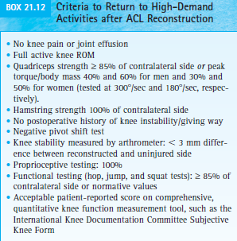
Return to activity

Slide 42
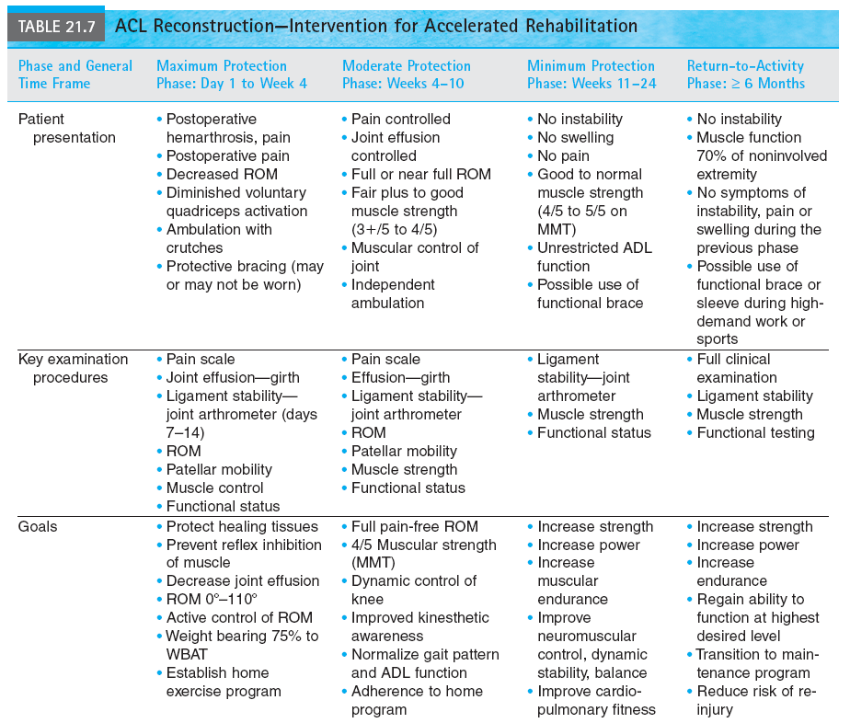

Slide 43
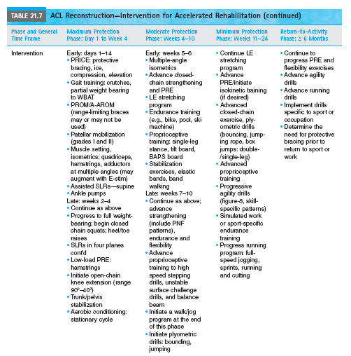

Slide 44
Rehabilitation following anterior cruciate ligament reconstruction
Systematic Review High level of evidence (Includes RCTs) | S. van Grinsven ,R. E. H. van Cingel , C. J. M. Holla, C. J. M. van Loon Knee Surg Sports Traumatol Arthrosc (2010) 18:1128–1144 DOI 10.1007/s00167-009-1027-2 | Aim:To assess the effectiveness of rehabilitation after ACL injury in athletic population | Results:indicated that an accelerated protocol without postoperative bracing, in which reduction of pain, swelling and inflammation, regaining range of motion, strength and neuromuscular control are the most important aims, has important advantages and does not lead to stability problems | Conclusion: rehabilitation post ACL reconstruction is effective to regaining range of motion, strength and neuromuscular control

Slide 45
MCQ’s
Q1. Which Ligament is not a Ligament of the Knee Joint?
Medical Collateral Ligament
B. Spring Ligament
C. Anterior Cruciate Ligament
D. Posterior Cruciate Ligament

Slide 46
Q2. Anterior Cruciate Ligament Injury is not found with
Foot ball Players
B. Lateral Rotational Injury to Tibia on Planted foot
C. Valgus force to the Knee
D. fall on the Back

Slide 47
Q3. Which Test is Performed to confirm ACL Injury
SLR test
B. PATRICK test
C. Anterior Drawer Test
D. Slump test

Slide 48
Q4. What is not the management for acute Grade 1 of ACL injury
Compression
B. Elevation
C. Rest
D. Endurance Training

Slide 49
Q5. Phase 3 of the ACL Reconstruction which exercise would be Beneficial
Static Quads
B. Breathing exs
C. Passive SLR
D Aerobic Exercises

