Slide 1

COMMUNICATION
Prepared By,
Mr. Swamy PGN
SNC

Slide 2
Presentation Outline
Introduction
What is Communication ?
Process of Communication.
Types of Communication.
Barriers of Communication.
Health Communication.

Slide 3
Definition of Communication
Communication is a process of sharing experience till it becomes a common possession. It modifies the disposition of both parties who partakes it - John Dewey.
Communication is sharing of ideas and feelings in a mood of mutuality - Edgar Dale.
Communication is a means of persuasion to influence other so that desired effect is achieved – Aristotle.

Slide 4
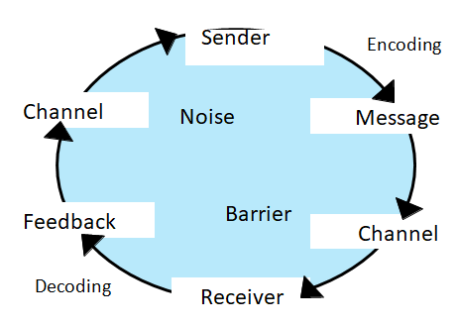
Communication
The World ‘Communication’ is derived from Latin World ‘Communis’, which means common.
It is a process of exchanging..
Information
Ideas
Thoughts
Feelings
Emotions
Through –
  Speech
  Signals
  Writing
  Behavior

Slide 5
Types of Communication
People communicate with each other in a number of ways that depend upon the message and its context in which it is being sent.
Types of communication based on the communication channels used are –
Verbal Communication is refers to the form of communication in which message is transmitted verbally. Communication is done by word of mouth and a piece of writing. In verbal communication remember the acronym “KISS” (keep it short and simple).

Slide 6
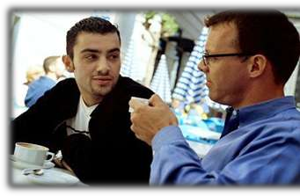
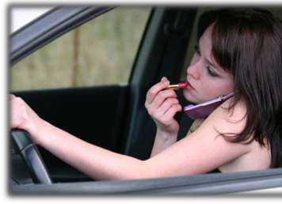
Types of Communication
Verbal Communication is divided into: Oral and Written Communication
Oral communication
In oral communication, Spoken words are used.
It includes face-to-face conversations, speech, telephonic conversation, video, radio, television, voice over internet.
Communication is influence by pitch, volume, speed and clarity of speaking.
Advantages: It brings quick feedback. In a face-to-face conversation, by reading facial expression and body language one can guess whether he/she should trust what’s being said or not.
Disadvantages: In face-to-face discussion, user is unable to deeply think about what he is delivering, so this can be counted as a fault.

Slide 7


Types of Communication
Verbal Communication is divided into: Oral and Written Communication
Written communication
In written communication, written signs or symbols are used to communicate.
In written communication message can be transmitted via email, letter, report, memo etc.
Written Communication is most common form of communication being used in business.
Advantages: Messages can be edited and revised Written communication provide record and backup. A written message enables receiver to fully understand it and send appropriate feedback.
Disadvantages: Written communication doesn’t bring instant feedback. It take more time in composing a written message as compared to word-of-mouth and number of people struggles for writing ability.

Slide 8
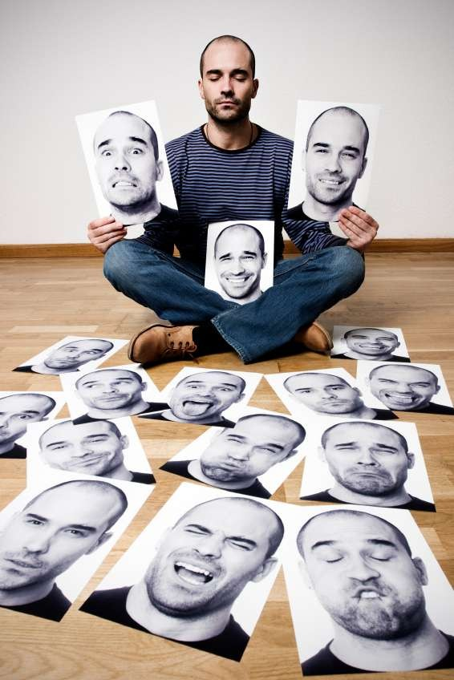
Types of Communication
Non-Verbal Communication is the sen or receiving of wordless messages. Such as gesture, body language, posture, ton of voice or facial expressions, is called nonverbal communication. Nonverbal communication is all about the body language of speaker.
Nonverbal communication have the following three elements –
1. Appearance
  Speaker – clothing, hairstyle, neatness, use of cosmetics
  Surrounding – room size, lighting, decorations, furnishings
2. Body Language facial expressions, gestures, postures
3. Sounds

Slide 9
Types of Communication
Visual Communication: Visual types of communication include signs, maps or drawings as well as colour or graphic design. These typically reinforce verbal communication, and they help to make a point. Visual aids can help a speaker remember important topics, give the audience something to look at, and generally help convey the message being presented.
Formal and Informal communication is communication within formal or informal groups or teams. It is group interaction that results in decision making, problem solving and discussion within an organization. Examples would be a group planning a surprise birthday party for someone. A team working together on a project.

Slide 10
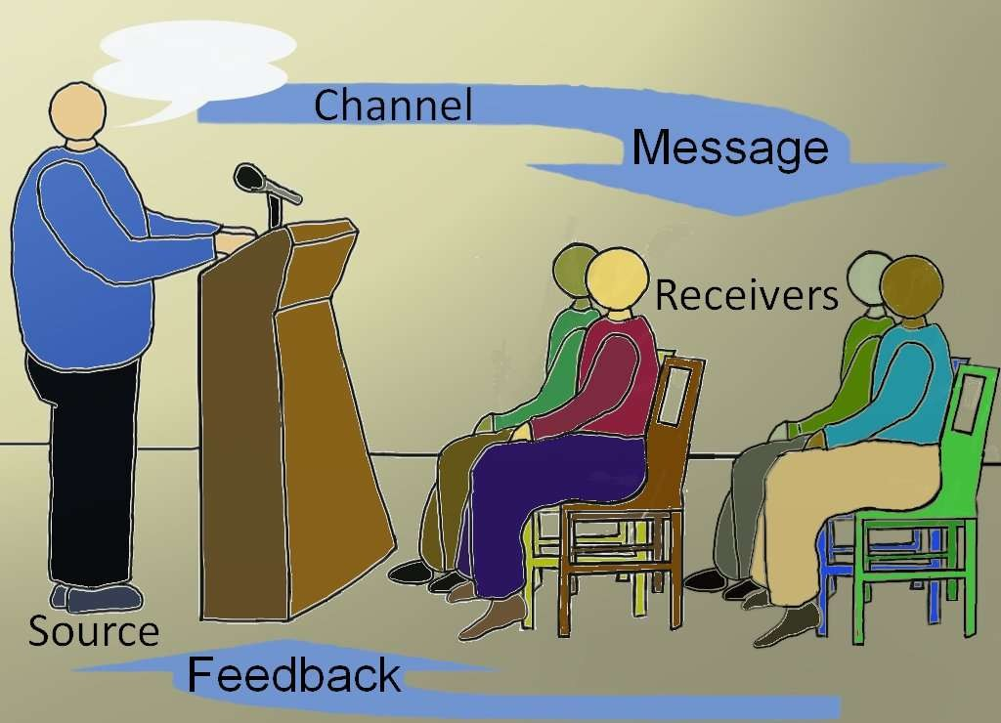
Types of Communication
One-Way communication: involves a speaker who seeks to inform, persuade or motivate an audience Examples are a teacher and a class of students. A preacher and a congregation. A speaker and an assembly of people in the auditorium.
Two way communication: The Socratic Method is a two way method of communication in which both the communicator and the audience take part. The audience may raise question and add their own information, ideas and opinions to the subject.

Slide 11
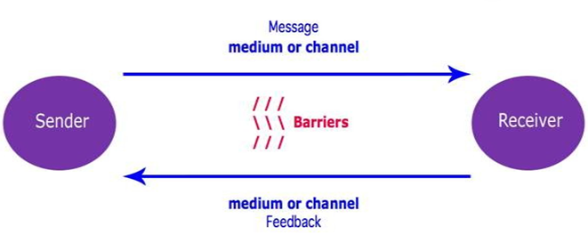
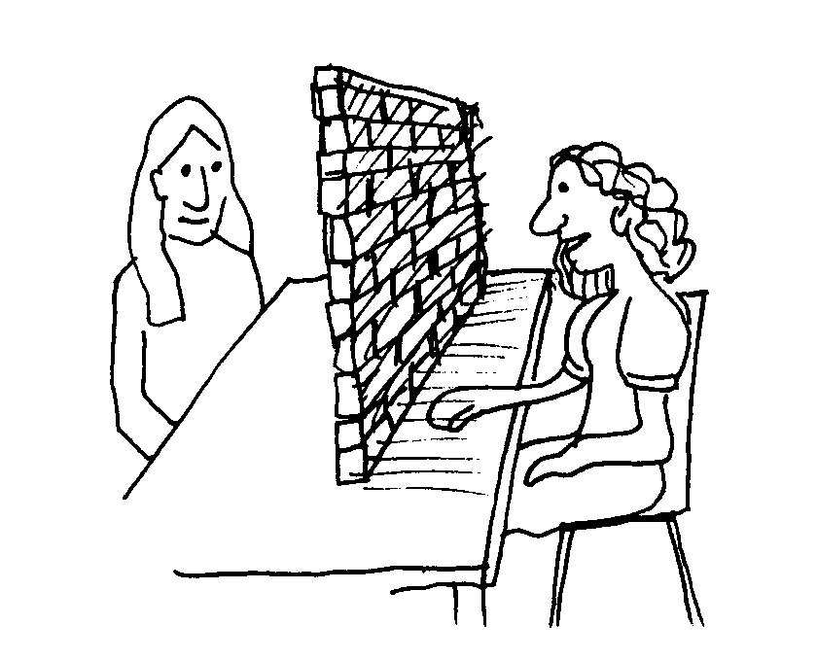
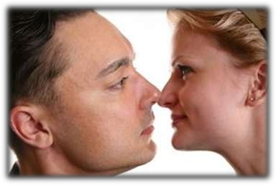
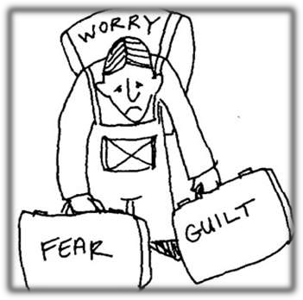
Barriers of Communication
Physical barriers
Perceptual barriers

Slide 12

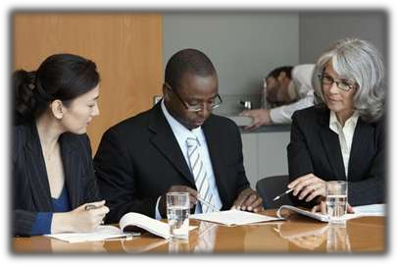



Barriers of Communication
Emotional barriers
Cultural barriers
Language barriers

Slide 13


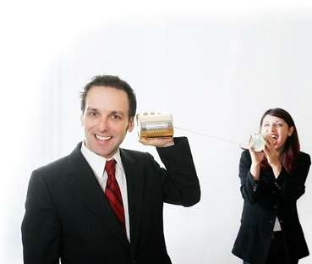
Barriers of Communication
Interpersonal barriers
Gender barriers

Slide 14
Barriers of Communication
How to Overcome Barriers of Communication:
Taking the receiver more seriously
Crystal clear message
Delivering messages skillfully
Focusing on the receiver
Using multiple channels to communicate instead of relying on one channel
Ensuring appropriate feedback
Be aware of your own state of mind/emotions/attitude

Slide 15
Health Communication
Health is the concern of everyone for everyone. Health communication is therefore an important area of communication.
Health communication has to cater to the following needs,
  Information
  Education
  Motivation
  Persuasion
  Counseling
  Raising Moral
  Health development
  Organization

Slide 16

INTERPERSONAL
RELATIONSHIPS

Slide 17
Presentation Outline
Introduction
Definition of Interpersonal Relation
Types of Interpersonal Relation
Phases of Interpersonal Relation
Barriers of Interpersonal Relation
Johri Window

Slide 18
Interpersonal Relationships
One of the most distinctive aspects of human beings is that we are social beings. Interpersonal relationships are & have been the core of our social system since the dawn of civilization. Nursing is a therapeutic process & demands an association between the nurse & the patient.
Definitions
Interpersonal relationships refer to reciprocal social & emotional interactions between two or more individuals in an environment.
Interpersonal relationship is defined as a close association between individuals who share common interests & goals.

Slide 19
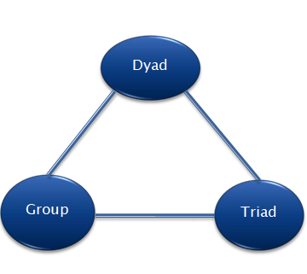
Dynamics of Interpersonal Relationships
Dyad
A dyad consists of two interacting people.
It is the simplest of the three interpersonal dynamics.
One person relays a message & the other listen.
It is one of the most unstable interpersonal dynamic. The interaction ends when one constituent of the dyad refuses to listen or share his or her message.
It is also one of the most intimate interpersonal dynamic as the focus of listening & communication is centered on only one person.

Slide 20
Dynamics of Interpersonal Relationships
Triad
A triad consists of three interaction people.
The members engage in the relay & reception of thoughts & ideas.
It is more stable than the dyad as the third members may act as a mediator when there is conflict between the other two.
Group
A group consists of more than three members & is a collection of traids & dyads.
It is the most stable from of interpersonal relationship.

Slide 21
Purpose of Interpersonal Relationships
  Interpersonal relationship for an Individual Personal growth & development
  Source of enjoyment
  Sense of security
  Context of understanding
  Interpersonal needs
  Establishing personal identity
  Interpersonal relationship for nurses
  Building a positive functional multidisciplinary team
  Improving intra-and/or inter-team communication, coordination & cooperation
  Building mutual understanding & cooperation
  Understanding self Improved decision making & problem solving

Slide 22
Purpose of Interpersonal Relationships
  Interpersonal relationship for patients
    Developing a sense of security & comfort
    Fostering trust & cooperation
    Facilitating communication
    Improving socialization
    Developing & maintaining positive feelings

Slide 23
Types of Interpersonal Relationships
  Interpersonal relationships are classified based on relational contexts of interaction & the types of mutual expectations between communicators.
  Some common types of interpersonal relation are
  Friendship
  Family & kinship
  Professional relationship
  Love
  Marriage
  Platonic relationship
  Casual relationships
  Brotherhood & sisterhood
  Acquaintances

Slide 24
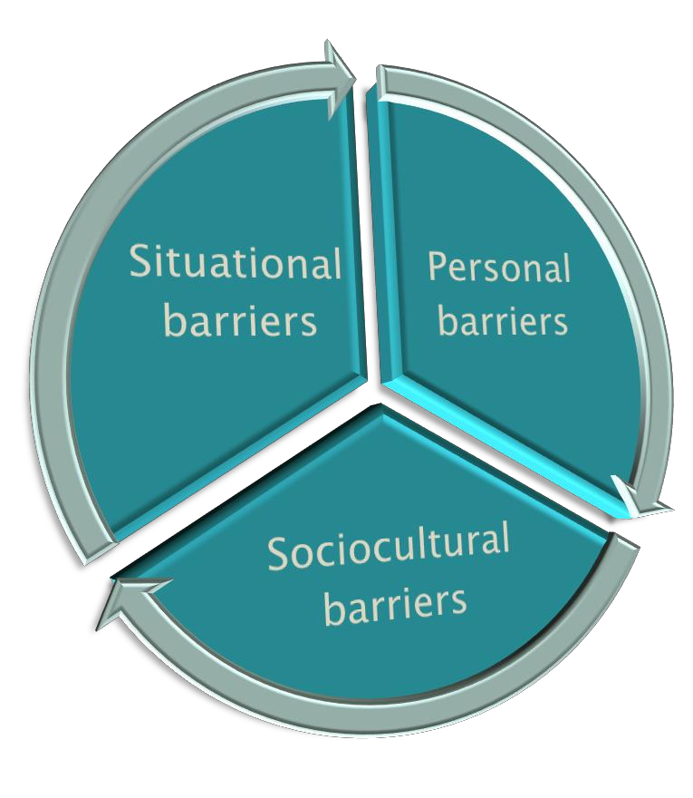
Barriers of Interpersonal Relationships
  Personal Barrier
    Gender
    Lack of honesty and trust
    Lack of compatibility
    Feeling of compatibility
    Feeling of insecurity
    Ineffective communication
    Lack of flexibility
    Lack of respect for rights of others
    fear of rejection
    Psychiatric problems
  Situational Barriers
    Complex interaction settings
    Adverse environmental situations
    Lack of territoriality
    High density of individual
    Large distance and time
  Socio-cultural Barriers
    Ethnic diversity
    Language
    Diversity
    Social
    Diversity
    Cultural
    diversity

Slide 25
Johari Window
  The johari window model is a simple & useful tool for illustrating & improving self-awareness & mutual understanding between individuals within a group.
  The johari window terminology refers to self & others.
  Self refers to the person subject to the Johari window analysis & others refers to other people in the person’
  The Johari window model represents self- awareness of an individual towards himself or herself, & later on become a widely used model for self-development by helping the person understand & learn about improvement of communication skills & IPRs s group or team.
  The johari window model was devised by American psychologist, Joseph Luft & Harry Ingham, in 1955. The model was first published in proceedings of the Western Training Laboratory in Group Development by UCLA extension Office in 1955.

Slide 26
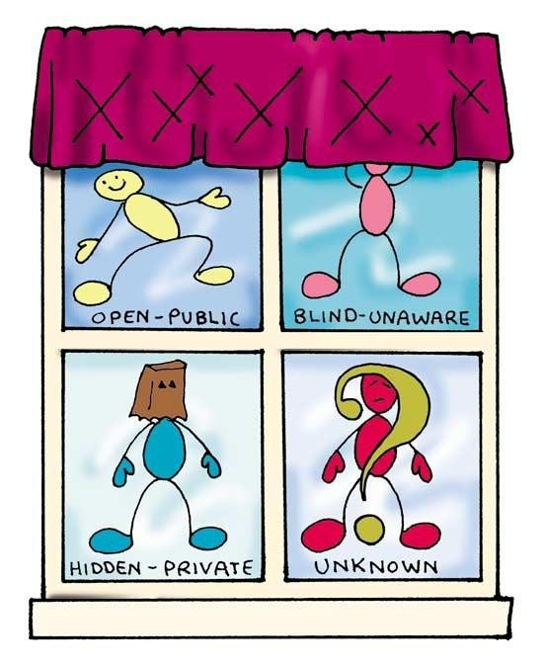
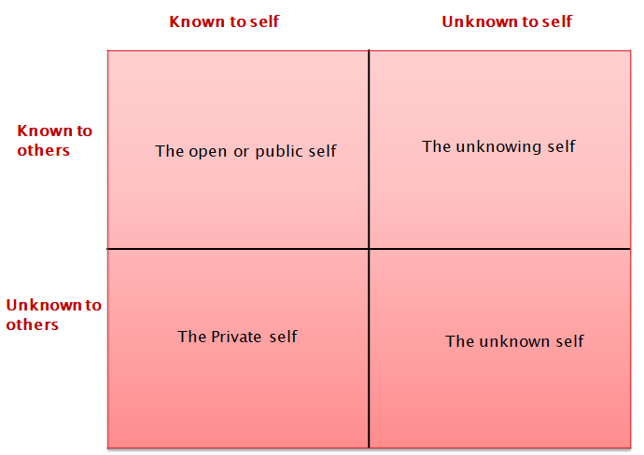
Johari Window

Slide 27
Functions of Johari Window
  It has become a widely used model for understanding & training self-awareness & personal development & improving communication, IPRs, group dynamics, team development & inter-group relationships.
  It puts emphasis on soft skills, behavior, empathy, cooperation, inter-group development & interpersonal development.
  It can also be used to improve an individual’s relationship with others or a group’s relationship with other groups.
  The model is a simple & useful tool for illustrating & improving self-awareness & mutual understanding between individuals in a group.

Slide 28
Functions of Johari Window
  The Johari model can also be used to assess & improving self-awareness & mutual understanding between individuals in a group.
  The johari window actually represents information – feelings, experiences, views attitudes, skills, intentions, motivation, etc. - within or about a person in relation to their group from four perspectives.
  The johari window provides a useful way to graphically visualize the process of self-disclosure.

Slide 29
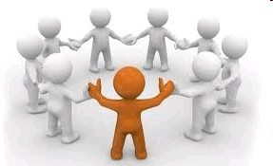
GROUP AND INDIVIDUAL DYNAMIC

Slide 30
Presentation Outline
Introduction
Definition of Group
Definition of Group dynamics
Types of Group
Characteristic of group
Group Problems
Phases of group development
Factors affect group dynamics
Functions of group leader in group dynamics
Group tash roles
Individual roles of group leader
Group Process
Role of manager in group dynamics

Slide 31
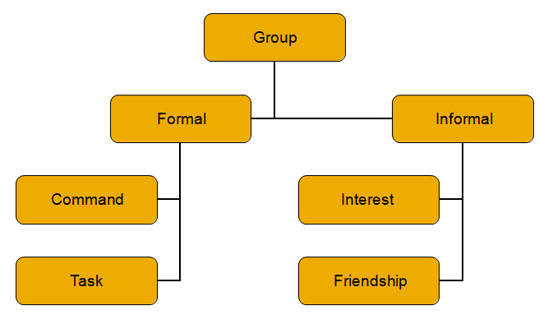
Group and Individual Dynamic
  Introduction
  Group dynamics is two ways communication implies a situation where not only two parties’ talk to each other as well as it helps in clarification of doubts, confusion and misconception. Both parties understanding each other and receiving and giving of feedback
  Definition of group
  A group may be defined as two or more people acting interdependently in a unified manner toward the achievement of common goals (harod koontz, 2004) An aggregate of individuals who interact and mutually influence each other

Slide 32
Group and Individual Dynamic
  Definition of group dynamic
  Group dynamics is viewed from the perspective of internal nature of group how they are formed, what are their structure and process, and how they affect individual members, other groups and the organization (mamoria, 1996)
  Group dynamics describes how a group should be organized and conducted. Democratic leadership member participation and overall co-operation are stressed in group dynamics.

Slide 33
Group and Individual Dynamic
  Characteristics of Groups
  Common motives conducive to group interaction
  A group structure with a hierarchical status system
  Standardization of norms and values
  One or more common goals
  Interactions and communication among members
  Group problems
  Lack of qualified Leaders and Participation
  Lack of Interest in program
  Disorderly meetings
  Poor Group Relations

Slide 34
Group and Individual Dynamic
  Functions/roles or group leader in group dynamics:
    Group task roles
    Group building and maintaining roles
    Individual roles
  1. Group task roles
  Initiator contributor
  Information seeker
  Information giver
  Opinion seeker
  Elaborator
  Coordinator
  Orienteer, Evaluator
  Energizer
  Procedural technician
  Recorder

Slide 35
Group and Individual Dynamic
  Functions/roles or group leader in group dynamics:
    Group task roles
    Group building and maintaining roles
    Individual roles
  2. Group building and maintaining roles
  Encourager
  Harmonizer
  Compromiser
  Gate keeper
  Standard setter
  Group
  Commentator
  Follower

Slide 36
Group and Individual Dynamic
  Functions/roles or group leader in group dynamics:
    Group task roles
    Group building and maintaining roles
    Individual roles
  3. Individual roles of group leader
  Aggressor
  Blocker
  Recognition seeker
  Self confessor
  Playboy
  Dominator
  Help-seeker
  Special interest pleader

Slide 37
Group and Individual Dynamic
  Group process
  Phase – I Orientation: Personal relations, testing and dependency
  Phase – II organizing to get work done: personal relations, intergroup conflict
  Phase – III Information Flow: Personal Relations, Group cohesion
  Phase – IV Problem Solving: Personal Relations, Interdependence

Slide 38
Group and Individual Dynamic
  Role of nurse manager in group dynamics
  Supervise and manage the overall performance of staff in department
  Analyzing, reporting, giving recommendations and developing strategies
  Achieve business and organization goals, visions and objectives.
  Involved in employee selection, career development, succession planning and periodic training
  Working out compensations and rewards
  Responsible for the growth and increase in the organizations’ finances and earnings
  Identifying problems, creating choices an

Slide 39
ORGANIZATIONAL BEHAVIOUR

Slide 40
Presentation Outline
Introduction
Definition of Organizational Behavior
Nature of Organizational Behavior
Challenges for Organizational Behavior
Scope of Organizational Behavior
Elements of Organizational Behavior
Importance of Organizational Behavior
Basic Organizational Behavior model

Slide 41
Organizational Behavior
  Introduction
  The study of organizations and of the collection of people within them together comprises the field of organizational behavior.
  Organizational behavior (OB) is the study of human behavior in organizational settings, the interface between human behavior and the organization, and the organization itself.
  Organizational Behavior is a field of study that investigates the impact that individuals, groups, and structure have on behavior within organizations for the purpose of applying such knowledge towards improving an organization‘s effectiveness.

Slide 42
Organizational Behavior
  When people join the organization to accomplish the goals/ objectives, some kind of structure is required. They use machinery, gadgets & technology to achieve the organizational goals.
  At the same time they are influenced by external environment. Organizations are defined as social arrangements, constructed by people, who can also change them.
  ----Buchanan and Huczynski (1997)
  Organizations are a system of cooperative activities -and their coordination requires something intangible and personal that is largely a matter of personal relationships.
  ---- Barnard (1938)
  OB is concerned with “the study of the structure, functioning and performance of organizations, and the behavior of groups and individuals within them ”.
  ---- Pugh (1971)

Slide 43
Organizational Behavior
  Nature of OB
  A field of study and not a discipline
  Interdisciplinary Approach
  An Applied Science
  Normative and Value Centered
  Humanistic & optimistic
  Oriented Towards Organizational Objectives
  A total Systems Approach

Slide 44
Organizational Behavior
  Challenges for OB
  Globalization to Respond
  Managing Diversity
  Improving Quality and Productivity
  Improving Customer Service
  Improving People Skills
  Stimulating Innovation and Change
  Coping with Temporariness
  Working in network organization
  Helping employees balance work-life conflicts
  Creating Positive work environment
  Improving Ethical Behavior

Slide 45
Organizational Behavior
  THE SCOPE OF THE ORGANIZATIONAL BEHAVIOUR IS AS UNDER:
  Impact of personality on performance
  Employee motivation
  Leadership, Perception, Job design
  How to create effective teams and groups
  How to create effective teams and groups
  Study of different organizational structures
  Individual behavior, attitude and learning
  Design and development of effective organization
  Impact of culture on organizational behavior
  Management of change, Management of conflict and stress
  Organizational development, Organizational culture
  Transactional analysis
  Group behavior, power and politic, Study of emotions

Slide 46
Organizational Behavior
  Importance of OB
  OB provides a road map to our lives in organizations
  OB uses scientific research to understand and make organization life, as it helps to predict what people will do under various conditions
  It helps to influence organizational events – to understand and predict events
  It helps individual understand herself/ himself in better Fashion.
  It helps manager to manage human resources effectively. Eg. Motivation
  It helps organizations for maintaining cordial industrial relations.
  It is also useful in the field marketing.

Slide 47
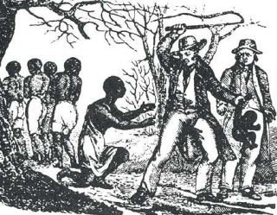
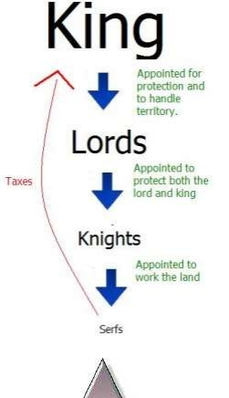
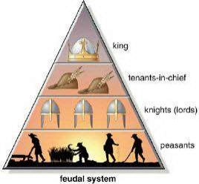
Organizational Behavior
  Models of OB:
    Autocratic Model
    Custodial Model
    Supportive Model
    Collegial Model
    SOBC Model

Slide 48
Organizational Behavior
Autocratic Model
Basis of Model | Power
Managerial Orientation | Authority
Employee Orientation | Obedience
Employee Psychological Results | Dependence on Boss
Employees Needs Met | Subsistence (Survival)
Performance Result | Minimum

Slide 49
Organizational Behavior
Custodial Model
Basis of Model | Economic Resources
Managerial Orientation | Money
Employee Orientation | Security & Benefits
Employee Psychological Results | Dependence on Organization
Employees Needs Met | Security
Performance Result | Passive Cooperation

Slide 50
Organizational Behavior
Supportive Model
Basis of Model | Leadership
Managerial Orientation | Support
Employee Orientation | Job Performance
Employee Psychological Results | Participation
Employees Needs Met | Status & Recognition
Performance Result | Awakened Drives

Slide 51
Organizational Behavior
Collegial Model
Basis of Model | Partnership
Managerial Orientation | Teamwork
Employee Orientation | Responsible Behavior
Employee Psychological Results | Self Discipline
Employees Needs Met | Self Actualization
Performance Result | Moderate Enthusiasm

Slide 52
Organizational Behavior
S O B C Model
Basis of Model | Facilitator
Managerial Orientation | Empathy
Employee Orientation | Belongingness
Employee Psychological Results | Ownership
Employees Needs Met | Higher Order Needs
Performance Result | Passion and Commitment

Slide 53
  Abstract
  Although the number of people living in the United States with limited English proficiency (LEP) is substantial, the impact of language on patients' experience of provider-patient communication has been little explored.
Population/Problem | Intervention | Comparison | Outcome
Language problem between patients and care provider | Obtain discussion about patient-provider communication | -- | Identified language discordant, language concordant, empowerment, providers' attitudes and issues with the health care system.

Slide 54
Abstract
  The global prevalence of childhood and adolescent obesity is high. Lifestyle changes towards a healthy diet, increased physical activity and reduced sedentary activities are recommended to prevent and treat obesity.
Population/Problem | Intervention | Comparison | Outcome
childhood and adolescent obesity | assess lifestyle in the areas of diet, physical activity, sedentary behaviour and behavioural therapy | success in children and adolescents with obesity compared with an attention placebo control group | Prevent and treat the obesity

Slide 55
Thank You…

