Slide 1
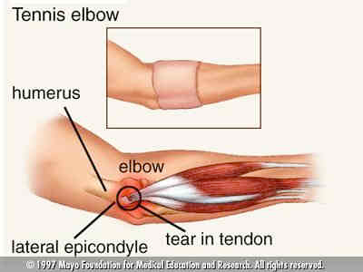
Lateral epicondylitis
Dr. Purvi

Slide 2
Objectives
To know:
What is tennis elbow
Pathology of tennis elbow
Signs and symptoms
Physiotherapy treatment for tennis elbow

Slide 3
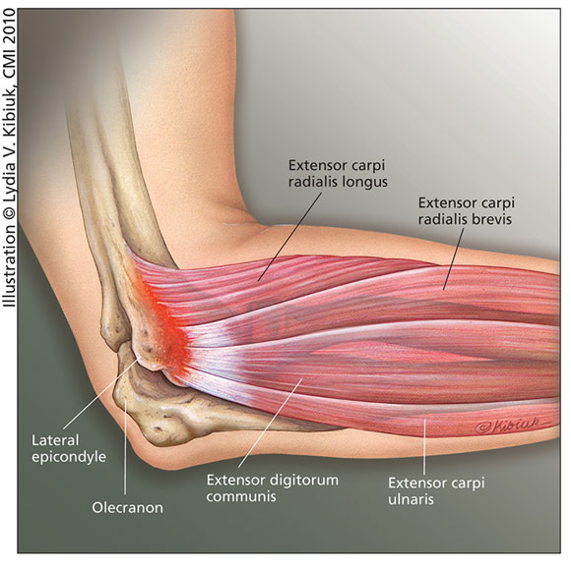

Slide 4
lateral epicondylitis, there is pain in the common wrist extensor tendons along the lateral epicondyle.
Activities such as the backhand stroke in tennis, requiring firm wrist stability, or repetitive work tasks such as computer keyboarding or pulling weeds in a garden, which requires repeated wrist extension, can stress the musculotendinous unit and cause symptoms.
Commonly extensor carpi radialis brevis muscle is affected.
Most common in 30 to 60 yrs of age .
It is evenly occur in both gender.

Slide 5
Etiology of Symptoms
The most common cause of epicondylitis is excessive repetitive use or eccentric strain of the wrist or forearm muscles.
The result is micro damage and partial tears, usually near the musculotendinous junction With continued irritation , chronic inflammation develops as there is no time for repair due to repeated activity

Slide 6
Inflammation of the periosteum may develop with formation of granulation tissue and adhesions.
Recurring problems are seen because the resulting immobile or immature scar is redamaged when returning to activities before there is sufficient healing or mobility in the surrounding tissue.

Slide 7
Cozen’s Test-
The patient sits with the examiner stabilizing the involved elbow while palpating the lateral epicondyle With a closed fist, the patient pronates and radially deviates the forearm and extends the wrist against the examiner’s resistance.
A positive result would be if there is pain along the lateral epicondyle.
Mill’s test
pain with passive wrist flexion with elbow extended and forearm pronated.
Lateral epicondylitis test.
Pain with resisted middle finger extension performed with the
elbow extended

Slide 8
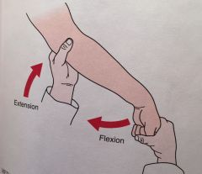
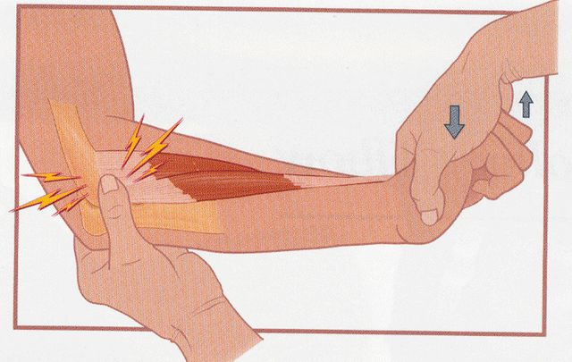

Slide 9
Common Complaints
• Diffuse achiness
• Morning stiffness
• Occasional night pain
• Dropping of objects/ weak grip strength
• Pain on palpation of lat. Epicondyle
• Pain on active or resisted extension
Pain while grasping objects with the effected hand

Slide 10
Common Functional Limitations/Disabilities
Inability to participate in provoking activities, such as racket sports, throwing
Difficulty with repetitive forearm/wrist tasks, such as sorting or assembling small parts, typing on a keyboard or using a mouse, gripping activities, using a hammer, turning a screwdriver, shuffling papers, or playing a percussion instrument.

Slide 11
Nonoperative Management
Protection Phase
To Decrease Pain, Edema, or Spasm
Immobilization. Rest the muscles by immobilizing the wrist in a splint , where the elbow and fingers are free to move.
Tennis elbow splint is given

Slide 12
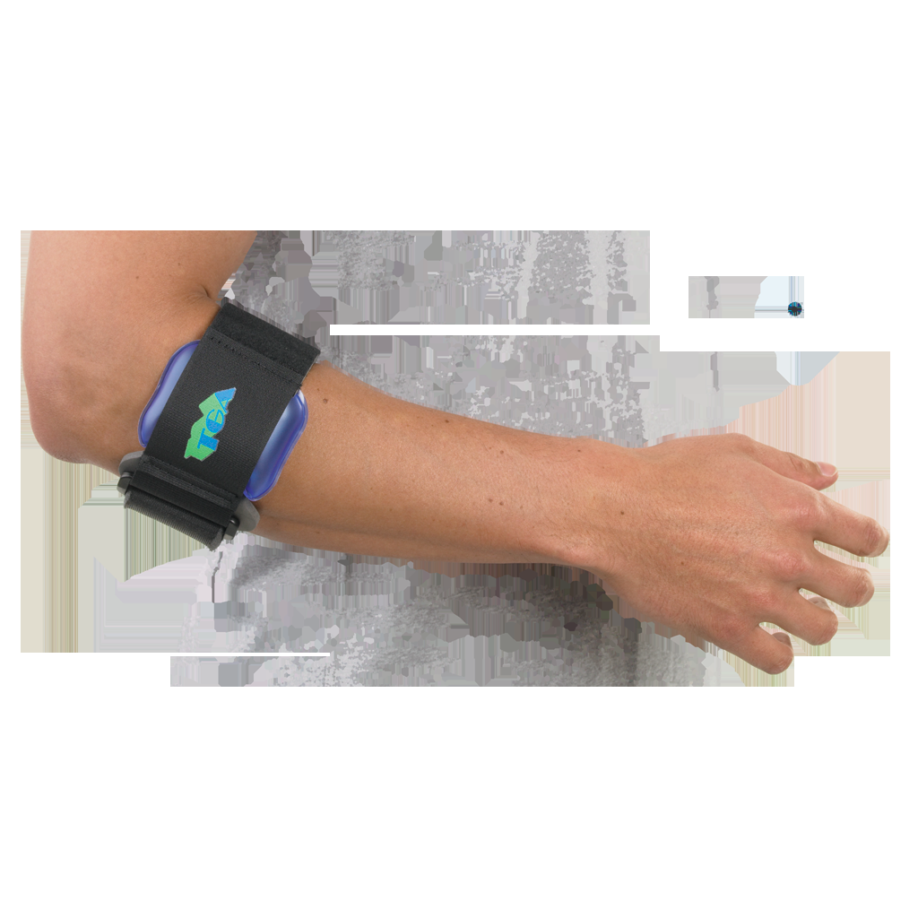
Tennis elbow splint

Slide 13
Avoid provoking activities.
Cryotherapy. Use ice to help control edema and swelling.
Ultrasound
Cross-fiber (friction) massage.
Palpate to localize the scar, then apply pressure and cross-fiber massage.
Increase the intensity of massage as the inflammation decreases.

Slide 14
Develop Soft Tissue and Joint Mobility
Multiple-angle muscle setting (low-intensity isometrics).
Have the patient remove the splint several times a day and perform gentle multiple-angle setting techniques to the involved muscle followed by pain-free ROM.
Maintain Upper Extremity Function
Active ROM.
Have the patient perform ROM to joints
Resistive exercises.
Have the patient perform shoulder and scapular ROM exercises with the resistance applied proximal to the elbow.

Slide 15
Nonoperative Management: Controlled Motion and Return to Function Phases
Manual stretching techniques.
hold–relax, and passive stretching techniques to elongate the tight muscle to the end of its range

Slide 16
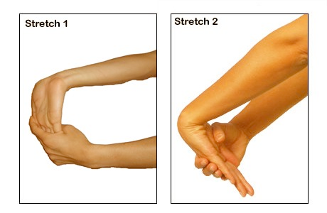
Stretching of wrist flexors and extensore

Slide 17
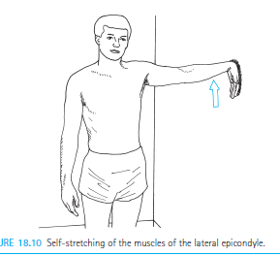

Slide 18
Improve Muscle Performance and Function
Isometrics.
Progress the isometric exercises by applying resistance in various pain-free positions.
Dynamic exercise.
Progress the exercises to using free weights and elastic resistance through pain-free ranges. Initially use low-intensity resistance with multiple repetitions for muscular endurance, then progress to more intense resistance to strengthen the muscles in preparation for functional demands.

Slide 19
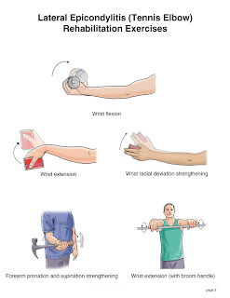
Strengthening exercises

Slide 20
The short-term efficacy of laser, brace, and ultrasound treatment in lateral epicondylitis: a prospective, randomized, controlled trial.
P-lateral epicondylitis
I –laser
C –ultrasound and brace
O-improvement in strength and pain

Slide 21
Rct | Kahraman Y, Ayhan F et al 2008, ;21(1):63-7 | The aims of this study were to evaluate the effects of low-level laser therapy (LLLT) and to compare these with the effects of brace or ultrasound (US) treatment in tennis elbow | Grip strength and pain severity were evaluated with visual analog scale (VAS) at baseline, at the second week of treatment, and at the sixth week of treatment. VAS improved significantly in all groups after the treatment and in the ultrasound and laser groups at the sixth week (p<0.05). Grip strength of the affected hand increased only in the laser group after treatment, but was not changed at the sixth week | The results show that, in patients with lateral epicondylitis, a brace has a shorter beneficial effect than US and laser therapy in reducing pain, and that laser therapy is more effective than the brace and US treatment in improving grip strength.

Slide 22
Is eccentric exercise an effective treatment for lateral epicondylitis?
A systematic review
P-lateral epicondylitis
I –eccentric ex and other ex
C-other ex
O –improved in pain ,grip strength and functional

Slide 23
Systemic review | Frances L Cullinane et al Clinical Rehabilitation 2014, Vol 28(1) 3–19 | Aim of the study was To establish the effectiveness of eccentric exercise as a treatment intervention for lateral epicondylitis. | Results shows that Seven studies reported improvements in pain, function, and/or grip strength for therapy treatments inclusive of eccentric exercise when compared with those excluding eccentric exercise. | The majority of consistent findings support the inclusion of eccentric exercise as part of a multimodal therapy programme for improved outcomes in patients with lateral epicondylitis. K

Slide 24
THANK YOU

