Slide 1
Osteoporosis
Dr. Purvi

Slide 2
Definition of Osteoporosis
Osteoporosis is a metabolic bone disease characterized by low bone mass and microarchitectural deterioration of bone tissue, leading to enhanced bone fragility and increased fracture risk.
It is most common in females as they have lighter thinner bones and bone mass loss is increased after menopause.

Slide 3
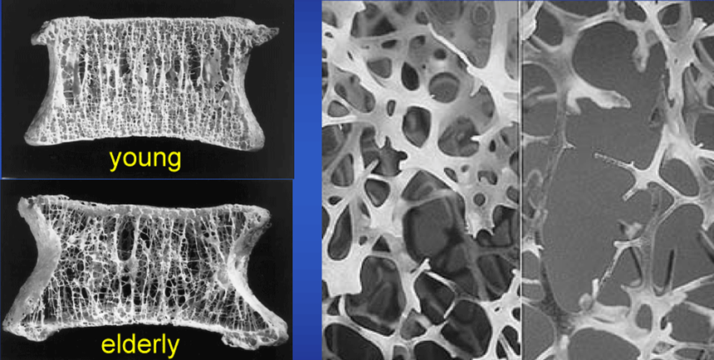
Age and Osteoporosis

Slide 4
Two categories of osteoporosis exist: primary and secondary osteoporosis.
Primary osteoporosis represents bone mass loss related to aging and loss of gonadal function in women.
Secondary osteoporosis results from a variety of chronic conditions that significantly contribute to bone mineral loss, or from effects of medications and nutritional deficiencies.

Slide 5
Possible Secondary Causes of Osteoporosis
Long-term use of corticosteroids
Antiseizure medication (e.g., phenytoin)
Gonadotropin hormones (for treatment of endometriosis)
Excessive use of aluminum-containing antacids
Excessive thyroid hormone medication
Certain anticancer drugs
Inflammatory disorders treated with steroids (rheumatoid
arthritis, asthma, and lupus)
Hypogonadism (inadequate function of the gonads)
Hyperparathyroidism
Cushing's syndrome (overactive adrenal glands)

Slide 6
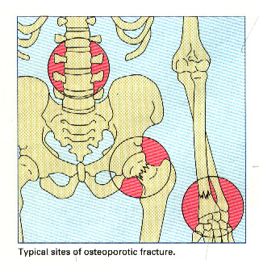
Common osteoporotic fracture sites
Fractures of the wrist, spine, and hip are most commonly involved.

Slide 7
Risk Factors
Current cigarette smoking
Low body weight « 127 pounds)
Alcoholism
Estrogen deficiency
  Prolonged amenorrhea (> 1 yr)
  Early menopause («45 yr) or bilateral ovariectomy
Lifelong low calcium intake
Recurrent falls
Poor health/fragility
Inadequate physical activity
Impaired eyesight.

Slide 8
Nonmodifiable Modifiable
Age Sedentary
White/Asian Smoking
Low body wt Excessive alcohol
F/ h/o osteoporosis Estrogen Deficiency
Nulliparity Use of medications
Diet

Slide 9
Pathogenesis
Cellular component of bone includes osteoblasts and osteoclasts.
Osteoblasts are responsible for forming new bone and osteoclasts are responsible for bone resorption.
Throughout its life bone can respond to external forces or loads (pull of tendon on bone or weight bearing).

Slide 10
Bone is most sensitive to mechanical loading during childhood.
External forces and mechanical loads increases the osteoblastic activities and thus increase in bone mass.
Without this forces, osteoclast activities predominates and thus bone mass decreases. This leads to osteopenia and if this process continues leads to osteoporosis.

Slide 11
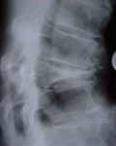
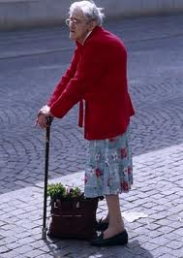
signs and symptoms
A sudden strain, bump, or fall causes a hip fracture or a vertebra to collapse.
Collapsed vertebra may initially be felt or seen in the form of severe back pain
loss of height
Spinal deformities such as kyphosis, or severely stooped posture
Reduced vision

Slide 12
Diagnosis and investigations
Dual energy X-ray absorptiometry (DEXA) technology, the gold standard for diagnosing osteoporosis by measuring bone density
bone mineral density test (BMD)
Radiographic imaging

Slide 13
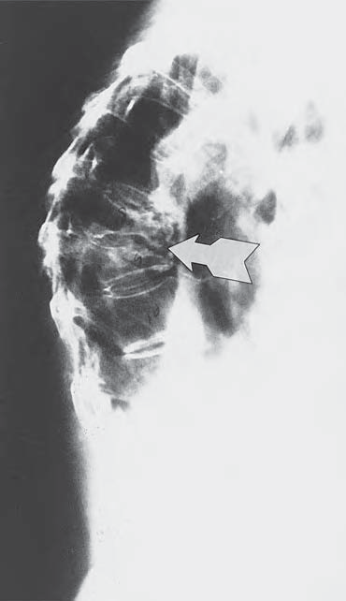
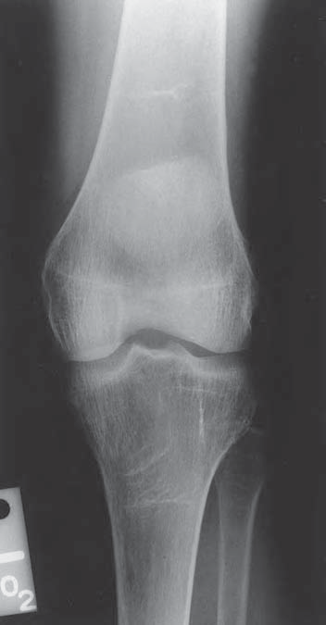

Slide 14
BMD:
The diagnosis of osteoporosis is determined by the T score of a bone mineral density (BMD) scan. The T score is the number of standard deviations (SD) above or below a reference value(young, healthy Caucasian women). The World Health Organization (WHO) has established the following criteria.
Normal: –1.0 or higher
Osteopenia: –1.1 to –2.4
Osteoporosis: –2.5 or less

Slide 15
Prevention of Osteoporosis
The National Osteoporosis Foundation (NOF) recommends four ways to prevent osteoporosis.
Diet rich in calcium and vitamin D
Weight-bearing exercise
Healthy lifestyle with moderate alcohol consumption and no smoking
Testing bone for its density and medication if needed.

Slide 16
Goals of Treatment
Fracture prevention,
Enhancement of bone mass,
Improvement of bone quality.

Slide 17
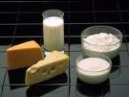
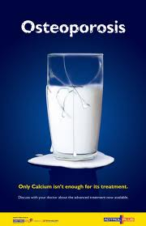

Treatment of Osteoporosis
Non-Pharmacologic Treatment:
dietary supplementation with calcium and vitamin D.

Slide 18
Lifestyle modification:
encouraging smoking cessation
moderation of alcohol consumption,
counsel patients about fall prevention and
reduce the risk of fracture:
  weight training exercises; balance training exs.

Slide 19

Pharmacologic:
  Agents that promote :Bone Resorption prevention.
  Agents that promote :Bone Formation .

Slide 20
Physical Activity
Physical activity has been shown to have a positive affect on bone remodeling.
In children and adolescents, this activity may increase the peak bone mass. In adults, it has been shown to maintain or increase bone density; and in the elderly, it has been shown to reduce the effects of age related or disuse-related bone loss.
Maintenance of, or an increase in, bone density is important for preventing fracture associated with osteoporosis.

Slide 21
Effects of Exercise
Muscle contraction (e.g., strengthening exercises, resistance training) and mechanical loading (weight bearing) deform bone. This deformation stimulates osteoblastic activity and improves BMD.

Slide 22
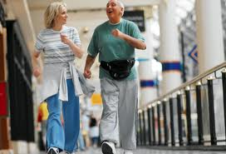
Exercise prescription
Weight-bearing exercises:
Patients should walk (or perform comparable exercise)15 to 20 minutes three to four times a week.
Brisk walking is advisable until it is contraindicated.(arthritis; cardiovascular limitations)
Avoid running
Non weight-bearing exercises:
such as with a bicycle ergometer.

Slide 23

Resistance training:
Resistance training, should involve all major muscle groups so that it will affect the bones of the upper body as well as the legs.
Movements should be slow and controlled.

Slide 24
Frequency
Two to three days/week with one day of rest between each session
Intensity
At 80% of one repetition maximum (1 RM) with resistance training for the upper extremities
One to three sets of 8 to 12 repetitions
At 16/20 on the Borg scale of perceived exertion for trunk exercise.

Slide 25

Resistance Training Exercises
Hip extension-gluteal, hamstring, and low back.
Lumbar extension-low back (avoid lumbar flexion).
Leg press-gluteal, quadriceps, and hamstring.
Pullover-latissimus dorsi, shoulders, trapezius, and abdominaIs.
Torso arm or rowing-latissimus dorsi, shoulders, and biceps.
Arm cross-chest and shoulders.
Chest press-chest, shoulders, and triceps.

Slide 26
Assessment
History Should include:
Any h/o fall or fracture;
Medical history;
f/h/o osteoporosis
Personal history of smoking or alcohol, diet.

Slide 27
Physical assessment should include:
Pain
Deformity
Balance
Strength
Functional assessment
Quality of life

Slide 28
Evidence based practice
Title: Exercise for preventing and treating osteoporosis in postmenopausal women (Review)
Authors:
Howe TE,
Shea B,
Dawson LJ,
Downie F,
Murray A,
Ross C,
Harbour RT,
Caldwell LM,

Slide 29
Journal:
Cochrane review
P=Population:
post menopausal women with osteoporosis aged between 45 and 70 years.
I= Intervention: weight bearing , non weight bearing exercises and combination of both
C= comparator:
post menopausal women who continued their usual activity without any exercise prescription.
O= bone mineral density and frequency of fractures after menopause

Slide 30
The exercise interventions into the following six categories.
• Static weight bearing (SWB); including single leg standing.
• Dynamic weight bearing exercise low force (DWBLF);
including walking.
• Dynamic weight bearing exercise high force (DWBHF);
including jogging, jumping, running, dancing and vibration platform.

Slide 31
Non-weight bearing exercise low force (NWBLF); e.g. low load, high repetition strength training.
• Non-weight bearing exercise high force (NWBHF); e.g.progressive resisted strength training.
• Combination (COMB); more than one of the above
exercise interventions.

Slide 32
Length of exercise programme in majority of the studies were around 12 months and frequency were 2-2-3 days per week.
Comparison:
The studies have compared BMD at different sites like hip , spine, distal radius mainly; after the intervention and compared it with control group.

Slide 33
TITLE | AUTHORS | METHODOLOGY | RESULTS | CONCLUSION
Level of evidence: Ia Exercise for preventing and treating osteoporosis in postmenopausal women (Cochrane Review;2009) | Howe TE, Shea B, Dawson LJ, Downie F, Murray A, Ross C, Harbour RT, Caldwell LM | Cochrane review was conducted in which 43 RCTs were included and analysed for effect of exercises in postmenopausal women. | Most effective type for spine: combination of WB and NWB; and for hip NWB high force exercises. No effect on fracture incidence. | Results suggest a relatively small statistically significant, but possibly important, effect of exercise on bone density compared with control groups

Slide 34
THANK YOU

Slide 35
Questions
Osteoporosis can be result from:
A. Decrease in bone density;
B. Decrease in bone microarchitecture;
C. Decrease calcium intake
D. All of above.

Slide 36
Osteoporosis can be result from BMD<
A. 0.5
B. 1
C. 2
D. 2.5

Slide 37
Osteoporosis can be represented in later stage by:
A. Scoliosis
B. kyphosis
C. Lordosis
D. None of them

Slide 38
Find the owd one from below for treatment of osteoporosis:
Dietary intake of calcium
Resistance exercises
High impact exercises
Supports like collar.

Slide 39
Osteoporosis is common in perimenopausal women due to:
Excessive oestrogen loss
Progesterone loss
Increase estrogen levels
None of them.

