Slide 1

Sumandeep nursing college
Topic: minor disorders in pregnancy
PRESENTED BY:
Ms. Sijo Koshy
Asst. Professor
Sumandeep Nursing College

Slide 2


Slide 3

Introduction:
Many women experience some minor disorders during pregnancy.
These disorders should be treated adequately as they may escalate & become life threatening.

Slide 4
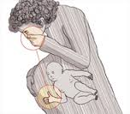
Digestive system:
Nausea & Vomiting:
Disorder seen in about 50% women between 4th & 16th week of gestation.
Hormonal influence are through to be the most likely cause.
Human chorionic gonadotropin, that is present in large amounts in the first trimester, estrogen & progesterone are also contributors to this.
The sickness is confirm to “early morning” but can occur any time in the day.
The smell of food cooking will often the mother to retch

Slide 5
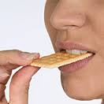
ADVICE:
Salads & light snacks are more tolerable than full meals.
Carbohydrate snacks at bedtime can prevent hypoglycemia which if often shown as a cause of nausea & vomiting.
Dry toast or biscuit on working up & breakfast after half an hour

Slide 6
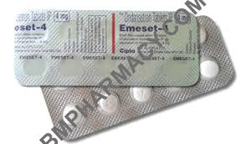
If vomiting become severe, the mother may lose weight & become dehydrated. This condition is called hyperemesis gravidarum, & warrants specialized care & appropriate referral.
Antiemetic drugs given to mother as per prescription

Slide 7
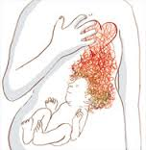
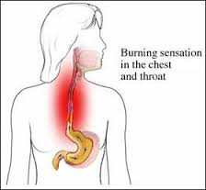
2) Heartburn:
This is the burning pain in the mediastinal region caused by reflux of stomach content into the esophagus.
It occurs because cardiac sphincter relaxes during pregnancy due to effect of progesterone.
The condition tends to worsen as pregnancy advances because the stomach is displaced upward by the enlarging uterus.
most troublesome at about 30th to 40th week of gestation because at this stage the stomach is under pressure from the growing uterus.

Slide 8

Advice:
The reflux can be prevented by avoiding bending & kneeling while doing household chores.
Small meals take less room in the reduced stomach space & are digested more easily.
Fried & fatty food should be avoided.
Sleeping with the more pillows than usual & lying on the right side semi reclining can sometimes help.

Slide 9

Sleeping with the more pillows than usual & lying on the right side semi reclining can sometimes help.
For persistent heartburn antacids may be prescribed by the physician.

Slide 10

3)Excessive Salivation (Ptyalism):
This occur from 8th week of gestation & it is though that the hormones of pregnancy are the cause for it. It may accompany heartburn.

Slide 11
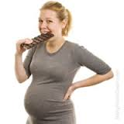
4)Pica:
This is term used when the mother craves certain foods or unnatural substances such as coal.
The cause is unknown but hormones & changes in the metabolism are through to contribute to this.
If the substances craved are harmful to the unborn baby, the mother must be helpful to seek medical advice.

Slide 12

5)Constipation:
This is due to smooth muscle relaxant effect of progesterone causing decreasing peristalsis of the gut.
Pressure of gravid uterus on the colon near term makes it worse as the colon gets displaced.
It is usually overcome by adjustment the diet.

Slide 13
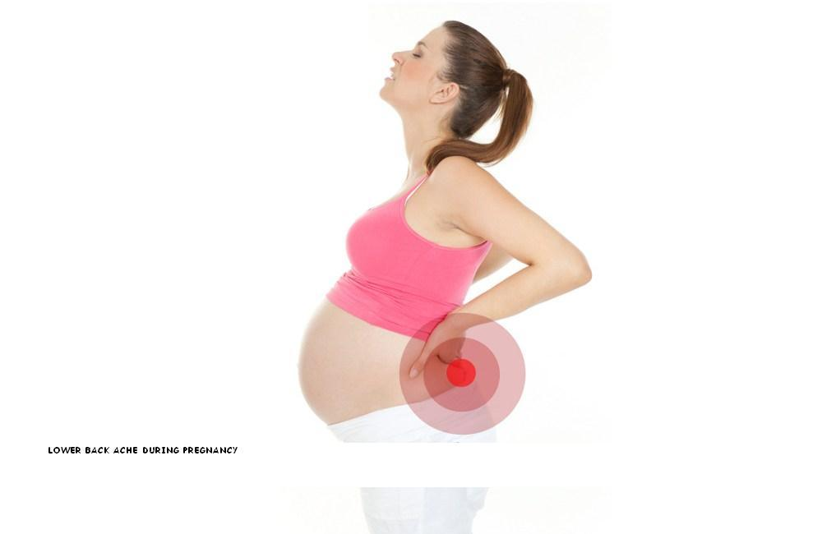
Musculoskeletal system:
1) BACKACHE
The gradual weight gain & the change in the body’s center of gravity combined with the stretching of weak abdominal muscles often lead to a hollowing of the lumber spine.
There is a tendency for back muscles to shorten as the abdominal muscles stretch & extra is put on the ligaments.
This results in backache, usually of sacroiliac or lumber origin.

Slide 14
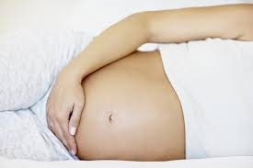
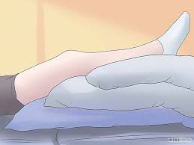
Women with this problem must be helped with:
Postural re-education, including correlation of the “pelvic tilt”
Advice relating to comfortable positions in sitting, standing, lying, general mobility & how to lift correctly.
Lying on the side away from the discomfort, with the affected leg uppermost may relieve the problem
Pillows should be placed to support the whole limbs.

Slide 15
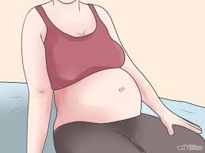
2) LEG CRAMPS
These are quite common, usually in the leg.
There are worse at night.
The cause of leg cramps in pregnancy is not known, but has been contribute to deficiency of vitamin B1 & decreased levels of calcium.
It may be due to ischemia or changes in PH or electrolyte status.

Slide 16


It may be helpful to:
Make gentle leg movement whilst in a warm bath prior to setting for the night.
Sleep with the foot end of the bed elevated by 20 to 25 cm
Take vitamin B complex & calcium supplements.
An attack can be aborted by sharply stretching the involved muscle. Once a cramp has occurred, gentle kneading is effective.

Slide 17
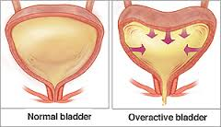
Genitourinary system:
1) Frequency of Micturition
This occur in the first trimester when there is pressure of the gravid uterus on the urinary bladder.
It is spontaneously relieved when the uterus rises up in the abdomen.
It may recur late in pregnancy when the fetal head descends into the pelvis.
Urinary tract infection should always be ruled out before attributing the frequency to pregnancy.
Reassurance is sufficient.

Slide 18

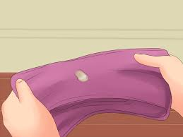
2) Leucorrhea:
This is the term used for the increased white, non-irritant vaginal discharge in pregnancY
If the mother finds the discharge disturbing, it is helpful to offer simple advice of personal hygiene.
Frequency washing of the vulva (3-4 times a day) with plain water would be sufficient.
She should wear cotton underwear & avoid tights
The midwife should exclude the possibility of infection such as thrush & Trichomonas.

Slide 19
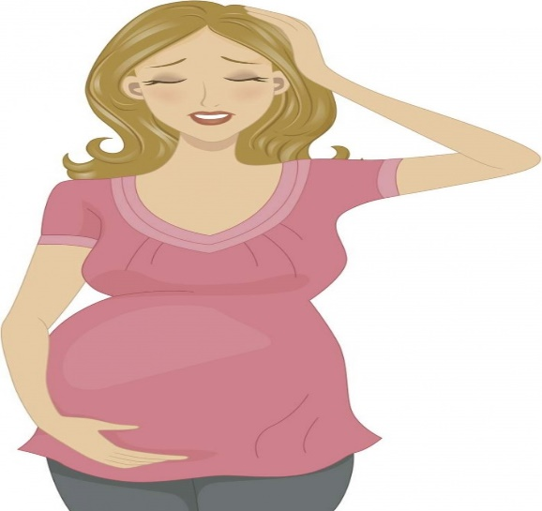
Circulatory system:
1) FAINTING
In the early pregnancy fainting may occur due to vasodilatation under the influence of progesterone
It may subside following the compensatory increase in the blood volume.
Measure for relief include avoiding long period of standing as well as sitting or lying when she feels slightly faint.
Later in pregnancy, a mother may feel faint while lying flat on her back.
These is because the weight of the uterine contents presses on the inferior vena cava & slows the return of blood to the heart.

Slide 20
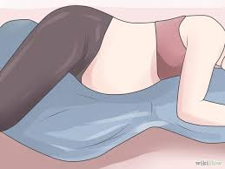
Turning the mother quickly on to her side will bring rapid recovery.
She should be advised not to lie on her back except during abdominal examination

Slide 21
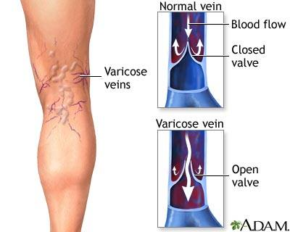
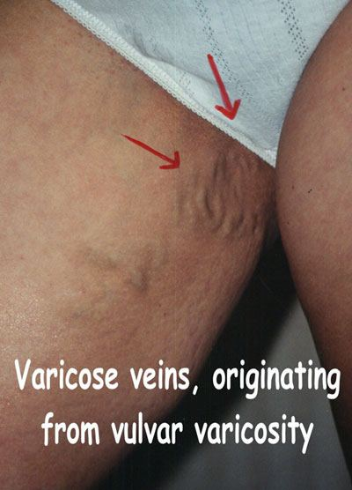
2) Varicosities:
Progesterone relaxes the smooth muscles of the veins & results in sluggish circulation (slow moving).
The valves of the dilated veins become inefficient & varicosities result.
Varicose vein occur in leg, anus (hemorrhoids) & vulva.
The situation is often compounded by pelvic congestion.
Mother with a family history of varicose veins & those doing work, which demands long periods of standing & sitting usually develop varicose veins.

Slide 22
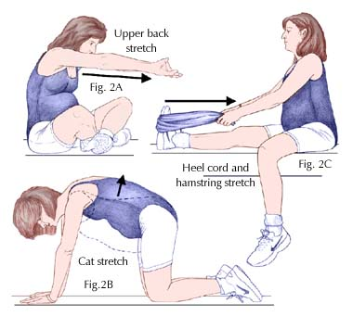

Advice:
Measures to reduce the discomfort of leg varicosities include:
Exercising the calf muscles by rising on to the toes or making circling movements with ankles.
Resting with the legs vertical against the wall for a short time.
Wearing support tights before rising or after resting with led elevated.

Slide 23
Those with hemorrhoids or tendency to develop them should be advised about:
Avoidance of constipation by including fiber in the diet & adequate fluids.
Seeking medical advice for topical applications.
Vulvar varicosities are rare & very painful.
A panty Girdle or sanitary pad may give support.
Vulvar varicosities may rupture & bleed during delivery.
Occasionally numerous spider varices develop on the skin. Most of those enlarged veins disappear after delivery.

Slide 24
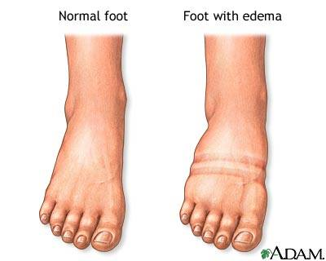
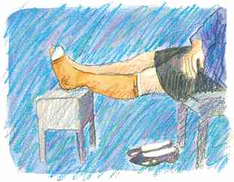
3) Edema:
It is the result of venous & lymphatic stasis.
Additional factors responsible are – changes in osmotic pressure of blood & tissue fluids & altered capillary permeability.
The blood pressure should be checked to see if the patient has pregnancy induced hypertension.
The treatment of gestational edema of feet is elevation of legs, sleeping on left lateral position & avoiding sitting with the feet hanging down.

Slide 25
Advice:
Measures to reduce the discomfort of leg varicosities include:
Exercising the calf muscles by rising on to the toes or making circling movements with ankles.
Resting with the legs vertical against the wall for a short time.
Wearing support tights before rising or after resting with led elevated.

Slide 26
Integumentary system:

Slide 27
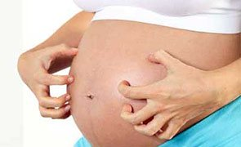
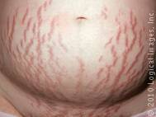
Skin problem:
Generalized itching, which often starts over the abdomen.
This is thought to have some connection with the liver’s response to the hormones in pregnancy & with raised bilirubin levels.

Slide 28


Advice:
local applications
Antihistamine

Slide 29

Mild soap & cotton underwear might help to ease the irritation.

Slide 30
Nervous system:

Slide 31
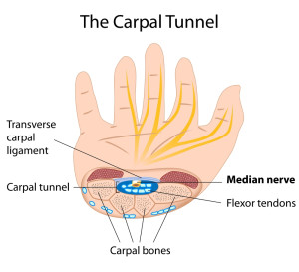
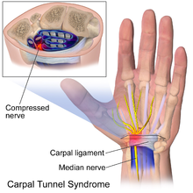
1) Carpal tunnel syndrome:
Mothers complains of numbness & pins & needles in their fingers & hands.
This usually happen in the morning, but it can occur at any time of the day.
It is caused by fluid retention, which creates edema & pressure on the median nerve

Slide 32
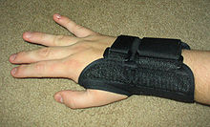

Advice:
Wearing splint at night
Restriction of salt intake

Slide 33
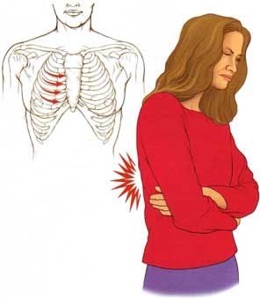
2) Intercostal neuralgia:
It may develop in late pregnancy due to muscle spasm.
It may be unilateral or girdle type.

Slide 34
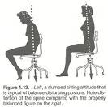
Advice:
Sitting in straight- backed chair, using a cushion for lumber support & lateral flexion exercises relieves it.

Slide 35
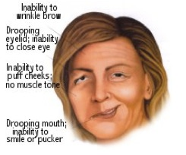

3) Bell’s plasy:
It may rarely develop in the last trimester due to edema compressing the facial nerve.
It is relived spontaneously in 3 to 4 weeks following delivery.

Slide 36
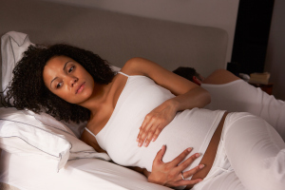

4) insomnia:
caused by the fetal movements, frequency of micturition & difficulty in finding a comfortable positions.
It may also be due to some deep seated anxiety or fear.

Slide 37

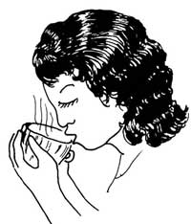

Advice:
Tuck a pillow under the abdomen when lying in a lateral position.
Talk about her fears & anxieties so that she can have sense of normality & lightness.
Take rest in afternoon
Drink a glass of warm milk at bed time.

Slide 38
MULTIPLE CHOICE QUETIONS:
……………….. Hormone is present in large amounts in the first trimester.
Estrogen
Progesterone
Human chorionic gonadotropin
Thyroxin
2)Which is one of the treatment of leg cramp in pregnancy?
Intake of more water
Administer laxative drugs
Take vitamin B complex & calcium supplements
Iron supplements
3) One woman has white nonirritant vaginal discharge in pregnancy, which term is used?
Leucorrhea
Varicosities
Fainting
Amenorrhea

Slide 39
4) Varicose veins occur in anus is also known as………………
Hemorrhoids
Fistula
Skin integrity
Ptyalism
5) Which causes are common for insomnia in pregnancy?
Fetal movement
Frequency of micturition
Difficult in finding comfortable position
a), b) & c)

Slide 40


Slide 41

Thank You !

