Slide 1

ROLE OF MIDWIFE, INDEPENDENT MIDWIFE AND ROLE OF MIDWIFE IN FAMILY WELFAIR PROGRAME
PRESENTED BY:
Ms. Sijo Koshy
Asst. Professor
Sumandeep Nursing College

Slide 2
INTRODUCTION

Slide 3
OBJECTIVE’S
To avoid unwanted birth.
To bring about wanted births.
To regulate the intervals between pregnancies.
To control the time at which births occurs in relation to the age of the parents.
To determine the number of children in the family.

Slide 4
DEVELOPMENT:
Target Bound Programmed
Integration
All India hospitals postpartum programmed
Oral Contraceptives
Medical Termination of Pregnancy Act
Incentives and Disincentives
Family Welfare:
The Target Free Approach (Community Needs Assessment)

Slide 5
ROLE OF NURSE IN FAMILY WELFARE PROGRAMME
FUNCTIONL ROLE-
ADMINISTRATIVE ROLE-
SUPERVISORY ROLE-
EDUCATIONAL ROLE-
ROLE IN RESEARCH-
ROLE OF EVALUATION-

Slide 6
ACTIVITY OF NURSE MIDWIFE IN FAMILY PLANNING-

Slide 7
INCREASE INTREST IN FAMILY PLANNING SERVICES
EDUCATE ABOUT HUMAN REPRODUCTION AND POPULATION DYNAMIC
CONTRACEPTIVE METHOD

Slide 8
ROLE OF NURSE MIDWIFE

Slide 9
DEFINITION
A midwife is a person who, having been regularly admitted to a midwifery educational program that is duly recognized in the country in which it is located, has successfully completed the prescribed course of studies in midwifery and has acquired the requisite qualifications to be registered and/or legally licensed to practice midwifery.
WHO and the International Federation of Gynecology and Obstetrics

Slide 10
TYPE OF MIDWIFE:-
Certified Professional Midwife
Licensed Midwife
Lay Midwife

Slide 11
JOB SPECIFICATION:-
As a midwife practitioner she has appropriate knowledge, skills & competence to provide care, supervision & advice to a woman from conception, through pregnancy, labour, birth the post-partum period.
This care includes preventive measures, the diction of abnormal conditions in the mother & child.

Slide 12
This practice may be in the home or hospital & should base on the best available current evidence.
The post requires effective communication & ability to provide support to the clinical lead in their area of work.

Slide 13
JOB RESPONSIBILITY
Professional responsibilities
Management responsibilities
Educational responsibilities
Personal responsibilities

Slide 14
ROLE OF MIDWIFE

Slide 15

MIDWIFE AS A TEACHER

Slide 16
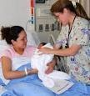
Care provider

Slide 17
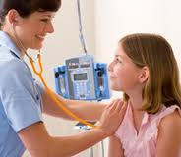
Sensitive observer

Slide 18

Educator

Slide 19
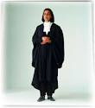
Advocate / Adviser

Slide 20

Concerned adviser / counselor

Slide 21
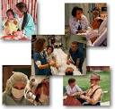
Change agent

Slide 22
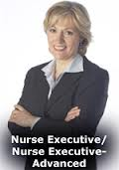
Manager

Slide 23

Planner

Slide 24

Organizer

Slide 25

Director

Slide 26

Coordinator

Slide 27

Controller

Slide 28

Evaluator

Slide 29

Leadership role

Slide 30

Collaborator

Slide 31

Researcher

Slide 32

Resourceful

Slide 33
QUALITIES OF A NURSE MIDWIFE

Slide 34
Quality
Planner
Able to access the women
Skillful
Assist the doctor
Professional Competent
Counsellor
Good Communication
Care Provider
Coordin-ator
Health Educator
Team Leader

Slide 35
ACTIVITIES OF A MIDWIFE
family planning information and advice.
diagnosis pregnancies and monitor normal pregnancies. examination monitoring pregnancy.
diagnosis of pregnancies at risk.

Slide 36
parenthood preparation
assist the mother during labour and to monitor the fetus in utero
conduct spontaneous deliveries including where required an episiotomy and in urgent cases a breech delivery

Slide 37
To recognize the warning signs of abnormality in the mother or infant which necessitate referral to a doctor and to assist the latter where appropriate; to take the necessary emergency measures in the doctor’s absence, in particular the manual removal of the placenta, possibly followed by manual examination of the uterus.

Slide 38
To examine and care for the newborn infant; to take all initiatives which are necessary in case of need and to carry out where necessary immediate resuscitation.

Slide 39
To examine and care for the newborn infant; to take all initiatives which are necessary in case of need and to carry out where necessary immediate resuscitation.

Slide 40
To examine and care for the newborn infant; to take all initiatives which are necessary in case of need and to carry out where necessary immediate resuscitation.

Slide 41
To care for and monitor the progress of the mother in the post-natal period and to give all necessary advice to the mother on infant care to enable her to ensure the optimum progress of the new-born infant.

Slide 42
To examine and care for the newborn infant; to take all initiatives which are necessary in case of need and to carry out where necessary immediate resuscitation.
To carry out the treatment prescribed by a doctor.
To maintain all necessary records

Slide 43
AN HOLISTIC,
INTEGRATED MODEL OF A COMPETENT MIDWIFE

Slide 44
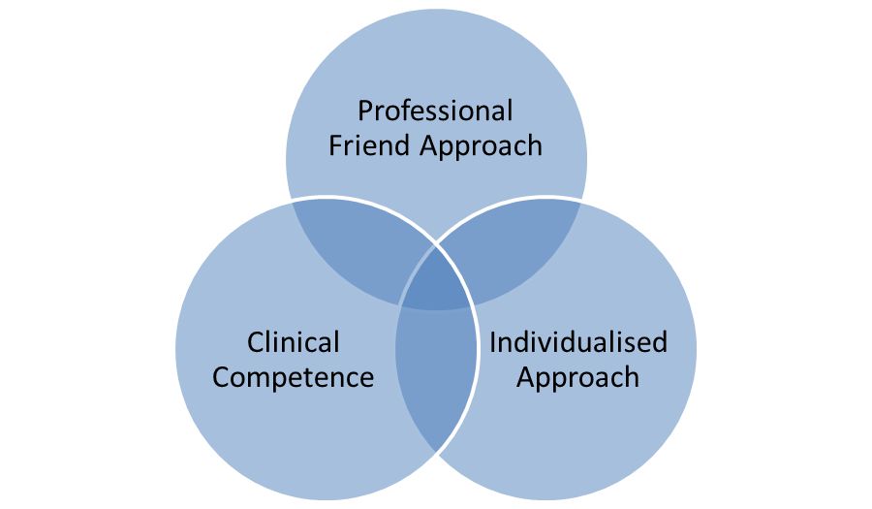

Slide 45
PROFESSIONAL PROFILE
Care enhancement – development in practices standard setting empowering women.
Reducing risk- health promotion and screening identification of health problems protection of individuals.
Clint patient support.
Practice development.
Educational development

Slide 46
CAREER PATHWAY
Responsible and accountable for this work.
Self-reliant in this way of working.
Adaptable to changing demands.
Changing and creative.
Innovative
Resourceful
Able to work as change agent.
Able to share and promote good practice and knowledge.

Slide 47
INDEPENDENT MIDWIFE PRACTICESNOR

Slide 48
HISTORY
In 1985 independent midwife association started by 8 member in USA.
Independent Midwife 1992 started in uk.
1996 Indian government adopted
In december 1996 national abortion federation given permission services for abortion

Slide 49
Definition
Independent midwives are specialists in normal pregnancy care. They are practitioners in their own right, responsible for the primary health care of mainly healthy women and babies. They can provide total care from early pregnancy through the labor and birth until the baby is a1 month old.

Slide 50
OBJECTIVE
Creating greater public awareness of natural birth opportunities for women
Promoting best midwifery practice through continuity of care

Slide 51
Increasing pathways for all midwifery practitioners
Providing initiatives for midwifery students to participate in independent midwifery practice

Slide 52
PHILOSOPHY
Pregnancy and birth are seen as a normal part of a woman’s life.
Midwifery care is a trusting, mutually respectful partnership between the woman and her careers.

Slide 53
Advising government and health authorities on the benefits of independent midwifery practice to women and society at large
Collaborating with like-minded groups at national and international level

Slide 54
The midwife “follows the women,” thereby enabling care either at home or in the hospital, as appropriate to the women’s needs and choices.
Women have the right to be given evidence based information in order to make informed choices throughout pregnancy, birth and the postnatal period.

Slide 55
Each woman is entitled to get to know the midwives caring for her throughout her pregnancy and childbirth regardless of recognized risk factors, complications, or place of birth.
Women should be able to give birth to their babies in a safe and satisfying way in the place of their choice.

Slide 56
Education, licensing and board certification

Slide 57
AREA OF PRACTICES SATTING
Nurse practitioner practices/offices
Nursing homes
Private & public schools, universities and colleges
Physician/private medical practices
Retail-based clinics

Slide 58
Community clinics, health centers, urgent care centers
Health maintenance organizations (HMOs)
Home health care agencies
Hospitals
Hospital clinics
Hospice care

Slide 59
MIDWIFE AS AN INDEPENDENT PRACTIONER NEED THE FOLLOWING QUILITIES

Slide 60
Communication
Research awareness
A team member
Keeping the law
Ethical issues
Responsibility to keep record

Slide 61
Skills of midwife
Promotion of health
Assessment
Managing care
Independent action
Initiating the action of other
Undertaking care prescribed by a doctor

Slide 62
“Legislation to govern independent midwifery practice”.

Slide 63
Enable midwives to practice freely in any setting.
Ensure the profession is governed by midwives.
Support the midwife in the use of life-saving knowledge and skills in a variety Of settings in countries where there is no ready access to medical support.

Slide 64
Recognize that all women have a right to be attended by a competent midwife.
Allow for the midwife to practice in her own right.
Recognize the importance of separate midwifery regulation and legislation which supports and enhances the work of midwives in improving maternal, child and public health.

Slide 65
Enable midwives to have access to ongoing education.
Require regular renewal of right to practice.
Adopt a ‘Definition of the Midwife’ appropriate to the country within the legislation.
Provide for consumer representation on the regulatory body.

Slide 66
Provide for entry to the profession that is based on competencies and standards and which makes no distinction on routes of entry.
Provide the mechanism for a regulatory body that is governed by midwives with the aim of protecting the public.
Provide for regular review of the legislation to ensure it remains appropriate and not outdated, as midwifery education and practice and the health services advance.

Slide 67
Encourage the use of peer review and analysis of perinatal, maternal and newborn outcomes in the legislative review process.
Provide for transition education programes in the adoption of new legislation requiring increased levels of competency of the midwife

Slide 68
Benefits Of
Independent Midwives

Slide 69
Continuity of Care/Career
Grater control
Ability for a Homebirth

Slide 70
COST
Pre-pregnancy advice
Advice about birth options
Childbirth education classes
Sibling preparation classes
Continuous midwifery care during pregnancy
Preparation for and attendance at births in an appropriate environment of the parents' choice

Slide 71
Postnatal care following birth at home, birth centre or hospital
Separate postnatal care for women who want private midwifery care for this period only or who are discharged home early from hospital
Lactation consultancy
Acupuncture and Chiropractic

Slide 72
Referral to and advice about other health professionals
Some midwives have a special interest and expertise in supporting women in special areas such as vaginal birth after caesarean section (VBAC), breech births, water births and postnatal depression.

Slide 73
Legal Authority of Nurse-Midwifery Certificate and CNM Scope of Practice

Slide 74
Episiotomies
Dispensing
Request and Receipt of Pharmaceutical Samples and Devices
Signing Birth Certificates:

Slide 75
Informing patient of positive & negative aspect of blood transfusion
Supports for abortion care
Treating STDs

Slide 76
EXPANDED ROLE
Knowledge and skills up-to-date throughout working life.
Practice should be skillfully and competent
Supervision
Facilitated student to develop competent enough
Evidence based practice

Slide 77
THANK YOU

