Slide 1

ADVANCED CONTRACEPTIVE METHOD
PRESENTED BY:
Ms. Sijo Koshy
Asst. Professor
Sumandeep Nursing College

Slide 2
INTRODUCTION-

Slide 3
IMPORTANCE-
Spacing of children is importance for promotion of health child and mother both.
Limitation of family size has become important. To ensure batter standard of living.
To control excessive world population.
To reduce the maternal and infant mortality rate.
To prevent unwanted and early pregnancy.

Slide 4
OBJECTIVE-
To reduce the birth rate
Eligible couple- who are in reproductive age group 15-45 year
Require the use of family planning method.
To bring about certain social changes like to educate and motivate the sexually activity and fertile couple to accept the small family norm.
To increased literacy rate.
To raise the marriageable age
Girl-18 year
Boy-21 year
To minimize the access of good quality family planning service to fulfill the unmet need of contraception.

Slide 5
FERTILITY CONTROL-It includes fertility inhibition and fertility stimulation.
CONTRACEPTION- It is fertility inhibition. It includes all permanent and temporary method designed to prevent pregnancy due to coital act.
IDEAL CONTRACEPTIVE METHOD-It is acceptable, inexpensive, simple to use, safe, effective required minimal motivation, maintenance and supervision.

Slide 6
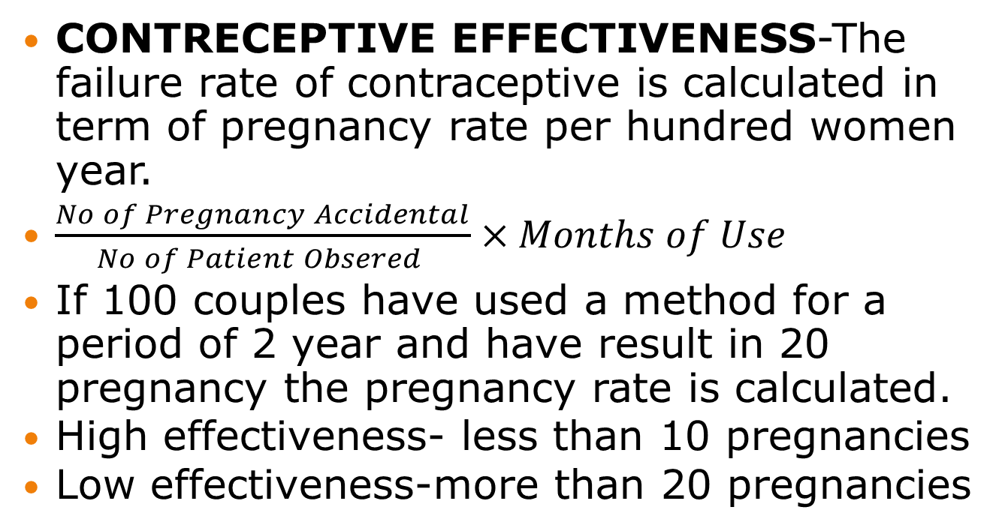
CONTRECEPTIVE EFFECTIVENESS-The failure rate of contraceptive is calculated in term of pregnancy rate per hundred women year.
$\frac{No of Pregnancy Accidental}{No of Patient Obsered }×Months of Use$
If 100 couples have used a method for a period of 2 year and have result in 20 pregnancy the pregnancy rate is calculated.
High effectiveness- less than 10 pregnancies
Low effectiveness-more than 20 pregnancies

Slide 7
METHOD OF CONTRACEPTION
TEMPRARY METHOD
NATURAL METHOD-
BARRIER METHOD-
INTRA UTERIN DEVICE
STEROIDAL CONTRACEPTION
PERMANENT METHOD
TUBECTOMY
VASECTOMY

Slide 8
CONTRACEPTIVE METHOD FOR MALE

Slide 9
WITHDRAWAL- COITUS INTERRUPTUS

Slide 10
It is ancient method of contraception the male withdrawal just before ejection .it prevents semen in the vagina.
Risk rate is high because pre ejector fluid containing sperms ooze out during intercourse without either partner being aware of it.

Slide 11
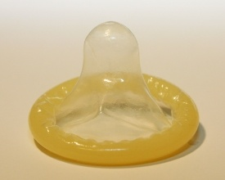
CONDOM-

Slide 12
A condom is a sheath or covering made to fit over a man’s erect penis.
made of thin latex rubber.
Some condoms are coated with a dry lubricant or with spermicide.
Different sizes, shapes, colors and textures may be available.

Slide 13
Advantages
It prevents STDs, HIV/AIDS, as well as pregnancy
It helps protect against conditions caused by STDs pelvic inflammatory disease infertility in both men and women.
To prevent STD infection during pregnancy.
Can be used immediately after childbirth.
No effect on breast milk
It is safe and has no hormonal side effects.
Can be used by men of all ages.
Can be used without seeing a health care provider first.
Often helps prevent premature ejaculation (helps the man last longer during sex.)

Slide 14
Disadvantages
Latex condoms may cause itching or for a few people who are allergic to latex.
May decrease sensation, making sex less enjoyable for either partner.
Couple must take time to put the condom on the erect penis before sex.
It may be embarrassing for some people to purchase, ask a partner to use.

Slide 15

GOSSYPOL – MALE CONTRACEPTIVE PILL

Slide 16
It is a polyphenol derived from cottonseed plant endocrine feedback loop to suppress spermatogenesis. The negative feedback of sex steroid that can block spermatogenesis in men but it will produce loss of libido and potentially extinguish sexual performance.comdining testosterone one with progestin allow a lower dose for the androgen with efficiency comparable to use of testoerone alone.

Slide 17
Side effect
Digestive problem
kidney disease
producing hypokalemia
permanent sterility.

Slide 18
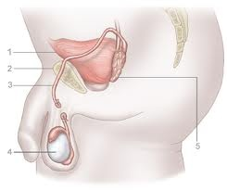
Vasectomy

Slide 19
Vasectomy provides permanent contraception for men who decide they do they will not want more children. It is a safe, simple and quick surgical procedure it does not affect sexual ability.
The doctor makes a small opening in the man’s scrotum and closes off both tubes that carry sperm from his testicles. This keeps the sperm out of his semen.
Correct using condoms or another family planning method consistently for the first 20 ejaculations or the for 3 months after the procedure whichever comes first.

Slide 20
Advantages
It is very effective and is a permanent method.
Nothing to remember except to use condoms or another effective method for the first 20 ejaculations or the first three months, whichever comes first.
It does not affect the ability to have sex.
No apparent long-term health risks.

Slide 21
Disadvantages
Common minor short term complications of surgery: Usually uncomfortable for 2 to 3 days
Uncommon complication of surgery Bleeding or infection
Not immediately effective. The first 20 ejaculations after vasectomy may contain sperm. The couple must use another contraceptive method for the first 20 ejaculations or the 3 months whichever comes first.
Reversal surgery is difficult.

Slide 22
Important points to remember:
It is a permanent family planning method. A man must think carefully and decide that he will never want more children before choosing Vasectomy.
It is very effective after 20 ejaculations or three months whichever comes first.

Slide 23
CONTRACEPTIVE METHOD FOR
FEMALE

Slide 24
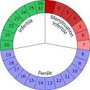
RHYTHM METHOD

Slide 25
In this method the couple refrain from sexual indulgence for 2 week starting from the 7th day after last period .this fortnight is the danger period or fertile period .at about the ovum is available for fertilization first and last week of cycle is safe period. Also known as Calendar Method.

Slide 26
Based on Orgino-knaus theory that ovulation, release of mature female egg takes place about 14 + 2 days before the next menstrual period. The calendar method attempts to predict ovulation using a woman’s menstrual history.

Slide 27
A written record should be kept.
The day on which bleeding starts, should be marked as day 1.
This should be done for at least 6 months.
Then count the days in each cycle of course, you have no assurance that your cycle variations will remain the same. So you must continue to mark each Day 1 and list the length of your last cycle. Note the length of shortest and longest cycle.

Slide 28
Charting Your Pattern
To find out the unsafe period:
Note the days of your shortest cycle.
For e.g. 27 days.
Subtract 18 from the total number.
I.e. 27 – 18 = 9

Slide 29
That’s the day you are likely to be fertile and you must start using contraception to avoid unwanted pregnancy.
Now, take the longest cycle
Say for e.g. 32
Subtract 11 from that number
I.e. 32 – 11 = 21

Slide 30
This is the last day of your unsafe period.
So, in summary, a woman having a shortest cycle of 27 days and a longest cycle of 32 days for the last 6 – 8 cycles, the probable unsafe period is between day 9 to day 21 of her cycle, throughout.
I.e. it is safe to have unprotected sex between 0 – 8 days and between day 22 – till menses (safe time)

Slide 31
Important point
If all your cycles are shorter than 27 days, don’t try to use calendar estimates at al

Slide 32

BASAL BODY TEMPRATURE

Slide 33
TEMPERATURE METHOD
In most women temperature usually rises slightly with ovulation and remains up during the second part until just before her next period recording each days temperature helps to indicate when ovulation has occurred.
Normal BBT graph
The temperature registers when at rest.
most women, 96 to 98 degrees taken orally are considered normal before ovulation and 97 to 99 after. easy-to-read thermometer that registers only from 96 to 100 degrees.
A rectal reading is more reliable.

Slide 34
Taking Your Temperature
Each morning take your temperature, as soon as you wake up – before getting out of bed, talking, eating, drinking, having sex,
Charting Your Temperature Pattern
Each reading must be recorded As each day’s temperature is plotted on the graph,. The pattern may vary from cycle to cycle.
The Safe Times
After the temperature rise has lasted for at least three days, you can assume that your safe days have begun. When you become confident about using your BBT to determine your safe days, you may not need to take your temperature between the start of the infertile time and the beginning of your next menstrual period.

Slide 35

CERVICAL MUCOUS METHOD

Slide 36
It involve s the day to day study of cervical mucus .in the first few day of the cycle .it is thick and viscid one day become watery and profuse due to the effect of ovulation. That day +5day is danger.
The hormones that control menstrual cycle phases also act on the glands of the cervix that produce mucus secretions. The mucus secreted by the cervix collects in the cervix and vagina. It changes in quality and quantity just before and during ovulation. With proper personal instruction, many women can learn to recognize the changing characteristics. . The cervical mucus method is also known as the "ovulation method" or the "Billings method".

Slide 37
The cycle begins with menstruation. During vaginal bleeding, the flow disguises the mucus signs.
The menstrual period is usually followed by a few days when no mucus is present – these are "dry days."
As an egg starts to ripen, mucus increases in the vagina and appears at the vaginal opening. It is generally yellow or white, cloudy and sticky.
The greatest amount of cervical mucus usually occurs immediately before ovulation during the "wet days." The mucus becomes clear and slippery resembling raw egg whites. When the mucus can be stretched between the fingers it is called spinnbarkeit – German for stretchable. This is the peak period of fertility.
About four days after the wet days begin, mucus may abruptly become cloudy and sticky, reduce sharply in volume, and a few dry days may return before your period starts.

Slide 38
1 Dry | 2 Dry | 3 Dry | 4 Dry | 5 Dry | 6 Dry | 7 Sticky
8 Sticky | 9 Sticky | 10 Wet | 11 Wet | 12 Wet | 13 Wet | 14 Wet
15 Wet | 16 Wet | 17 Wet | 18 Wet | 19 Dry | 20 Dry | 21 Dry
22 Dry | 23 Dry | 24 Dry | 25 Dry | 26 Dry | 27 Dry | 28 Dry
Charting Your Mucus Pattern
Chart:

Slide 39

SYMPTOTHERMIC METHOD

Slide 40
This method include BBT method and cervical method ,to determine day of ovulation.

Slide 41
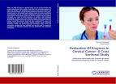
CERVICAL ENZYME TEST

Slide 42
This case a strip containing glucose oxides’ and a day is applied to cervical mucous every day .the strip change colour is the day of ovulation.

Slide 43

LACTAIONAL AMENORRHEA METHOD

Slide 44
The method consists in fully breast feeding the baby .it is effective only for the first 6 month of birth of baby. Provided the mother has not commenced menstruating.

Slide 45

Emergency Oral Contraception

Slide 46
After unprotected sex, emergency oral contraception can prevent pregnancy. called postcoital or ‘morning after’ contraception. Mainly stops ovulation.
To prevent about three-fourths of pregnancies.
Up to 72 hours after unprotected sex, the woman should take 4 low-dose or 2 "standard-dose" combined oral contraceptives, and then take another equal dose 12 hours later.
Anti progestin -600 mg signal dose

Slide 47
COMPLICATION-
Nausea
Abdominal pain
Fatigue
Headache
Dizziness
Brest tenderness
Menstrual disturbance

Slide 48
ALTERNATIVE DELIVERY SYSTEM OF HORMONAL CONTRACEPTIVES

Slide 49
Combination hormonal pill
Each film coated white colored tablet contains levonorgestrel-0.15 mg and
ethinyloestradiol- 0.03mg. Each brown colure film coated tablet contains ferrous
fumerate 60mg equivalent to ferrous iron 19.5mg Mechanism of Action: Combination hormonal contraceptives inhibit ovulation. In addition, they also produce alterations in
the genital tract, including changes in the cervical mucus, rendering it unfavorable for
sperm penetration even if ovulation occurs. Changes in the endometrium may also occur,
producing an unfavorable environment for fertilization.

Slide 50
Dosage: Dose starts on first day of menstrual cycle taking 1 tablet daily for 21
consecutive days, followed by 7 days of Iron and folic acid supplementation.
Advantages of Hormonal OCPs
• Decrease in menstrual flow and cramps.
• May improve anemia.
• Regulate menstrual cycles.
• Protect against ovarian and endometrial cancer.
• Decrease benign breast lumps.
• Prevent ectopic pregnancy.

Slide 51
Contra Indications
• Nausea and dizziness
• Breast tenderness
• Intermittent bleeding
• Headaches
• Weight gain

Slide 52
Combined contraceptives contain two hormones similar to the natural hormones in a woman’s body an estrogen and a progestin.
Stop ovulation (release of eggs from ovaries)
Thicken cervical mucus, making it difficult for sperm to pass through.

Slide 53
  INJECTIBAL COMBINED ESTROGEN/PROGESTIN CONTRACEPTIVE-Injection are administrated every 28-30 day deep i/m injection.
Inj-clofem- 25mg progestin,5mg estrogen
Inj-misigyna -50mg progestin,5mg estrogen

Slide 54
TRANS DERMAL-
Size-20cm2
20µg ethinylestrodol+150µg norestromin
Each patch lasts 7 day 3 patches being used consecutively with a placebo patch or patch free interval in week 4 when withdrawal bleeding occurs.

Slide 55
VAGINAL –
Vaginal ring releasing 15µg ethinylestrodol+120µg etonorgestral
Outer diameter is 54 mm.
Cross sectional diameter of 4 m

Slide 56
Advantages
Very effective
Decrease iron deficiency, anemia
Helps prevent:
-Ectopic pregnancies
-Endometrial cancer
-Ovarian cancer
-Ovarian cysts
-Pelvic inflammatory disease
-Benign breast disease

Slide 57
Disadvantages
Nausea
Spotting or bleeding
Breast tenderness Slight weight gain
stroke, blood clots in deep veins of the legs
Heart attack
High blood pressure
Do not protect against sexually transmitted diseases (STDs)

Slide 58
CONTRAINDITION-
HTN
Arterial disease
D/m
Obesity
Smoking
Cancer
Withdrawal bleeding
Dysmenorrhea
Menstrual migraine

Slide 59
COMPLICATION-
Affect of metabolism of CHO, lipid plasma protein ,amino acid ,vitamins
Headache
Weight gain
Vomiting and nausea
Cardiovascular disease
Breast cancer
Cervical cancer
Ovarian cancer
Endometrial cancer
Colon cancer
Irregular bleeding during first 3 mount.

Slide 60
PROGESTIN-ONLY ORAL CONTRACEPTIVES

Slide 61
Women who use Progestin-only Oral Contraceptives should swallow a pill every day to prevent pregnancy. It contains very small amounts of only one kind of hormone, a progestin.
It thickens the cervical mucus, making it difficult for sperm to pass through.
It reduces ovulation to half of that of menstrual cycle.
Progestin-only oral contraceptives do not disrupt existing pregnancy.
For breast feeding women: Progestin is more effective than combined oral contraceptives.
It is most effective when taken about the same time every day.

Slide 62
CONTRAINDITION-
because of oestrogen
HTN
Arterial disease
D/m
Obesity
Smoking
Cancer
Withdrawal bleeding
Dysmenorrhea
Menstrual migraine

Slide 63
COMPLICATION-
Affect of metabolism of CHO, lipid plasma protein ,amino acid ,vitamins
Headache
Weight gain
Vomiting and nausea
Cardiovascular disease
Breast cancer
Cervical cancer
Ovarian cancer
Endometrial cancer
Colon cancer

Slide 64
Advantages:
nursing mothers start 6 weeks after childbirth.
It does not increase risk of estrogen-related complications, such as heart attack or stroke.
Women take one pill every day without break. It is easier to understand than taking 21-day combined pills.

Slide 65
Disadvantages:
Changes in menstrual cycle
headaches and breast tenderness.
Should be taken at about the same time each day to work best. For women not breast-feeding, even taking a pill more than a few hours late, increases the risk of pregnancy, and missing two or more pills increases the risk greatly.
A woman can be given progestin –only oral contraceptives at any time and told when to start taking them.
Inhibition of ovulation .oestrogen inhibit pituitary FSH suppressing the development of ovarian follicle while progestogen inhibit the development of the Lh surge.

Slide 66
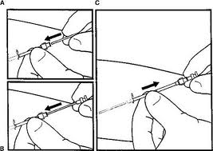
NORPLANT

Slide 67
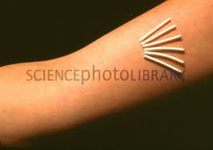
NORPLANT IMPLANTS
The Norplant (a registered levonorgestrel sub dermal implants) implant system is a set of six small plastic capsules. The capsules are placed under the skin of a woman’s upper arm.
Norplant capsules contain a progestin, similar to natural hormone that a woman’s body makes. It is released very slowly from all six capsules. Thus the capsules supply a steady, very low dose. Norplant implants contain no estrogen.

Slide 68
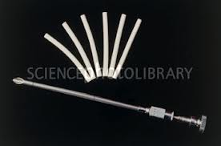
A set of Norplant capsules can prevent pregnancy for at least five years. It may prove to be effective longer.
Norplant capsules thicken cervical mucus making it difficult for sperm to pass through. It stops ovulation (release of eggs from ovaries) in about half of the menstrual cycles after the first year of use

Slide 69
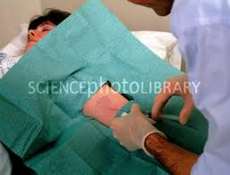
Advantages:
Norplant capsules are very effective even in heavier women.
It provides long term pregnancy protection, but is reversible.
A single decision can give very effective contraception up to five years.
It gives increased sexual enjoyment, as there is no need to worry about pregnancy.
Fertility returns almost immediately after the capsules are removed.
It does not harm the quality and quantity of the breast milk and can be used by nursing mothers starting six weeks after childbirth.
It has no estrogen side effects.

Slide 70
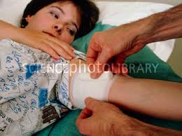
Disadvantages:
Changes in menstrual bleeding is normal, including:-Light spotting or bleeding between monthly periods (common),
Prolonged Amenorrhea.
Headaches
Enlargement of ovaries
Dizziness
Breast tenderness and discharge
Nervousness
Nausea
Acne or skin rash
Change in appetite
Weight gain
Hair loss or more hair growth on the face.
Capsules must be inserted and removed in by a specially trained practitioner.

Slide 71
Discomfort for several hours to one day after insertion
These capsules do not protect against sexually transmitted diseases including HIV/AIDS.
Breast feeding women may start as early as six weeks after birth.

Slide 72

.
NONHORMONAL CONTRACEPTIVE PILL

Slide 73
It is a non steroidoidlnon hormonal birth control pill .
Tab-centchroman30 mg taken twice a week in the first 3 month then after weekly.Frist day of period.1st pill should be taken 1st day of period.
Mechanism of Action: The molecule centchroman offers a unique combination of weak
estrogenic and potent anti estrogenic properties. Due to this subtle mix of estrogenic and
anti estrogenic action it inhibits the fertilized ovum from nidation and thus prevents
pregnancy

Slide 74
ADVANTAGE-
highly effective
Rapid return of fertility on stoppage
No adverse effect

Slide 75
INTRAUTERINE DEVICES
An intrauterine device (IUD) usually is a small, flexible plastic frame. It often has copper wire or copper sleeves on it. It is inserted into a woman’s vagina through her uterus. Almost all brands of IUDs have two strings, or threads, tied to them. The strings hang through the opening of the cervix into the vagina. A provider can remove the IUD by pulling gently on the strings with forceps.

Slide 76
TYPE
The type now most widely used is:
Tcu380A and MLCu-375. COPPER –T 200 multioad copper 250 and multiload copper375-
LIPPE’S LOOP- It is made-up of polyethylene integrated with barium sulfate for radio opacity .it is inserted with push out method of contraception.
Hormone-releasing IUDs –
made of plastic
steadily release small amounts of hormone progesterone or another progestin such as levenorgesterel.
LNG-20 and Progestasert are this type.
IUDs work chiefly by preventing sperm and egg from meeting. Perhaps the IUD makes it hard for sperm to move through the woman’s reproductive tract, and it reduces the ability of sperm to fertilize the egg. It could also prevent the egg from implanting itself in the wall of the uterus.

Slide 77
INSERTION AND REMOVAL-
First 7 day of cycle
after 4 week of child birth .
immediately after abortion .

Slide 78
HORMONE RELEASING IUD –
Levonorgesterl intra uterine system and progestaasert are the 2 hormone relisting IUD.
T SHAPED device which contains 52 mg levonorgestreldisperred in poly –dimethylsiloxane.
ACTION-inhibiting implantation sperm capacities penetration and survival ovulation is partially inhibit cervical mucuse is thikned creating a barrier to sperm penetration .the device release 20 ug /day of levonorgestrelinitially.mannorrhagiais a side effect.

Slide 79
FREMELESS IUD-
It is marketed as flexyguad cu fix . It consist of 6 copper strung on a nylon thread which is knotted at the end .it is pushed thus fixing the needle in the myometrium . The insertion need experienced hand but expulsion rates are very low.

Slide 80
Advantages:
A single decision leads to effective long-term prevention of pregnancy.
Long lasting. The most widely used IUD ,the
Tcu-380A, lasts at least 10 years. Inert IUDs need never be replaced.
They are very effective and very little need be remembered.
No interference with sex.
Increased sexual enjoyment because there is no need to worry about pregnancy.
It can be inserted be inserted immediately after childbirth (except hormone releasing IUDs) or after induced abortion

Slide 81
Disadvantages:
Menstrual changes
Bleeding or spotting between periods
More cramps or pain during periods
Does not protect against sexually transmitted diseases (STDs) including HIV/AIDS. Not a good method for women with recent STDs or with multiple sex partners (or partners with multiple sex partners).
Pelvic inflammatory disease (PID) is more likely to follow STD infection if a woman uses an IUD. PID can lead to infertility.

Slide 82
CONTRAINDICATION-
Uterine anomaly
Active PID
Menorrhagia or dysmenorrheal
Pregnancy

Slide 83
VAGINAL DIAPHRAGM-
It is consist of a circular rubber dome of various diameter supported by circumferential mental spring .it is used with spermicidal jelly or cream. Implementation of diaphragm-
Vaginal examination
Size of diaphragm inserted into the vagina. Check by palpation
The diaphragm can be inserted hours before intercourse but if more than 2 hours elapse additional spermicidal jelly should be placed in the upper vagina .it should be left in place for at least 6 hrs after intercourse to allow for immobilization of sperm
it should not be left in place for longer than 24 hrs.

Slide 84
ADVANTAGES-
Prevent STD
DISADVANTAGE-
It required medical assistance
Displacement
UTI

Slide 85
FEMALE CONDOM-
Made of the polyurethane material with 2 flexible ring at each side .open ring remains outside the vagina and the symphysis like a diaphragm.

Slide 86
ADVANTAGES-
It is control of female partner
It offers protection against STD and HIV.
DISADVANTAGE-
Costly
Displacement

Slide 87
LEA’S SHIELD-
It is reusable washable barrier made of which is placed adjusted the cervix it safety and efficiency are similar to that of other vaginal barrier method acceptability is high.

Slide 88
SPERMICIDAL PREPRATION-
Nonoxynal-9 or octoxnal with a base of cream, jelly aerosol, foam tablate,film ,suppository

Slide 89
CERVICAL CAP-
The prevent if cervical cap is a flexible cap like device made of natural rubber that is fitted around the base of the cervix .it is made up of silicone rubber.

Slide 90
THE SPONG TODAY-
It is polyurethane dome shaped device containing nonoxynol-9 it is moisten with water and then inserted high in vagina to cover the cervix.

Slide 91

TUBECTOMY

Slide 92
Female Sterilization-
Female sterilization provides permanent contraception for women who do not want more children. It is a safe and simple surgical procedure and can usually be done with local anesthesia and light sedation.
A small incision is made by the doctor in the woman’s abdomen and the two fallopian tubes are blocked off or cut. These tubes carry eggs from the ovaries to the uterus. With the tubes blocked, the woman’s egg cannot meet the man’s sperm.

Slide 93
Advantages:
Very effective.
It is permanent. A single procedure leads to lifelong, safe and very effective family planning.
Nothing to remember, no supplies needed and no repeated clinic visits required.
No interference with sex. Does not affect a woman’s ability to have sex.
No known long-term side effects or health risks.

Slide 94
Disadvantages:
It is usually painful for several days after the operation.
Infection or bleeding at the incision
Internal infection or bleeding
Injury to internal organs
risks of allergic reaction surgery is difficult, expensive and not available in most areas.
Women who may want to become pregnant in the future should choose a different method.

Slide 95
The right time to undergo Female Sterilization
A woman can have female sterilization procedure anytime that:
She decides that she will never want children in future.
It is reasonably certain that she is not pregnant.
These times can include:
Immediately after childbirth or within 7days, if she has made a voluntary informed choice in advance;
Six weeks or more after childbirth
Immediately after abortion (within 48 hours)

Slide 96
THANKYOU

