Slide 1

ADVANCED NEONATAL PROCEDURE
Prepared by :
Vruti patel
Assistant Professor
SNC

Slide 2
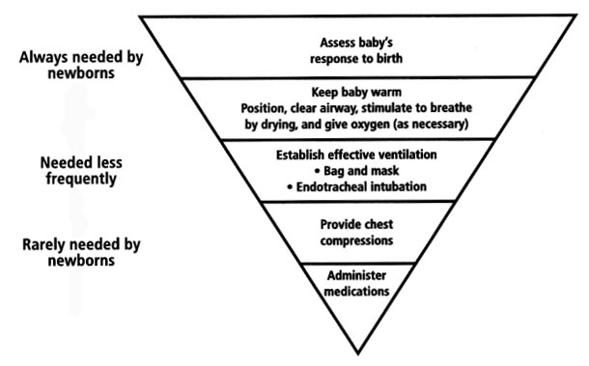
RESUSCITATION OF THE NEWLY BORN
5 to 10% of newly born infants have difficulty during the transition phase and may require some form of assistance at birth
Ideally, at least one person trained in newborn resuscitation should attend every delivery

Slide 3
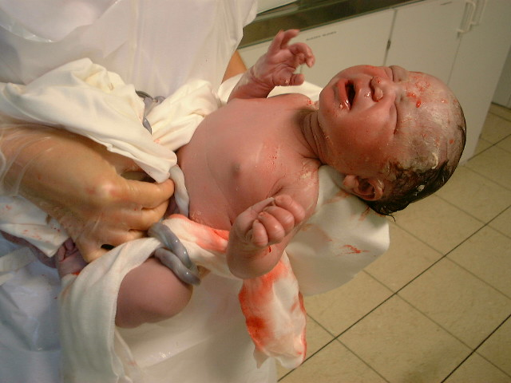
Visual inspection of the newly born
Clear of meconium
Spontaneously breathing or crying
Good muscle tone
Skin colour pink
Term gestation

Slide 4
Assess breathing:
Assessment | Decision
Baby is crying | No need for resuscitation or suctioning; Start skin-to-skin contact and breastfeeding
Baby is not crying, but breathing at 30 to 60 times per minute | No need for resuscitation or suctioning
Baby is gasping | Start resuscitation immediately
Baby is not breathing | Start resuscitation immediately

Slide 5
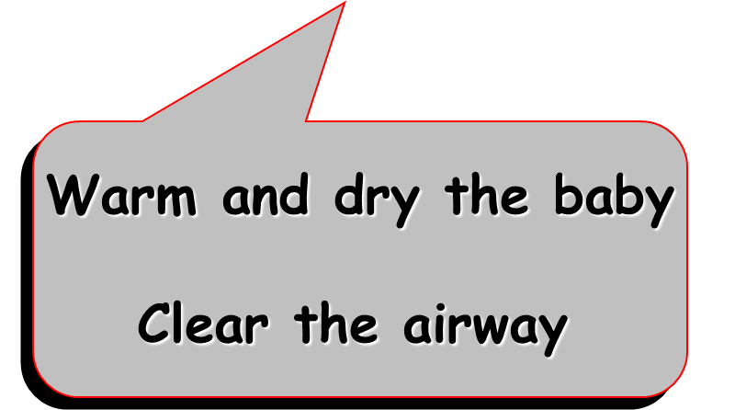
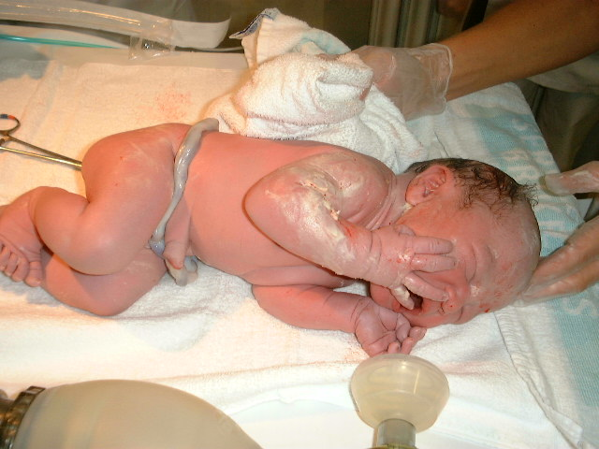
Evaluation of the newly born
Most term newborns do not require any resuscitative intervention at birth
Few essential steps are generally followed in every setting:

Slide 6
Prematurity
Increased likelihood of need for resuscitation
Asphyxia is much more frequent than the term neonate
Major risk of heat loss, respiratory distress and intraventricular haemorrhage
Minimising heat loss in preterm infants improves survival

Slide 7
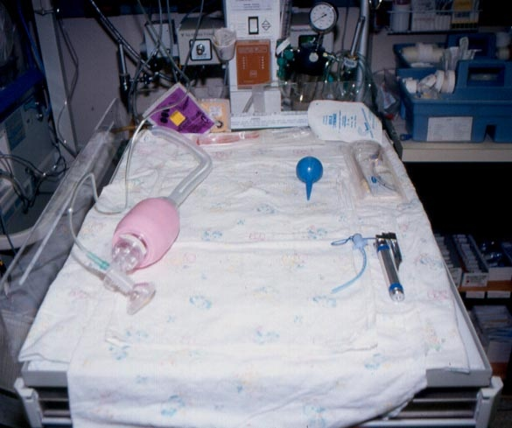
Steps of resuscitation
If the baby is not breathing or gasping
  Call for help!
  Cut cord quickly, transfer to a firm, warm surface [under a radiant heater]
  Inform the mother that baby has difficulty breathing and you will help the baby to breathe
  Start newborn resuscitation
7

Slide 8
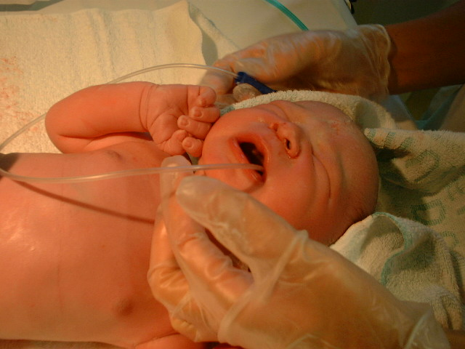
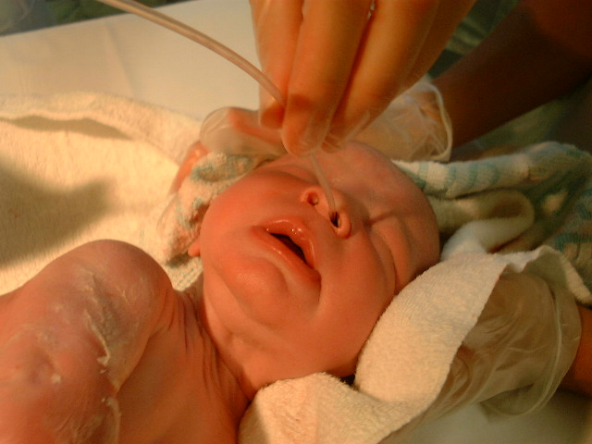
A- AIRWAY
Clearing the airway
Positioning of the infant and removal of secretions as needed
Secretions should be cleared first from the mouth and then from the nose
Neutral or slightly extended position by placing a towel under the infant's shoulders

Slide 9
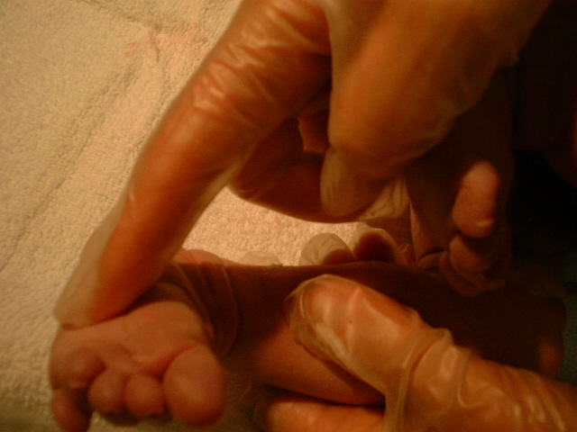
B - BREATHING & STIMULATION
Routine drying and suctioning
Alternative methods:
  rubbing the back
  flicking the soles of the feet
If no response to tactile stimulation occurs within few seconds:
Bag and mask ventilation
with 100% oxygen

Slide 10
Meconium
Efforts to remove meconium from the oropharynx and trachea must precede any other intervention when assisting a depressed newly born
  absent or inadequate respiration
  heart rate < 100 bpm
  poor muscle tone

Slide 11
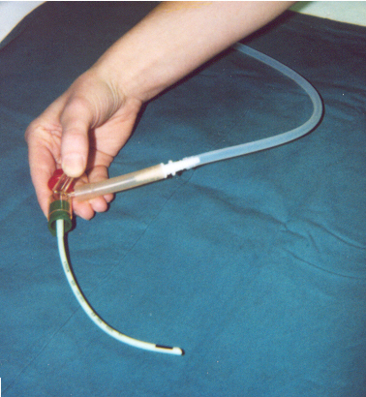
Meconium
Suctioning of the hypopharynx under direct vision
Repeated tracheal intubation and direct suction via the endotracheal tube

Slide 12
Meconium
Key point
The infant's level of activity, rather than the consistency of meconium, indicates the need for direct tracheal suctioning

Slide 13
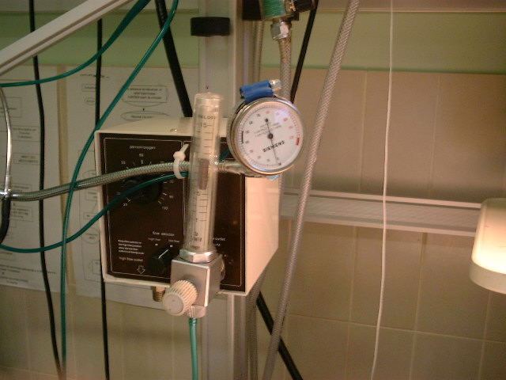
B - BREATHING
Oxygen
The optimal concentration of oxygen for neonatal resuscitation is still uncertain
Increasing data on the use of room air during positive pressure ventilation as an alternative to 100% O₂
Further work is needed before making new recommendations

Slide 14
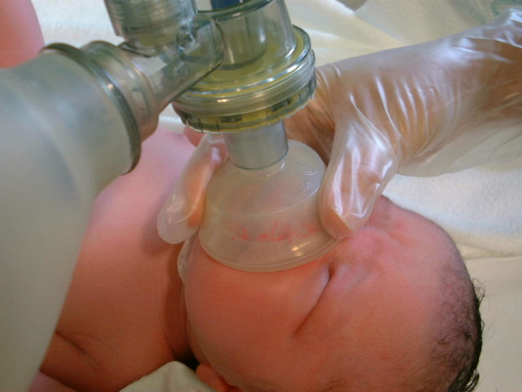
B - BREATHING
Positive Pressure Ventilation
Adequate expansion of the lung is often the only and most important measure needed for successful resuscitation
Indications for positive pressure ventilation:
  Apnoea or gasping breath
  Heart rate <100 bpm
  Persistent central cyanosis

Slide 15
B - BREATHING
Artificial Ventilation
Most newborns who require positive-pressure ventilation can be adequately ventilated with a bag and mask
BMV should be mastered by all healthcare providers who may be asked to deal with an emergency delivery

Slide 16
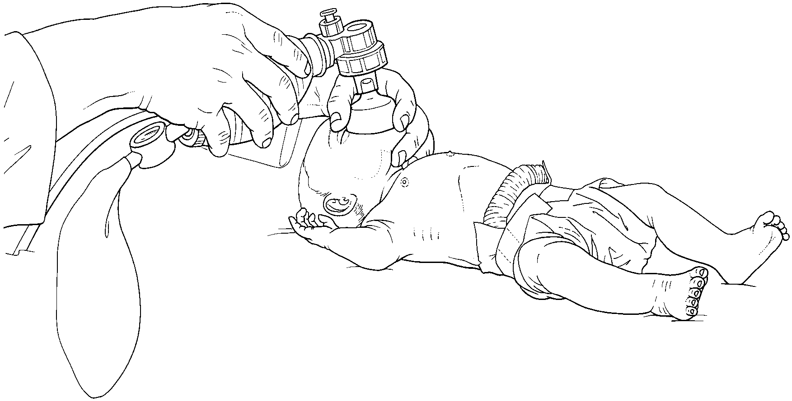
Bag and Mask Ventilation
Face masks of various size, with cushioned rims and low dead space

Slide 17
Bag and Mask Ventilation
If the heart rate is less than 60 bpm, chest compressions must be started while continuing assisted ventilation
Progress to endotracheal intubation should be considered

Slide 18
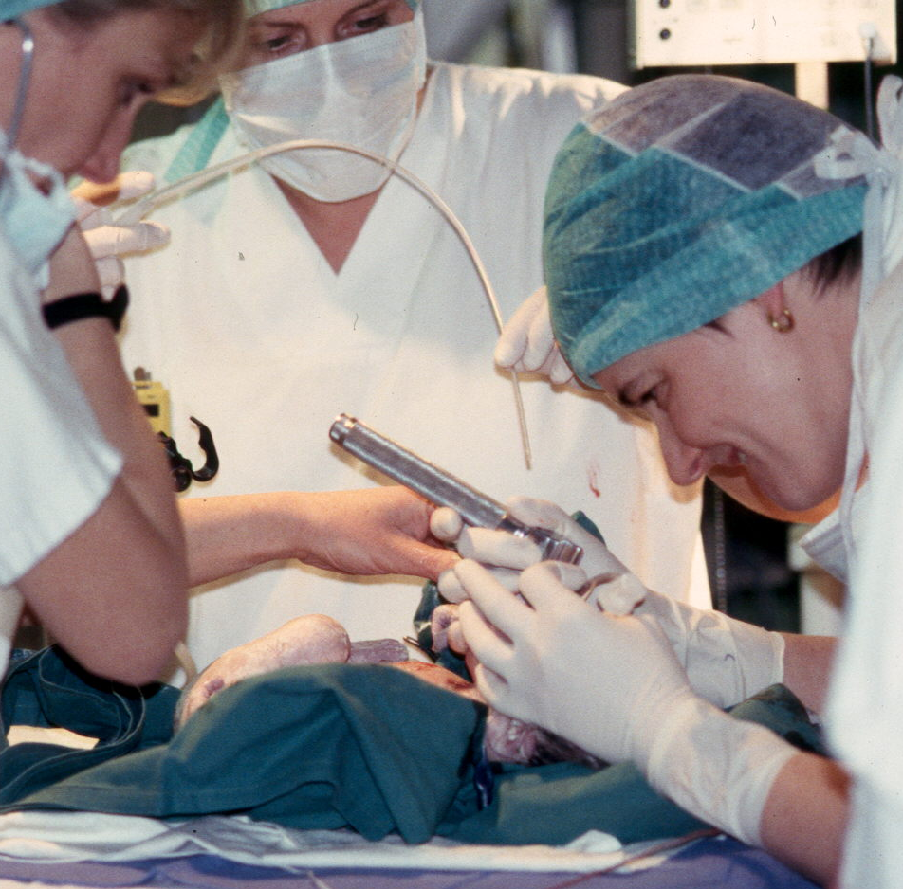
Endotracheal intubation
Indications for endotracheal intubation may occur at several points during neonatal resuscitation:
    Tracheal suctioning for meconium (depressed baby)
    BMV ineffective or prolonged
    Chest compressions needed
    Tracheal administration of medications
    Congenital diaphragmatic hernia
    Extreme prematurity
    Transport

Slide 19
Endotracheal intubation
A straight blade should be used (size 0 for premature infants, size 1 for term infants)
An estimate for the correct oral insertion distance of the ET tube use the following formula:
Weight in kilograms + 6 cm
=
insertion depth at lip in cm

Slide 20
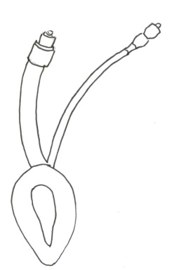
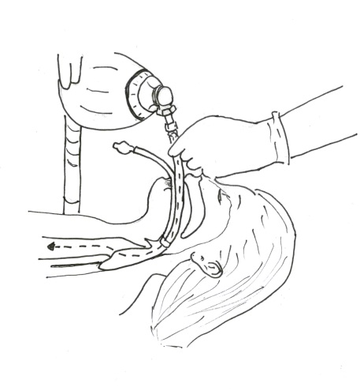
LARYNGEAL MASK AIRWAY
    Successfully used in the resuscitation of term and near term infants at birth
    Little experience in small preterm infants and in newborns with meconium
    May be an alternative in the case of ineffective BMV or failed endotracheal intubation

Slide 21
C - CIRCULATION
Chest compressions
0.03 to 0.12% of newly borns require chest compressions
Bradycardia and asystole are virtually always a result of respiratory failure, hypoxaemia and tissue acidosis
Adequate ventilation and oxygenation will be sufficient to restore vital signs in the vast majority of infants

Slide 22
Chest compressions
If the heart rate is less than 60 bpm despite 30 seconds of effective positive pressure ventilation with 100% oxygen:
  Start chest compressions

Slide 23
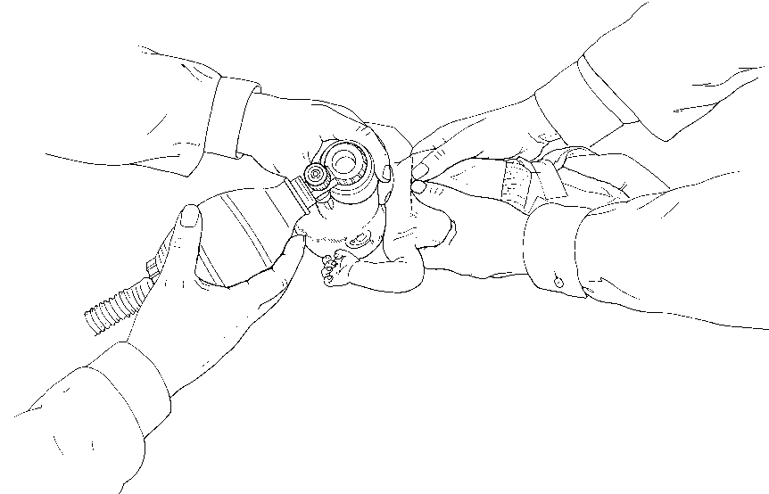
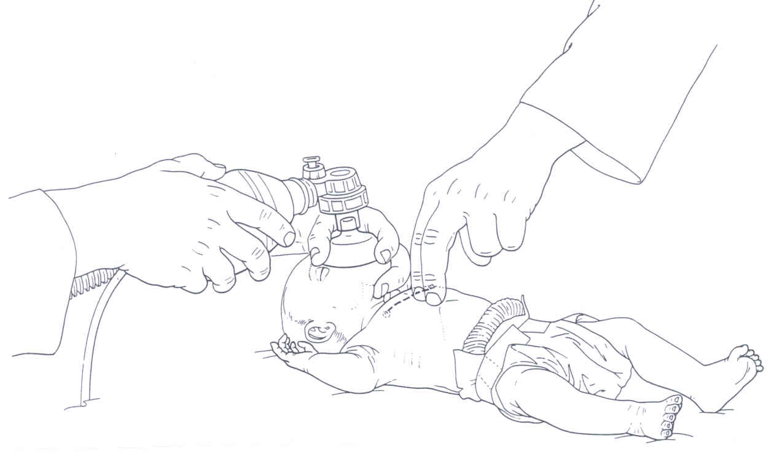
Chest compressions
Chest compressions performed in conjunction with ventilation with 100% oxygen
(3 to 1 ratio  90 compressions and 30 breaths per minute)

Slide 24
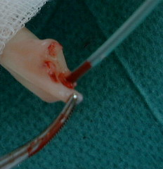
Routes of drugs administration
Umbilical vein still widely recommended in the delivery room
Umbilical catheterisation may be a challenge for physicians not skilled in neonatal resuscitation
Tracheal route is a rapid accessible route for drug administration during resuscitation

Slide 25
Emergency drugs and fluids
If heart rate is less than 60 bpm after 30 seconds of adequate ventilation and chest compressions, or in the presence of asystole
  Adrenaline

Slide 26
Emergency drugs and fluids
Adrenaline
Dose (I.V., ET or I.O.):
  0.1 to 0.3 mL/kg of a 1:10.000 solution
  (0.01 to 0.03 mg/kg)
  repeat every 3 to 5 minutes as indicated

Slide 27
Emergency drugs and fluids
Volume expanders
Cristalloids (normal saline or Ringer's lactate) are the fluids of choice for volume expansion
If blood loss is likely, O-negative red blood cells
10 ml/kg i.v. over 5 to 10 minutes

Slide 28
Initial assessment of the newly born
Clear of meconium
Breathing or crying
Good muscle tone
Pink
Term
Warm and dry
Clear the airway
YES

Slide 29
Initial assessment of the newly born
Clear of meconium
Breathing or crying
Good muscle tone
Pink
Term
Warm and dry
Position
Clear the airway (*)
Stimulate
Give oxygen (if needed)
NO
(*) consider endotracheal intubation

Slide 30
Continue evaluation
Respiratory activity
Heart rate
Colour
Breathing
Heart rate > 100
Pink
Apnoea or gasping
Heart rate < 100
Standard care
Positive pressure ventilation (*)
Oxygen

Slide 31
Positive pressure ventilation
and oxygen
Ventilating
Heart rate > 100
Pink
Ongoing support
Heart rate < 60
Positive pressure ventilation (*)
Chest compressions

Slide 32
Positive pressure ventilation and chest compressions
Heart rate > 60
Positive pressure ventilation(*)
Oxygen
Heart rate < 60
Adrenaline (*)
(via intravenous, endotracheal, intraosseus)

Slide 33
Transport of the newly born
Infants transferred under controlled conditions with skilled assistance do arrive at destination in better clinical conditions:
  warmer
  less hypotensive
  less acidotic
With such assistance mortality, morbidity and duration of intensive care stay are reduced

Slide 34
ETHICS
Indication for initiation or suspension of resuscitation are debatable in
  extremely premature infants
  severe congenital abnormalities
  infants who do not respond to prolonged resuscitative efforts
In many countries, non-initiation of resuscitation in the delivery room is appropriate
  infants with confirmed G.A. <23 weeks or B.W. <400 g
  anencephaly
  confirmed trisomy 13 or 18

Slide 35
Ethics
Discontinuation may be appropriate if resuscitation of an infant does not result in spontaneous circulation within 15 minutes

Slide 36
Post resuscitation management
Principles
Keeping normal temperature
Maintaining oxygenation
Maintaining physiological milieu- fluids , glucose
Maintaining perfusion
Treating seizures
Monitoring organ function
36
Notes:
36

Slide 37
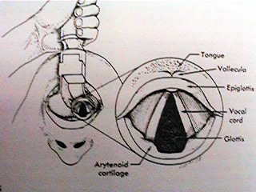
ENDOTRACHEAL INTUBATION

Slide 38
Indications for intubation
Meconium suctioning in non vigorous baby
Diaphragmatic hernia
Prolonged PPV
Ineffective B & MV
Elective
  < 1Kg
  with CC
  for medication

Slide 39
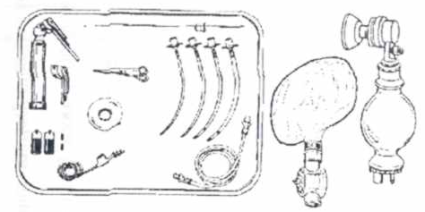
Intubation equipment

Slide 40
Preparing laryngoscope
No. 1 for full term
No. 0 for preterm / LBW
No. 00 for extremely preterm (optional)

Slide 41
Selecting endotracheal tube
Tube Size | Weight | Gest. Age
2.5 (ID mm) | <1000 gm | < 28 wks
3.0 (ID mm) | 1000-2000 gm | 28-34 wks
3.5 (ID mm) | 2000-3000 gm | 35-38 wks
4.0 (ID mm) | >3000 gm | > 38 wks
ID=Internal Diameter

Slide 42
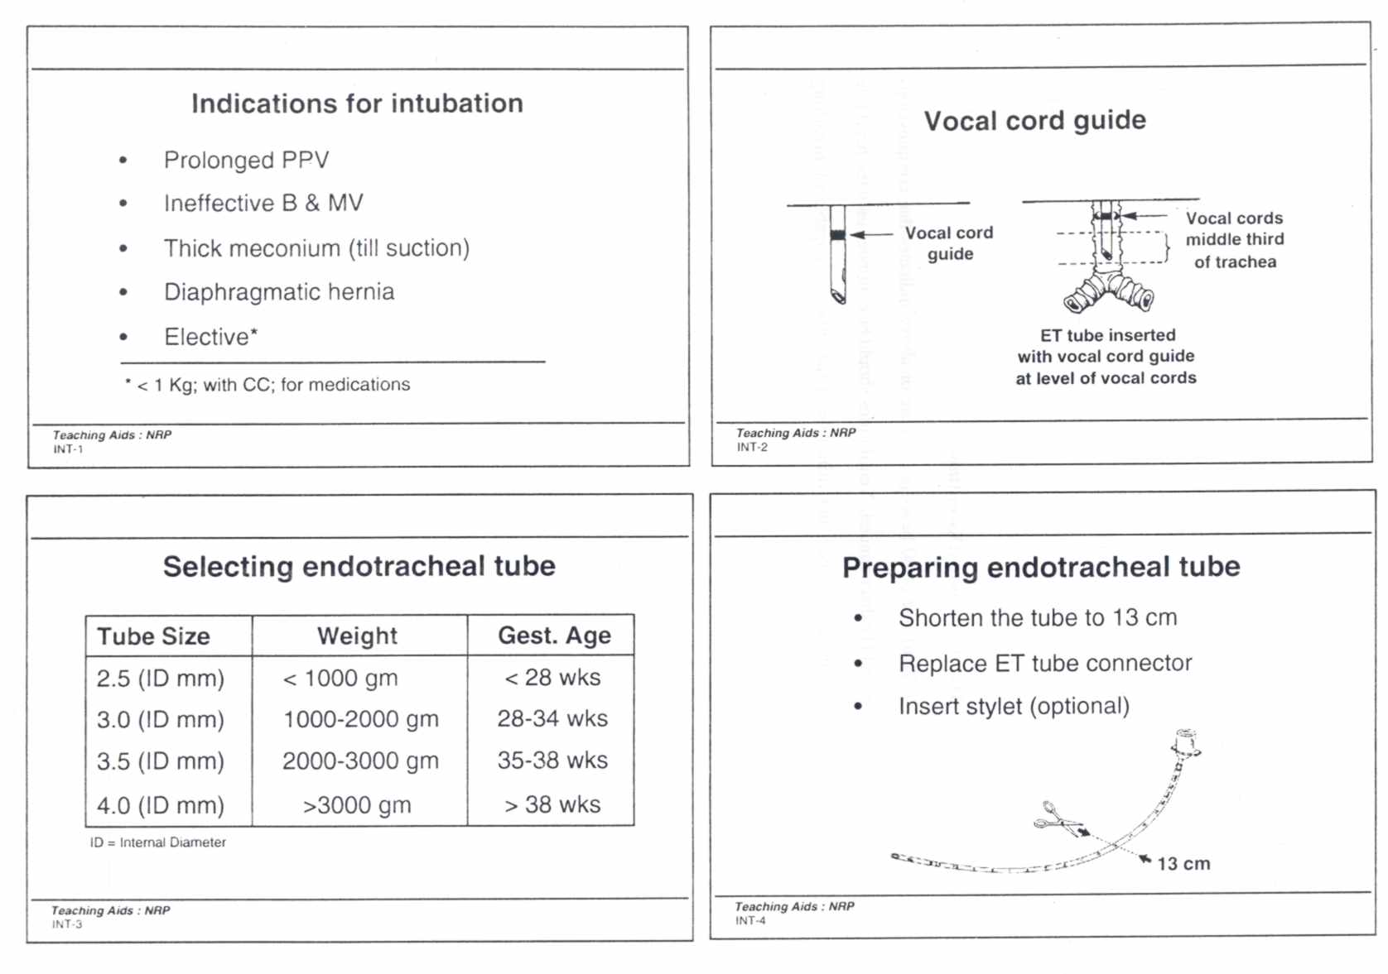
Preparing endotracheal tube
Shorten the tube to 13 cm
Replace ET tube connector
Insert stylet (optional)

Slide 43
Additional items
Tape
For securing the tube
Suction equipment
DeLee mucus trap or mechanical suction
Oxygen
For free flow oxygen during intubation
For Use with the resuscitation bag
Resuscitation Bag and Mask
To ventilate the infant in between intubation
To check tube placement

Slide 44
Positioning the infant
On a flat surface, head in midline and neck slightly extended
Optimal viewing of glottis

Slide 45
Visualizing the Glottis with Laryngoscope
Preparing for insertion
Stand at the head end of the infant
Hold the laryngoscope in your left hand
Stabilize the infant’s head with right hand
Introducing Blade
Slide it over the tongue with the tip of the blade resting on the vallecula
Visualizing Glottis : Lift Blade
Lift it slightly, thus lifting the tongue out of the way to expose the pharyngeal area

Slide 46
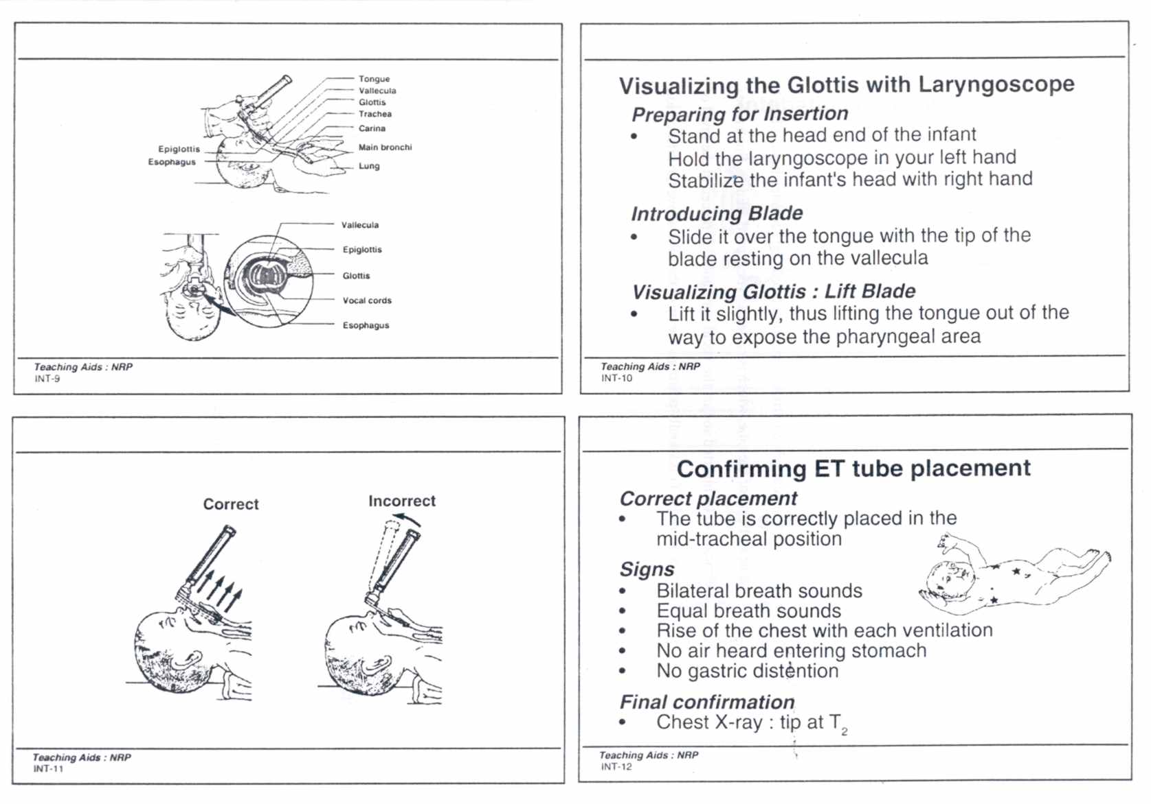

Slide 48
Vocal cord guide

Slide 49
Tip to lip distance (6+wt. in kg)
Weight | Distance
1 kg | 7 cm
2 kg | 8 cm
3 kg | 9 cm

Slide 50
Confirming ET tube placement
Correct placement
ETCO₂ - the recommended method
Signs
Bilateral breath sounds
Equal breath sounds
Rise of the chest with each ventilation
No air heard entering stomach
No gastric distention
Confirmation of tip position in trachea
Chest X-ray: tip at T₂

Slide 51
Tube in Rt. Main bronchus
Breath sounds only on right chest
No air heard entering stomach
No gastric distention
Action: Withdraw the tube, recheck

Slide 52
Tube in esophagus
No breath sounds heard
Air heard entering stomach
Gastric distention may be seen
No mist in tube
No CO₂ in exhaled air
Action : Remove the tube, oxygen the infant with a bag and mask, reintroduce ET tube

Slide 53
Three actions after intubation
1. Note the cm. Mark on the tube at level of the upper lip
2. Secure the tube to the infant’s face
3. Shorten tube 4 cm. from the lip margin

Slide 54
Complications of intubation
Hypoxia
Bradycardia
Apnea
Pneumothorax
Soft tissue injury
Infection

Slide 55
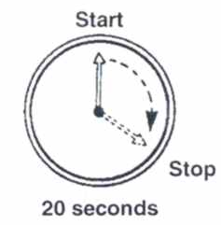
Minimizing hypoxia during intubation
Providing free-flow oxygen (Assistant’s responsibility)
Limiting each intubation attempt to 20 seconds

Slide 56
LMA(Lyrangeal Mask Airway) – its role in neonatal resuscitation
Effective for ventilation during resuscitation in term and near term newborns
Used by trained care providers
NOT TO BE USED IN:
  In the setting of meconium stained amniotic fluid
  When chest compression is required
  In VLBW babies
  For delivery of medications

Slide 57
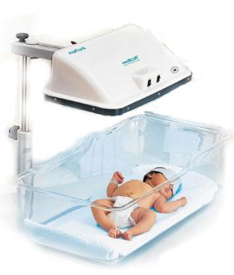
PHOTOTHERAPY
Notes:
Mechanism of phototherapy : light prompt bilirubin excretion

Slide 58
What is phototherapy?
Phototherapy (light therapy) is a way of treating jaundice. Special lights help break down the bilirubin in your baby's skin so that it can be removed from his or her body. This lowers the bilirubin level in baby's blood.
Application of fluorescent light to the infant’s exposed skin used to breakdown the bilirubin in the skin.

Slide 59
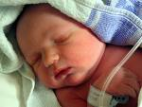
INDICATION OF PHOTOTHERAPY
Treatment of Hyperbilirubinemia
The phototherapy will help the liver to process bilirubin, bringing your baby's level down to normal
Prevent Kernicturus

Slide 60
CAUSES OF JAUNDICE
Breast-feeding jaundice:
baby does not drink enough breast milk.
It occurs in 5% to 10% of newborns. The jaundice symptoms are similar to those of physiological jaundice, just more pronounced.
The jaundice indicates a need for help with breast-feeding.

Slide 61
CONTI..
Physiological jaundice
most common cause of newborn jaundice
occurs in more than 50% of babies. Because the baby has an immature liver, bilirubin is processed slower.
The jaundice first appears at 2 to 3 days of age.
It usually disappears by 1 to 2 weeks of age, and the levels of bilirubin are harmless.

Slide 62
Breast-milk jaundice
Breast-milk jaundice occurs in 1% to 2% of breast-fed babies. I
caused by a special substance that some mothers produce in their milk.
This substance causes your baby's intestine to absorb more bilirubin back into his body than normal.
This type of jaundice starts at 4 to 7 days of age. It may last 3 to 10 weeks. It is not harmful.

Slide 63
Blood group incompatibility (Rh or ABO problems
If a baby and mother have different blood types, sometimes the mother produces antibodies that destroy the newborn's red blood cells.
Rh problems formerly caused the most severe form of jaundice.
However, they are now preventable if the mother is given an injection of Rho GAM within 72 hours after delivery. This prevents her from forming antibodies that might endanger other babies she has in the future

Slide 64
MECHANISM OF ACTION
Bilirubin is a naturally occurring molecule of the red blood cells. It is released into the bloodstream when the red blood cells break down. This is normal and occurs often. Our livers break down the bilirubin and it is excreted.

Slide 65
MECHANISM OF ACTION-CONTINUE
Phototherapy (light treatment) is the process of using light to eliminate bilirubin in the blood.
baby's skin and blood absorb these light waves. These light waves are absorbed by your baby's skin and blood and change bilirubin into products, which can pass through their system.
wavelength of 420-448 nm, oxidized the bilirubin to biliverdin, a soluble product that does not contribute to kernicterus

Slide 66
Mechanism of action
The phototherapy will help the liver to process bilirubin, bringing baby's level down to normal
The light waves convert the bilirubin to water soluble nontoxic forms which are then easily excreted.
The advantages of phototherapy are that it is noninvasive, effective, inexpensive and easy to use.

Slide 67
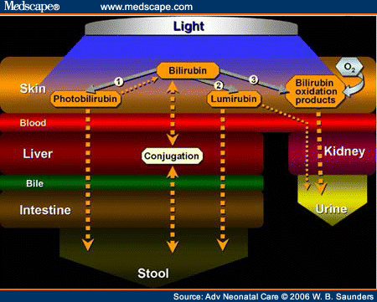
MECHANISM OF WORKING

Slide 68
What are the benefits of phototherapy?
• The jaundice can be treated
preventing the need for more invasive treatment
the serious complications, which can occur if excessive levels of bilirubin develop
Phototherapy is a safe.
Effective method of treatment.
provides the highest level of therapeutic light available to treat baby. This is the same form of light found in sunlight This is safer than sunlight though, because it filters out the harmful ultraviolet and infrared energy.

Slide 69
FACTORS AFFECTING EFFICACY OF PHOTOTHERY
1- Type of light used
2- Light intensity
3- Surface area of skin exposed to light
4- The distance of the light source from the baby, the optimum distance being 35 - 50 cm in conventional lights.

Slide 70
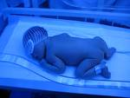
ASSESSMENT SHOULD BE BEFORE PHOTOTHERAPY
GA Of the baby
Weight The baby
Postnatal Age
Types of Jaundice
the level of jaundice

Slide 71
NURSING CARE FOR INFANT
RECEIVING PHOTOTHERAPY

Slide 72

Baby will need to be in an incubator whilst under photo therapy to keep warm,
• The photo therapy unit will be placed over the top of the incubator occasionally more than one unit may be used. This can be switched off when your baby needs to come out to be fed

Slide 73
Proper covering and shielding of gonad
Assess skin exposure
Proper position

Slide 74
Assess and adjust thermoregulation device .
Promoting elimination and skin integrity .
Hydration.

Slide 75

-Assure effective of phototherapy
-provide eye protection Eyes are covered with eye-patches to prevent damage to the retina by the .

Slide 76
Baby is placed naked 45 cm away from the tube lights in a crib or incubator.
If using closer, monitor temperature of the baby.
Baby is turned every two hours or after each feed.
During phototherapy, the bilirubin level in your baby’s blood will be checked at least once every day. Phototherapy is stopped when the bilirubin level decreases.

Slide 77
Temperature is monitored every two to four hours.
Weight is taken at least once a day.
More frequent breastfeeding or 10-20% extra fluid is provided.
Urine frequency is monitored daily.
Serum bilirubin is monitored at least every 12 hours.
Phototherapy is discontinued if two serum bilirubin values are < 10 mg/dl.

Slide 78
Baby should spend as much time as possible under the phototherapy lights for it to be most effective, baby can come out for feeding or cuddles if he or she is upset.
Baby will need to have regular (usually daily) blood tests whilst under photo therapy to assess the levels of bilirubin and ensure the phototherapy is effective.

Slide 79

Promoting infant parent interaction.

Slide 80

SIDE EFFECT OF PHOTOTHERAPY
Bronze – baby syndrome.
Loss , greenish stool .
Transient skin rashes.
Hyperthermia .
Increasing metabolic rate.
Dehydration .
Electrolyte disturbance .

Slide 81
Thank You For your Attention

