Slide 1
Chronic Obstructive Pulmonary Disease
(COPD)
By, Dr. Kalpesh Satani

Slide 2
Difference between Obstructive and restrictive pulmonary disease
OBSTRUCTIVE PULMONARY DISEASE | RESTRICTIVE PULMONARY DISEASE
It is a pulmonary condition, in which obstruction of the airflow in the conducting airways of the lower respiratory tract and alters ventilation and gas exchange. | It is characterized by the inability of the lungs to expand fully as a result of extra-pulmonary and/or pulmonary disease or restriction.
e.g. Chronic bronchitis, Emphysema, Bronchiectasis, Asthma | e.g. Pneumonia, Tuberculosis, Rib fracture

Slide 3
DEFINITION
COPD is defined as a disease state characterized by airflow limitation that is not fully reversible.
COPD mainly includes two diseases:
  Chronic bronchitis
  Emphysema

Slide 4
CHRONIC BRONCHITIS
It is defined as the presence of chronic productive cough on most days for 3 months, in each of two consecutive years, in a patient in whom other causes of chronic cough have been excluded.
  Simple bronchitis : Hyper-secretion of mucus
  Chronic or recurrent muco-purulent bronchitis : Persistent or intermittent muco-purulent sputum
  Chronic obstructive bronchitis: chronic sputum production, associated with airflow obstruction.

Slide 5
EMPHYSEMA
It is defined as an abnormal permanent enlargement of the airspaces, distal to the terminal bronchioles, accompanied by destruction of their walls and without obvious fibrosis.
Three types
  Centrilobular emphysema - Enlarged airspaces are initially clustered around the terminal bronchiole.
  Panacinar (panlobular) emphysema - Enlarged airspaces are distributed throughout the acinar unit.
  Periacinar (paraseptal or distal acinar) emphysema enlarged airspaces are along the edge of acinar unit.

Slide 6
RISK FACTORS / ETIOLOGICAL FACTORS
Cigarette smoking: single most important identifiable aetiological factor in COPD.
Passive or second-hand smoking
Air pollution
Occupational dusts and chemicals: coal mining, cotton textile dust etc.
α₁ Antitrypsin deficiency or α₁ protease inhibitor (congenital emphysema)
Chronic broncho-pulmonary infection

Slide 7
PATHOLOGY OF COPD
Hallmark is hypertrophy of, and an increase in number of mucous glands in the larger bronchi and evidence of inflammatory changes in the small airways.

Slide 8
CLINICAL FEATURES
History ???

Slide 9
PHYSICAL EXAMINATION
Most common features are Cough with expectoration and exertional dyspnea (difficulty in breathing during activity).
Current smokers may have signs of active smoking, including an odor of smoke or nicotine staining of fingernails.
In pts. with more severe disease, the physical examination is notable for a prolonged expiratory phase. (pursed lip breathing which may serve to slow expiratory flow and permit more efficient lung emptying).

Slide 10
In addition, signs of hyperinflation include a barrel chest and enlarged lung volumes with poor diaphragmatic excursion.
Resting respiratory rate is often increased to more than 20 breaths per minutes and shallow breathing.
Patients with severe airflow obstruction may also exhibit use of accessory muscles of respiration, [sternocleidomastoid, scalene, and intercostal muscles].
Patients may develop cyanosis (due to hypoxia), visible in nail beds.

Slide 11
BLUE BLOATERS | PINK PUFFER
Heavy and cynotic | Thin and non-cynotic
Common in Chronic bronchitis | Common in emphysema
Advanced disease may be accompanied by systemic wasting, with significant weight loss, and diffuse loss of subcutaneous adipose tissue.
Some patients with advanced disease have paradoxical inward movement of the rib cage with inspiration (‘Hoover’s sign’).

Slide 12
AUSCULTATION
  Patients with COPD often have reduced breath sound.
  Presence of wheezing during quiet breathing is pointer to of airflow limitation.
  Inspiratory crackles occur in some patient indicates presence of secretions.

Slide 13
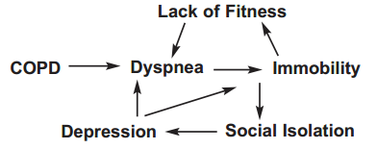
Physical, psychological and social consequences of COPD

Slide 14
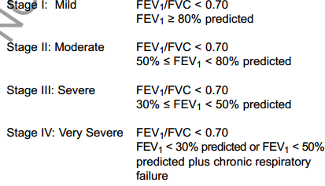
LABORATORY FINDINGS
The hallmark of COPD is airflow obstruction.
Pulmonary function testing shows airflow obstruction with a reduction in FEV₁and FEV₁/FVC.
Spirometric classification of COPD

Slide 15
ABG analysis shows,
Ventilation/perfusion mismatch is expected in COPD and leads to a low arterial oxygen pressure (PaO₂) with or without retention of carbon dioxide (CO₂). As the disease becomes severe, the arterial carbon dioxide pressure (PaCO₂) may rise.
X-RAYS
No characteristic abnormality is seen in the early stages of the disease.
If there is significant obstruction there may be signs of hyperinflation of chest, flattening of diaphragm.

Slide 16
MRC grading for dyspnea
Grade | Description
0 | None. Not troubled with breathlessness except with strenuous exercise.
1 | Slight. Troubled by shortness of breath when hurrying on the level or walking up a slight hill.
2 | Moderate. Walks slower than people of the same age on the level because of breathlessness or has to stop for breath when walking at own pace on the level.
3 | Severe. Stops for breath after walking about a 100 yards or after a few minutes on the level.
4 | Very severe. Too breathless to leave the house or breathless when dressing or undressing.

Slide 17
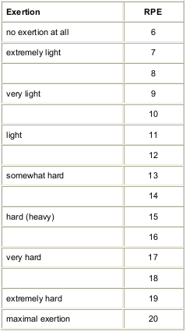
BORG’S Scale

Slide 18
MANAGEMENT
Effective management should be aimed at following goals:
  Relieve symptoms
  Improve exercise tolerance
  Improve health status
  Prevent and treat exacerbations and complications
  Prevent disease progression
  Reduce mortality

Slide 19
PHARMACOLOGICAL THERAPY (In brief)
  To reduce bronchospasm
Commonly used drugs are bronchodilators (e.g. salbutamol), anticholinergic (e.g.ipratropiumbrmide) and corticosteroids.
  To control or decrease amount of sputum
Mucoactive agents (Drugs that promote the mobilisation and removal of secretions from respiratory tract are called mucoactive drugs.)
  To control infection
Drugs like antibiotics

Slide 20
Physiotherapy management or
Pulmonary rehabilitation for COPD
Goals
To facilitate the removal of secretions
To control dyspnea, to improve the pattern of breathing, breathing control
To improve exercise tolerance, and ensure a long-term commitment to exercise.
To teach local relaxation, improve posture and help allay fear and anxiety
To increase knowledge of the patient's lung condition and control of the symptoms.
To give advice about self management in activities of daily living.

Slide 21
To facilitate removal of secretions
  Postural drainage
  Percussion
  Vibration
  Active Cycle of Breathing Technique (ACBT)
  3 phases
  Breathing control
  Thoracic expansion exercise
  Force expiratory technique

Slide 22
An evidence of airway clearance techniques in patient with COPD who has excessive cough with expectoration

Slide 23
Airway clearance techniques for COPD.
Cochrane Database of Systematic Reviews 2012, Issue 3
Osadnik C R, McDonald C F, Jones AP, Holland AE
P | A COPD patients who has complain of cough with expectoration.
I | Airway clearance techniques like postural drainage, percussion, vibrations, lung expansion therapy, assisted coughing technique
C | No treatment, cough or sham technique
O | Rate or time of acute exacerbation of COPD, sputum clearance and expectoration, Health related Quality of life, PFT, Exercise tolerance, Antibiotics used, Mortality etc.

Slide 24
Airway clearance techniques for COPD
Cochrane Database of Systematic Reviews 2012, Issue 3
Osadnik C R, McDonald C F, Jones AP, Holland AE
High level evidence (Systemic review) | Aim of the review was to assess the safety and efficacy of airway clearance techniques for individuals with Acute Exacerbation COPD and stable COPD. | 28 articles including randomized controlled trial and randomized cross over trials for airway clearance techniques in COPD included in study | Evidence from this review indicates that airway clearance techniques like postural drainage, percussion, vibrations, lung expansion therapy, assisted coughing are safe for individuals with COPD and confer small beniﬁcial effects on some clinical outcomes.

Slide 25
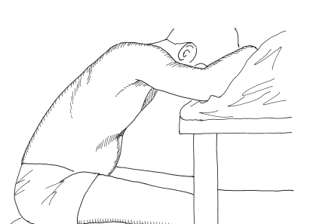
To control dyspnea
Pursed lip breathing (pursing the lips together during controlled exhalation)
Pacing Activities
Relaxed positioning

Slide 26
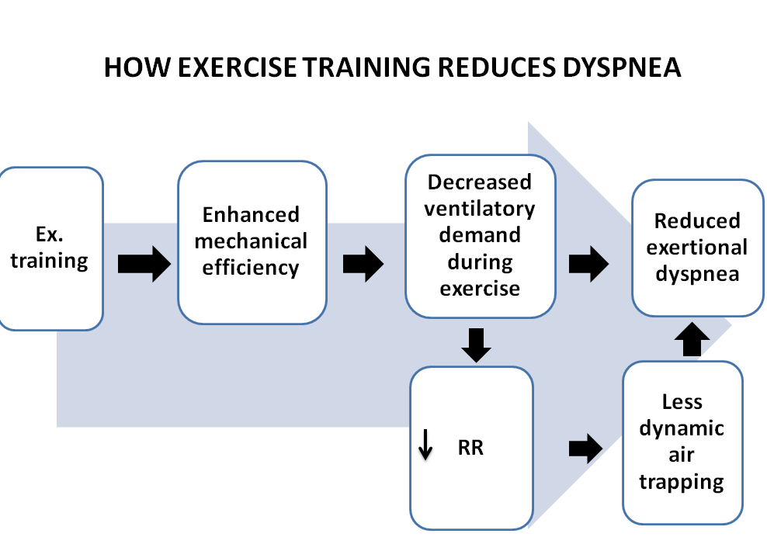
To improve exercise tolerance

Slide 27
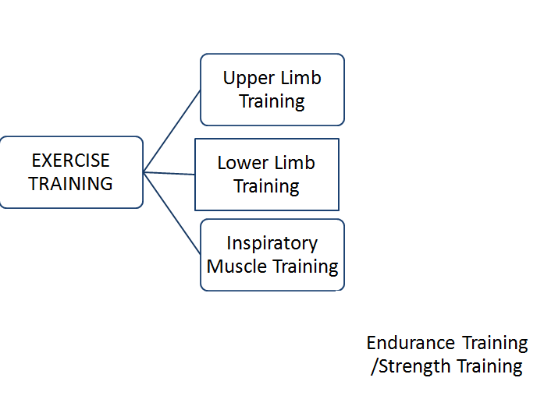

Slide 28
Exercise can be prescribed as a FITT principle
For e.g.
Frequency | 3 to 5 days per week
Intensity | According to patient tolerance (Decide by exercise testing prior to exercise training)
Time | 30-40 minutes per session
Type | Aerobic (endurance training) or Resistance (strength training). Continuous training or interval training.

Slide 29
An evidence for exercise training in COPD patients

Slide 30
A clinical practice guideline for physiotherapists treating patients with chronic obstructive pulmonary disease based on a systematic review of available evidence
Clinical Rehabilitation 2009; 23: 445–462
High level evidence (Systemic review) | Aim of the review was to Update of a clinical practice guideline for the physiotherapy management of patients with COPD | A total of 103 studies were included in the systematic review, consisting of five meta-analyses of randomized controlled trials, 84 randomized controlled trials and 14 uncontrolled studies. | Evidence from this review indicates Strong recommendations support the use of physical exercise training to improve health-related quality of life and functional exercise capacity. | Recommendation for training in COPD is Supervised endurance training either on a treadmill or on a cycle ergometer thrice a week at initial phase, interval training for sever COPD patients, lower limb resistance training for all patients 2 or 3 times a week at 60–80% of the 1RM using 8–15 repetitions, arm exercises as an adjunct to standard physical exercise training in selected patients with arm muscle weakness, inspiratory muscle training to improve inspiratory muscle strength at 30% of Pi max

Slide 31
Nutritional Support
Depending on the underlying cause of nutritional imbalance (decreased dietary intake or increased nutritional requirements), initial nutritional therapy may range from adaptations of the dietary behaviour and food pattern followed by implementation of nutritional supplements.

Slide 32
Psychosocial Management
Chronic respiratory disease is associated with increased risk of anxiety, depression and other mental health disorders.
Psychological and social support provided within the pulmonary rehabilitation setting can facilitate the adjustment process by encouraging adaptive thought and behaviours helping patients to diminished negative emotion, and providing a socially supportive environment.

Slide 33
BENIFITS OF PULMONARY REHABILITATION IN PATIENT WITH COPD:
Improves the exercise capacity
Reduces perceived intensity of breathlessness
Reduces number of hospitalization and days of hospital stay
Reduces anxiety and depression associated with COPD
Improves the survival
Improves the health related quality of life

