Slide 1
Mastectomy and Physiotherapy Management
Dr. Parthkumar Devmurari

Slide 2
Objectives
Introduction of Breast cancer and stages of breast cancer
What is Mastectomy
Types of Mastectomy
Pre and post Physiotherapy management in mastectomy

Slide 3
Definition
Mastectomy is an operation in which the entire breast tissues, usually including the nipple and the areola, is removed.
Mastectomy is usually performed as a treatment of breast cancer.

Slide 4
Risk factors for breast cancer
Age ; women over age 50
Previous history of breast cancer
A family history of breast cancer
A genetic predisposition
Estrogen exposure
  Women who began to menstruate before age 12 and/ or experienced menopause after age 50
  Having a first child after age 30
Oral contraceptive
Hormone replacement therapy
Life style factors
  Obesity
  Lack of exercise
  Alcohol use
Radiation

Slide 5
Prevention
A woman's best chance of surviving breast cancer is early detection through
Regular self-breast examinations,
Clinical breast examinations, and
Mammography

Slide 6
Symptoms
New lumps or a thickening in the breast or under the arm
Nipple tenderness, discharge, or physical changes (such as a turned inward nipple or a persistent sore)
Skin irritation or changes, such as dimples, scaliness, or new creases
Warm, red, swollen breasts with a rash resembling the skin of an orange (peau d'orange)
Pain in the breast

Slide 7
Stages of breast cancer
Stage –I - Tumour up to 2 cm, No lymph node affected, No evidence of spread beyond the breast.
Stage – II – Tumour between 2 cm and 5 cm and /or lymph node in armpit is affected, No evidence of spreads beyond armpit.
Stage – III – Tumour more than 5 cm, Lymph node in armpit is affected, No evidence of spread beyond armpit.
Stage – IV – Tumour of any size, Lymph node in armpit often affected, cancer has spread to other part of the body.

Slide 8
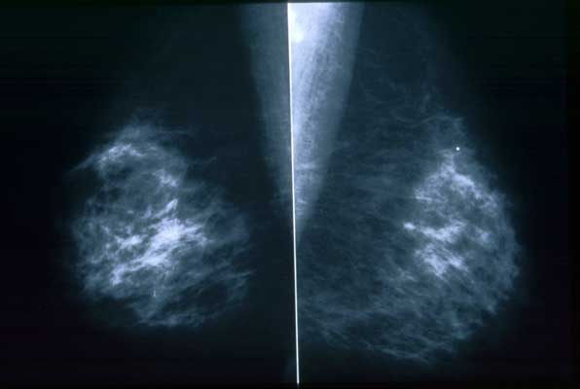
Diagnosis:
Diagnostic Mammography

Slide 9
MRI
Ultrasound
Surgical tests
Core biopsy
Stereotactic fine needle biopsy (S- FNAC)
Fine needle biopsy (FNAC)

Slide 10
Additional tests
Chest x-ray
Bone scan
(CT or CAT) scan
Positron-emission tomography (PET)

Slide 11
TYPES OF BREAST CANCER SURGERY
Surgery
lumpectomy
Simple mastectomy
Total mastectomy
Radical Mastectomy
modified radical mastectomy

Slide 12
A lumpectomy is the removal of the cancerous breast tissue as well as a surrounding rim of healthy breast tissue. A lumpectomy is a breast-conserving surgery that is usually followed by radiation therapy (high-dose X-rays or other high-energy rays to kill cancer cells).
A woman may decide to have a mastectomy versus a lumpectomy based on the following:
If the tumor is big and, after the lumpectomy, very little breast tissue would remain
If she does not want to undergo radiation therapy after the surgery
If she believes she will have less anxiety about a recurrence of breast cancer with a mastectomy
If the woman has tumor in more than one quadrant of the breast, most cancer doctors recommend a mastectomy.

Slide 13
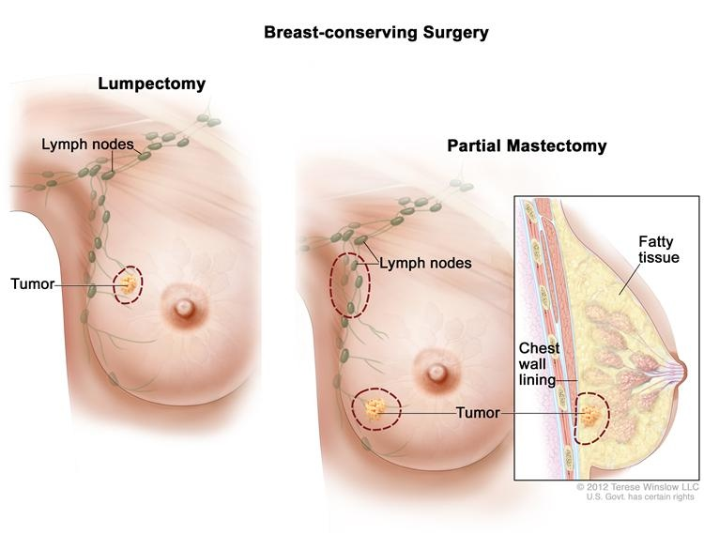
Breast Sparing Surgery: Lumpectomy & Partial Mastectomy

Slide 15
Simple or total mastectomy
The surgeon removes the entire breast tissue but does not remove the muscle tissue under the breast.
This mastectomy can be combined with a sentinel lymph node biopsy in any case of an early invasive cancer and in some cases of ductal carcinoma in-situ when a mastectomy is chosen as the treatment option.
Any of these can also be combined with an axillary lymph node dissection (which by convention turns the total mastectomy into a "modified radical mastectomy"). There are several subtypes of simple or total mastectomy depending on how much skin is removed.

Slide 16
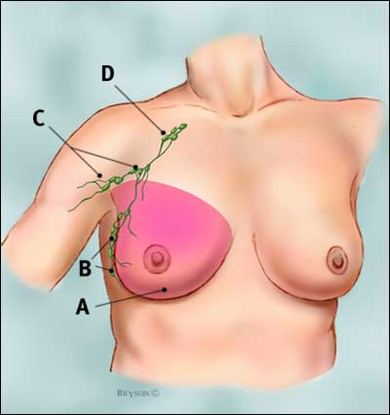
Total Mastectomy
Woman with total (simple) mastectomy.
A pink highlighted area indicates tissue removed at mastectomy
B axillary lymph nodes: levels I
C axillary lymph nodes: levels II
D axillary lymph nodes: levels III

Slide 17
Indications for breast conservative surgery are as follow ;
If the tumour is more than 3 or 4 cm in diameter mastectomy should be recommended
Contraindication to breast Conservative Surgery:-
Tumour more than 4cm in size.
Extensive nodal metastasis, and distance metastasis.
Multicentricity of tumour which was detected by mamography.
Central lesion – when nipple has to be sacrificed total mastectomy has been performed.

Slide 18
Radical mastectomy
The surgeon removes the entire breast tissue, all the lymph nodes in the armpit, and the muscles of the chest wall (pectoral muscles) that lie under the affected breast.
Radical mastectomy was common in the past; however, it is rarely performed now.

Slide 19
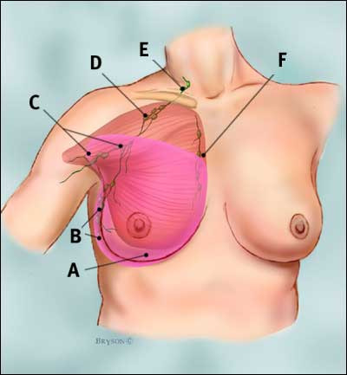
Radical Mastectomy ( Halsted Procedure)
Woman with radical mastectomy.
A pink highlighted area indicates tissue removed at mastectomy
B axillary lymph nodes: levels I
C axillary lymph nodes: levels II
D axillary lymph nodes: levels III
E supraclavicular lymph nodes
F internal mammary lymph nodes

Slide 20
It was developed and first performed by William Stewart Halsted in 1882.
Following Structures are removed ;
The whole breast
The portion of the skin overlying the tumour, included nipple,
The subcutanious fat & deep fascia
Surrounding Lymph nodes
The pectoralis major, pectoralis minor.

Slide 21
Modified radical mastectomy
This combines a simple or total mastectomy, including the skin of the nipple and the areola, and includes removal of most of the lymph nodes in the armpit (axillary nodes) using a 6- to 8-inch incision. A woman undergoing a modified radical mastectomy can have immediate or delayed breast reconstruction.

Slide 22
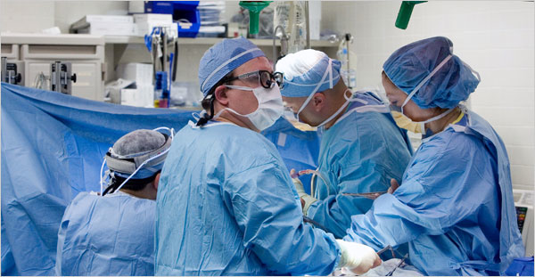
Modified Radical Mastectomy
WHAT IS IT?
*Removal of the breast and axillary lymph nodes
*Preservation of pectoralis muscle
*Most commonly used with large sized tumors
*Breast reconstructive surgery is an option.
POTENTIAL COMPLICATIONS
*Short-term: Skin flap, necrosis, seroma,
hematoma, infection
*Long-term: Sensory loss, muscle
weakness, lymphedema
SIDE EFFECTS
*Chest wall tightness
*Phantom breast sensations
*Arm swelling
*Sensory changes
PATIENTS PROBLEM
*Loss of breast
*Incision
*Body image
*Impaired arm mobility

Slide 23
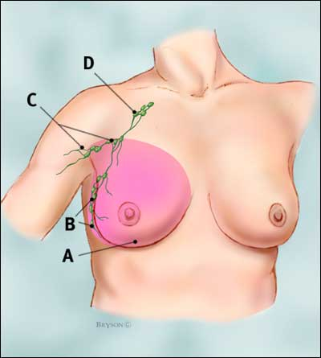
Modified Radical Mastectomy
Woman with modified radical mastectomy.
A pink highlighted area indicates tissue removed at mastectomy
B axillary lymph nodes: levels I
C axillary lymph nodes: levels II
D axillary lymph nodes: levels III

Slide 24
This modification was design to reduce the cosmetic deformity produced by halsted radical mastectomy.
It preserves pectoralis major muscles and remove level –I, II, & III lymph nodes.
As pectoralis major remains intact, so that it avoids a hollow defect inferior to the clavicle.

Slide 25
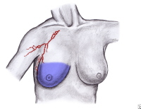
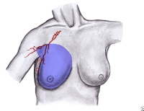
The blue highlighted area
indicates breast tissue removed
during total (simple) mastectomy
The blue highlighted area
indicates breast and lymphatic tissue
removed during modified
radical mastectomy.

Slide 26
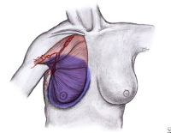
The blue highlighted area indicates breast and lymphatic tissue and the red highlighted area indicates muscle removed during radical mastectomy

Slide 27
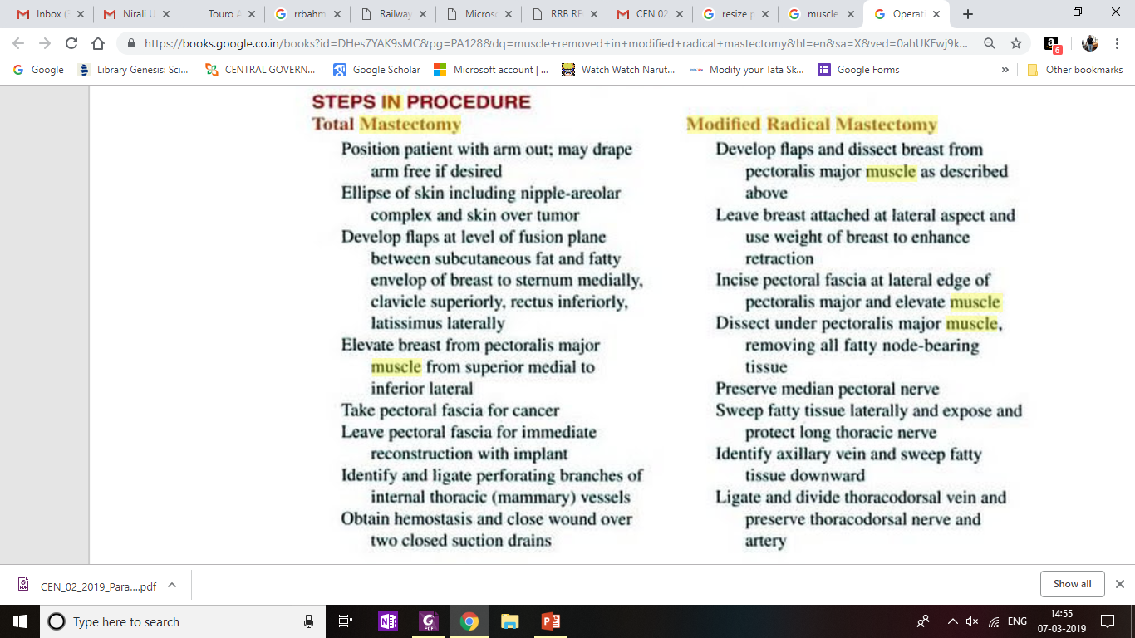

Slide 28
Physiotherapy has an important role in the rehabilitation of breast cancer patients.
Through rehabilitation physiotherapists promote independence and a return to normal activities, ultimately improving the quality of life of the patients.

Slide 29
Pre operative physiotherapy
Full assessment of any existing shoulder or neck problems that may affects post operative outcomes.
Identification of any risk factors.
Information and educational advices, including a leaflet on post operative exercise routines.
Prevention of complication like lymphodema, chest tightness, other secondary respiratory complications, Psychological counselling.

Slide 30
Post operative physiotherapy
Post operative assessment & examination
Identification of problem list.
Development of Aims & Goals.
Associated treatment.

Slide 31
Aim :-
Pain management.
Prevention of shoulder and neck stiffness.
Preventing muscle weakness
Postural advices.
Prevention of chest wall stiffness.
Prevention of secondary respiratory complication.
Prevention of Lymphodema.
Incision care
Psychological support.

Slide 32
Pain Management :-
It is usual for patients to experiences post operative pain and this is relieved by medication.
Some patients may go on to the chronic pain, which may be far more complex due to biomecahnical, behavioural, emotional and socio cultural influences.
PT : - TENS, soft tissue & joint mobilisations, relaxation techniques and alternative and cognitive therapies can all help.

Slide 33
Prevention of shoulder & neck stiffness :-
Shoulder & neck mobility exercise.
Emphasis on Shoulder girdle specific movements.
Shoulder overhead abduction/ flexion, lateral rotation retraction etc.
Pectoralis stretching.

Slide 34
Preventing muscle weakness :-
Self Stretching of pectoralis muscle within the pain free range .
Shoulder joint Active Range of motion in the available ROM.
Gradually progression towards the strengthening exercise of shoulder joint.

Slide 35
Prevention of chest wall stiffness :-
- Chest mobility exercise
- Butterfly exercise
- B/L shoulder abduction
- Breathing associated with flexion &
extension of trunk.

Slide 36
Prevention of lymphodema.
PT :-
Skin care :-
Daily application of emollient cream & advises of skin care .
Compression Garments :-
These are used to limit & control swelling in the limb.
In breast cancer, a glove, a sleeve or combined glove and sleeve can be used depending upon the extent of the swelling.
Garments are usually worn during the day, especially for exercise and when working.
In some cases a bandaging system described as multilayer lymphodema bandaging. (MLLB) is used in combination with lymphatic massage to reverse complications such as severe swelling or distorted limb shape, prior to the introduction of compression garments.

Slide 37
Dynamic exercise :-
This is important as lymphatic drainage is enhanced by the effect of muscle pump, particularly when compression garment is worn.
Gentle stretching exercise also helps to maintain or improve range of movement and to facilitate good posture.
Excessive exercise can increase the lymphatic load an results in further swelling, so patients are warned to introduce any new activity gradually.

Slide 38
Lymphatic massage :-
Manual Lymphatic Drainage (MLD) is characterised by the pressure and sequence of the technique, designed to stimulate drainage through the functioning lymphatic .
This is usually the only method of care available to treat midline oedema.

Slide 39
Effects of manual lymphatic drainage on breast cancer-related lymphedema: a systematic review and meta-analysis of randomized controlled trials
World Journal of Surgical Oncology 2013, 11:15
P | A patient with breast-cancer-related lymphedema
I | Manual lymphatic drainage
C | Sleeve and glove compression, Exercise,
O | Incidence of lymphedema and the reduction in the volume of the patient’s arm

Slide 40
Manual lymphatic drainage on breast cancer-related lymphedema: a systematic review and meta-analysis of randomized controlled trials. High level evidence | Systemic review was done to evaluate the effectiveness of MLD in the prevention and treatment of breast-cancer-related lymphedema | Included RCTs or quasi-RCTs from the literature that evaluated the outcome of MLD in preventing and treating breast-cancer-related lymphedema. For inclusion in study, the trials were required to describe: 1) the inclusion and exclusion criteria used for patient selection, 2) the MLD technique used, 3) the compression strategy used, 4) the definition of lymphedema, and 5) the evaluation of lymphedema severity | No significant difference in the incidence of lymphedema in patients treated with or without MLD

Slide 41
Scaring :-
Surgical scar may become adhere to underlying structure , i.e fascia, resulting in tightness and discomfort in the axilla and chest wall regions.
Friction massage can be given.

Slide 42
Prevention of cording/axillary web syndrome:-
- Tender cord like structure, thought to be a results of lymphangitis or lymphatic thrombosis, may arise from the chest wall to the axilla, sometimes extending down the arm itself.
These cord restrict movement and cause significant pain.
PT :-
It is mobilised gently with soft tissue massage
Encourage active & passive movement.

Slide 43
Numbness :-
During axillary surgery the cutanious nerves are incised, resulting in sensory loss in the axilla, lateral chest wall and upper arm.
- It is not uncommon for patients to experience pain and paresthesia as sensory recovery occurs.

Slide 44
Radiotherapy treatment :-
Prior to radiotherapy shoulder mobilization is again important to facilitate radiotherapy positioning.
Post radiotherapy patients should be encouraged to continue their shoulder mobility exercise as treatment can cause delayed onset stifness.

Slide 45
Return to function :-
All patients can encouraged to lead an active and normal life after having breast surgery that could improve quality of life.
Psychological support.

Slide 46
THANK YOU

